Slide 1
Education Spending & Literacy in Rural Punjab (PSLM 2019–20)
ECO346 · DATA VISUALIZATION · ASSIGNMENT 1
Student: Fatima Babar Murtaza (FA24-BEDS-024, Section B)
Assigned Variant: Variant 0 — Punjab Rural (24 = 3 × 8 + 0)
Sample: 9,173 students (ed_total > 0) for education spending; 24,630 persons aged 10–64 for literacy

Slide 2
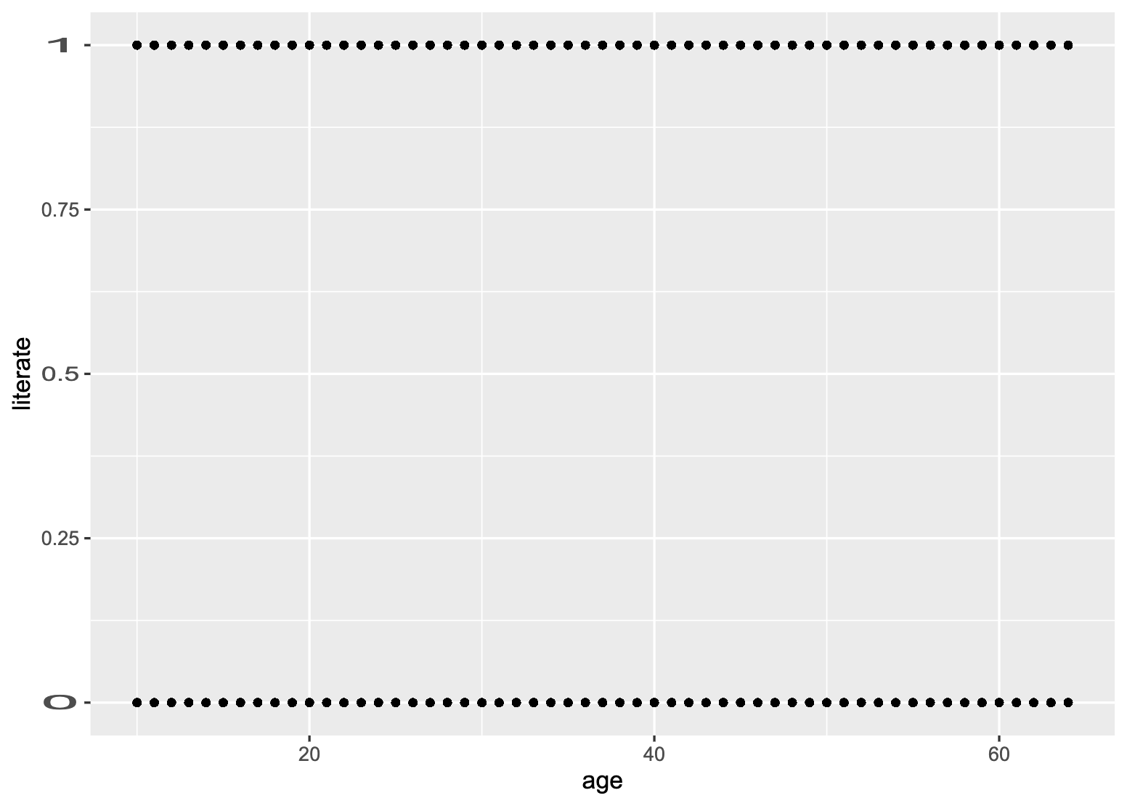
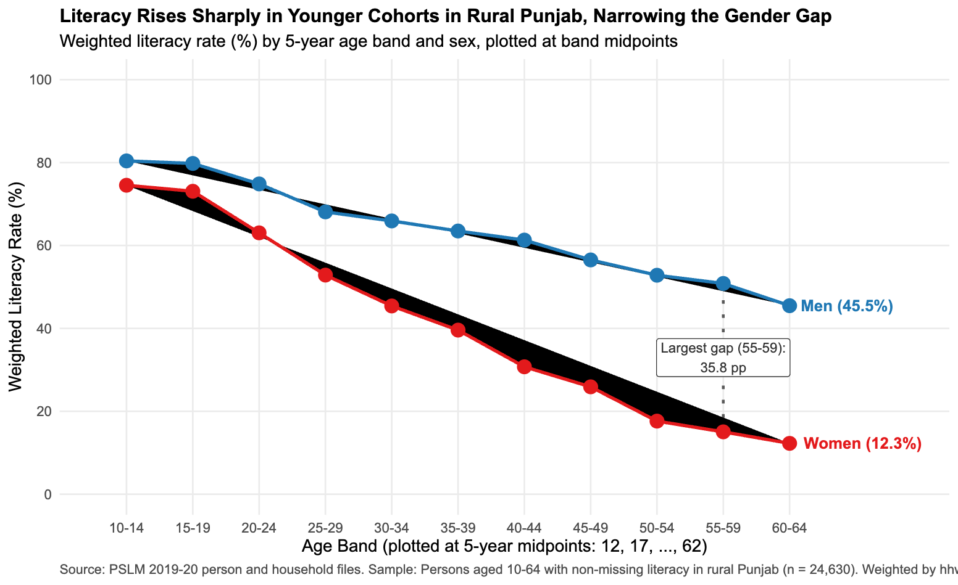
The Makeover: Default vs. Redesign
Overplotting → Conditional Means
Perceptual Channels
Data-Ink & Direct Labeling
Replaces 24,630 stacked binary (0/1) points with 5-year weighted literacy rates
Uses vertical position on a common scale + color-coded trajectories for Men and Women
Removes legend in favor of direct end-of-series labels and annotates the maximum gap (35.8 pp at ages 55–59)

Slide 3

Most Important Finding: Generational Convergence in Female Literacy
Sharp Cohort Improvement
Female literacy in rural Punjab nearly quintuples from 15.0% (ages 55–59) to 73.1% (ages 15–19)
Narrowing Gender Gap
The male–female literacy gap drops from 35.8 pp (ages 55–59) to 6.7 pp (ages 15–19) and 5.9 pp (ages 10–14)
Caveat
Single cross-section cannot separate cohort schooling expansion from life-cycle aging effects

Slide 4
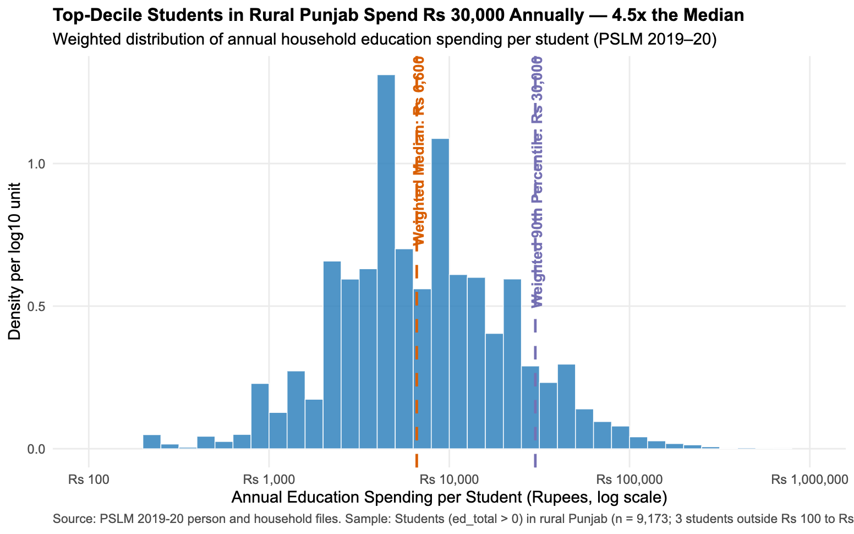
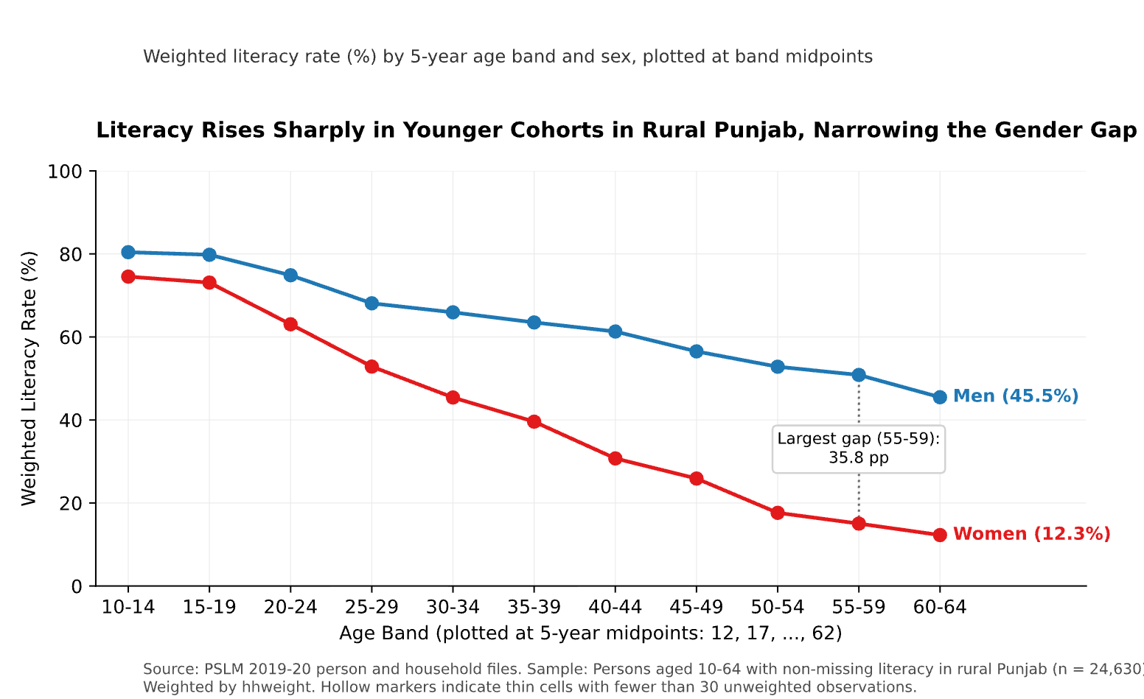
Inequality in Rural Education Spending & Python Replication
Right-Skewed Spending
15x Top-to-Bottom Decile Ratio
Cross-Language Verification
Weighted median is Rs 6,600 (unweighted Rs 7,000), while the 90th percentile reaches Rs 30,000
90th percentile (Rs 30,000) is 15.00 times the 10th percentile (Rs 2,000)
Python (pandas/matplotlib) matches R's weighted band table to one decimal place (73.1% for women aged 15–19)

