Slide 1
Renewable Energy Mapping Using Weather Sensors & Data (REMUWS)

Slide 2
Content
Problem Definition
Solution overview
System design
Current data
Weather Station
Analysis Algorithm
Demo
Facts & Business opportunities
Future Work

Slide 3
95,126,560 barrel/day
34,000,000,000 barrel/year
And a lot of users
473.1 BILLION tonnes/year

Slide 4
peak oil 2030

Slide 5

We know the HOW
Not so sure about the WHERE

Slide 6
REMUWS
A robust energy solution that aims to locate optimum hotspots by means of forecast as well as deploy sensors in remote area to further increase coverage.

Slide 7
Our process is simple
Analyze big data from available ground stations
Deploy sensors in remote areas
Make accurate predictions
Ensure sound investment

Slide 8

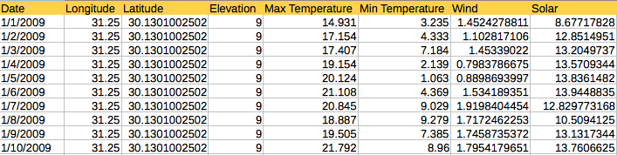
Current Database
1979-2014
869 stations

Slide 9
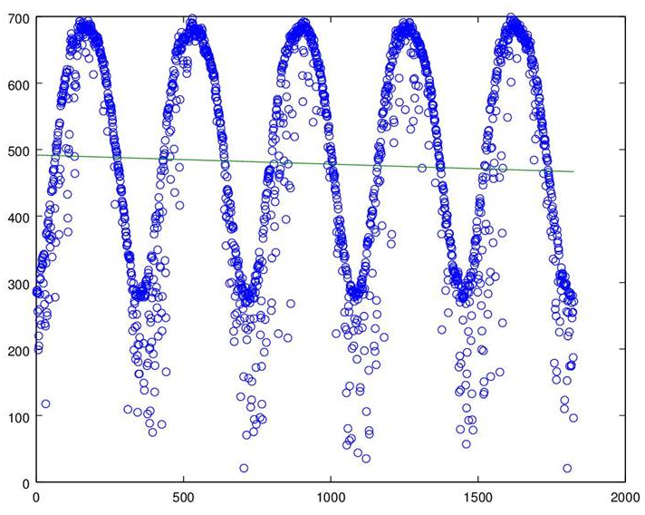
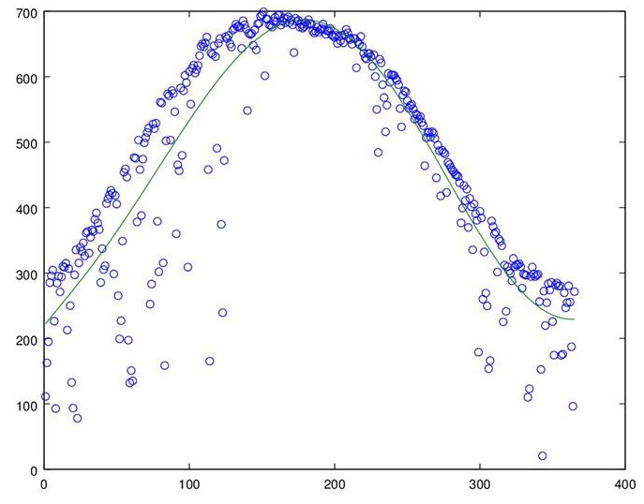

Analysis Algorithm
Convert readings to watts
Fit slope to data points of last known 5 years to obtain climatic trend
Curve fit the latest recorded year, to act as a template for forecasted years

Slide 10
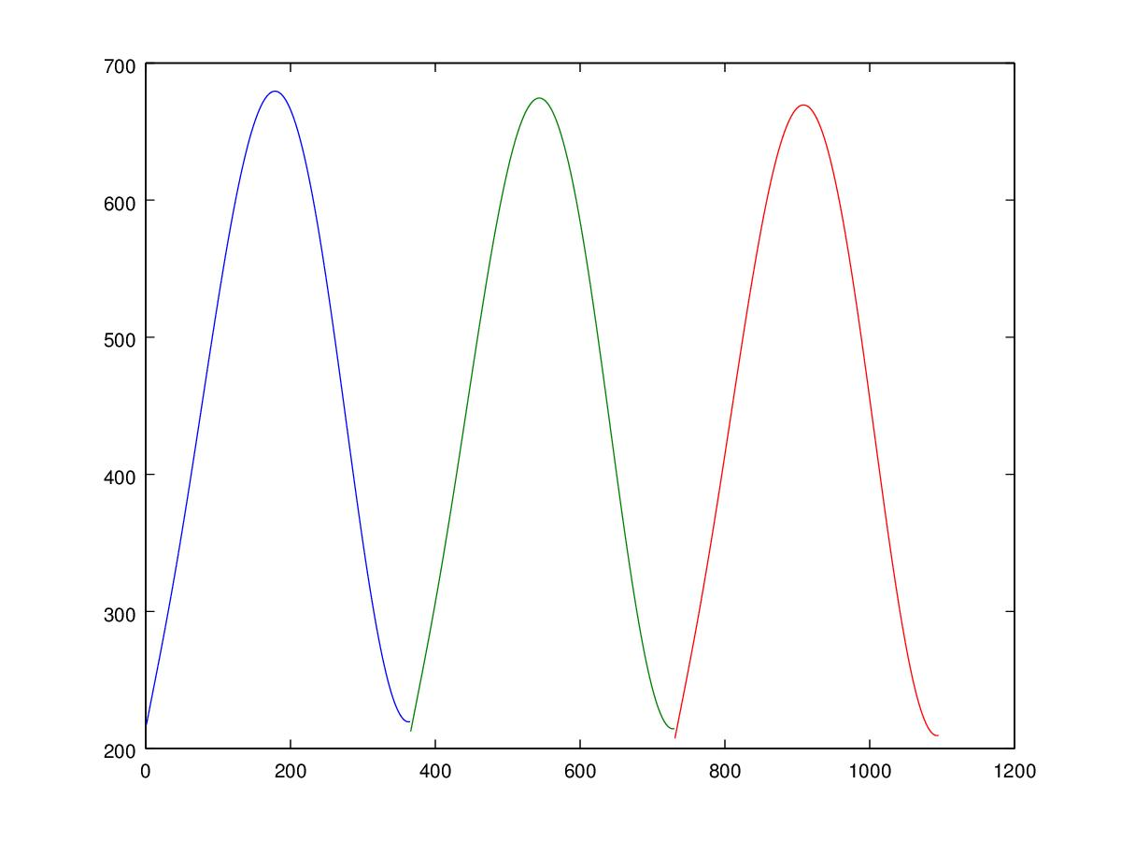
Forecast
2016
2017
2018
By applying the slope in (2)to the curve fit of the latest year (3) as a vertical shift, we obtain a forecast of upcoming years by adding the slope shift

Slide 11

What about all of this space?

Slide 12
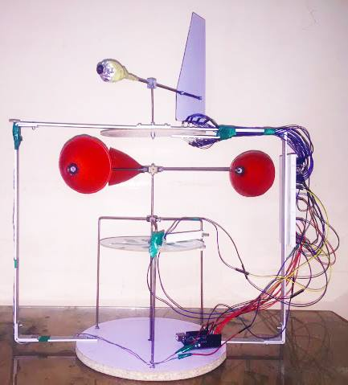
Weather Station
Cheap
Monitors 3 metrics
Easily deployable
Accurate

Slide 13
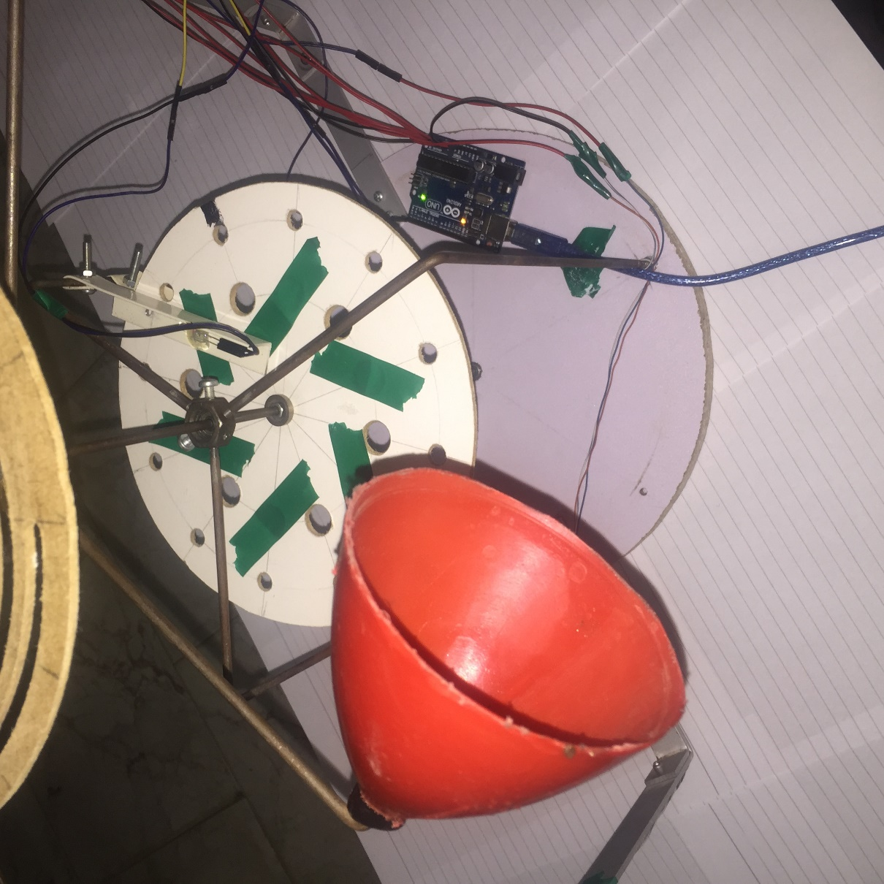
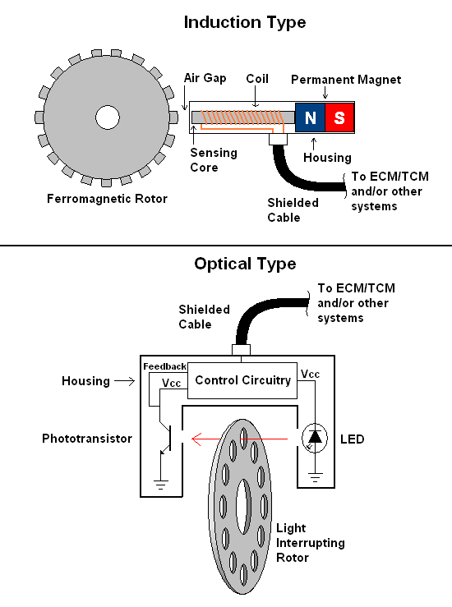
Wind Speed

Slide 14
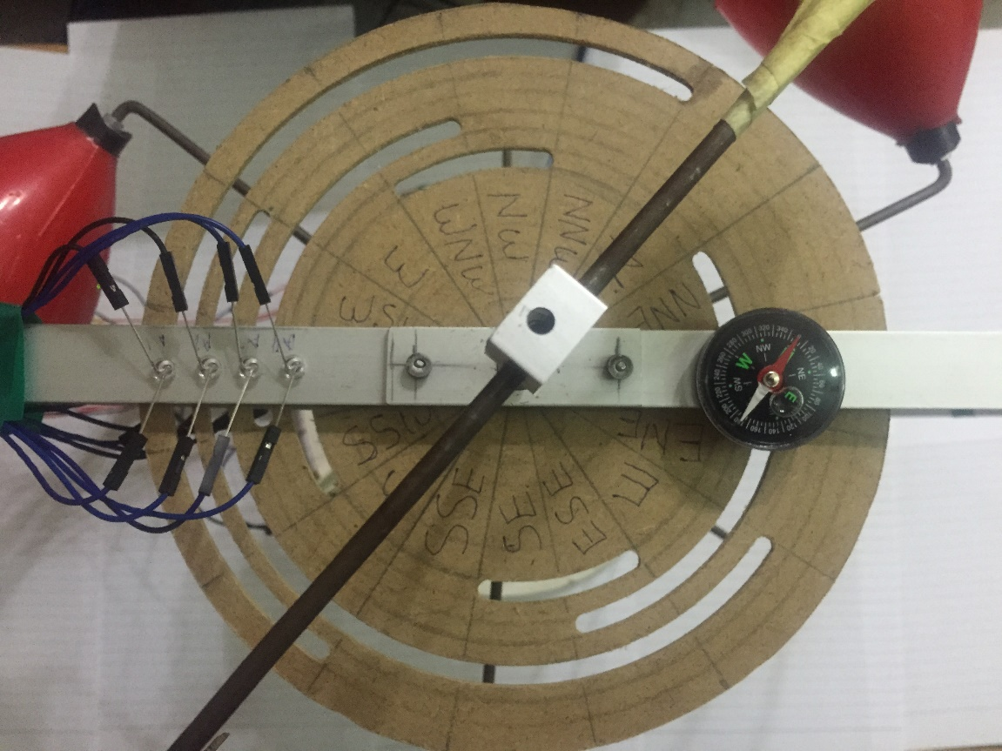


Wind Direction

Slide 15
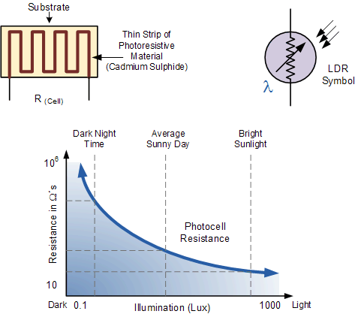

Light intensity
LUX sensor (LDR)

Slide 16
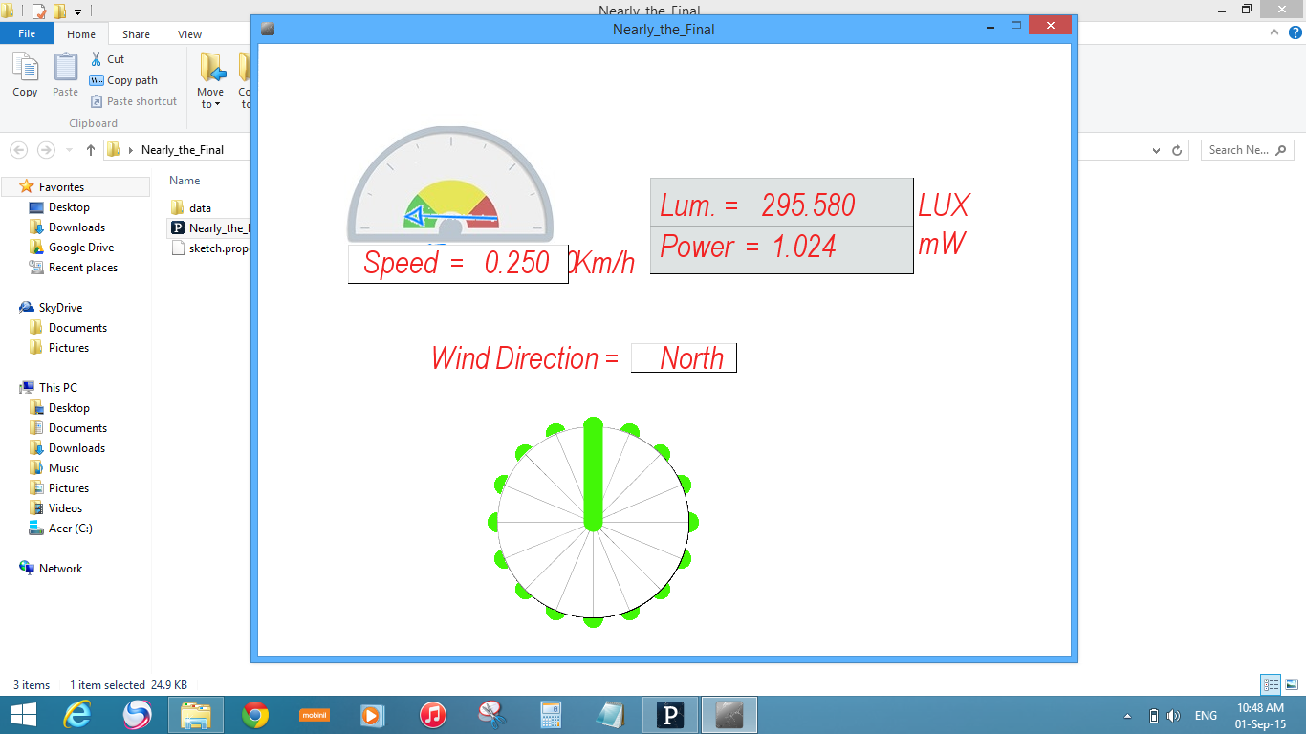

Slide 17

$614.92 billion

Slide 18
Facts & business opportunities
“A business will only survive if it has customers that want what you provide.”

Slide 19

Facts & business opportunities (cont.)
Can power about 500 average homes for a full year
20-25 years lifetime
120,000 hours
Car engine: 4,000 to 6,000 hours

Slide 20
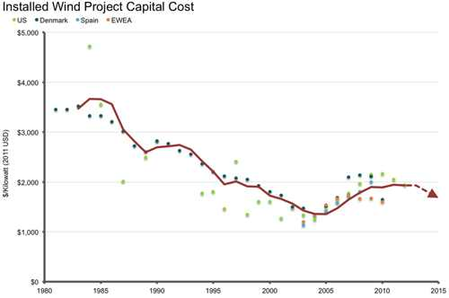
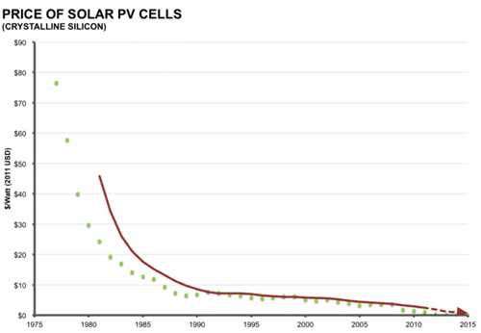
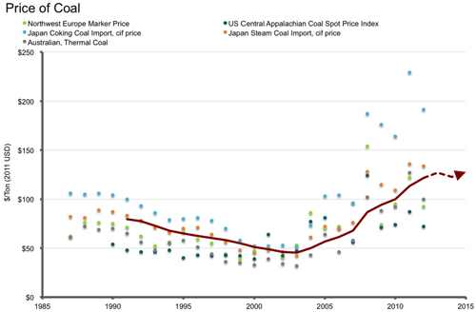
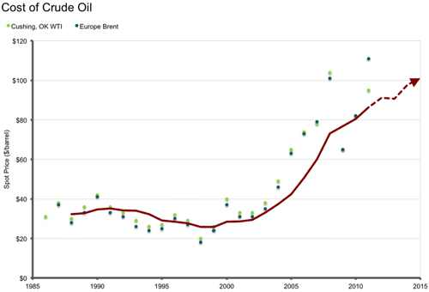
Charts

Slide 21
Future Work
Improve analysis algorithm for better and more accurate forecasts
Improve sensor design for better accuracy and sustainable operation
Collaborate with other institutions for better overall output
Seek funding and government support for project implementation

Slide 22
Thanks!
Any questions?
You can contact us at:
ali.elsaeed94@gmail.com
fatima.fouda35@gmail.com
hesham52007@hotmail.com
joealazhary@gmail.com
Special thanks to all the people who made and released these awesome resources for free:
Presentation template by SlidesCarnival
Photographs by Unsplash

