Slide 1
Chapter 10:
Project Communications Management Project Procurement Management

Slide 2
Contents:
Project Communications Management
Keys to Good Communications
Planning Communications Management
Managing Communications
Monitoring Communications
The Importance of Project Procurement Management
Planning Procurement Management
Conducting Procurements
Controlling Procurements

Slide 3
Week 12 Learning Outcome:
Discuss the importance of project communications management and project procurement management.
Explain why identifying project stakeholders and managing stakeholder expectations are important.
Explore the strategies, processes, tools, and techniques used in project communication and procurement management.
Outline the elements of a communications plan and procurement management plan.
Discuss the strategies used in conducting, administering, and closing procurements.

Slide 4
Project Communications Management
Communication failure leads to the failure of projects
Communication failure occurs between IT professionals and
nontechnical business teammates.
Three key processes in Project Communications Management
  Planning communications management
  Managing communications
  Monitoring communications

Slide 5
Keys to Good Communications
Communicating effectively with other people is a challenging job.
  Focusing on group and individual communication needs
    the complexity of communications increases with the increasing number of team members.
    People with different personalities have different
communication needs
Be aware of your own communication style
People with different cultural backgrounds
and from
different countries also have different communication needs

Slide 6
Keys to Good Communications
Formal and Informal methods for communicating
  Informal communications are preferred by many people
  Many people love to talk or have a two-way conversation rather than reading reports
  Excellent project managers have the ability to promote relationships through good communication
  They must be empathic listeners

Slide 7
Keys to Good Communications
Distributing timely manner
  Technical
important information in an effective and
information
and any changes should be
documented properly
Short and frequent important information
meetings are necessary to know
Stand-up meetings force
important information timely
people to communication

Slide 8
Keys to Good Communications
Setting the stage for communicating bad news
  Always communication with contextual information
  The impact of the situation should be analyzed, alternatives should be considered, then recommendations should be made

Slide 9
Keys to Good Communications
Determining the number of communication channels
  Adding more people to the project, increase the number of communication channels and also the complexity of communication
  To determine the number of communication channels:
    Number of communication channels = n(n-1)/2
    Where n indicates the number of people involved

Slide 10
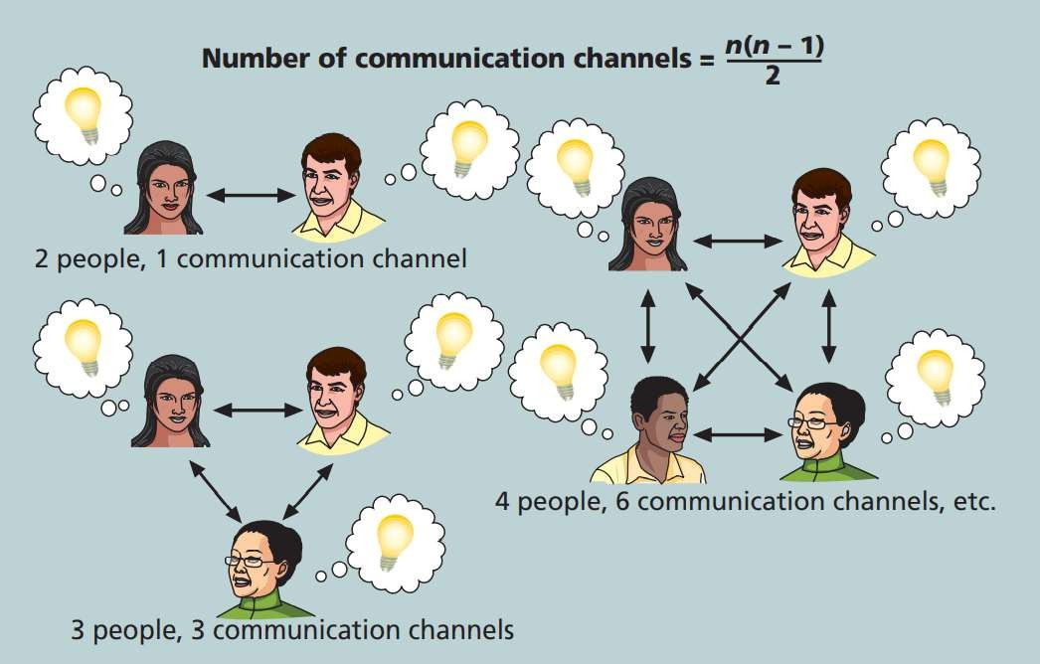
Keys to Good Communications
The impact of the number of people
on communication channels

Slide 11
Planning Communications Management
Communications management plan is a document that includes guidelines about project communications.
Following items should be included in communications management plan
  Stakeholder communications requirements
  Information to be communicated with format, content, and level of detail
  Who will receive/produce the information
  Suggested methods or technology for communicating information
  Frequency of information
  Escalation procedures for resolving issues
  Revision procedures for updating the communications management plan
  A glossary of common terminology

Slide 12
Planning Communications Management
It is essential to know that a particular stakeholder should receive what kind of information.
Unnecessary information dissemination wastes time and money

Slide 13
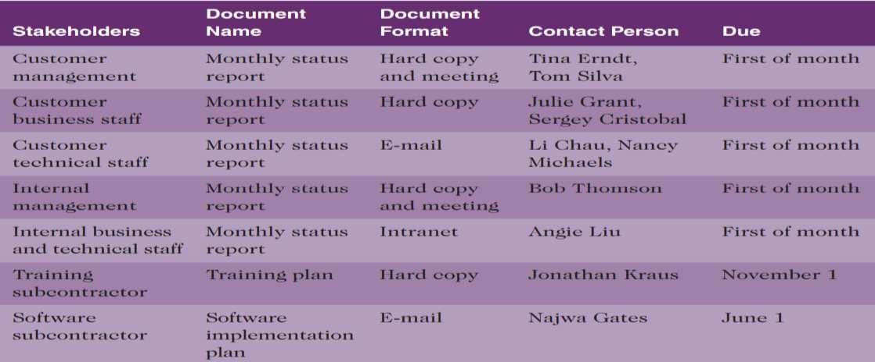
Planning Communications Management
Sample stakeholder
communications analysis

Slide 14
Managing Communications
Disseminating the project information to the right people at the right time in a useful format is as important as producing the information
Considerations in managing information
  Latest technology should be used for enhanced communication
  Appropriate methods either formal or informal for information dissemination should be used

Slide 15
Managing Communications
Email, instant examples that effectively
messaging,
cell
phones,
texting are some
can be used
to distribute information
Project management information systems can be used to create and organize project related documents

Slide 16
Managing Communications
Communication methods can be classified:
  Interactive communication: two or more people interact via phone calls, video conferencing, or face-to-face meetings to exchange information
  Push communication: information is pushed or sent to the recipients in the form of reports or e-mails without being requested by the recipients
  Pull communication: information is sent upon request using

Slide 17
Managing Communications
Selection of communication method and important
media are equally
Table 10-2 provides guidelines for selecting communication methods and media

Slide 18
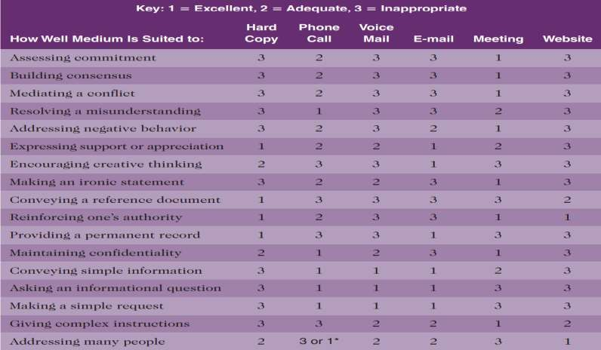
Managing Communications
Media choice table

Slide 19
Managing Communications
Performance Reporting can be used as a tool for project communications management
Stakeholders have up to date information about resource usage
Progress reports signify the accomplishments of project team during a specific time period whereas status reports highlight the current situation of the project at a specific point in time.
Forecasts are used to predict the project status in future from preceding information
Status review meeting may also be conducted to report performance.

Slide 20
Monitoring Communications
Monitoring information
communications
ensures the optimal
flow of
Processes of planning and managing project communications may be modified in case of any communication problems
External facilitator may be hired to analyze the effectiveness of communications

Slide 21
The Importance of Project Procurement Management
Procurement refers to acquiring goods and services supplier or service provider.
from an external
Key processes in project procurement management
  Planning procurement management determines procure
what, when, and how to
Conducting procurements refers to obtaining seller responses, selecting sellers, awarding contracts
Controlling procurements involves relationship management with the sellers, contract performance monitoring, making alterations, and terminating contracts.

Slide 22
Planning Procurement Management
Make-or-buy decision involves determining whether to make a product or perform a service in-house or obtain it from an external source.
  Whether to procure
  How, what, how much, and when to procure
Procurement management processes are not organization is not purchasing a product or
needed
if an
service
from
external supplier or service provider.

Slide 23
Planning Procurement Management
Inputs for planning procurements are
  Project charter
  Business documents
  The project management plan
  Project documents enterprise environmental factors
  Organizational process assets

Slide 24
Planning Procurement Management
Three broad categories of contracts exist.
  Fixed price or lump sum contracts specify a fixed total price for a well-defined product or service.
  Cost reimbursable contracts include payments to the seller for direct and indirect actual costs.
    Cost plus incentive fee (CPIF) contract
Cost plus fixed fee (CPFF) contract
Cost plus award fee (CPAF) contract
Cost plus percentage of costs (CPPC) contract
Time and material contracts are a combination of fixed-price
and cost-

Slide 25
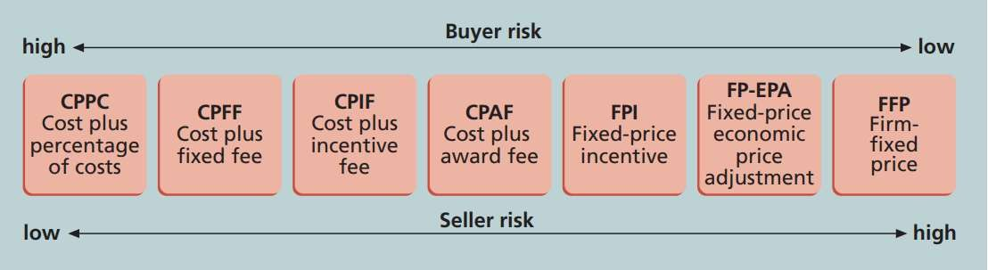
Planning Procurement Management
Contract types versus risk

Slide 26
Planning Procurement Management
Unit pricing the buyer needs to pay a predetermined amount for each unit of product or service.
Point of Total Assumption (PTA) refers to the cost at which the contractor accepts total responsibility for each additional dollar of contract cost.
Termination clause allows the buyer or seller to terminate the contract.

Slide 27
Planning Procurement Management
A number of tools and techniques exist procurement management.
to help
in planning
Make or Buy Analysis
Expert judgement
Market Research

Slide 28
Planning Procurement Management
Procurement management plan refers to a document that elaborates how the procurement processes will be managed, from production of documentation for making external acquisitions or purchases to contract closure.
For detailed contents of a procurement management plan, see page 518 of the book.

Slide 29
Planning Procurement Management
Statement of Work (SOW) refers needed for the procurement.
to the
description of work
If SOW is used to describe particular contract then it
only the required is referred to
work for a as contract
statement of work.
Contract SOW is a type of scope statement.
A good contract SOW offers bidders a better understanding of
the buyer’s expectations.

Slide 30
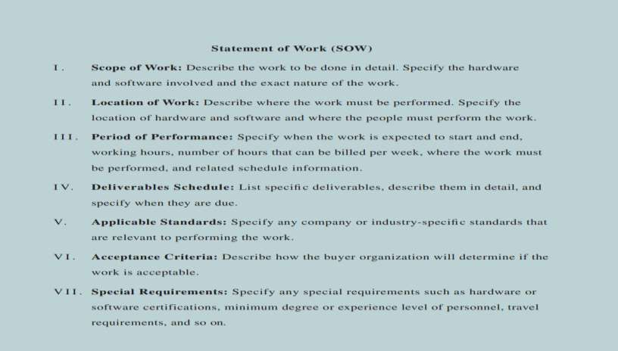
Planning Procurement Management
Statement template
of work
(SOW)

Slide 31
Planning Procurement Management
Procurement documents
  Request for Proposal
potential sellers.
(RFP) is used to solicit proposals from
A proposal is a document prepared by a vender when buyer needs can be met in different ways.
Request for Quote (RFQ) is used to solicit quotes or bids from potential suppliers.
  A bid (tender or quote; short for quotation) is prepared by sellers that provides pricing for standard items clearly defined by the buyer.

Slide 32
Planning Procurement Management
Examples from a Real RFP can be seen in Tables 12-1 and 12-2 from the book

Slide 33
Planning Procurement Management
Some form of evaluation criteria for source selection should be
developed by organizations.
Organizations usually use weighting importance of each criterion.
Factors like technical approach, past
schemes to identify the
performance, management
approach, and price are some of the factors to be considered.
In some situations, the potential seller may be asked to deliver a technical presentation

Slide 34
Conducting Procurements
This process involves:
  Deciding whom to ask to do the work
  Sending appropriate documentation to potential sellers
  Obtaining proposals or bids
  Selecting a seller
  Awarding a contract

Slide 35
Conducting Procurements
Procurement can be done in many different ways:
  From a specific supplier of choice
  From several potential sellers
  From anyone interested
A bidder’s conference (supplier conference or
conference) refers to the meeting with potential
pre-bid
suppliers
before preparing their proposals or bids.

Slide 36
Conducting Procurements
Source Selection refers to the proposals or bids from suppliers and
procedure
of evaluating
Chooses the best one
Negotiates the contract
Awards the contract

Slide 37
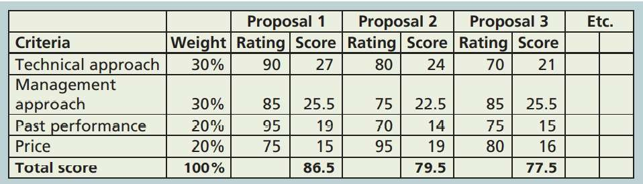
Conducting Procurements
Sample Proposal Evaluation
Sheet

Slide 38
Conducting Procurements
Seller Selection
After initial evaluation, Potential sellers are shortlisted for further evaluation
Short | listed | sellers | are | asked | to | prepare | a | Best | and | Final
Offer | (BAFO).
The final output is a contract that is signed by the two parties (the buyer and selected seller).

Slide 39
Controlling Procurements
Controlling Procurement ensures that the seller’s performance is complies with the contractual requirements.
These contracts are legal relationships that are subject of state and federal contract laws. Therefore, legal and contracting professionals should be involved in developing these contracts.
Constructive change orders refer to oral or written acts or omissions by someone with actual or apparent authority that can be interpreted to have the same effect as a written change order.

Slide 40
Chapter summary
Communications Management
  Plan Communications
  Manage Communications
  Monitor Communications
Procurement Management
  Plan Procurement
  Conduct Procurement
  Control Procurement

