Slide 1
Chapter 11:
Project Risk Management

Slide 2
Contents:
The Importance of Project Risk Management
Planning Risk Management
Common Sources of Risks on IT Projects
Identifying Risks
Performing Qualitative Risk Analysis
Performing Quantitative Risk Analysis
Planning Risk Responses
Implementing Risk Responses
Monitoring Risks

Slide 3
Week 13 Learning Outcome:
Explain the importance of managing project risks.
Discuss the processes involved in risk management and illustrate
the components of a risk management plan.
Identify the common sources for risk in information technology
projects.
Describe the suggested tools and techniques used for identifying
risks.
Explore the methodologies used for performing qualitative and
quantitative risks analysis.
Discuss the strategies used for planning, monitoring, and

Slide 4
The Importance of Project Risk Management
Project risk management is the art and science of identifying, analyzing, and responding to risk throughout the life cycle of a project to meet the project objectives in best possible manner.
Risk management can increase the chances of success for a project.
Risk management can help in selecting projects, determining their scope, and producing accurate schedules and cost

Slide 5
The Importance of Project Risk Management
William Ibbs and Young H. Kwak found that all the ratings for risk management were less than 3 showing lowest maturity for this knowledge area, after conducting a survey across 38 organizations to analyze the project management maturity.
KLCI Research Group has conducted another study that involves
260 software organizations across the globe. The findings of the study identified benefits by following good practices.

Slide 6
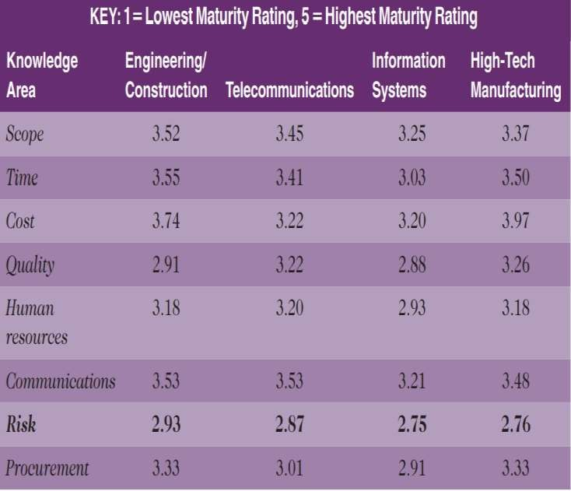
The Importance of Project Risk Management
Project Management Maturity by Industry Group and Knowledge Area

Slide 7
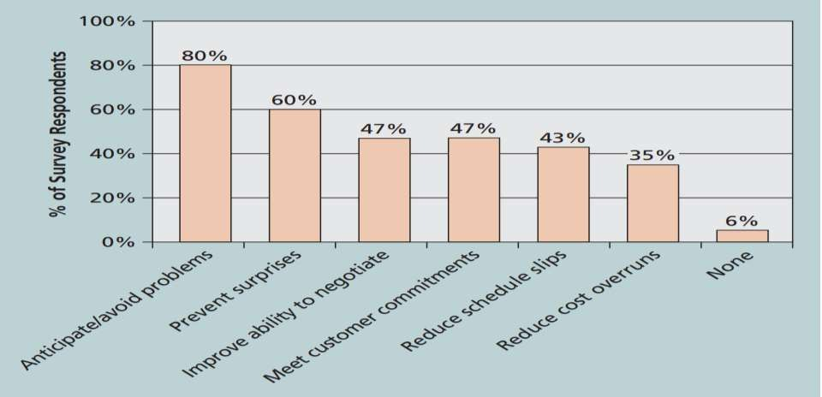
The Importance of Project Risk Management
Benefits from Software Risk
Management Practices

Slide 8
The Importance of Project Risk Management
Risk is defined as “the possibility of loss or injury.”
A project risk can be defined as “an uncertainty either positive or negative impact on meeting the objectives.”
that has
project

Slide 9
The Importance of Project Risk Management
Negative risks refer to recognizing potential problems
that may
effect the project. Negative risk management refers to a number of possible actions that can be taken be Project Managers to avoid, change, reduce, or accept the prospective effects of risks.
Positive risk may lead to more opportunities. Project risk management is an investment in future opportunities.
The objective of project risk management is to minimize potential effects of negative risks and maximize the impact of prospective positive risks.

Slide 10
The Importance of Project Risk Management
Risk utility refers to the amount of pleasure or satisfaction received from a potential reward.
Utility theory of risk
  Risk-averse
  Risk seeking
  Risk neutral

Slide 11
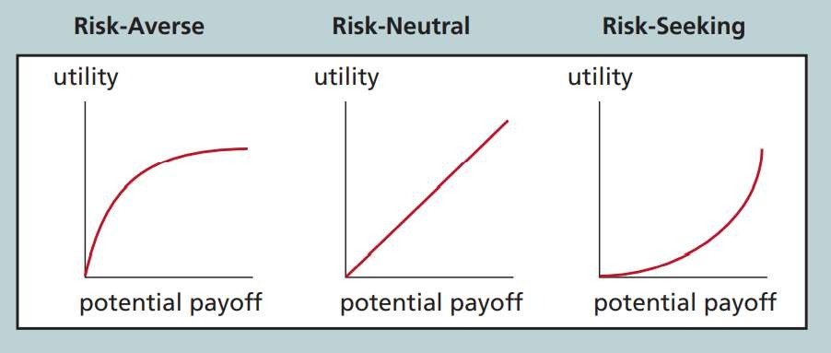
The Importance of Project Risk Management
Risk Utility Function and Risk
Preference

Slide 12
The Importance of Project Risk Management
Processes in Project Risk Management
  Planning risk management
  Identifying risks
  Performing qualitative risk analysis
  Performing quantitative risk analysis
  Planning risk responses
  Implementing risk responses
  Monitoring risk

Slide 13
Planning Risk Management
Planning risk management process produces a risk management plan that describes the procedures for risk management throughout the life cycle of a project.
The project team should evaluate project documents and stakeholders’ approaches to risk.
A risk management plan allows you to know how risk management will be applied to a project.

Slide 14
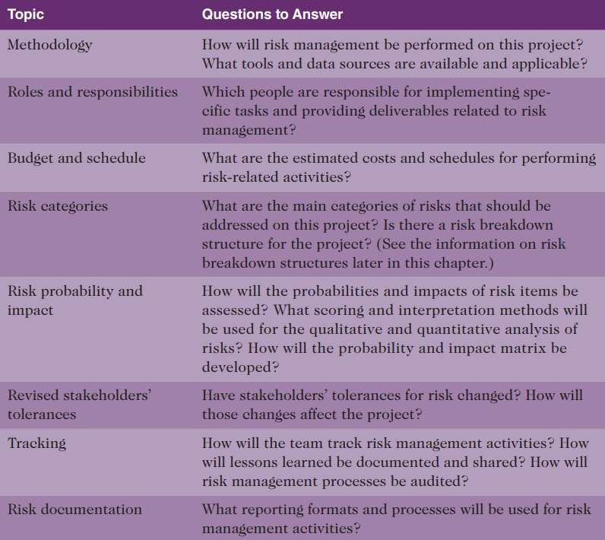
Planning Risk Management
Topics addressed in a risk management plan

Slide 15
Planning Risk Management
Beside risk management plan, a Project also includes:
  Contingency plans describe predefined activities that will take
effect in case of occurrence of an identified risk.
  Fallback plans are described for high impact risks and take effect if efforts on reducing the risks do not work.
  Contingency reserves (allowances) are included in the cost baseline that can be utilized to lessen cost or schedule overruns in case any known risk occurs. .
  Management reserves are used for management control purposes in case
any unknown risk occurs.

Slide 16
Common Sources of Risks on IT Projects
A number of studies have found that IT projects are affected by some common sources of risk.
IT success potential scoring sheet based on potential risks is developed by Standish Group.
Broad categories of risks may be identified by different organizations according to their own needs.

Slide 17
Common Sources of Risks on IT Projects
Broad categories of risks may include:
  Market risk
  Financial risk
  Technology risk
  People risk
  Structure /process risk

Slide 18
Common Sources of Risks on IT Projects
Risk Breakdown Structure tool is used by Project Managers to categorize risks for a project. It is similar to a WBS but identifies and categorizes risks.

Slide 19
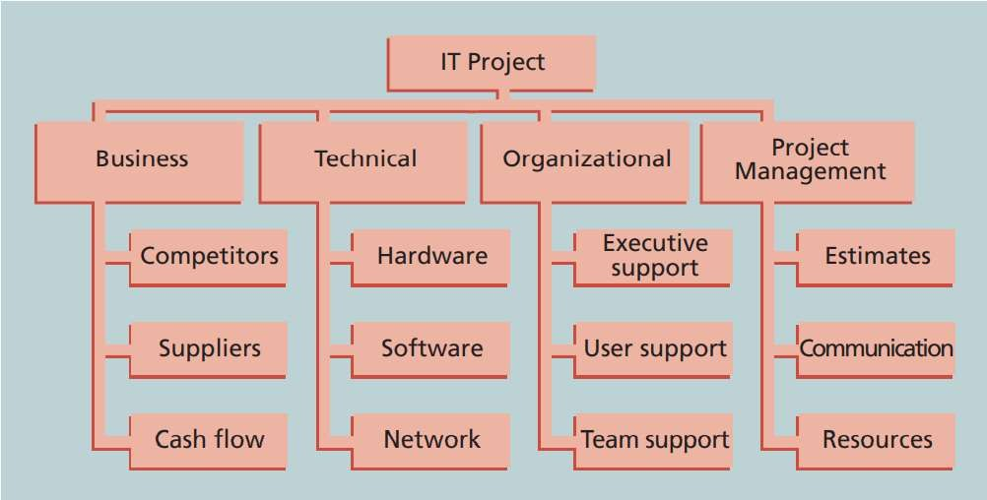
Common Sources of Risks on IT Projects
Sample Risk Breakdown
Structure

Slide 20
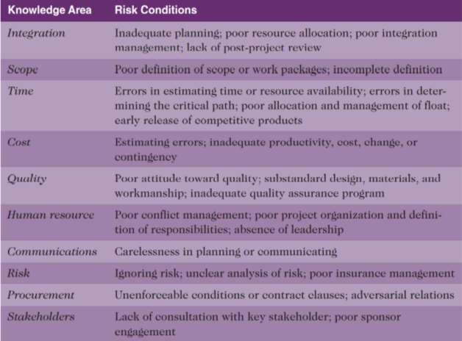
Common Sources of Risks on IT Projects
Potential Negative Risk Conditions
Associated with Each Knowledge Area

Slide 21
Identifying Risks
The process of understanding what prospective events may hurt or enhance a
particular project.
Risk Identification tools and techniques include:
  Brainstorming technique is used to generate spontaneous ideas without any judgement. An experienced facilitator should run the session.
  Delphi technique is used to reach an agreement among a panel of experts
who predicts future developments.
  Interviewing technique is used to collect information in virtual, face-
to-face, e-mail or phone discussions.
  SWOT (strengths, weaknesses, opportunities, threats) analysis can be

Slide 22
Identifying Risks
The risk identification process produces a list of identified risks and other information that may be required to create a risk register.
A risk register refers to a document that comprises of outputs of a number of risk management processes and often shown in a tabular or spreadsheet format.
Risk events are those specific and uncertain events that may occur to damage or improve a project.

Slide 23
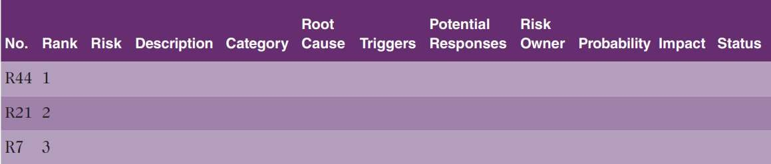
Identifying Risks
Sample Risk Register

Slide 24
Identifying Risks
Risk report is also created once the risks are identified.
Risk report includes
  Sources of overall project risks
  Important drivers of overall project risk exposure
  Summary information on risk events

Slide 25
Performing Qualitative Risk Analysis
In Qualitative risk analysis, the likelihood and impact of the identified risks are analyzed to determine their magnitude and priority.
Qualitative risk analysis can be performed using:
  Probability /Impact Matrixes to Calculate Risk Factors
  Top Ten Risk Item Tracking

Slide 26
Performing Qualitative Risk Analysis
the relative
relative
Probability / impact matrix or chart depicts
probability of a risk occurrence along one axis and the impact of the risk occurrence along the other axis.
The stakeholders will list the potential risks and then label them as high, medium, or low probability of occurrence and a high, medium, or low impact if it occurs.
Risk factors refer to numbers that represent the overall risk of specific events, based on their probability of occurring and the consequences to project if they do occur.

Slide 27
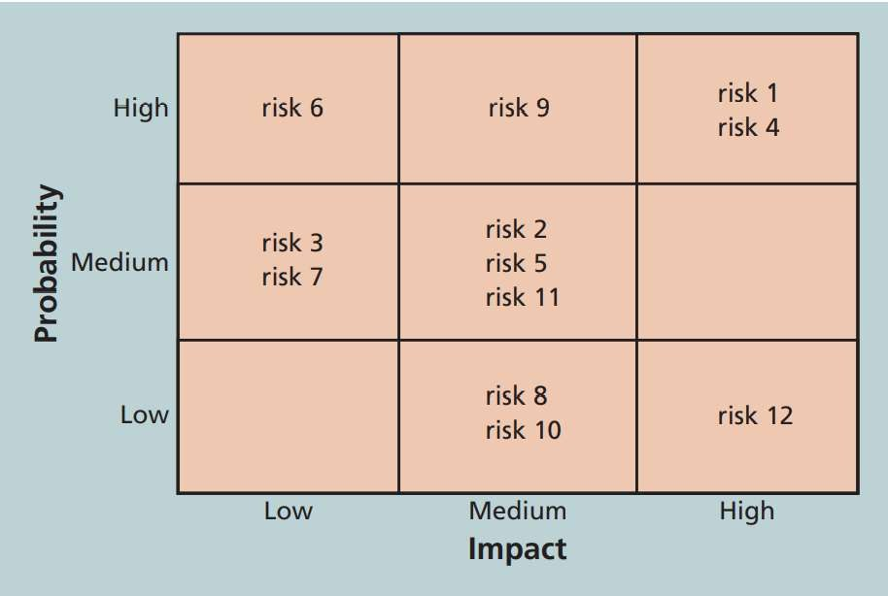
Performing Qualitative Risk Analysis
Sample Probability /Impact
Matrix

Slide 28
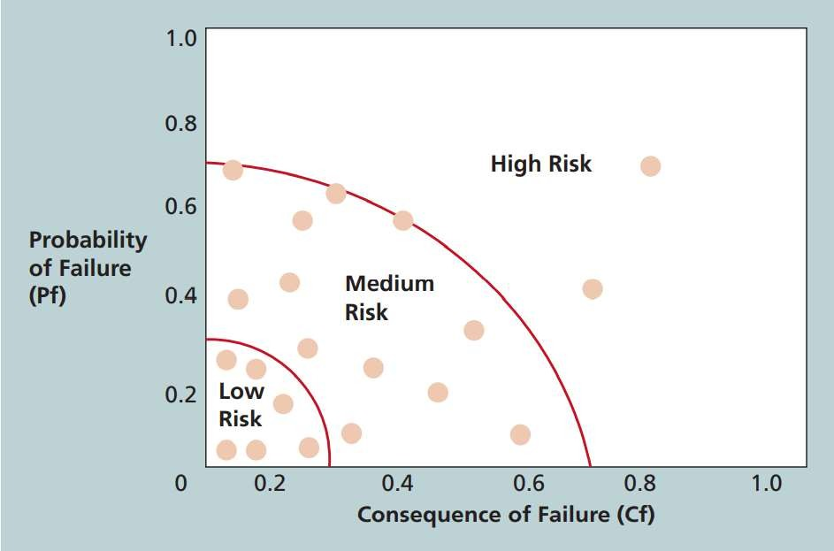
Performing Qualitative Risk Analysis
Chart showing high-, medium-,
and low-risk technologies

Slide 29
Performing Qualitative Risk Analysis
Top Ten Risk Item Tracking tool not only identifies
risks but also
preserves information about risks throughout the life of a project.
A periodic review has been developed for the most significant risks
items.
The review commences with a summary of the status of the top ten risk sources.
The summary includes:
  Current ranking, previous ranking, number of times it appears.

Slide 30
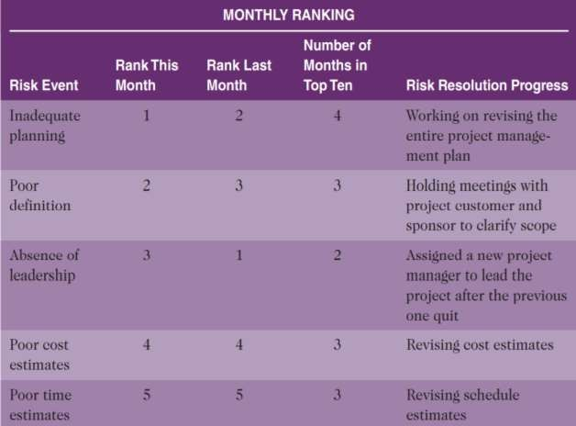
Performing Qualitative Risk Analysis
Example of Top Ten Risk Item Tracking

Slide 31
Performing Quantitative Risk Analysis
In Quantitative risk analysis is performed qualitative risk analysis.
after
Extensive quantitative analysis is required for large and complex projects involving leading-edge technologies.
Techniques may include:
  Decision Tree and Expected Monetary Value
  Simulation
  Sensitivity Analysis

Slide 32
Performing Quantitative Risk Analysis
Decision Tree is diagramming analysis technique identify the best alternative when the future
used to
outcomes are
uncertain.
Expected Monetary Value (EMV) is calculated by multiplying the risk event probability with the risk event’s monetary value.

Slide 33
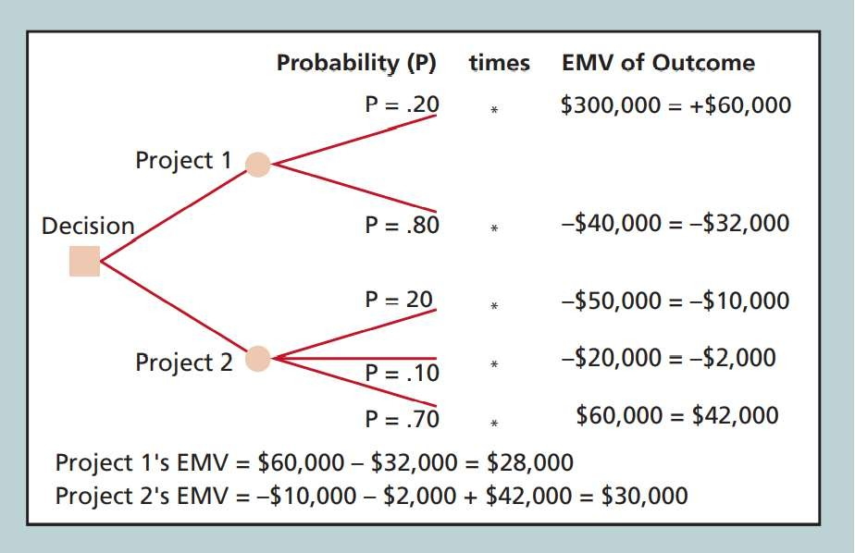
Performing Quantitative Risk Analysis
Expected Monetary Value (EMV)
example

Slide 34
Performing Quantitative Risk Analysis
Simulation exploits a representation or model of a system to examine its expected behavior or performance.
Monte Carlo Analysis produces a statistical distribution of the calculated results by performing simulation of a model’s prediction many times.
Monte Carlo Simulation can be performed by using three values
namely, most likely, approximation of the
optimistic, likelihood
and pessimistic plus an of a variable occurring

Slide 35
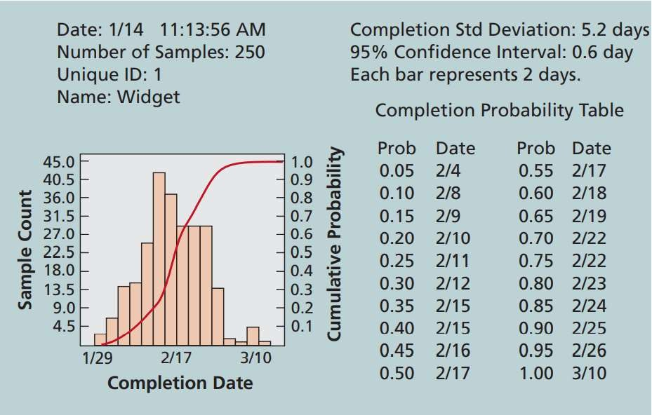
Performing Quantitative Risk Analysis
Sample Monte Carlo-based Simulation Results for Project Schedule

Slide 36
Performing Quantitative Risk Analysis
Sensitivity Analysis technique is use to see the effect of modifying one or more variables on an outcome of a system
Spreadsheet software is a common tool for performing sensitivity analysis.

Slide 37
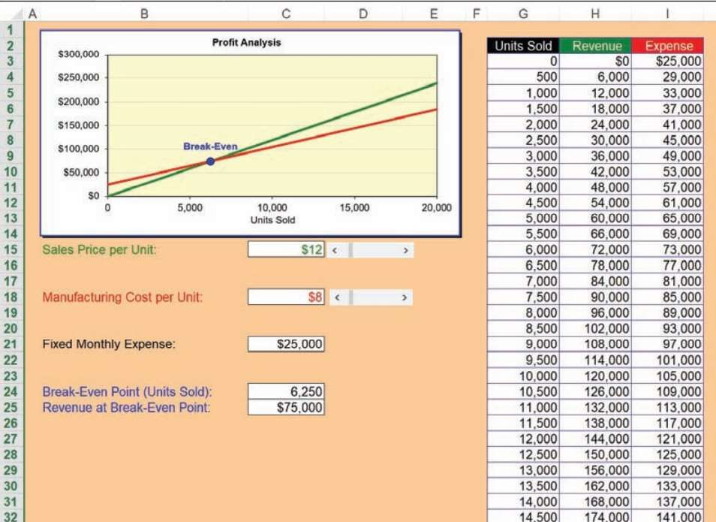
Performing Quantitative Risk Analysis
Sample Sensitivity Analysis for Determining Break-even point

Slide 38
Planning Risk Responses
After the risks are identified and quantified, the next step is to how to respond to them
Basis Response Strategies for negative risks include:
  Risk avoidance
  Risk acceptance
  Risk transference
  Risk mitigation
  Risk escalation

Slide 39
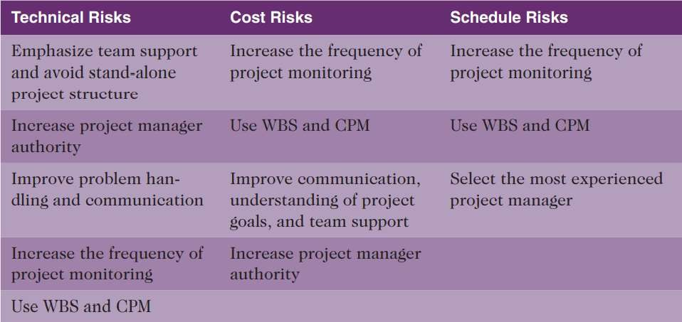
Planning Risk Responses
General Risk Mitigation Strategies for Technical, Cost, and Schedule Risks

Slide 40
Planning Risk Responses
Basis Response Strategies for positive risks include:
  Risk exploitation
  Risk sharing
  Risk enhancement
  Risk acceptance
  Risk escalation

Slide 41
Planning Risk Responses
Residual risks refer to those risks that are left behind after all the other risks have been responded.
Secondary risks refer to those risks thar are produced as a direct result of implementing a risk response.

Slide 42
Implementing Risk Responses
Implementing Risk Responses refer to the implementation of risk response strategies to respond risks..
The outputs are:
  Change requests and project documents updates

Slide 43
Monitoring Risks
Monitoring risks process ensures that
  appropriate risk responses are implemented
  identified risks are properly tracked
  new risks are identified and analyzed
  Effectiveness of risk management is evaluated
Workarounds are unplanned responses to risk events that are implemented in the absence of contingency plans.

Slide 44
Monitoring Risks
Tools and Techniques for Monitoring Risks
Data analysis
Audits
Meetings
Outputs of this process include:
  Work performance information
  Change requests
  Updates to the project
management plan, project documents, and
organizational process assets

Slide 45
Chapter summary
Project Risk Management processes include:
  Plan risk management
  Identify risks
  Perform qualitative risk analysis
  Perform quantitative risk analysis
  Plan risk responses
  Implement risk responses
  Monitor risk

