Slide 1
Chapter 12:
Multiple Teams Management

Slide 2
Contents:
What is a Multiple Team Project?
Challenges to Managing a Multiple Team Project.
Classifying Multiple Team Projects.
Project Office Structure.
Core Team Structure
Super Team Structure
Putting It All Together

Slide 3
Week 14 Learning Outcome:
Define the multiple team (multi-team) project situation.
Know the different types and complexities of multi-team
projects.
Understand the challenges presented by multi-team projects.

Slide 4
What Is a Multiple Team Project?
A multiple team collaboration and teams.
project is any project that requires involvement of
two or more independent

Slide 5
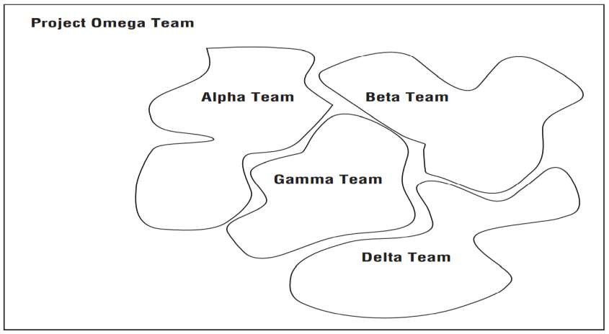
What Is a Multiple Team Project?
Definition of multi-team project
a

Slide 6
Challenges to Managing a Multiple Team Project
When projects involve more than two team, you should expect potential conflicts between methodologies.
Integration of independently developed processes may be simple or might be very complex based on the maturity of the team processes.

Slide 7
Challenges to Managing a Multiple Team Project
In the presence of multiple independent teams, the project manager seems to have been managing multiple projects.
However, in reality it is not true. Everyone should be clear to everyone that all the teams are working on s single project.
Every team will have a separate project manager at the team level. However, there may be one Project Manager for the overall project.

Slide 8
Challenges to Managing a Multiple Team Project
These team-level project managers are responsible to establish the management infrastructure, which will be responsible for the entire project.
The lack of resources compel a number of project managers to manager concurrent, multiple, and dependent projects.

Slide 9
Challenges to Managing a Multiple Team Project
Working with Teams from different companies (two organizations)
  Lead to most complex type of multiple team projects
or more
Team from your organization and team from a contractor’s
organization
Collaborative
organizations
efforts from two or more independent
The contractor will try to impose their processes on your leading
to conflicting processes

Slide 10
Challenges to Managing a Multiple Team Project
Working with fiercely independent Team cultures
  More mature processes practiced by a team will
fierce independence
lead to
They may have served the clients well
It may not work well for multiple team projects.

Slide 11
Challenges to Managing a Multiple Team Project
Working with different Team processes
  Integration of Processes may be the result of a multiple team
project.
  One process will be established or
  Establish a process that will combine the deliverables from
several processes.
  Integration of Human Resource Management may rise another
concern.
    The entire project team will be managed as a single team or as

Slide 12
Challenges to Managing a Multiple Team Project
Accommodating competing priorities
  Team members usually give priority to their clients rather
than to the multi-team project.
  Balancing these competing and conflicting priorities is a challenging task.

Slide 13
Challenges to Managing a Multiple Team Project
Communicating within the Team structure
  The importance of communication is determined by the extent
of integrating multiple teams.
  The more layer of communications, the more will there be problems.

Slide 14
Challenges to Managing a Multiple Team Project
Establishing a Project Management Structure
  Multi-team projects are complex and managing
challenging
them is
Team structure should be chosen to meet the needs of multi- team project.

Slide 15
Challenges to Managing a Multiple Team Project
Establishing one Project Management Life Cycle
  Life cycles generate certain patterns of thinking
project teams
among
Your time will be controlled by multi-team demands
The project life cycle should be developed at the inception of the project, be documented, and become part of the working project schedules
The phases should be used as high-level summary tasks

Slide 16
Challenges to Managing a Multiple Team Project
Building an Integrated Project Plan and Schedule
  The overall project schedule is the most important part of
the project plan
  The integration possibilities go from not integrated to fully integrated
  What level is appropriate for the project and to what extent the integration should span the entire project?

Slide 17
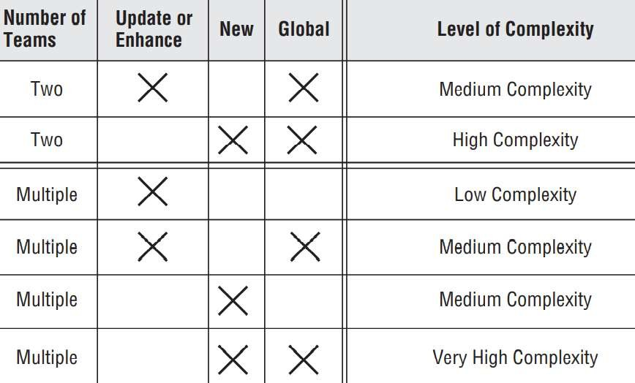
Classifying Multiple Team Projects
Figure 14-2 Types of multiple multi-team projects
Types of multiple team projects

Slide 18
Project Office Structure
In order to manage large or mission-critical projects, organizations establish Project Office (PO).
Temporary structure and exists only to serve the needs
projects.
Some organizations establish a PO, whenever the size of
of those
the team
reaches to some number.
Project Office is a temporary management structure established to coordinate and support the work of several independent teams who are concurrently working on the same single project that has task

Slide 19
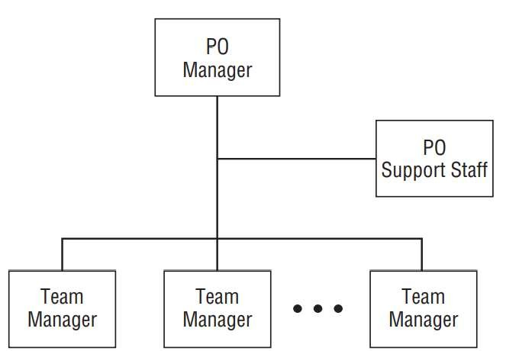
Project Office Structure
Project Structure
Office

Slide 20
Project Office Structure
The roles and responsibilities of the PO Manager and support staff include:
  Organize and manage the entire project
  Develop the high-level project plan in collaboration with team managers
  Integrate and coordinate the project plans of each team
  Maintain the overall project schedule
  Monitor and manage resource use
  Prepare and distribute project status reports
  Plan and conduct team meetings
  Process scope change requests
  Solve problems escalated from the individual teams
  Negotiate and solve problems between teams

Slide 21
Core Team Structure
A Core Team (CT) is a temporary team comprising a small number of subject matter experts (SMEs) chosen and managed by the CT Manager. These SMEs consult, advise, and support the CT Manager and the teams assigned to the project.

Slide 22
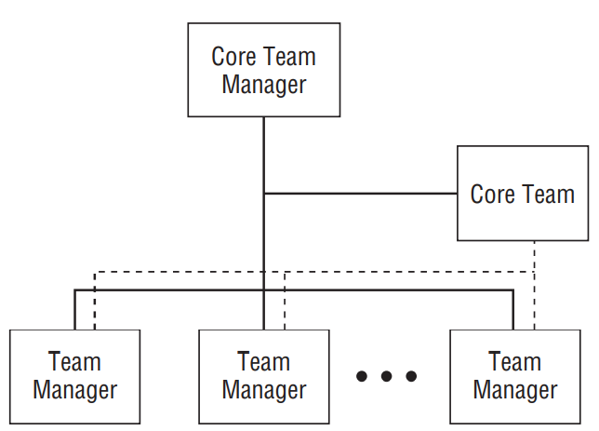
Core Team Structure
Core Team Structure

Slide 23
Core Team Structure
The roles and responsibilities of the CT and the CT Manager include:
  Advise each team on technical matters
  Provide subject matter expertise on enterprise systems and processes
  Support each team as requested and as needed
  Collaborate with and advise the CT Manager as requested

Slide 24
Super Team Structure
A Super Team (ST) is a temporary management structure used for a single project that integrates several independent teams into a single team managed by a senior-level project manager and supported by several subproject managers.

Slide 25
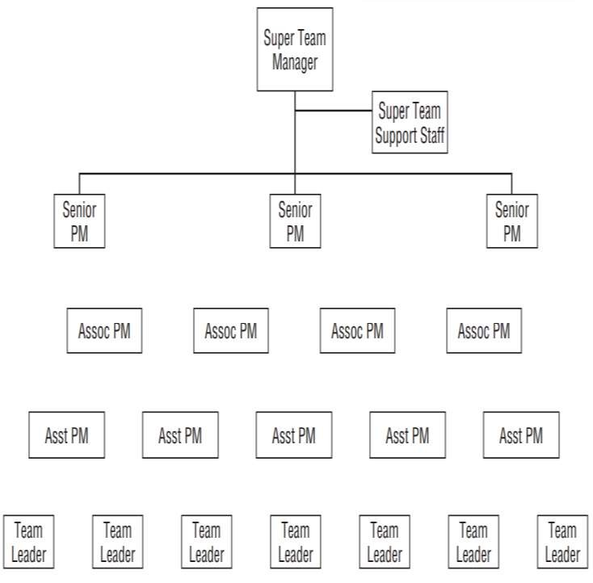
Super Team Structure
Super Team Structure

Slide 26
Super Team Structure
The roles
include:
and responsibilities of the ST Manager and the team leaders
Organize and manage the project
Develop the project plan
Maintain the overall project schedule
Monitor and manage resource utilization
Prepare and distribute project status reports
Plan and conduct team meetings
Process scope change requests

Slide 27
Putting It All Together
The following four factors are discussed that affect your choice of a best-fit project structure.
  Project management maturity
  Complexity and uncertainty
  Total team size
  Criticality

Slide 28
Putting It All Together
Project Management Maturity
  Either a PO or CT structure is recommended for organizations
at Level 1 or 2 maturity.
  Organizations at Level 3 to 5 may use any structure with better results.

Slide 29
Putting It All Together
As complexity and uncertainty increase, structure changes from PO to CT and finally to ST.
the best-fit

Slide 30
Putting It All Together
Total team size
  As team size increases, the best-fit structure changes from
CT to ST to PO.

Slide 31
Putting It All Together
As criticality increases, the best-fit structure changes from PO to ST to CT.

Slide 32
Chapter summary
The following are covered related to Multiple Team Projects
  Project Office Structure
  Core Team Structure
  Super Team Structure

