Slide 1

Chapter 1:
Introduction to Project Management: Concepts and Definitions

Slide 2
Contents:
Introduction.
What is A Project?
What is Project Management?
Program and Project Portfolio Management.
The Role of The Project Manager.

Slide 3
Week Learning Outcome:
Define what a project is.
Identify varying tools and techniques used for project management.
Describe the roles of project managers.
Discuss the differences between project management and project portfolio management.
Describe careers associated with IT project management.

Slide 4
Introduction
Many organizations today have a new or renewed interest in project management.
Until the 1980s, project management primarily focused on providing schedule and resource data to top management in the military, computer, and construction industries.
Today’s project management involves much more, and people in every
industry and every country manage projects.

Slide 5
Introduction
According to the latest forecast by Gartner:
Worldwide IT spending is projected to total $4.1 trillion in 2021, an increase of 8.4% from 2020.
Organizations waste $97 million for every $1 billion spent on projects, according to PMI’s Pulse of the Profession report.

Slide 6
Introduction
The world as a whole spends nearly $10 trillion of its $40.7 trillion gross product on projects of all kinds.
In 2017, the average annual salary (without bonuses) for someone in the project management profession was $112,00 per year in the United States and $130,866 in Switzerland, the highest-paid country.

Slide 7
Introduction
Many organizations assert that using project management techniques provides advantages, such as the following:
Better control of financial, physical, and human resources
Improved customer relations
Shorter development times
Lower costs and improved productivity
Higher quality and increased reliability
Higher profit margins
Better internal coordination
Positive impact on meeting strategic goals
Higher worker morale

Slide 8
What is A Project?
A project is “a temporary endeavor undertaken to create a unique product,
service, or result”
Operations is work done to sustain the business
Projects end when their objectives have been reached or the project has been terminated
Projects can be large or small and take a short or long time to complete

Slide 9
What is A Project?
Projects come in all shapes and sizes, the following attributes help define a project further:
A project has a unique purpose.
A project is temporary.
A project drives change and enables value creation.
A project is developed using progressive elaboration.
A project requires resources, often from various areas.
A project should have a primary customer or sponsor.
A project involves uncertainty.

Slide 10
What is A Project?
Project managers work with the project sponsors, team, and the other people involved to achieve project goals.
Every project is constrained in different ways, often by its scope, time, and cost goals. These limitations are sometimes referred to in project management as the triple constraint.

Slide 11
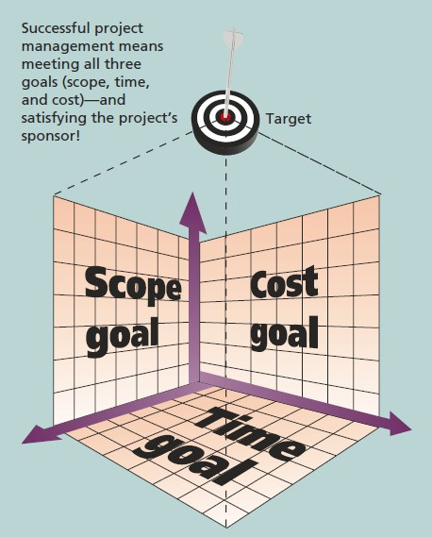
What is A Project?
To create a successful project, a project manager must consider scope, time, and cost and balance these three often- competing goals

Slide 12
What is Project Management?
Project management is “the application of knowledge, skills, tools and techniques to project activities to meet project requirements”
Project managers strive to meet the triple constraint by balancing project scope, time, and cost goals

Slide 13
What is Project Management?
Project Stakeholders are the people involved in or affected by project activities, and include:
the project sponsor
project team
support staff
customers
Users
suppliers
opponents of the project.

Slide 14
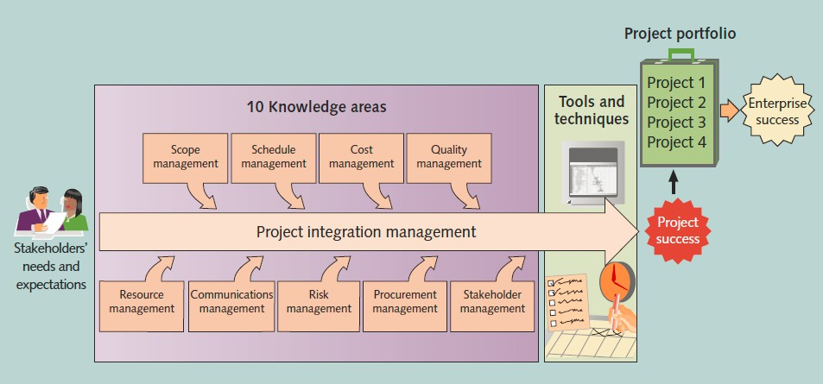
What is Project Management?

Slide 15
What is Project Management?
Project management knowledge areas describe the key competencies that project
managers must develop.
4 core knowledge areas lead to specific project objectives (scope, Schedule, cost, and quality)
5 facilitating knowledge areas are the means through which the project objectives are achieved (resource, communications, risk, procurement, and stakeholder management
1 knowledge area (project integration management) affects and is affected by all of the other knowledge areas.

Slide 16
What is Project Management?
Project management tools and techniques assist project managers and their
teams in various aspects of project management
Some specific ones include:
  Project charter, scope statement, and WBS (scope)
  Gantt charts, network diagrams, critical path analysis, critical chain scheduling (time)
  Cost estimates and earned value management (cost)
See Table 1-1 for many more

Slide 17
What is Project Management?
“Super tools” are those tools that have high use and high potential for improving project success, such as:
  Software for task scheduling (such as project management software)
  Scope statements
  Requirements analyses
  Lessons-learned reports
Tools already extensively used that have been found to improve project importance include:
  Progress reports
  Kick-off meetings
  Gantt charts
  Change requests

Slide 18
What is Project Management?
There are several ways to define project success:
  The project met scope, time, and cost goals
  The project satisfied the customer/sponsor
  The results of the project met its main objective, such as making or saving a certain amount of money, providing a good return on investment, or simply making the sponsors happy.

Slide 19
What is Project Management?
Recent research findings show that companies that excel in project delivery
capability:
  Use an integrated project management toolbox (use standard/advanced PM tools, lots of templates)
  Grow project leaders, emphasizing business and soft skills
  Develop a streamlined project delivery process
  Measure project health using metrics, like customer satisfaction or return on investment.

Slide 20
Program and Project Portfolio Management
A program is “a group of related projects managed in a coordinated way to obtain benefits and control not available from managing them individually”
A program manager provides leadership and direction for the project managers heading the projects within the program
Examples of common programs in the IT field include infrastructure, applications development, and user support

Slide 21
Program and Project Portfolio Management
As part of project portfolio management, organizations group and manage projects and programs as a portfolio of investments that contribute to the entire enterprise’s success
Portfolio managers help their organizations make wise investment decisions
by helping to select and analyze projects from a strategic perspective.

Slide 22
Program and Project Portfolio Management
 | Projects | Programs | Portfolios
Definition | A project is a temporary endeavor undertaken to create a unique product, service, or result. | A program is a group of related projects, subsidiary programs, and program activities that are managed in a coordinated way to obtain benefits not available from managing them individually. | A portfolio is a collection of projects, programs, subsidiary portfolios, and operations managed as a group to achieve strategic objectives.
Managemen t | Project managers manage the project team to meet the project objectives. | Programs are managed by program managers who ensure that program benefits are delivered as expected, by coordinating the activities of a program’s components. | Portfolio managers may manage or coordinate portfolio management staff, or program and project staff that may have reporting responsibilities into the aggregate portfolio.

Slide 23
Program and Project Portfolio Management
 | Projects | Programs | Portfolios
Monitoring | Project managers monitor and control the work of producing the products, services, or results that the project was undertaken to produce. | Program managers monitor the progress of program components to ensure that the overall goals, schedules, budget, and benefits of the program are met. | Portfolio managers monitor strategic changes and aggregate resource allocation, performance results, and risk of the portfolio.
Success | Success is measured by product and project quality, timeliness, budget compliance, and degree of customer satisfaction. | A program’s success is measured by the program’s ability to deliver its intended benefits to an organization, and by the program’ efficiency and effectiveness in delivering those benefits. | Success is measured in terms of the aggregate investment performance and benefit realization of the portfolio.

Slide 24
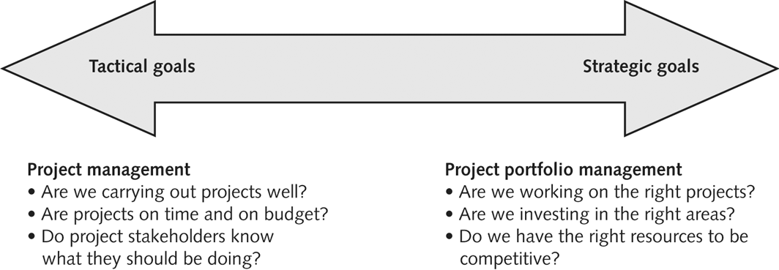
Program and Project Portfolio Management
Project Management Compared to Project Portfolio Management

Slide 25
Program and Project Portfolio Management
A best practice is “an optimal way recognized by industry to achieve a stated goal or objective”
Robert Butrick suggests that organizations need to follow basic principles of project
management, including these two mentioned earlier in this chapter:
Make sure your projects are driven by your strategy; be able to demonstrate how each project you undertake fits your business strategy, and screen out unwanted projects as soon as possible
Engage your stakeholders; ignoring stakeholders often leads to project failure; be sure to engage stakeholders at all stages of a project, and encourage teamwork and commitment at all times.

Slide 26
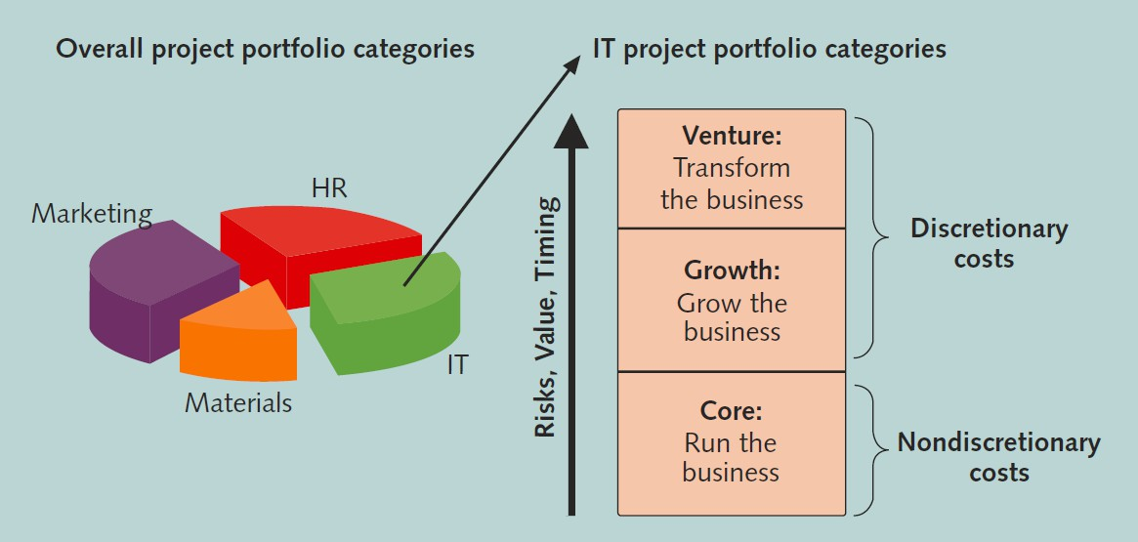
Program and Project Portfolio Management

Slide 27
The Role of The Project Manager.
Project managers need a wide variety of skills, they should:
Be comfortable with change.
Understand the organizations they work in and with.
Be able to lead. teams to accomplish
project goals
Have the Project Management Body of Knowledge
Have application area knowledge, standards, and regulations
Have project environment knowledge
Have General management knowledge and
skills
Have soft skills or human relations skills

Slide 28
The Role of The Project Manager.
Job descriptions vary, but most include responsibilities like planning, scheduling, coordinating, and working with people to achieve project goals
Remember that 97% of successful projects were led by experienced project managers, who can often help influence success factors.

Slide 29
The Role of The Project Manager.
Ten Most Important Skills and Competencies for Project Managers are:
People skills
Leadership
Listening
Integrity, ethical behaviour, consistent
Strong at building trust
Verbal communication
Strong at building teams
Conflict resolution, conflict management
Critical thinking, problem solving
10. Understands, balances priorities

Slide 30
The Role of The Project Manager.
A leader focuses on long-term goals and big-picture objectives while inspiring people to reach those goals
A manager deals with the day-to-day details of meeting specific goals
Project managers often take on the role of both leader and manager
Effective project managers provide leadership by example

Slide 31
The Role of The Project Manager.
Practically, the needed skills vary based on the situations:
  Large projects: leadership, relevant prior experience, planning, people skills, verbal communication, and team-building skills were most important
  High uncertainty projects: risk management, expectation management,
leadership, people skills, and planning skills were most important
  Very novel projects: leadership, people skills, having vision and goals, self
confidence, expectations management, and listening skills were most important

Slide 32
The Role of The Project Manager.
In the real world, the profession of project management is growing at a very rapid pace.
It is helpful to understand the history of the field, the role of professional societies like the Project Management Institute, and the growth in project management software.

Slide 33
The Role of The Project Manager.
In terms of project management certification, PMI provides certification as a Project Management Professional (PMP)
A PMP has documented sufficient project experience, agreed to follow a code of ethics, and passed the PMP exam.
The number of people earning PMP certification is increasing quickly.
PMI and other organizations offer additional certification programs.

Slide 34
The Role of The Project Manager.
Ethics, loosely defined as a set of principles that guide our decision making based on personal values of what is “right” and “wrong”
Project managers often face ethical dilemmas
In order to earn PMP certification, applicants must agree to PMI’s Code of Ethics and Professional Conduct
Several questions on the PMP exam are related to professional responsibility, including ethics

Slide 35
The Role of The Project Manager.
There are hundreds of different products to assist in performing project management
Three main categories of tools:
Low-end tools: handle single or smaller projects well, cost under $200 per user
Midrange tools: handle multiple projects and users, cost $200-600 per user, Project
2007 most popular
High-end tools: also called enterprise project management software, often licensed on a per-user basis, like VPMi Enterprise Online (www.vcsonline.com) – see front cover for trial version information.

Slide 36
Chapter summary
A project is a temporary endeavor undertaken to create a unique product, service, or result
Project management is the application of knowledge, skills, tools, and techniques to project
activities to meet project requirements
A program is a group of related projects managed in a coordinated way
Project portfolio management involves organizing and managing projects and programs as a portfolio of investments
Project managers play a key role in helping projects and organizations succeed
The project management profession continues to grow and mature.

