Slide 1
Chapter 2:
The Project Management and Information Technology Context

Slide 2
Contents:
A Systems View of Project Management
Project and Product Life Cycles
The Context of Information Technology Projects

Slide 3
Week Learning Outcome:
Describe the systems approach for project management.
Describe the ten characteristics of an organization's culture and how they affect project management.
Identify the elements, purpose, and benefits of using project and life-cycle phases.
Describe the characteristics and diverse nature of IT projects.
Identify the recent trends that affect IT project management.

Slide 4
A Systems View of Project Management
Projects must operate in a broad organizational environment.
Project managers need to use systems thinking:
  Taking a holistic view of carrying out projects within the context of the organization
Senior managers must make sure projects continue to support current business needs.

Slide 5
A Systems View of Project Management
A systems approach emerged in the 1950s to describe a more analytical approach to management and problem solving.
Three parts include:
  Systems philosophy: an overall model for thinking about things as systems
  Systems analysis: problem-solving approach
  Systems management: address business, technological, and organizational issues before making changes to systems

Slide 6
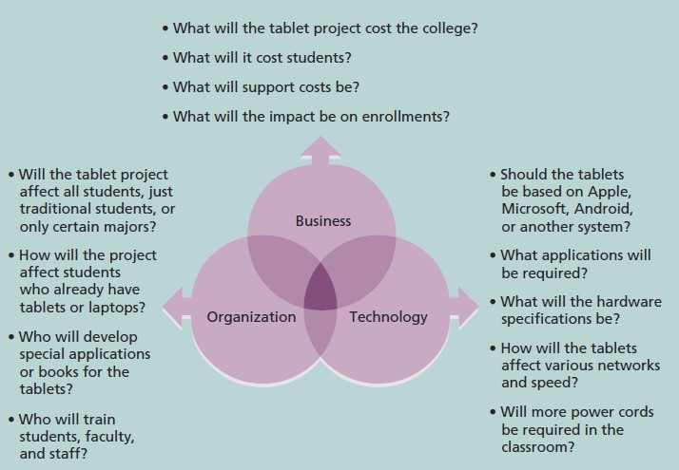
A Systems View of Project Management
Three Sphere Model for Systems
Management

Slide 7
A Systems View of Project Management
Structural Frame: Focuses on roles and responsibilities, coordination and control. Organization charts help define this frame. | Human Resources Frame: Focuses on providing harmony between needs of the organization and needs of people.
Political Frame: Assumes organizations are coalitions composed of varied individuals and interest groups. Conflict and power are key issues. | Symbolic Frame: Focuses on symbols and meanings related to events. Culture is important.

Slide 8
A Systems View of Project Management
The organization’s structures can be divided into:
  Functional Organizational: functional managers report to the CEO.
  Project Organizational: program managers report to the CEO.
  Matrix Organizational: middle ground between functional and project
structures
    personnel often report to two or more bosses.
structure can be weak, balanced, or strong matrix.

Slide 9
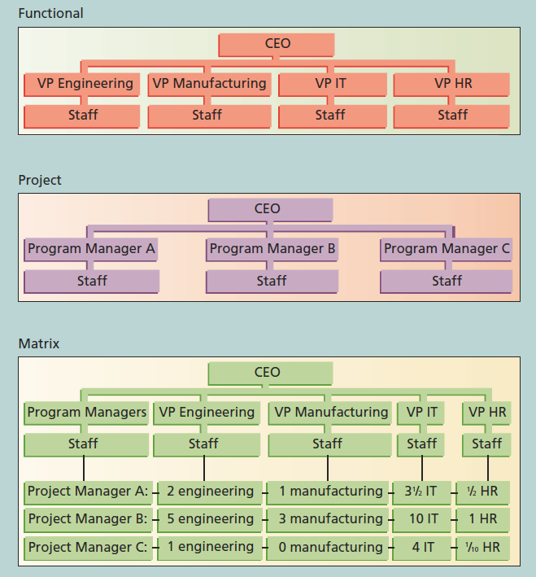
A Systems View of Project Management
Functional, project, and matrix organizational structures

Slide 10
A Systems View of Project Management
Organizational culture is a set of shared assumptions, values, and behaviors that characterize the functioning of an organization.
Many experts believe the underlying causes of many companies’ problems are not the structure or staff, but the culture

Slide 11
A Systems View of Project Management
There are 10 characteristics of organizational culture:
Member identity.
Group emphasis.
People focus.
Unit integration.
Control.
Risk tolerance
Reward criteria
Conflict tolerance
Means-ends orientation
Open-systems focus

Slide 12
A Systems View of Project Management
Project managers must take time to identify, understand, and manage relationships with all project stakeholders.
Using the four frames of organizations can help meet stakeholder needs and expectations.
Senior executives/ top management are very important stakeholders.

Slide 13
A Systems View of Project Management
People in top management positions are key stakeholders in projects.
A very important factor in helping project managers successfully lead projects is the level of commitment and support they receive from top management.
Without top management commitment, many projects will fail.
IT governance addresses the authority and control for key IT activities in organizations, including IT infrastructure, IT use, and project management.

Slide 14
A Systems View of Project Management
Top management commitment is crucial to project managers for the following reasons:
  Providing adequate resources.
  Approving unique project needs in a timely manner.
  Getting cooperation from other parts of the organization.
  Mentoring and coaching on leadership issues.

Slide 15
A Systems View of Project Management
It is very difficult for an IT project to be successful if the organization itself does not value IT.
Many companies have realized that IT is integral to their business and have created a vice president or equivalent position for the head of IT, often called the Chief Information Officer (CIO).
IT governance addresses the authority and control for key IT activities in organizations, including IT infrastructure, IT use, and project management.

Slide 16
A Systems View of Project Management
Another problem in most organizations is a lack of standards or guidelines to follow when performing project management.
Standards and guidelines help project managers be more effective
Senior management can encourage:
  The use of standard forms and software for project management.
  The development and use of guidelines for writing project plans or providing status information.
▪ The creation of a project management office or centre of excellence.

Slide 17
Project and Product Life Cycles
A project life cycle is a collection of project phases. Projects pass through these phases from their start to their completion.
A deliverable is a product or service produced or provided as part of a project.
The generic project life cycle to includes the following four phases:
  Starting the project.
  Organizing and preparing.
  Carrying out the work.
  Finishing the project.

Slide 18
Project and Product Life Cycles
These phases should not be confused with the project management process groups of
initiating, planning, executing, monitoring and controlling, and closing.
The project life cycle defines:
  What work will be performed in each phase?
  What deliverables will be produced and when?
  Who is involved in each phase ?
  How management will control and approve work produced in each phase?

Slide 19
Project and Product Life Cycles
In early phases of a project life cycle:
  Resource needs are usually lowest.
  The level of uncertainty (risk) is highest.
  Project stakeholders have the greatest opportunity to influence the project.

Slide 20
Project and Product Life Cycles
In middle phases of a project life cycle:
  The certainty of completing a project improves .
  More resources are needed.

Slide 21
Project and Product Life Cycles
The final phase of a project life cycle focuses on:
  Ensuring that project requirements were met.
  The sponsor approves completion of the project.

Slide 22
Project and Product Life Cycles
A product life cycle is a process used to define, create, and deliver products.
The Systems Development Life Cycle (SDLC) is a framework for describing the phases
involved in developing and maintaining information systems.
Systems development projects can follow :
  Predictive life cycle: The scope, schedule, and cost are determined early, and changes to scope are carefully managed. PMI also refers to predictive life cycles as waterfall.
  Iterative life cycle: The scope is determined early, but time and cost estimates are modified as the understanding of the product increases. This approach works best when there is a high degree of change and a low frequency of delivery.

Slide 23
Project and Product Life Cycles
Incremental life cycle: Deliverables are produced through a series of iteration that add functionality within a set time frame. The deliverable is not complete until after the final iteration. This approach works best when there is a low degree of change and a high frequency of delivery.
Adaptive life cycle: Stakeholders define and approve the detailed scope before the start of an iteration, producing a useable product at the end of each iteration. PMI also refers to adaptive life cycles as agile or change driven. This approach works best when there is a high degree of change and a high frequency of delivery.
Hybrid life cycle: combination of approaches is used based on the nature of the work.

Slide 24
Project and Product Life Cycles
There are several predictive SDLC models:
  Waterfall model: has well-defined, linear stages of systems development and support
  Spiral model: shows that software is developed using an iterative or spiral approach rather than a linear approach.
  Incremental build model: provides for progressive development of operational
software.
  Prototyping model: used for developing prototypes to clarify user requirements.
  Rapid Application Development (RAD) model: used to produce systems quickly
without sacrificing quality.

Slide 25
Project and Product Life Cycles
Please note that the project should successfully pass through each of the project phases in order to continue on to the next.
Management reviews, also called phase exits or kill points, should occur after each phase to evaluate the project’s progress, likely success, and continued compatibility with organizational goals.

Slide 26
The Context of Information Technology Projects
IT projects can be very diverse in terms of size, complexity, products produced, application area, and resource requirements
IT project team members often have diverse backgrounds and skill sets
IT projects use diverse technologies that change rapidly; even within one technology area, people must be highly specialized

Slide 27
The Context of Information Technology Projects
Recent trends such as increased globalization, outsourcing, virtual teams, and agile project management are creating additional challenges and opportunities for IT project managers and their teams:
  Globalization: lower trade and political barriers and the digital revolution have made it possible to interact almost instantaneously with billions of other people across the planet
  Outsourcing: outsourcing is when an organization acquires goods and/or sources from an outside source; offshoring is sometimes used to describe outsourcing from another country.

Slide 28
The Context of Information Technology Projects
Virtual teams: a virtual team is a group of individuals who work across time and space using communication technologies.
Agile project management: Agile means being able to move quickly and easily, but some people feel that project management, as they have seen it used, does not allow people to work quickly or easily.

Slide 29
Globalization
Issues
  Communications
  Trust
  Common work practices
  Tools
Suggestions
  Employ greater project discipline
  Think global but act local
  Keep project momentum going
  Use newer tools and technology

Slide 30
Outsourcing
Organizations remain competitive by using advantage, such as finding ways to reduce costs.
outsourcing to their
Their next challenge is to make strategic IT investments with outsourcing by improving their enterprise architecture to ensure that IT infrastructure and business processes are integrated and standardized.
Project managers should become more familiar with negotiating contracts and other outsourcing issues

Slide 31
Virtual Teams (Advantages)
Increasing competitiveness and responsiveness by having a team of workers available 24/7.
Lowering costs because many virtual workers do not require office space or support beyond their home offices.
Providing more expertise and flexibility by having team members from across
the globe working any time of day or night.
Increasing the work/life balance for team members by eliminating fixed office

Slide 32
Virtual Teams (Disadvantages)
Isolating team members.
Increasing the potential for communications problems.
Reducing the ability for team members to network and transfer information informally.
Increasing the dependence on technology to accomplish work.
See text for a list of factors that help virtual teams succeed, including team

Slide 33
Chapter summary
Project managers need to take a systems approach when working on projects.
Organizations have four different frames: structural, human resources, political, and symbolic.
The structure and culture of an organization have strong implications for project managers.
Projects should successfully pass through each phase of the project life cycle.
Project managers need to consider several factors due to the unique context of information
technology projects.
Recent trends affecting IT project management include globalization, outsourcing, and virtual
teams.

