Slide 1

Chapter 3:
The Project Management Process Groups

Slide 2
Contents:
Project management process groups.
Mapping the process groups to the knowledge areas .
Developing an IT Project Management Methodology.
Case Study.

Slide 3
Week Learning Outcome:
Describe the five project management process groups
Discuss the varying nature by which project
Identify different methodologies used to manage information technology project.
Review an organizational case study which incorporates elements for managing a project from start to finish.

Slide 4
Project management process groups
A process is a series of actions directed toward a particular result.
Project management can be viewed as a number of interlinked processes.
The project management process groups include:
  Initiating processes
  Planning processes
  Executing processes
  Monitoring and controlling processes
  Closing processes

Slide 5
Project management process groups
The level of activity and length of each process group varies for every project.
According to Andy Growe, “Spending more time on planning should pay off in execution”, and that was not an opinion.

Slide 6
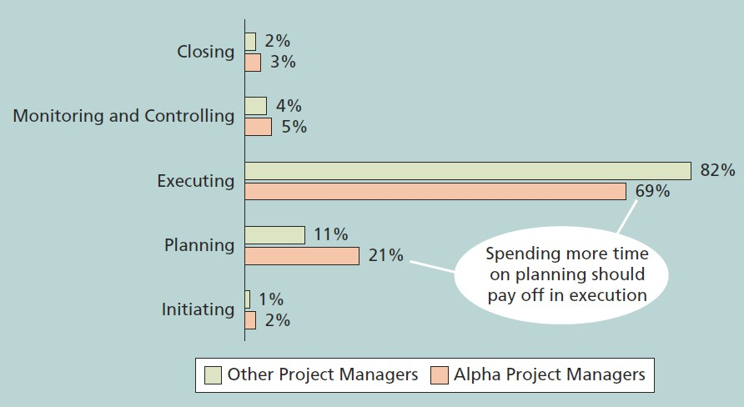
Project management process groups

Slide 7
Project management process groups
pure and simple, good, methodology-centric, predictable, and repeatable project management is the SINGLE greatest factor in the success (or in this case failure) of any project. When a key stakeholder says, “I didn’t know how bad things were,” it is a direct indictment of the project manager’s
communications management plan.

Slide 8
Mapping the process groups to the knowledge areas
You can map the main activities of each PM process group into the nine knowledge areas using the PMBOK® Guide 2017
Note that there are activities from each knowledge area under the planning and monitoring and controlling process groups.
You can map the main activities of each project management process group into the 10 project management knowledge areas.

Slide 9

Mapping the process groups to the knowledge
aKnroewleadgesArea
 | Project Management Process Groups
 | Initiating Process Group | Planning Process Group | Executing Process Group | Monitoring and Controlling Process Group | Closing Process Group
Project Integration Management | - Develop Project Charter | - Develop Project Management Plan | Direct and Manage Project Work Manage Project Knowledge | Monitor and Control Project Work Perform Integrated Change Control | - Close Project or Phase
Project Scope Management |  | Plan Scope Management Collect Requirements Define Scope Create WBS |  | Validate Scope Control Scope
Project Schedule Management |  | Plan Schedule Management Define Activities Sequence Activities Estimate Activity Durations Develop Schedule |  | - Control Schedule

Slide 10

Mapping the process groups to the knowledge
aKnroewleadgesArea
 | Project Management Process Groups
 | Initiating Process Group | Planning Process Group | Executing Process Group | Monitoring and Controlling Process Group | Closing Process Group
Project Cost Management |  | Plan Cost Management Estimate Costs Determine Budget |  | - Control Costs
Project Quality Management |  | - Plan Quality Management | - Manage Quality | - Control Quality
Project Resource Management |  | Plan Resource Management Estimate Activity Resources | Acquire Resources Develop Team Manage Team | - Control Resources
Project Communications Management |  | - Plan Communications Management | - Manage Communications | - Monitor Communications

Slide 11

Mapping the process groups to the knowledge
aKnroewleadgesArea
 | Project Management Process Groups
 | Initiating Process Group | Planning Process Group | Executing Process Group | Monitoring and Controlling Process Group | Closing Process Group
project Risk Management |  | Plan risk management Identify risks Perform qualitative risk analysis Perform quantitative risk analysis Plan risk responses | - Implement risk responses | - Monitor risks
Project Procurement Management |  | - Plan procurement management | - Conduct procurements | - Conduct procurements
Project Stakeholder Management | - Identify stakeholders | - Plan stakeholder engagement | Manage stakeholder engagement | - Monitor stakeholder engagement
project Risk Management |  | Plan risk management Identify risks Perform qualitative risk analysis Perform quantitative risk analysis Plan risk responses | - Implement risk responses | - Monitor risks

Slide 12
Developing an IT Project Management Methodology
Just as projects are unique, so are approaches to project management.
Many organizations develop their own project management methodologies, especially for IT projects.
A methodology describes how things should be done; a standard describes what should be done.

Slide 13
Developing an IT Project Management Methodology
many organizations use other guides or methods, such as the following:
  PRINCE2, Agile, RUP, and Six Sigma provide different project management methodologies.
PMI estimates that poor project performance costs over $109 million for every
$1 billion invested in projects and programs.

Slide 14
Case Study (JWD Consulting’s Project Management Intranet Site Project)
The following fictitious case provides an example of the elements involved in managing a project from start to finish.
This example also uses Microsoft Project to demonstrate how project management software can assist in several aspects of managing a project.
Several templates illustrate how project teams prepare various project management documents.

Slide 15
Case Study (JWD Consulting’s Project Management Intranet Site Project)
Project Pre-initiation
In project management, initiating includes recognizing and starting a new project.
An organization may initiate IT projects for several reasons, but the most important reason is to support business objectives.
It is good practice to lay the groundwork for a project before it officially starts.

Slide 16
Case Study (JWD Consulting’s Project Management Intranet Site Project)
Project Pre-initiation
Senior managers often perform several pre-initiation tasks, including the following:
  Determine the scope, time, and cost constraints for the project
  Identify the project sponsor
  Select the project manager
  Develop a business case for a project (see Table 3-2 for an example)
  Meet with the project manager to review the process and expectations for managing the project
  Determine if the project should be divided into two or more smaller projects

Slide 17
Case Study (JWD Consulting’s Project Management Intranet Site Project)
Project initiation
The main goal is to formally select and start off projects.
The main tasks were to identify all of the project stakeholders and to develop the project charter.
The main outputs are a project charter and a stakeholder register.

Slide 18

Case Study (JWD Consulting’s Project Management Intranet Site Project)
Project initiation
Knowledge Area | Initiating Process | Outputs
Project Integration Management | Develop project charter | Project charter Assumption log
Project Stakeholder Management | Identify stakeholders | Stakeholder register Change requests Project management plan updates Project documents updates
Project initiation knowledge areas, processes, and outputs

Slide 19
Case Study (JWD Consulting’s Project Management Intranet Site Project)
Project initiation
A stakeholder analysis is a technique that project managers can use to help
understand and increase the support of stakeholders throughout the project.
Results of the stakeholder analysis can be documented in a stakeholder register or in
a separate stakeholder management strategy.
This strategy includes basic information such as stakeholder names, level of interest in the project, level of influence on the project, and potential management strategies for gaining support or reducing obstacles from each stakeholder.

Slide 20

Case Study (JWD Consulting’s Project Management Intranet Site Project)
Project initiation
Name | Position | Internal/ External | Project role | Contact information
Joe Fleming | CEO | Internal | Sponsor | joe_fleming@jwdconsulting.com
Erica Bell | PMO Director | Internal | Project Manager | erica_bell@jwdconsulting.com
Michael Chen | Senior Consultant | Internal | Team Member | michael_chen@jwdconsulting.com
Kim Phuong | Business Analyst | external | Advisor | kim_phuong@client1.com
Louise Mills | PR Director | InternSatal keholder reg | iAstdevrisor | louise_mills@jwdconsulting.com

Slide 21

Case Study (JWD Consulting’s Project Management Intranet Site Project)
Project initiation
Name | Level of interest | Level of influence | Potential Management Strategies
Joe Fleming | High | High | Joe likes to stay on top of key projects and make money. Have a lot of short, face-to-face meetings and focus on achieving the financial benefits of the project.
Louise Mills | Low | High | Louise has a lot of things on her plate, and she does not seem excited about this project. She may be looking at other job opportunities. Show her how this project will help the company and her resume.
Stakeholder management strategy

Slide 22
Case Study (JWD Consulting’s Project Management Intranet Site Project)
Drafting the Project Charter
Charters are normally short stakeholder signatures.
and include key project information and
It’s good practice to hold a kick-off meeting at the beginning of a project so that stakeholders can meet each other, review the goals of the project, and discuss future plans.

Slide 23
Case Study (JWD Consulting’s Project Management Intranet Site Project)
kick-off meeting
The main topics in an agenda:
  Meeting objective.
  Agenda (lists in order the topics to be discussed).
  A section for documenting action items, who they are assigned to, and when each person will complete the action.
  A section to document the date and time of the next meeting.

Slide 24
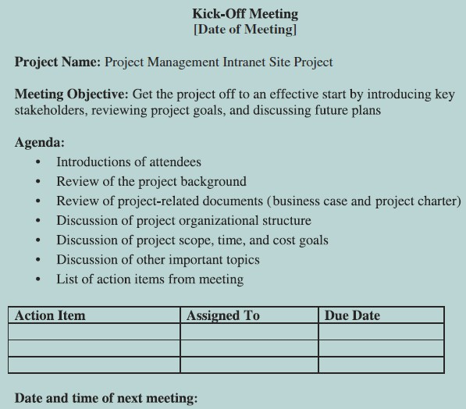
Case Study
(JWD Consulting’s Project Management Intranet Site Project)
kick-off meeting

Slide 25
Case Study (JWD Consulting’s Project Management Intranet Site Project)
Project planning
Main purpose of project planning is to guide execution.
Every knowledge area includes planning information (see pages 106- 108)
Key outputs included in the JWD project include:
  A team contract
  A project scope statement
  A work breakdown structure (WBS)
  A project schedule, in the form of a Gantt chart with all dependencies and resources entered
  A list of prioritized risks (part of a risk register)

Slide 26
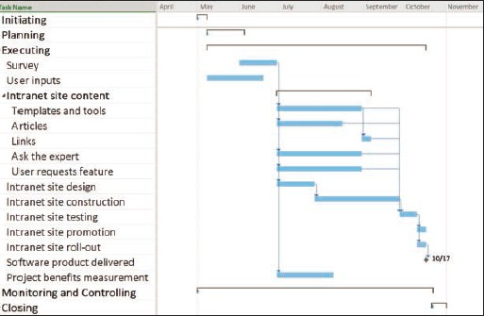
Case Study
(JWD Consulting’s Project Management Intranet Site Project)
Project planning
JWD Consulting intranet site project baseline Gantt chart

Slide 27

Case Study
Ranking | Potential Risk
1 | Lack of inputs from internal consultants
2 | Lack of inputs from client representatives
3 | Security of new system
4 | Outsourcing/purchasing for the article retrieval and Ask the Expert Features
5 | Outsourcing/purchasing for processing online payment transactions
6 | Organizing the templates and examples in a useful fashion
7 | Providing an efficient search feature
8 | Getting good feedback from Michael Chen and other senior consultants
9 | Effectively promoting the new system
10 | Realizing the benefits of the new system within one year
(JWD Consulting’s Project Management Intranet Site Project)
Project planning
List of prioritized risks

Slide 28
Case Study (JWD Consulting’s Project Management Intranet Site Project)
Project Execution
Executing the project involves taking the necessary actions to complete the activities
in the project plan.
Usually takes the most time and resources to perform project execution .
Project managers must use their leadership skills to handle the many challenges that occur during project execution.
A milestone report can help focus on completing major milestones.

Slide 29
Case Study (JWD Consulting’s Project Management Intranet Site Project)
Project Execution
For Executing processes and outputs (see pages 118 - 119).
For Milestone report (see pages 120- 121).

Slide 30
Case Study (JWD Consulting’s Project Management Intranet Site Project)
Project Monitoring and Controlling
Monitoring and controlling is the process of measuring progress toward project objectives, monitoring deviation from the current plan, and taking corrective action to match progress with the current plan.
Monitoring and controlling is done throughout the life of a project and involves all 10 project management knowledge areas.
Affects all other process groups and occurs during all phases of the project life cycle.
For Monitoring and controlling processes and outputs (see pages 123- 124).

Slide 31
Case Study (JWD Consulting’s Project Management Intranet Site Project)
Project Monitoring and Controlling
Project team members submitted a brief progress report every Friday (that may vary) to show work performance information.
In addition to progress reports, an important tool for monitoring and controlling
the project was using project management software.
For Sample weekly progress report (see page 125).

Slide 32
Case Study (JWD Consulting’s Project Management Intranet Site Project)
Project Closing
The closing process involves gaining stakeholder and customer acceptance of the final products and services and then bringing the project or project phase to an orderly end.
It includes verifying that all of the deliverables are complete, and it often includes a
final project report and presentation.
Even though many IT projects are canceled before completion, it is still important to formally close any project and reflect on what can be learned to improve future projects.

Slide 33

Case Study (JWD Consulting’s Project Management Intranet Site Project)
Project Closing
Knowledge Area | Closing Process | Outputs
Project Integration Management | Close project or phase | Project documents updates Final product, service, or result transition Final report Organizational process assets updates
Closing processes and output

Slide 34
Case Study (JWD Consulting’s Project Management Intranet Site Project)
Project Closing
Outputs include project archives and lessons learned, part of organizational process assets.
Most projects also include a final report and presentation to the sponsor/senior management.
For Final project report table of contents (see page 129).

Slide 35
Chapter summary
The five project management process groups are initiating, planning, executing,
monitoring and controlling, and closing.
You can map the main activities of each process group to the nine knowledge areas.
Some organizations develop their own information technology project management methodologies.
The JWD Consulting case study provides an example of using the process groups and shows several important project documents.

