Slide 1

Chapter 4:
Project Integration Management

Slide 2
Contents:
What is Project Integration Management?
Strategic Planning and Project Selection.
Developing a Project Charter.
Project Management Plans.
Project Execution .
Directing and Managing Project Work.
Change Control Management.
Using Software to Assist in Project Integration Management.

Slide 3
Week Learning Outcome:
Describe the main process included in project integration management.
Explain the strategic planning process and why it is important.
Identify and describe the components of a project charter.
Describe the tools and techniques used for directing and implementing projects.
Describe the three main objectives of integrated change

Slide 4
What is Project Integration Management?
Project integration management involves coordinating all of the other project management knowledge areas throughout a project’s life cycle.
This integration ensures that all the elements of a project come together at the right times to complete a project successfully.
Project integration management is not the same thing as software integration

Slide 5
What is Project Integration Management?
Project Integration Management Processes are:
Developing the project charter involves working with stakeholders to create the document that formally authorizes a project—the charter.
Developing the project management plan involves coordinating all planning efforts to create a consistent, coherent document—the project management plan.
Directing and managing project work involves carrying out the project management plan by performing the activities included in

Slide 6
What is Project Integration Management?
4. Managing project knowledge involves using existing knowledge and creating new knowledge to achieve project
objectives while also
contributing to organizational learning.
Monitoring and controlling project work involves overseeing activities to meet the performance objectives of the project.
Performing integrated change control involves identifying, evaluating,
and managing changes throughout the project life cycle.
Closing the project or phase involves finalizing all activities to formally close the project or phase.

Slide 7
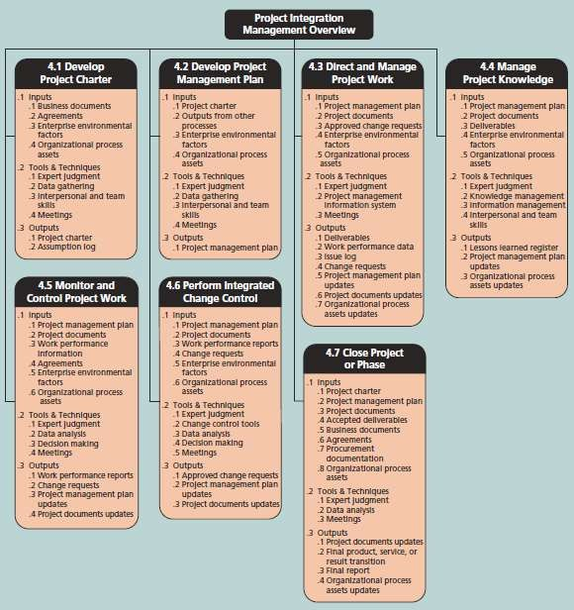
What is Project Integration Management?
The inputs, tools and techniques, and outputs
of project integration management.

Slide 8
Strategic Planning and Project Selection
Strategic planning involves determining long-term
objectives,
predicting future trends, and projecting the need for new products
and services.
Organizations often perform a SWOT analysis (Analyzing Strengths,
Weaknesses, Opportunities, and Threats).
As part of strategic planning, organizations:
  Identify potential projects.
  Use realistic methods to select which projects to work on.
  Formalize project initiation by issuing a project charter.

Slide 9
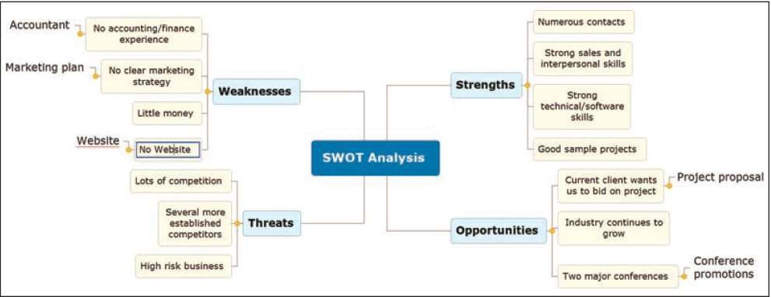
Strategic Planning and Project
Selection
Mind map of a SWOT analysis to help identify potential projects

Slide 10
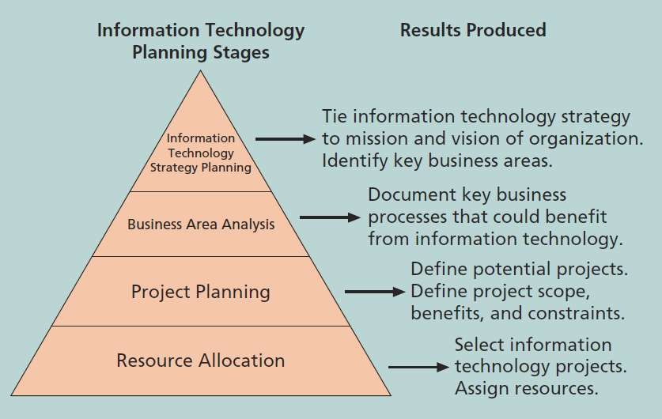
Strategic Planning and Project Selection
Planning process for selecting IT projects

Slide 11
Strategic Planning and Project Selection
Aligning IT projects with business strategy is at the heart of selecting IT projects.
IT governance helps organizations maximize their investments in IT and address IT-related risks and opportunities.
The organization must develop a strategy for using IT to define how it will support the organization’s objectives. This IT strategy must align with the organization’s strategic.

Slide 12
Strategic Planning and Project Selection
Selecting projects is not an exact science, and many methods exist for selecting projects. Five common techniques are as follows:
  Focusing on broad organizational needs
  Categorizing IT projects
  Performing net present value or other financial analyses
  Using a weighted scoring model
  Implementing a balanced scorecard

Slide 13
Strategic Planning and Project Selection
In practice, many organizations use a combination approaches to select Projects.
of these
Each approach has advantages and disadvantages, and it is up to management to determine the best approach for selecting projects based on their particular organization.

Slide 14
Strategic Planning and Project Selection
Projects that address broad organizational needs are much more likely to be successful because they will be important to the organization.
One method for selecting projects based on broad organizational needs is to determine whether they first meet three important criteria:
  There is a need for the project.
  There are funds available.
.

Slide 15
Strategic Planning and Project Selection
Another method for selecting projects is based on the impetus, and that could be :
  Problems.
  Opportunity.
  Directives.
Organizations can also categorize IT projects based on timing, or
priority.

Slide 16
Strategic Planning and Project Selection
Financial considerations are often an important consideration in selecting projects
Three primary methods for determining the projected financial value of projects:
  Net present value (NPV) analysis
  Return on investment (ROI)
  Payback analysis

Slide 17
Strategic Planning and Project Selection
Net present value (NPV) analysis is a method of calculating the expected net monetary gain or loss from a project by discounting all expected future cash inflows and outflows to the present point in time.
Projects with a positive NPV should be considered if financial value is a key criterion.
The higher the NPV, the better.

Slide 18
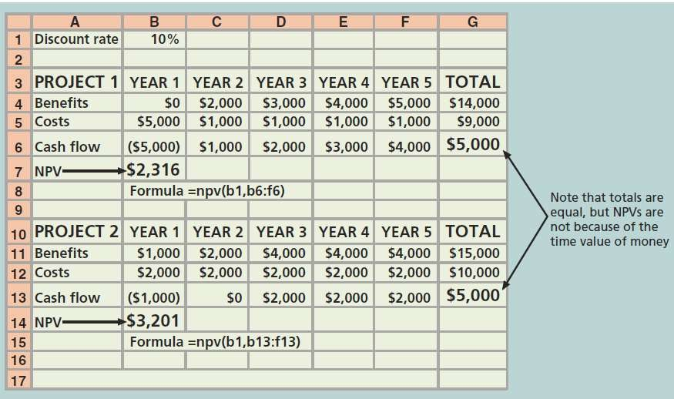
Strategic Planning and Project Selection

Slide 19
Strategic Planning and Project Selection
Determine estimated costs and benefits for the project and the products it produces.
life of the
Determine the discount rate (check with your organization on what to use).
Calculate the NPV (see text for details).
Notes: Some organizations consider the investment year as year 0, while others start in year 1; some people enter costs as negative numbers, while others do not.

Slide 20
Strategic Planning and Project Selection
Return on investment (ROI) is calculated by subtracting the project costs from the benefits and then dividing by the costs
ROI = (total discounted benefits - total discounted costs) /
discounted costs
The higher the ROI, the better.
Many organizations have a required rate of return or minimum
acceptable rate of return on investment for projects.
Internal rate of return (IRR) can by calculated by finding the
discount rate that makes the NPV equal to zero.

Slide 21
Strategic Planning and Project Selection
Another important financial consideration analysis.
is payback
The payback period is the amount of time it will take to recoup, in the form of net cash inflows, the total dollars invested in a project.
Payback occurs when the net cumulative discounted benefits equals the costs.
Many organizations want IT projects to have a fairly short

Slide 22
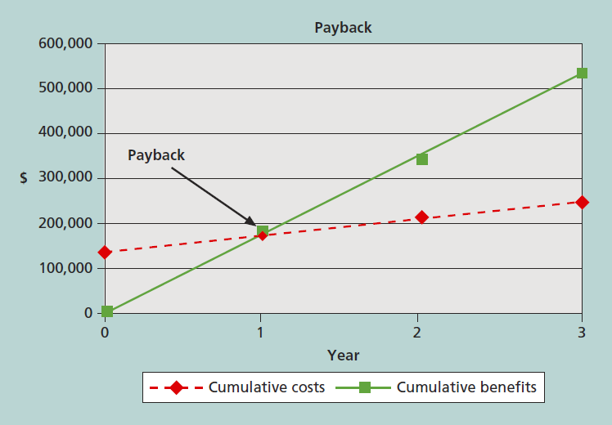
Strategic Planning and Project Selection
Charting the payback period for the JWD Consulting project

Slide 23
Strategic Planning and Project Selection
A weighted scoring model is a tool that provides a systematic process for selecting projects based on many criteria:
  Identify criteria important to the project selection process.
  Assign weights (percentages) to each criterion so they add up to 100%.
  Assign scores to each criterion for each project.
  Multiply the scores by the weights and get the total

Slide 24
Strategic Planning and Project Selection
Drs. Robert Kaplan and David Norton developed this approach to help select and manage projects that align with business strategy
A balanced scorecard is a methodology that converts an organization’s value drivers, such as customer service, innovation, operational efficiency, and financial performance, to a series of defined metrics.
See www.balancedscorecard.org for more information

Slide 25
Developing a Project Charter
After deciding what project to work on, it is important to let the rest of the organization know.
A project charter is a document that formally recognizes the existence of a project and provides direction on the project’s objectives and management.
Key project stakeholders should sign a project charter to acknowledge agreement on the need and intent of the project; a signed charter is a key output of project integration

Slide 26
Project Management Plans
A project management plan is a document used to coordinate all project planning documents and help guide a project’s execution and control.
Plans created in the other knowledge areas are subsidiary parts of the overall project management plan.
Many organizations use guidelines to create project management plans.

Slide 27
Project Management Plans
Project management plans should be dynamic, flexible, and receptive to change when the environment or project changes.
common elements to most project management plans, as follows:
Introduction/overview of the
project.
Project organization.
Management and technical processes (including project lifecycle description and
development approach, as
applicable).
Work to be performed (scope).
Schedule and budget information.
References to other project planning documents.

Slide 28
Project Execution
Project execution involves managing and performing the work described in the project management plan.
The majority of time and money is usually spent on execution.
The application area of the project directly affects project execution because the products of the project are produced during execution.
Project planning and execution are intertwined and
inseparable activities.

Slide 29
Project Execution Tools and Techniques
Expert judgment: experts can help project managers and their teams make many decisions related to project execution
Project management information systems: there are hundreds of project management software products available on the market today, and many organizations are moving toward powerful enterprise project management systems that are accessible via the Internet

Slide 30
Directing and Managing Project Work
Project managers must lead by example to demonstrate the importance of creating and then following good project plans.
Organizational culture can help project execution by:
  Providing guidelines and templates
  Tracking performance based on plans

Slide 31
Directing and Managing Project Work
Changes are inevitable on most projects, so it’s important to develop and follow a process to monitor and control changes
Monitoring project work includes collecting, measuring, and disseminating performance information
A baseline is the approved project management plan plus approved changes

Slide 32
Change Control on Information Technology Projects
Former view: the project team should strive to do exactly what was planned on time and within budget
Problem: stakeholders rarely agreed up-front on the project scope,
and time and cost estimates were inaccurate.
Modern view: project management is a process of constant communication and negotiation.
Solution: changes are often beneficial, and the project team should
plan for them.

Slide 33
Change Control Management
Change Control System is a formal, documented process that describes when and how official project documents and work may be changed, and describes who is authorized to make changes and how to make them.
Change Control Board (CCB) is A formal group of people responsible for approving or rejecting changes on a project.
CCBs provide guidelines for preparing change requests, evaluate change requests, and manage the implementation of

Slide 34
Integrated Change Control
Three main objectives are:
  Influencing the factors that create changes to ensure that
changes are beneficial
  Determining that a change has occurred
  Managing actual changes as they occur

Slide 35
Configuration Management
Ensures that the descriptions of the project’s products are correct and complete
Involves identifying and controlling the functional and physical design characteristics of products and their support documentation.
Configuration management specialists identify and document configuration requirements, control changes, record and report changes, and audit the products to verify conformance

Slide 36
Closing Projects and Phases
To close a project or phase, you must finalize all activities and transfer the completed or cancelled work to the appropriate people.
Main outputs include:
  Final product, service, or result transition
  Organizational process asset updates

Slide 37
Using Software to Assist in Project Integration Management
Several types of software can be used to assist in project integration management:
  Documents can be created with word processing software.
  Presentations are created with presentation software.
  Tracking can be done with spreadsheets or databases.
  Communication software like e-mail and Web authoring tools facilitate communications.
  Project management software can pull everything together and show
detailed and summarized information.

Slide 38
Chapter summary
Project integration management involves coordinating all of the other knowledge areas throughout a project’s life cycle.
Main processes include:
Develop project charter
Develop project management plan
Direct and manage project execution
Monitor and control project work
Perform integrated change control
Close the project or phase

