Slide 1
Chapter 5:
Project Scope Management

Slide 2
Contents:
What is Project Scope Management?
Planning Scope Management.
Collecting Requirements.
Creating the Work Breakdown Structure.
Approaches to Developing WBSs
The WBS Dictionary
Controlling Scope
Using Software to Assist in Project Scope Management.

Slide 3
Week Learning Outcome:
Define project scope management and summarize the main process within its framework.
Review the methods used for collecting and documenting project
requirements.
Define and describe the elements of a work breakdown structure.
Discuss different approaches to creating a work breakdown structure.
Explain why verifying and controlling the project scope is essential to managers and customers.

Slide 4
What is Project Scope Management?
Scope refers to all the work involved in creating the products of the project and the processes used to create them.
A deliverable is a product produced as part of a project, such as hardware or software, planning documents, or meeting minutes.
Project scope management includes the processes involved in defining and controlling what is or is not included in a project

Slide 5
What is Project Scope Management?
There are six main management:
  Planning scope
processes are involved in project scope
management involves determining how the
project’s scope and requirements will be managed.
2. Collecting requirements involves defining and documenting the features and functions of the products as well as the processes used for creating them.

Slide 6
What is Project Scope Management?
3. Defining scope involves reviewing the scope management plan,
requirements documents, and organizational process assets to
project charter,
create a scope
statement, adding more information as requirements are developed and change requests
are approved.
Creating the WBS involves subdividing the major project deliverables into smaller, more manageable components.
Validating scope involves formalizing acceptance of the project deliverables. Key project stakeholders, such as the customer and sponsor for the project, inspect and then formally accept the deliverables during this process. If the deliverables are not acceptable, the customer or sponsor usually requests changes.
Controlling scope involves controlling changes to project scope throughout the life of the project—a challenge on many IT projects. Scope changes often influence the team’s ability to meet project time and cost goals, so project managers must carefully

Slide 7
Planning Scope Management.
The first step in project scope management is planning how the scope will be managed throughout the life of the project.
After reviewing the project management plan, project charter, enterprise environmental factors, and organizational process assets, the project team uses expert judgment, data analysis, and meetings to develop two important outputs:
  the scope management plan and II) the requirements management plan.

Slide 8
Planning Scope Management.
In general, information:
a scope management plan includes the following
How to prepare a detailed project scope statement?
How to create a WBS?
How to maintain and approve the WBS?
How to obtain formal acceptance of the completed project deliverables?

Slide 9
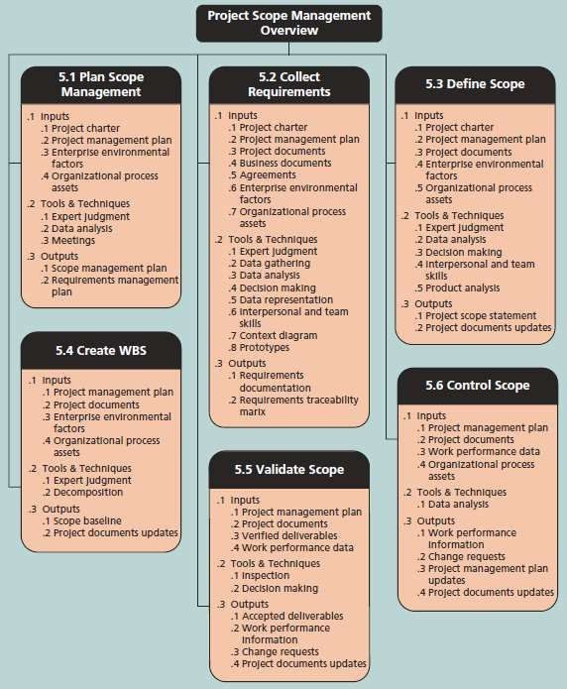
Planning Scope Management
Project scope management overview

Slide 10
Planning Scope Management.
For software projects, it is helpful to divide requirements development into the software engineering steps called elicitation, analysis, specification, and validation.
These steps include all the activities involved in gathering, evaluating, and documenting requirements for a software or software-containing product.
The requirements management plan documents how project requirements will be analyzed, documented, and managed.

Slide 11
Planning Scope Management.
A requirements management plan can include the following information:
  How to plan, track, and report requirements activities
  How to perform configuration management activities
  How to prioritize requirements
  How to use product metrics
  How to trace and capture attributes of requirements

Slide 12
Collecting Requirements.
A requirement is “a condition or capability that must be met or possessed by a system, product, service, result, or component to satisfy a contract, standard, specification, or other formal document” .
For some IT projects, it is helpful to divide requirements development into categories called elicitation, analysis, specification, and validation .
It is important to use an iterative approach to defining

Slide 13
Collecting Requirements.
There are several ways to collect requirements. Interviewing stakeholders one on one is often very effective, although it can be expensive and time consuming.
Holding focus groups and facilitated workshops, and using group creativity and decision-making techniques to collect requirements are normally faster and less expensive than one- on-one interviews.
Questionnaires and surveys can be efficient ways to collect

Slide 14
Collecting Requirements.
Requirements documents are often generated by software and include text, images, diagrams, videos, and other media; they are often broken down into different categories such as functional, service, performance, quality, training requirements, and so on.
A requirements management plan describes how project requirements
will be analyzed, documented, and managed.
A requirements traceability matrix (RTM) is a table that lists
requirements, various attributes of each requirement, and the
are
status of the requirements to ensure that all requirements
addressed.

Slide 15
Defining Scope
Good scope definition is very important to project success because it helps improve the accuracy of time, cost, and resource estimates, it defines a baseline for performance measurement and project control, and it aids in communicating clear work responsibilities.
The main tools and techniques used in defining scope include expert judgment, data analysis, decision making, interpersonal and team skills, and product analysis.
The main outputs of scope definition are the project scope statement
and project documents updates.

Slide 16
Creating the Work Breakdown Structure.
A WBS is a deliverable-oriented grouping of the work involved in a project that defines the total scope of the project.
WBS is a foundation planning and managing and changes.
document that provides the basis for project schedules, costs, resources,
Decomposition is subdividing smaller pieces.
project
deliverables
into
• A work package is a task at the lowest level of the WBS.

Slide 17
Creating the Work Breakdown Structure.
A WBS is often depicted as a task-oriented tree of activities, similar to an organizational chart. Many people like to create a WBS in chart form first to help them visualize the whole project and all of its main parts.
Many documents, such as contracts, use the tabular format, but the numbering scheme may vary.
A work package is a task at the lowest level of the WBS. A work package also represents the level of work that the project

Slide 18
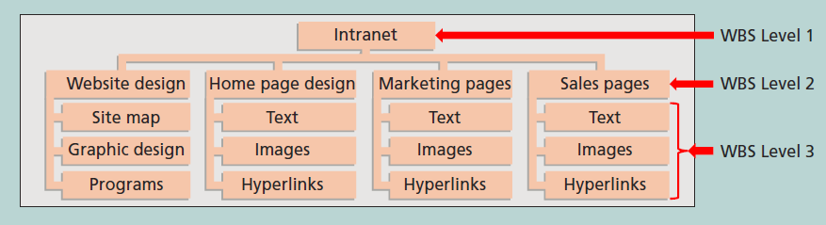
Creating the Work Breakdown Structure.
Sample intranet WBS organized by product

Slide 19
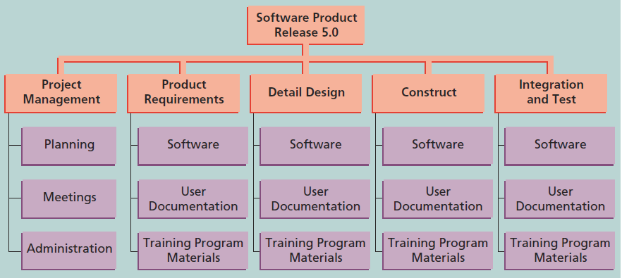
Creating the Work Breakdown Structure.
Sample intranet WBS organized by phase

Slide 20
Creating the Work Breakdown Structure.
Many people confuse tasks on a WBS with specifications. Tasks on a WBS represent work that needs to be done to complete the project.
It is also very important to involve the entire project team and the customer in creating and reviewing the WBS; people who will do the work should help to plan the work by creating the WBS.
Remember that the main purpose of the WBS is to define all of the work required to complete a project, so focus on that while following
your organization’s structural guidelines.

Slide 21
Creating the Work Breakdown Structure.
When using project management software, estimates of work time should be entered only at the work package level. The rest of the WBS items are just groupings or summary tasks for the work packages.
The software automatically calculates duration estimates for various WBS levels based on data entered for each work package and the WBS hierarchy.
Many people confuse tasks on a WBS with specifications.

Slide 22
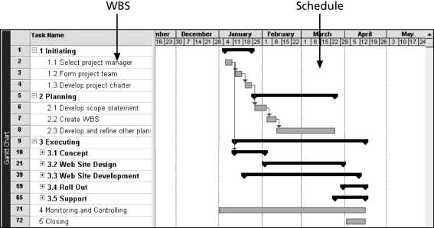
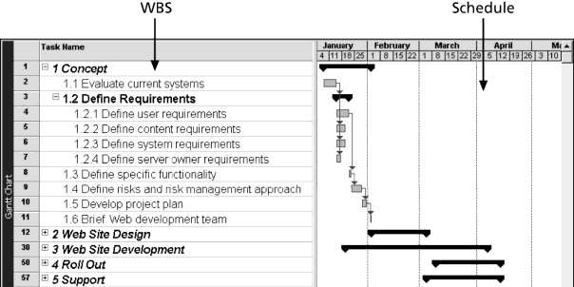
Creating the Work Breakdown Structure.
A WBS and Gantt chart for software development project ( see pages 2016, 217)
AWBS and Gantt chart for a website project, organized by
the five project management process groups.

Slide 23
Approaches to Developing WBSs
There are several approaches to develop a WBS:
  Using guidelines.
  The analogy approach.
  The top-down approach.
  The bottom-up approach.
The mind-mapping approach.
221, 222 )

Slide 24
The WBS Dictionary
Many WBS tasks are vague and must be explained more so people know what to do and can estimate how long it will take and what it will cost to do the work.
A WBS dictionary is a document that describes detailed information about each WBS item.
The approved project scope statement and its WBS and WBS dictionary form the scope baseline, which is used to measure performance in meeting project scope goals

Slide 25
Advice for Creating a WBS and WBS Dictionary
A unit of work should appear at only one place in the WBS.
The work content of a WBS item is the sum of the WBS items below it.
A WBS item is the responsibility of only one individual, even though many people may be working on it.
The WBS must be consistent with the way in which work is actually going to be performed; it should serve the project team first and other purposes only if practical.

Slide 26
Advice for Creating a WBS and WBS Dictionary
Project team members should be involved in developing the WBS to ensure consistency and buy-in.
Each WBS item must be documented in a WBS dictionary to ensure accurate understanding of the scope of work included and not included in that item.
The WBS must be a flexible tool to accommodate inevitable changes while properly maintaining control of the work content in the project according to the scope statement.

Slide 27
Verifying Scope
It is very difficult to create a good scope statement and WBS for a project.
It is even more difficult to verify project scope and minimize scope changes.
Scope verification involves formal acceptance of the completed project scope by the stakeholders.
Acceptance is often achieved by a customer inspection and then sign-off on key deliverables.

Slide 28
Controlling Scope
Scope control involves controlling changes to the project scope.
Goals of scope control are to:
  Influence the factors that cause scope changes.
  Assure changes are processed according to procedures developed
as part of integrated change control.
  Manage changes when they occur.
Variance is the difference between planned and actual performance.

Slide 29
Best Practices for Avoiding Scope Problems
Keep the scope realistic.
Involve users in project scope management.
Use off-the-shelf hardware and software whenever possible.
Follow good project management processes.

Slide 30
Suggestions for Improving User Input
Develop a good project selection process and insist that sponsors are from the user organization.
Have users on the project team in important roles.
Have regular meetings with defined agendas, and have users sign off on key
deliverables presented at meetings.
Deliver something to users and sponsors on a regular basis.
Don’t promise to deliver when you know you can’t.
Co-locate users with developers.

Slide 31
Suggestions for Reducing Incomplete and Changing Requirements
Develop and follow a requirements management process.
Use techniques such as prototyping, use case modeling, and JAD
to get more user involvement.
Put requirements in writing and keep them current.
Create a requirements management database for documenting and controlling requirements.

Slide 32
Suggestions for Reducing Incomplete and Changing Requirements
Provide adequate testing and conduct testing throughout the project life cycle.
Review changes from a systems perspective.
Emphasize completion dates to help focus important.
on what’s most
Allocate resources specifically for handling requests/enhancements like NWA did with ResNet.
change

Slide 33
Using Software to Assist in Project Scope Management.
Word-processing software helps create several scope-related documents.
Spreadsheets help to perform financial calculations and weighted scoring models and to develop charts and graphs.
Communication software like e-mail and the Web help clarify and communicate scope information.
Project management software helps in creating a WBS, the basis for tasks on a Gantt chart.
Specialized software is available to assist in project scope management

Slide 34
Chapter summary
Project scope management includes the processes required to ensure that the project addresses all the work required, and only the work required, to complete the project successfully
Main processes include:
  Collect requirements
  Define scope
  Create WBS
  Verify scope
  Control scope

