Slide 1

Chapter 6:
Project schedule Management

Slide 2
Contents:
The Importance of Project Schedules
Planning Schedule Management
Defining Activities
Sequencing Activities.
Developing and controlling the Schedule
Using Software to Assist in Project Schedule Management

Slide 3
Week Learning Outcome:
Discuss the importance of having good time management and the
processes used to ensure timely project completion.
Describe the process used for and elements of activity
sequencing
Identify the tools and techniques used for developing project schedules.
Describe the different components of a project schedule.
Explain how project schedules are controlled.

Slide 4
The Importance of Project Schedules
Managers often cite the need to deliver projects on time as one of their biggest challenges and the main cause of conflict.
Time is the variable that has the least amount of flexibility.
Individual work styles and cultural differences may also cause schedule conflicts.
Project schedule management, simply defined, involves the processes required to ensure timely completion of a project.

Slide 5
Planning Schedule Management
The first step in project schedule management is planning how the schedule will be managed throughout the life of the project.
Six main processes are involved in project schedule management:
(see page 245)
1. Planning schedule management involves determining procedures, and documentation that will be used executing, and controlling the project schedule.
the policies, for planning,
2. Defining activities involves identifying the specific activities that the project team members and stakeholders must perform to produce the project deliverables.

Slide 6
Planning Schedule Management
Sequencing activities involves identifying and documenting the relationships between project activities. Requirements, a resource breakdown structure, and project documents updates.
Estimating activity durations involves estimating the number of work periods that are needed to complete individual activities.
Developing the schedule involves analyzing activity sequences, resource requirements, and activity duration estimates to create the project schedule.
Controlling the schedule involves controlling and managing changes
to the project schedule.

Slide 7
Planning Schedule Management
The schedule management plan, like the scope management plan, can be informal and broad or formal and detailed, based on the needs of the project.
In general, a schedule management plan includes the following
  Project schedule model
information:
development.
Rules of performance
measurement.
Reporting formats.
Process descriptions.
Level of accuracy and units of
measure.
Control thresholds.

Slide 8
Defining Activities
An activity or task is an element of work normally found on the work breakdown structure (WBS) that has an expected duration, a cost, and resource requirements.
Activity definition involves developing a more detailed WBS and supporting explanations to understand all the work to be done so you can develop realistic cost and duration estimates.

Slide 9
Defining Activities
The Activity List is a tabulation of activities to be included on a project schedule.
The list should include the activity name, an activity identifier or
number, and a brief description of the activity.
The Activity Attributes provide schedule-related information about each activity, such as predecessors, successors, logical relationships, leads and lags, resource requirements, constraints, imposed dates, and assumptions related to the activity.
The activity list and activity attributes should agree with the WBS

Slide 10
Defining Activities
A milestone on a project is a significant event that normally has no duration.
It often takes several activities and a lot of work to complete a milestone, but the milestone itself is a marker to help in identifying necessary activities.
Milestones are also useful tools for setting schedule goals
and monitoring progress.
Not every deliverable or output created for a project is really

Slide 11
Defining Activities
The goal of defining activities is to ensure that the project team completely understands all the work it must do as part of the project scope so they can start scheduling the work.
We need have a good understanding of project activities in order to determine activity sequencing, durations, develop the schedule, or control the schedule.

Slide 12
Sequencing Activities.
The sequencing process involves evaluating the reasons for dependencies and the different types of dependencies.
A dependency or relationship pertains to the sequencing of project activities or tasks.
You must determine dependencies in order to use critical path analysis.
It is important that project stakeholders work together to define the activity dependencies in their project.

Slide 13
Sequencing Activities.
There are several types of dependencies among project activities:
  Mandatory Dependencies are inherent in the nature of the work being
performed on a project. They are sometimes referred to as hard logic.
  Discretionary Dependencies are defined by the project team. Discretionary dependencies are sometimes referred to as soft logic and should be used with care because they may limit later scheduling options.
  External Dependencies involve relationships between project and non
project activities.
  Internal Dependencies involve relationships between project activities that are generally inside the project team's control.

Slide 14
Sequencing Activities.
Network diagrams are activity sequencing.
the preferred
technique for showing
A network diagram is relationships among sequencing.
Some people refer to
a schematic display of project activities
the logical and their
network diagrams as project
schedule
network diagrams or PERT charts.

Slide 15
Sequencing Activities.
The format of this network diagram uses the Activity-On-Arrow (AOA) approach or the Arrow Diagramming Method (ADM)
All activities are represented by arrows and connected at points called nodes to illustrate the sequence of activities.
A node is simply the starting and ending point of an activity.
The first node signifies the start of a project and the last
node represents the end.

Slide 16
Sequencing Activities.
Process for Creating AOA Diagrams:
  Find all of the activities that start at node 1. Draw their finish nodes and draw arrows between node 1 and those finish nodes. Put the activity letter or name and duration estimate on the associated arrow.
  Continue drawing the network diagram, working from left to right. Look for bursts and merges. Bursts occur when a single node is followed by two or more activities. A merge occurs when two or more nodes precede a single node.
  Continue drawing the project network diagram until all activities are included on
the diagram that have dependencies.
  As a rule of thumb, all arrowheads should face toward the right, and no arrows should cross on an AOA network diagram.

Slide 17
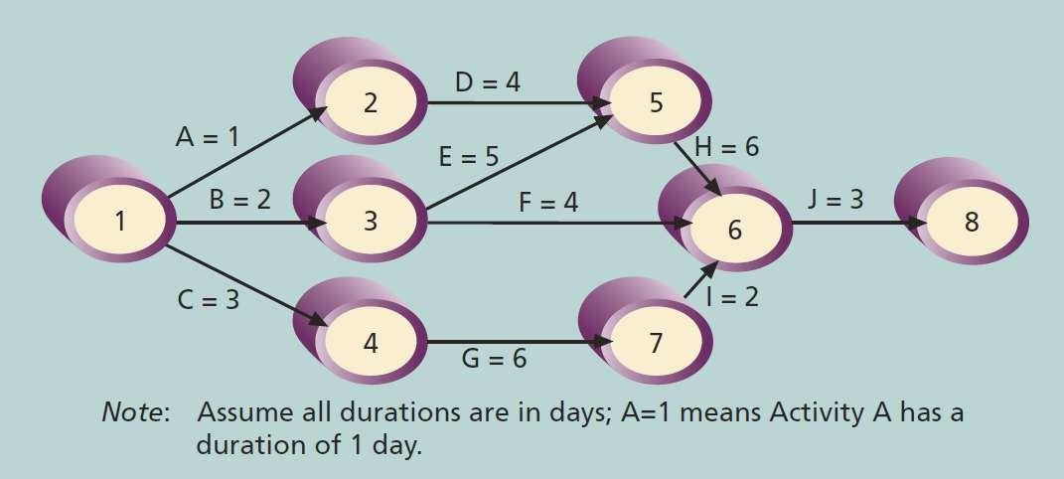
Sequencing Activities.
Network diagram for project X

Slide 18
Sequencing Activities.
The precedence diagramming method (PDM) is a network diagramming technique in which
boxes represent activities.
It is particularly useful for visualizing certain types of time relationships.
The precedence diagramming method is used more often than AOA network diagrams and
offers a number of advantages over the AOA technique.
  most project management software uses the precedence diagramming method.
  Help to avoid the need to use dummy activities. Dummy activities have no duration and no resources, but are occasionally needed on AOA network diagrams to show logical relationships between activities.
  PDM shows different dependencies among tasks, whereas AOA network diagrams use only
finish-to-start dependencies.

Slide 19
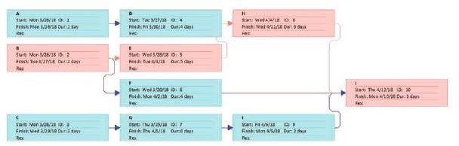
Sequencing Activities.
Precedence Diagramming Methods (PDM) Network Diagram For Project X

Slide 20
Sequencing Activities.
The four types of dependencies
activities include the following:
or relationships
between
Finish-to-start dependency.
Start-to-start dependency.
Finish-to-finish dependency.
Start-to-finish dependency.

Slide 21
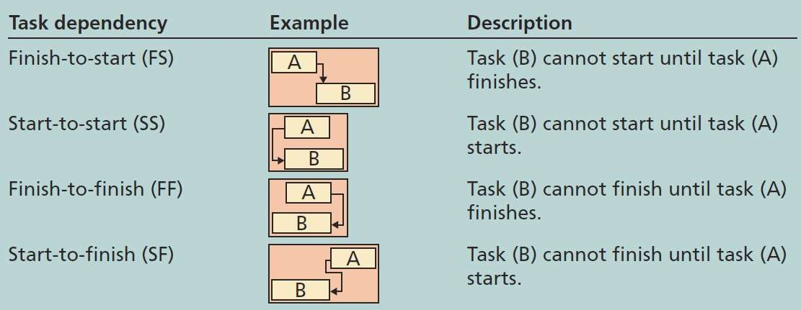
Sequencing Activities.
Task Dependency Types

Slide 22
Estimating Activity Durations
It is important to note that duration includes the actual amount of time worked on an activity plus elapsed time.
Do not confuse duration with effort.
One of the most important considerations in making activity
duration estimates is the availability of
resources, especially
human resources.
Effort is the number of workdays or work hours required to complete a
task

Slide 23
Estimating Activity Durations
The optimistic estimate while the pessimistic scenario.
is based on a best-case scenario, estimate
is based on a worst-case
The most likely estimate, as you might expect, is based on a most likely or expected scenario.

Slide 24
Developing and controlling the Schedule
Schedule development uses the results of all the preceding project schedule management processes to determine the start and end dates of the project and its activities.
The ultimate goal of developing a realistic project schedule is to provide a basis for monitoring project progress for the time dimension of the project.
The main outputs of this process are a schedule baseline, project schedule, schedule data, project calendars, change requests, project management plan updates, and project documents updates.

Slide 25
Developing and controlling the Schedule
A few of the tools and techniques for schedule development include the following:
  A Gantt Chart is a common tool for displaying project schedule
information.
  Critical Path Analysis is a very important tool for developing and controlling project schedules.
  Critical Chain Scheduling is a technique that focuses on
limited resources when creating a project schedule.

Slide 26
Developing and controlling the Schedule
Gantt charts provide a standard format for displaying project schedule information by listing project activities and their corresponding start and finish dates in calendar form.
Gantt charts are sometimes referred to as bar charts because the activities’
start and end dates are shown as horizontal bars.
There are different symbols on the Gantt chart:
  Black diamonds: milestones
  Thick black bars: summary tasks
  Lighter horizontal bars: durations of tasks
4. Arrows: dependencies between tasks

Slide 27
Developing and controlling the Schedule
Milestones can be a particularly important part of schedules, especially for large projects.
Many people like to focus on meeting milestones, so you can create them to emphasize important events or accomplishments on projects.
The milestones can be created by entering tasks with zero duration.

Slide 28
Developing and controlling the Schedule
To make milestones meaningful, some people use criteria to help define them, which means that should be:
the SMART milestones
Specific
Measurable
Assignable
Realistic
Time-framed

Slide 29
Developing and controlling the Schedule
The five key points of using project milestones following:
include the
Define milestones early in the project and include them in the
Gantt chart to provide a visual guide.
Keep milestones small and frequent.
The set of milestones must be all-encompassing.
Each milestone must be binary, meaning it is either complete or
incomplete.

Slide 30
Developing and controlling the Schedule
Critical Path Method (CPM) also called Critical Path Analysis,
diagramming technique used to predict total project duration.
is a network
A critical path for a project is the series of activities that determine the earliest time by which the project can be completed.
The critical path is the longest path through the network diagram and has the least
amount of slack or float.
Slack or float is the amount of time an activity may be delayed without delaying a
succeeding activity or the project finish date.
Normally, several tasks are done in parallel on projects, and most projects have multiple paths through a network diagram.
The longest path or the path that contains the critical tasks is what drives the
completion date for the project.

Slide 31
Developing and controlling the Schedule
In order to find the critical path for a project, you must first develop a good network diagram, which in turn requires a good activity list based on the WBS.
After that, you must estimate the duration of each activity to determine the critical path.
The longest path is the critical path
If one or more of the activities on the critical path takes longer than planned, the whole project schedule will slip unless the project manager takes corrective action.

Slide 32
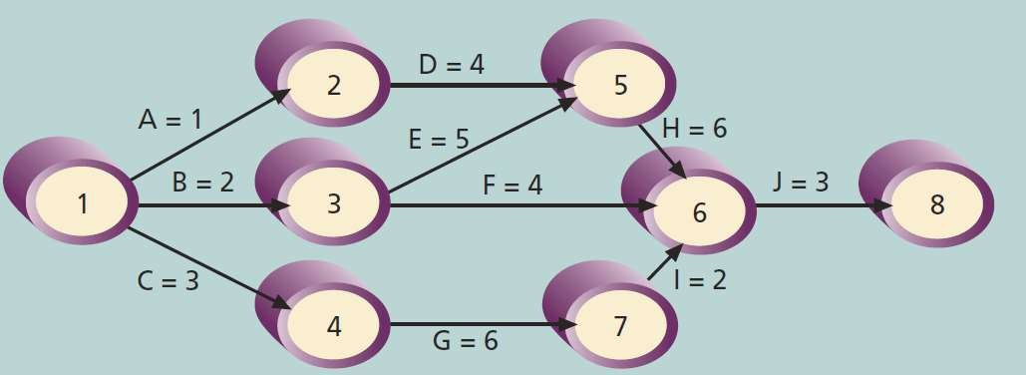
Developing and controlling the Schedule
Determining the critical path for project X

Slide 33
Developing and controlling the Schedule
It is important to know the critical path throughout the life of a project so the project manager can make trade-offs.
A technique that can help project managers make schedule trade-offs is determining the free slack and total slack for each project activity.
Free Slack or Free Float is the amount of time an activity can be delayed without delaying the early start date of any immediately following activities.
Total Slack or Total Float is the amount of time an activity can be

Slide 34
Developing and controlling the Schedule
A Forward Pass through the network diagram determines the early start and finish dates
A Backward Pass determines the late start and finish dates.
The early start date is the earliest possible time an activity can start based on the project network logic.
The early finish date is the earliest possible time an activity can finish based on the project network logic.

Slide 35
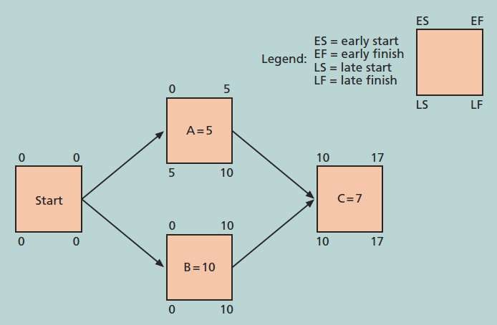
Developing and controlling the Schedule
Calculating early and late start and finish dates

Slide 36
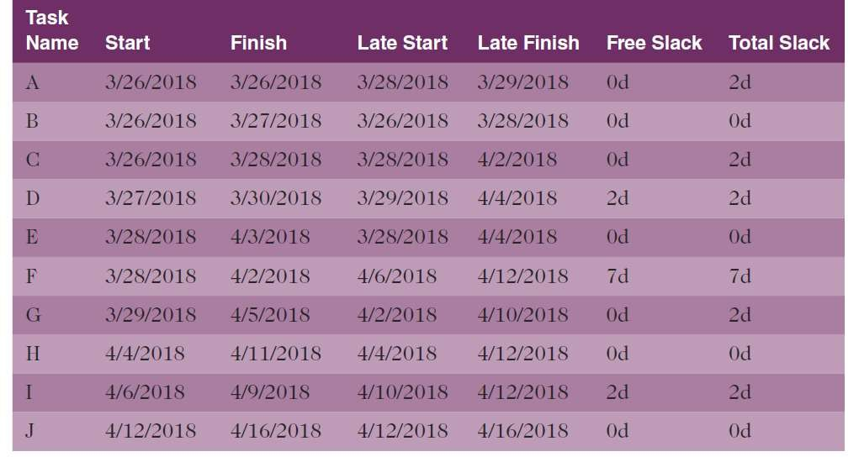
Developing and controlling the Schedule
Free and total float or slack for project X

Slide 37
Developing and controlling the Schedule
By knowing the critical path, the project manager and the team can use several duration compression techniques to shorten the project schedule.
The project manager can shorten the duration of critical path activities by allocating more resources to those activities or by changing their scope.
Several experts suggest that it is extremely difficult to shorten a reasonable project schedule by more than 25 percent.

Slide 38
Developing and controlling the Schedule
Crashing is a technique for making cost and schedule trade- offs to obtain the greatest amount of schedule compression for the least incremental cost.
The main disadvantage of crashing is that it often increases total project costs.
Fast tracking activities by doing them in parallel or overlapping them.
The main disadvantage of Fast tracking is that it can increase

Slide 39
Developing and controlling the Schedule
It is important to update project schedule information to meet time goals for a project.
The critical path may change as you enter actual start and finish dates.
If you know the project completion date will slip, negotiate with the project sponsor.

Slide 40
Critical Chain Scheduling
Critical considers schedule
chain scheduling is a method
of scheduling that
limited resources when and includes buffers to
creating protect
a project the project
completion date.
Uses the Theory of Constraints (TOC) which is a management philosophy developed by Eliyahu M. Goldratt and introduced in his book The Goal.
Attempts to minimize multitasking When a resource works on

Slide 41
Critical Chain Scheduling
A buffer is additional time to complete a task.
Murphy’s Law states that if something can go wrong, it will
Parkinson’s Law states that work expands to fill the time allowed.
In traditional estimates, people often add a buffer to each task and
use it if it’s needed or not.
Critical chain scheduling removes buffers from individual tasks and
instead creates:
Project Buffers or
due date.
This Presentationis▪maiFnlyedeepdenidenntgon thBe teuxtfbofoke: Inrfosrmatioonrtechnaoldogdy:iPrtojeictomnanaaglementt (i9thmeeditiona) bdy dScehwdale,bKe.
additional time added before the project’s
tasks on the

Slide 42
Program Evaluation and Review Technique (PERT )
PERT is a network analysis technique used to estimate project duration when there is a high degree of uncertainty about the individual activity duration estimates.
PERT uses Probabilistic Time Estimates
  Duration estimates based on using optimistic, most likely, and pessimistic estimates of activity durations, or a three-point estimate

Slide 43
Program Evaluation and Review Technique (PERT )
PERT weighted average =
optimistic time + 4X most likely time + pessimistic time
6
Example:
PERT weighted average =
8 workdays + 4 X 10 workdays + 24 workdays = 12 days
6
where optimistic time = 8 days
most likely time = 10 days, and
pessimistic time = 24 days
Therefore, you’d use 12 days on the network diagram instead of 10 when using PERT for the above
example

Slide 44
Controlling the Schedule
The final process in project schedule management is controlling the schedule.
Tools and techniques for Controlling the Schedule include:
  Data analysis tools
  Critical path method.
  Project management information systems.
  Resource optimization.
  Schedule compression

Slide 45
Reality Checks on Scheduling
One of a project manager’s first reality checks is to review the draft schedule
that is usually included in the project charter (realistic schedule goals).
Another type of reality check comes from progress meetings with stakeholders.
Alert top management well in advance if there are schedule problems.
Project managers should use:
  Empowerment
  Incentives
  Discipline
  Negotiation

Slide 46
Using Software to Assist in Project Schedule Management
Software for facilitating communications helps people exchange schedule-related information .
Decision support models help analyze trade-offs that can be made.
Project management software can help in various time management areas; such as, draw network diagrams, determine the critical path for a project, create Gantt charts, and report, view, and filter specific project schedule management

Slide 47
Chapter summary
Project time management is often cited as the main source of conflict on
projects, and most IT projects exceed time estimates
Main processes include:
  Define activities
  Sequence activities
  Estimate activity resources
  Estimate activity durations
  Develop schedule
  Control schedule

