Slide 1

Chapter 7:
Project Cost Management

Slide 2
Contents:
The Importance of Project Cost Management
Basic Principles of Cost Management
Planning Cost Management
Determining the Budget
Controlling Costs

Slide 3
Week 9 Learning Outcome:
Explain the importance of controlling the cost of projects.
Discuss the basic principles of cost management.
Define cost and the processes used for project cost
management.
Explain how project budgets are determined by organizations.
Present various tools and techniques used for estimating and controlling cost.

Slide 4
The Importance of Project Cost Management
According to a study conducted in 2011 and published in Harvard Business Review that identified 27 percent average cost overrun in IT projects.
Cost overrun is the additional percentage or dollar amount by which the actual costs exceed the estimates.
Among the studied projects, One in every six projects contained a “black swan” event.
Black Swan refers to a rare, unpredictable, but high-impact

Slide 5
The Importance of Project Cost Management
Cost refers to a resource that is sacrificed or given up in an exchange to achieve a specific objective. Cost is usually measured in monetary terms such as Dollars.
Project Cost Management consists of processes that guarantees the completion of a project within the sanctioned budget.

Slide 6
The Importance of Project Cost Management
Processes of Project Cost Management:
  Planning cost management
    Policies, procedures, and documentations are determined in this process that are used for planning, executing, and controlling the project cost.
  Estimating costs
    An estimate of the costs of the resources required to complete
a project is developed in this process.

Slide 7
The Importance of Project Cost Management
Determining the budget
  The overall cost estimate is allocated to individual work items that will help in establishing a baseline for measuring performance.
Controlling costs
  Changes to the process.
project budget are controlled in this

Slide 8
Basic Principles of Cost Management
Executive Board Members better understand financial terms rather than IT terms. It is therefore mandatory for IT Project Managers to communicate project information in financial as well as technical terms.
Profits are measured as “revenues minus expenditures”
Profit margin refers to the ratio of profits to revenues.
Life cycle costing takes into account the total cost of ownership or development plus support costs providing a the overall view of the cost of project throughout its life cycle.
Cash flow analysis is used to determine the estimated annual costs and
benefits for a project and the resulting annual cash flow.

Slide 9
Basic Principles of Cost Management
Tangible costs or benefits refer to those costs or benefits that can be measured easily in terms of dollars.
Intangible costs or benefits refer to those costs or benefits that
cannot be measured easily in terms of dollars.
Direct costs refer to costs that can be directly associated with
the creation of products or services of the project.
Indirect costs refer to costs that are not directly associated with
the products or services of the project, but indirectly related to

Slide 10
Basic Principles of Cost Management
Sunk cost refers to money that has been spent on a project in the past. When projects need to be identified for investment or deciding which project should be kept running, you should never include sunk costs rather consider it gone like a sunken ship that can never be raised.
Learning curve theory state that when many items are produced repetitively, the unit cost of those items decreases in a regular pattern as more units are produces.
Reserves refer to those dollar amounts that are include in a cost.

Slide 11
Basic Principles of Cost Management
Reserves refer to those dollar amounts that are include in a cost estimate to mitigate cost risks by allowing for future situations that are difficult to predict.
  Contingency reserves allow for future situations that may be partially planned for (sometimes called known unknowns) and are included in the project cost baseline.
  Management reserves allow for future situations that are unpredictable (sometimes called unknown unknowns)

Slide 12
Planning Cost Management
The project cost management begins with planning how the costs will be managed throughout the life of a project.
The Project Manager and other stakeholders use expert
judgement, data analysis, and meetings to produce the
management plan that describes how the organization
cost
will
manage cost variances on the project.
The cost management plan can be informal and broad or formal and detailed based on the needs of the project.

Slide 13
Estimating Costs
If Project Managers are willing to complete projects within the budget constraints, they must take cost estimates seriously.
After the resource requirement list is developed with care, Project Managers and their teams must develop several estimates of the costs for those resources.
It is mandatory to know the types of cost estimates, have expertise to prepare those cost estimates, and problems

Slide 14

Estimating Costs
Type Of Estimate | When Done | Why Done | Typical Range
Rough Order Of Magnitude (ROM) | Very early in the project life cycle, often 3 – 5 years before project completion | Provides estimate of cost for selection decisions | - 50% to + 100%
Budgetary | Early, 1 – 2 years out | Puts dollars in the budget plans | - 10% to + 25 %
Definitive | Later in the project, less than 1 year out | Provides details for purchases, estimates actual costs | - 5 % to + 10 %
Types of Cost Estimates

Slide 15
Estimating Costs
A number of tools and techniques are available Project Managers in creating a cos estimate.
to assist
Analogous estimates (top-down estimates) use the actual cost of a previous, similar project as the basis for estimating the cost of the current project.
Bottom-up estimates consider the approximate costs of individual work items or activities to estimate the cost of the entire project.

Slide 16
Estimating Costs
Three-point estimates takes into account the
optimistic, and pessimistic costs for items.
most
likely,
Parametric estimating uses a mathematical model that takes project characteristics as parameters and gives estimate of the project costs as output.

Slide 17
Estimating Costs
Typical Problems with IT Cost Estimates
  Despite the existence of many tools and techniques, a number of
IT project cost estimates are still very inaccurate particularly
for new technologies or software development.
points out four reasons:
Estimates are done too quickly
People lack estimating experience
Human beings are biased toward underestimating
Management desires accuracy
Tom-DeMarco

Slide 18
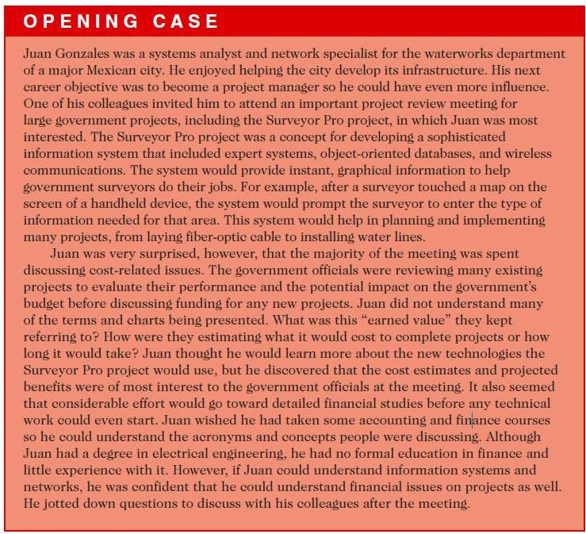
Estimating Costs
Sample Cost Estimate
  Refer to pages 299–304 to see the detailed example on how to create cost estimate for the Surveyor Pro project described in the opening case.
Collect as
possible
much
before
information as
creating the
estimate. Make clear assumptions and establish solid ground rules for estimate.
Estimate costs by major WBS
categories, if possible
Creating a cost model will facilitate
after-development modifications.
Always document the estimate.

Slide 19
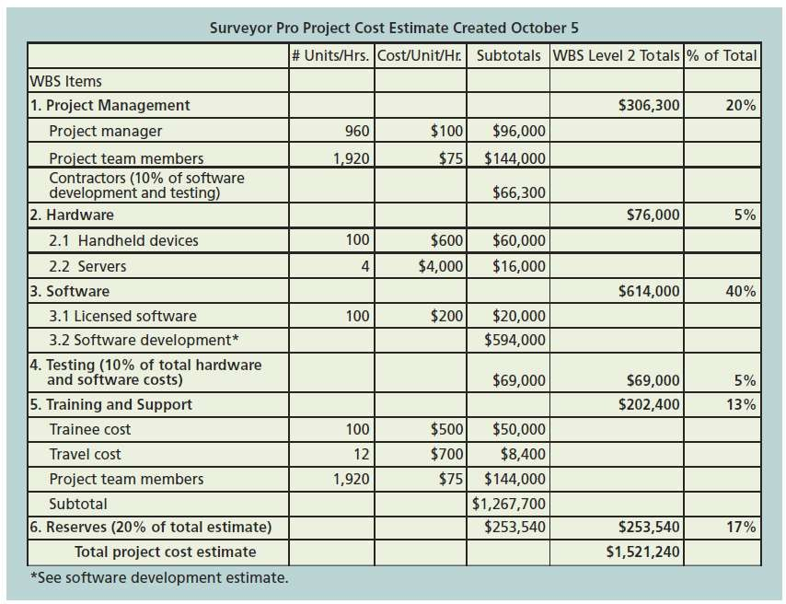
Estimating Costs
Surveyor Pro Project Cost Estimate

Slide 20
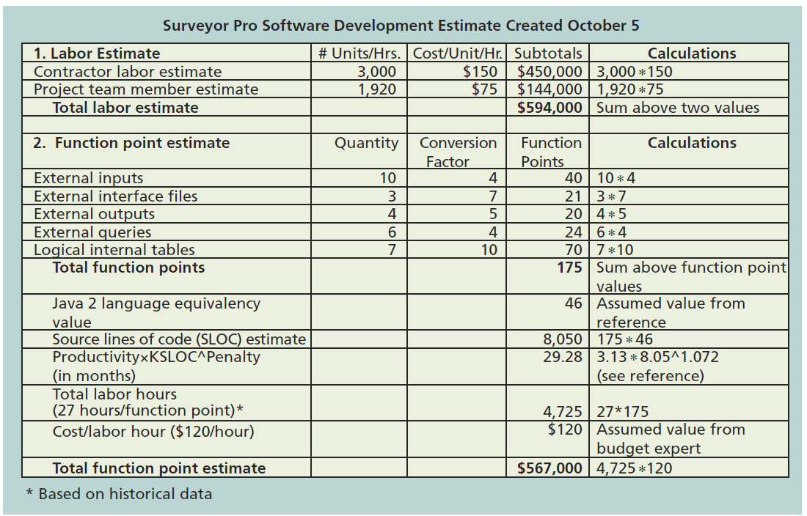
Estimating Costs
Surveyor Pro Software
Development Estimate

Slide 21
Determining the Budget
The project cost estimates are allocated to individual work items over time
The WBS defines the work items that is why it is a mandatory input to the cost budgeting process.
The main goal is to produce a cost baseline refers to a time- phased budget that is used by Project Managers to measure and monitor the cost performance.

Slide 22
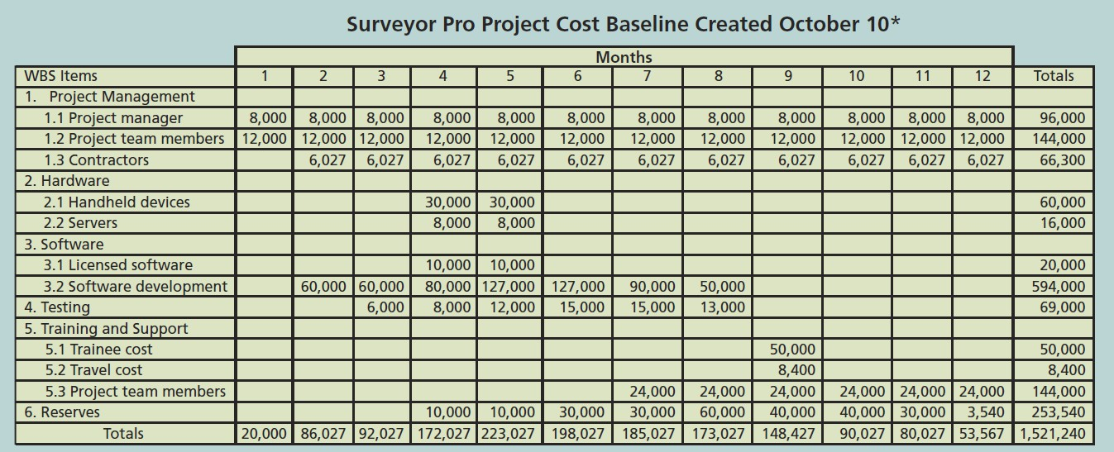
Determining the Budget
Surveyor Pro Project Cost Baseline

Slide 23
Project Budget Components
Project Budget Components
  The project budget is composed of the cost baseline plus management reserve whereas control accounts are work package cost estimates plus contingency reserve. Work package cost estimates are activity cost estimates plus activity contingency reserve.
  Figure 7-5 highlights the various components of the project budget.

Slide 24
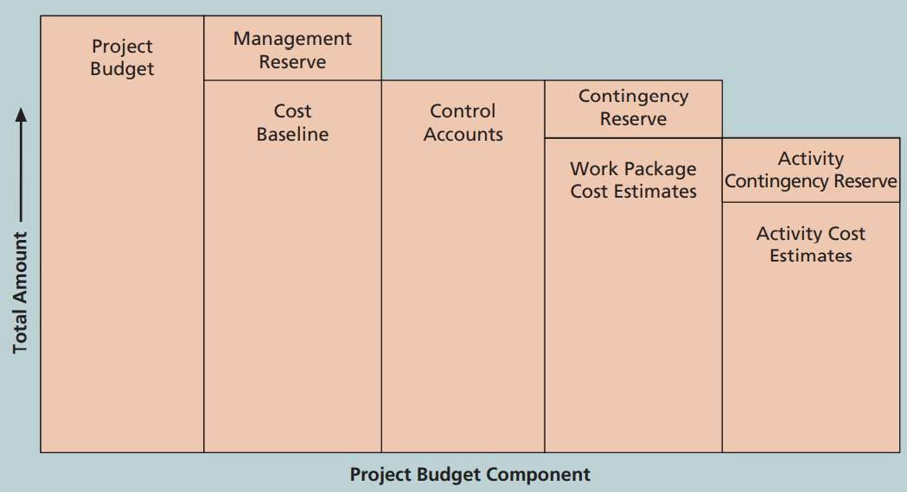
Determining the Budget
Project Components
Budget

Slide 25
Controlling Costs
Controlling activities.
costs
of a project includes the following
Monitoring cost performance
Ensuring that only appropriate project changes are included in a revised cost baseline.
Informing project stakeholders about authorized changes to the project that will affect costs.

Slide 26
Controlling Costs
Inputs and Outputs of Controlling Cost Process
  The inputs for controlling costs include project management plan, project documents, project funding requirements, work performance data, and organizational process assets.
The outputs include work performance information, forecasts, change requests, project management updates, and project documents updates.
cost plan

Slide 27
Controlling Costs
A number of tools and techniques exist in project cost control including expert judgement, data analysis, project management information systems, and the to-complete performance index.

Slide 28
Controlling Costs
Earned Value Management (EVM) is a project performance measurement technique that integrates scope, time, and cost data.
From a given cost performance baseline, Project Managers and their teams can determine how well the project is meeting the goals of scope, time, and cost.
Actual information must be provided to utilize EVM.

Slide 29
Controlling Costs
EVM considers the calculation of three values for each activity or summary activity from a project’s WBS.
  The Planned Value (PV) refers to the authorized budget
sanctioned for a scheduled work.
  Actual Cost (AC) refers to the realized cost spent for the work
performed on an activity during a specified period of time.
  The Earned Value (EV) refers to the measure of the value of
actual physical work done.

Slide 30

Controlling Costs
Activity | Week 1
Earned Value (EV) | 5000
Planned Value (PV) | 10000
Actual Cost (AC) | 15000
Cost Variance (CV) | -10000
Schedule Variance (SV) | -5000
Cost Performance Index (CPI) | 33%
Schedule Performance Index (SPI) | 50%
Earned Value Calculations for One Activity after
Week 1.

Slide 31

Controlling Costs
Term | Formula
Earned Value (EV) | EV = PV of all completed work
Cost variance (CV) | CV = EV - AC
Schedule variance (SV) | SV = EV - PV
Cost performance index (CPI) | CPI = EV / AC
Schedule performance index (SPI) | SPI = EV / PV
Estimate at completion (EAC) | EAC = BAC / CPI
Estimated to Complete (ETC) | ETC = EAC - AC
Earned Value Formulas

Slide 32
Controlling Costs
Cost Variance (CV) is the earned value minus the actual cost.
Schedule Variance (SV) is the earned value minus the planned value.
Cost Performance Index (CPI) refers to the ratio of earned value to
actual cost.
Schedule Performance Index (SPI) refers to the ratio of earned value to planned value.
Estimate at Completion (EAC) provides estimated cost of completing a
project based on performance to date.
To-Complete Performance Index (TCPI) is a measure of the cost
This Presentation is mai^{p}nl^{e}y d^{r}ep^{f}eºnd^{r}en^{m}t oªn ^{n}the^{c}t^{e}extb^{t}oo^{h}kª: In^{t}for^{m}ma^{u}ti^{s}on^{t}tec^{b}hn^{e}oloªgy^{c}: P^{h}ro^{i}je^{e}ct^{v}m^{e}an^{d}age^{w}m^{i}en^{t}t (^{h}9th^{t}ed^{h}iti^{e}on)^{r}b^{e}y S^{m}chªw^{i}al^{n}be^{i}, K^{n}. ^{g resources to meet a}

Slide 33
Controlling Costs
Rules of Thumb for EV numbers
  Problems exist if:
    Calculation of CV and SV lead to negative numbers
    CPI and SPI values are less than 100%
  Problems refer to the situation when the project cost is exceeding the planned budget (over budget) or taking longer than the planned time (behind schedule).
  CPI value can be used to estimate the projected cost of completing the project, which means EAC can be calculated using

Slide 34
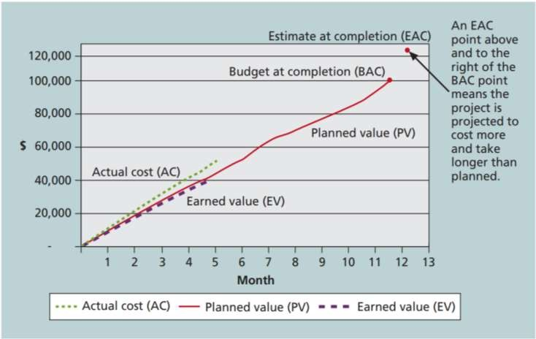
Controlling Costs
Earned Value Chart for Project after Five Months

Slide 35
Controlling Costs
Project Portfolio Management
  In a portfolio, organizations collect and control an entire suite of projects or investments as one set of interrelated activities.
  A project portfolio management can have five levels from simplest to most complex.
    Put all your projects in one database
    Prioritize the projects in your database
    Divide your projects into two or three budgets based on type of investment
    Automate the repository
    Apply modern portfolio theory, including risk-return tools that map project
risk on a curve.

Slide 36
Controlling Costs
Project Portfolio Manager for IT projects at Schlumberger organized 120 IT projects into a portfolio and saved $3 million.

Slide 37
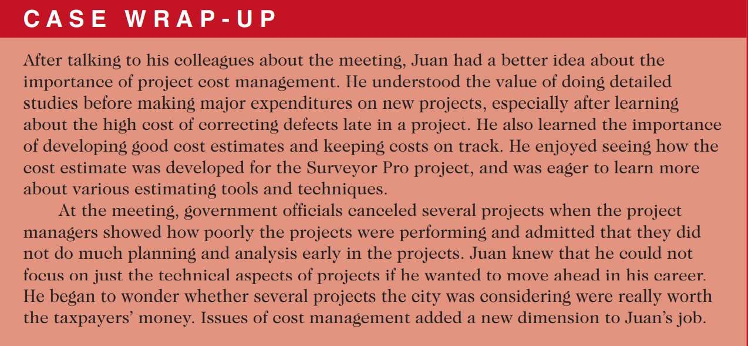
Case Wrap - up

Slide 38
Chapter summary
Key processes in Project Cost Management include:
  Plan Cost Management
  Estimate Costs
  Determine the Budget
  Control Costs

