Slide 1
Chapter 8:
Project Quality Management

Slide 2
Contents:
Project Quality Management.
Planning Quality Management.
Managing and Controlling Quality.
Tools and Techniques for Quality Control.
Modern Quality Management.
Improving IT Project Quality.

Slide 3
Week 10 Learning Outcome:
Discuss the meaning and importance of quality project management.
Identify various tools and techniques used for quality planning and improvement.
Describe and demonstrate different quality control tools and techniques.
Describe various models, theories, and standards that are used to reinforce modern quality management.

Slide 4
Project Quality Management
The International Organization for Standardization (ISO) defines quality as “the degree to which a set of inherent characteristics fulfils requirements” (ISO9000:2000)
Other experts define quality based on:
  Conformance to requirements indicates that the project’s processes and products meet the written specifications
  Fitness for use indicates that a product can be used as it was intended

Slide 5
Project Quality Management
Project Quality Management guarantees that the project will satisfy the
needs for which it was undertaken.
Project Quality Management involves three processes
  Planning quality management identifies which quality requirements and standards are relevant to the project and how to satisfy them.
  Managing Quality translates the quality management plan into
executable quality activities.
  Controlling Quality monitors specific project results to ensure that
they are complete, correct, and meet customer expectations.

Slide 6
Planning Quality Management
Planning is the first step to ensure project quality management.
Planning Quality Management implies the ability to anticipate situations and
prepare actions to bring about the desired outcome.
Quality planning involves communicating correct actions for ensuring quality in understandable and complete format
In modern quality management, the drive is to prevent the defects through a
program of:
  Selecting the proper materials
  Training and indoctrinating people in quality
  Planning a process that ensures the appropriate outcome

Slide 7
Planning Quality Management
A number of tools management.
and techniques exist for planning
quality
Design of Experiments is one such technique that is identify which variables have the most influence overall outcome of a process.
used to on the
It can also be applied to address other project management issues such as trade-offs between cost and schedule.
Quality planning for projects involves the description of key

Slide 8
Planning Quality Management
Quality Affecting Scope Aspects of IT Projects
  Functionality: the degree to which a system performs its intended function
  Features: they system’s special characteristics that appeal to users
  System outputs: the system generated screens and reports
  Performance: addresses how well a product or service accomplishes the
customer’s intended use
  Reliability: the ability of a product or service to demonstrate expected
performance under normal conditions
  Maintainability: refers to the ease of performing maintenance on a product

Slide 9
Managing and Controlling Quality
Managing Quality
  The term Quality
all the
relevant
assurance refers to describe
activities associated with the satisfaction of quality standards for a project.
Managing Quality includes all of the quality assurance activities plus product design and process improvements
The quality management plan, project documents, and organization process assets are important inputs for

Slide 10
Managing and Controlling Quality
Managing Quality
  Benchmarking compares specific project practices or product characteristics to those of other projects or products within or outside the performing organization and thus generates ideas for quality improvement.
  A quality audit is an important tool for managing quality. Quality Audit refers to a structured review of specific quality management activities that help identify lessons learned that could improve performance on current or future projects.

Slide 11
Managing and Controlling Quality
Controlling Quality
  Controlling quality is different from planning and managing quality.
  The key outcomes of Quality Control Process includes:
    Acceptance decisions whether the products or services that are
produced as part of the project will be accepted or rejected.
    Rework refers to the activity of bringing a rejected items back into compliance with the product requirements, specifications, or other stakeholder expectations.
    Process adjustments are applied to correct or prevent further
quality problems based on quality control measurements.

Slide 12
Tools and Techniques for Quality Control
Seven Basic Tools of Quality and their application to IT projects:
  Cause-and-effect diagrams.
  Control charts.
  Checksheet.
  Scatter diagrams.
  Histogram.
  Pareto chart.
  Flowcharts.

Slide 13
Tools and Techniques for Quality Control
Cause-and-effect diagrams (also known as diagrams) trace complaints about quality operations that caused those problems.
fishbone or Ishikawa problems
back to the
Cause-and-effect diagrams are helpful in finding the root cause of a problem.
5 whys technique of repeatedly asking the question “Why?” can also be used to help peel away the layers of symptoms that can lead to the root cause of a problem.
5 is a good rule of thumb, however, other number of questions can

Slide 14
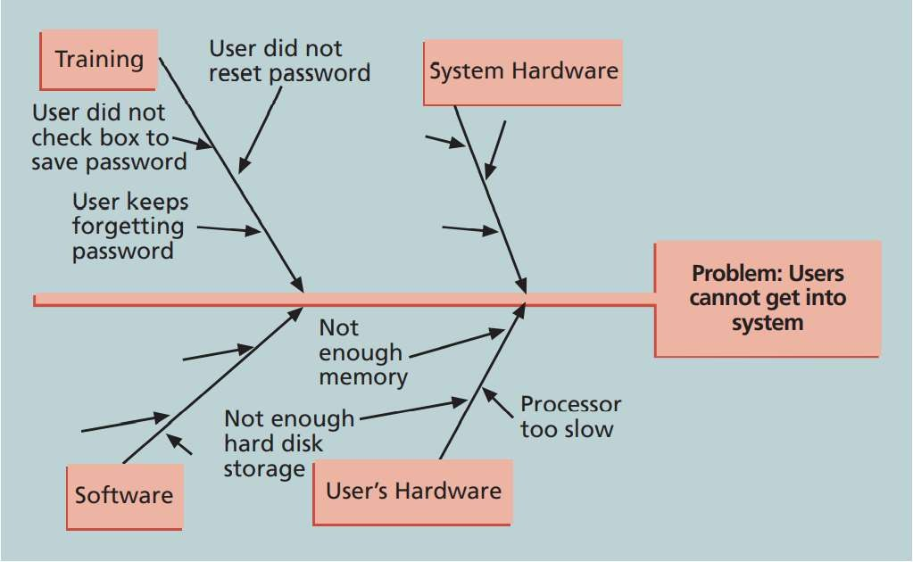
Tools and Techniques for Quality Control
Sample Cause-and- effect Diagram

Slide 15
Tools and Techniques for Quality Control
A control chart is a graphic display of data that highlights the results of a process over time.
Control charts enable you to determine whether a process is in
control or out of control.
When a process is in control, any variations in the process results are produced by random events. In-control processes do not need to be adjusted.
When a process is out of control, variations in the process results are caused by nonrandom events. For out-of-control events.

Slide 16
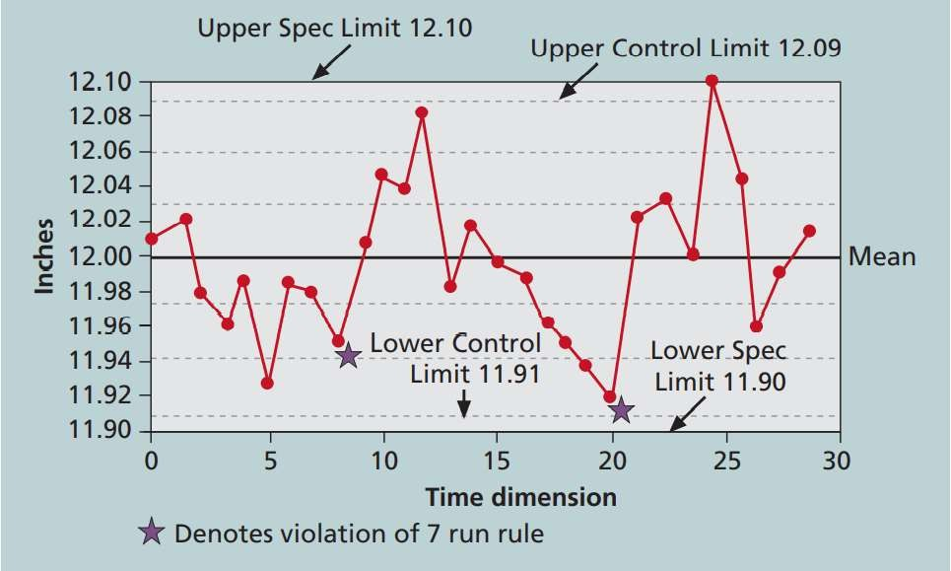
Tools and Techniques for Quality Control
Sample Control Chart
Quality control charts and the seven run rule can be used to look for patterns in data.
The seven run rule states that if seven data points in a row are all below the mean or above the mean, or are all increasing or decreasing, then the process needs to be examined for nonrandom problems

Slide 17
Tools and Techniques for Quality Control
Checksheet (sometimes called a tally sheet or
checklist
depending on its format) is used to collect and analyze data.
Tally marks are used to enter each data occurrence manually.

Slide 18
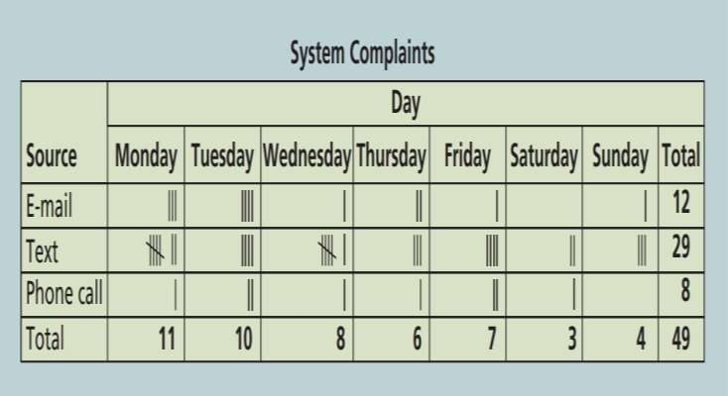
Tools and Techniques for Quality Control
Sample Checksheet

Slide 19
Tools and Techniques for Quality Control
Scatter diagram is used to highlight if there is a relationship between two variables.
If the data points are closer to a diagonal line, it indicates that the two variables are more closely related.

Slide 20
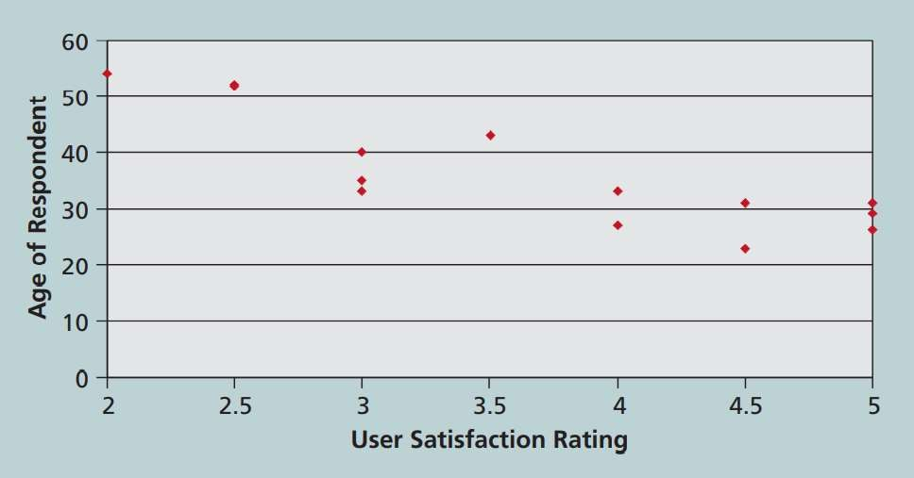
Tools and Techniques for Quality Control
Sample Scatter Diagram

Slide 21
Tools and Techniques for Quality Control
A histogram is a bar graph that shows distribution of variables.
Each bar depicts an attribute or characteristic of a problem or situation, and the height of the bar shows its frequency.

Slide 22
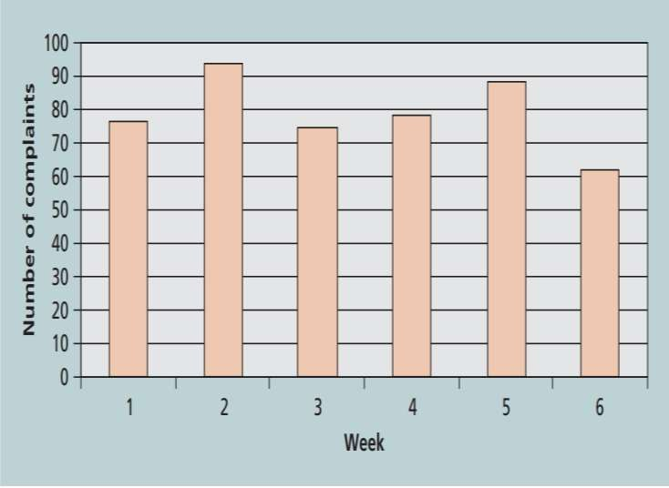
Tools and Techniques for Quality Control
Sample Histogram

Slide 23
Tools and Techniques for Quality Control
A pareto chart is a histogram that can be used to identify and prioritize problem areas.
  First, the variables in a histogram are ordered by their occurrence frequency.
  Then pareto charts can easily identify the vital top contributors that account for most of the quality related problems in a system.
Pareto analysis is also called 80-20 rule indicating that 80

Slide 24
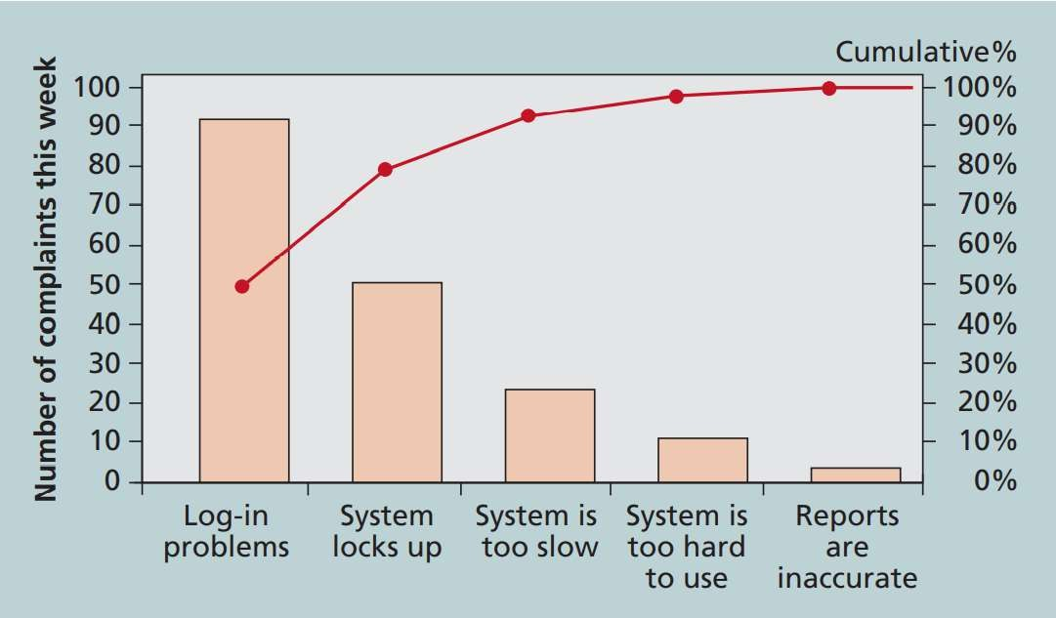
Tools and Techniques for Quality Control
Pareto Chart

Slide 25
Tools and Techniques for Quality Control
Flowcharts refer to graphic displays of the logic and flow of processes that assist you to analyze how problems occur and how processes can be enhanced.
Flowcharts highlight activities, decision points, and the order in which information is processed.
Figure 8-8 shows the process that can be used by project team to decide whether to accept or reject deliverables. This basic quality tool is called stratification: a technique that displays data from a number of different sources to see if a pattern emerges.

Slide 26
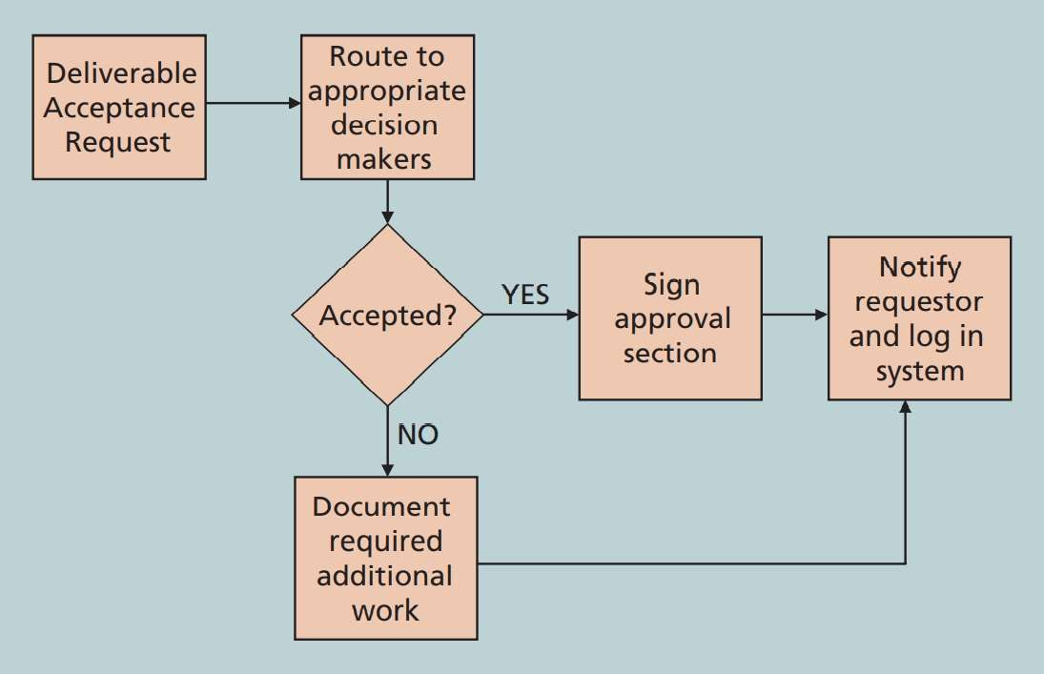
Tools and Techniques for Quality Control
Sample Flowchart

Slide 27
Tools and Techniques for Quality Control
Beside flowcharts, Run charts can also be stratification.
used for
A run chart shows the history and pattern of variation of a process over time.
It is a line chart that shows the data points plotted in the order of their occurrence.
Run chart can be used to analyzed trends in data and predict future outcomes using historical results.

Slide 28
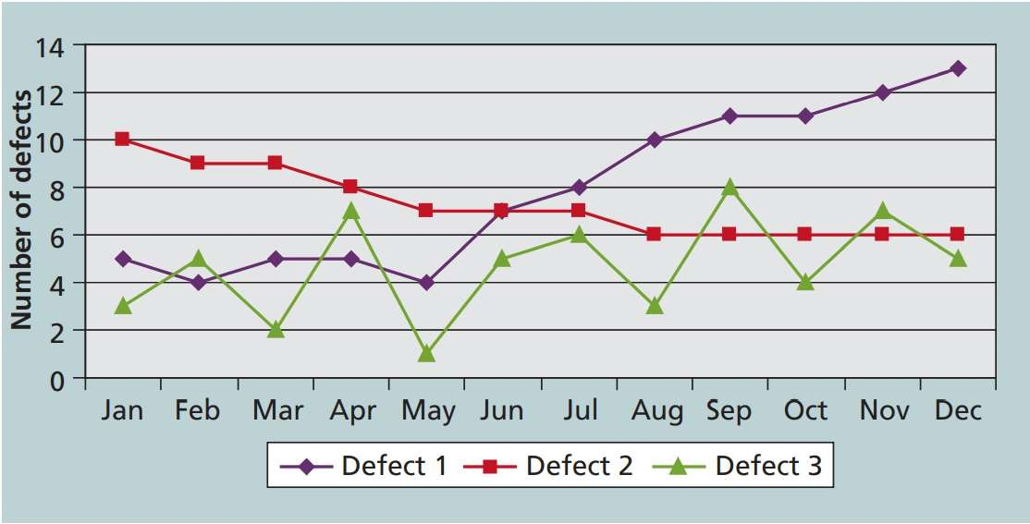
Tools and Techniques for Quality Control
Sample Run Chart

Slide 29
Tools and Techniques for Quality Control
Members of a project team who works on the quality control must have solid understanding of Statistical Sampling that has a key role in project quality management.
In statistical sampling, only part of a population of interest is chosen for
analysis.
The chosen sample size depends on how you want the sample to be
representative of the entire population.
A simple formula is given to determine the sample size:
  Sample size = 0.25 * (certainty factor /acceptable error)²
  certainty factor signifies how confident you want to be that the sampled
This Presentation is maidnlay dtepaendeintnonctlheutedxtebosok: Inofonrmlatyion tetchhnoolosgye: Projevcat mrainaagetmienot (n9thsedititonh) baytSchwoalcbec, Ku. r naturally in the

Slide 30
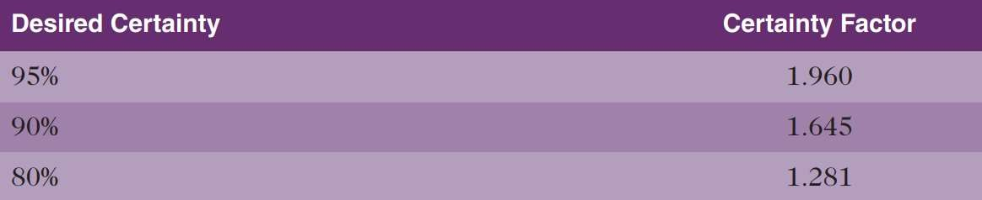
Tools and Techniques for Quality Control
Commonly Used Certainty Factors
The acceptable error is associated with the desired certainty
and is calculated using the formula: 1-percent certainty/100.

Slide 31
Tools and Techniques for Quality Control
Six Sigma is defined as “a comprehensive and flexible system
for achieving, sustaining and maximizing business success.
Six Sigma is uniquely driven
by close understanding of use of
customer needs, disciplined
facts, data, and
statistical analysis, and diligent attention improving, and reinventing business processes.”
to managing,

Slide 32
Tools and Techniques for Quality Control
Six Sigma’s threshold for quality is no more than 3.4 defects, errors, or mistakes per million opportunities.
Six Sigma’s principles can be applied to a variety of processes including design and production of a product, a help desk, or other customer-service processes.
A five-phase improvement process called DMAIC is normally followed by Six Sigma Projects. DMAIC is a systemic and closed- loop process for scientific and fact based continued

Slide 33
Tools and Techniques for Quality
DMAIC Five Phases
  Define: In this phase, the problem/opportunity, process, and customer
requirements are defined.
  Measure: In this phase, measures are defined after which data is collected, compiled, and displayed.
  Analyze: In this phase, process details are analyzed to look for
improvement opportunities.
  Improve: In this phase, solutions and ideas are generated to improve the
problem.
  Control: In this phase, stability of the improvements and

Slide 34
Tools and Techniques for Quality
Read the following
  Six Sigma and Project Selection and Management
  Six Sigma and Statistics

Slide 35
Tools and Techniques for Quality
Testing needs to be done almost during every phase of the systems development life cycle. Figure 8-11 is given on the next slide where several phases include specific work related to testing.
  Unit testing.
  Integration testing.
  System testing.
  User acceptance testing.

Slide 36
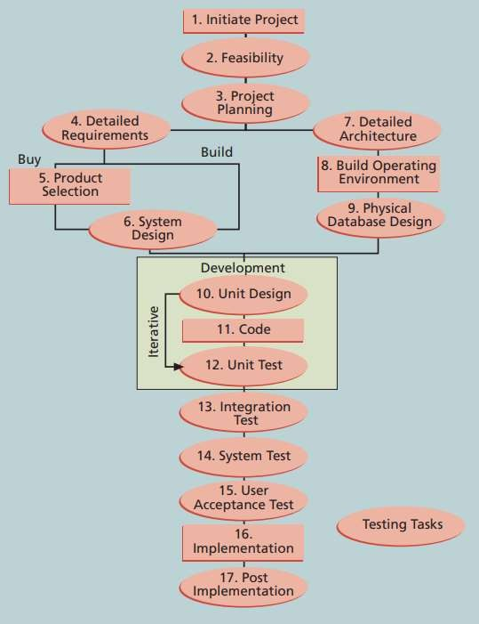
Tools and Techniques for Quality
Testing tasks in the software development life cycle

Slide 37
Modern Quality Management
Modern Quality Management:
  Requires customer satisfaction
  Prefers prevention to inspection
  Recognizes management responsibility for quality
Different quality experts proposed comprehensive guidelines
for quality improvement. Read pages 351-355

Slide 38
Improving IT Project Quality
Strong leadership
  understands the cost of quality.
  provides a good workplace to improve quality.
  works for the improvement of the organization’s overall
maturity level in software development

Slide 39
Improving IT Project Quality
Leadership
  Joseph
M. Juran said in 1945,
“It is most important that top
sincere
management be quality-minded. In the absence of
manifestation of interest at the top, little will happen below.”
A number of quality experts argue that the main cause of quality
problems is a lack of leadership.
Most of the quality related problems are due to the management
and not technical issues.

Slide 40
Improving IT Project Quality
The cost of quality equals to the cost of conformance plus the cost of nonconformance.
Conformance refers to the delivery of products, which meet requirements and fitness for use.
The cost of nonconformance means accepting responsibility of failures or not meeting quality expectations.

Slide 41
Improving IT Project Quality
Prevention cost includes the cost of planning and executing a project provided
that it is error-free or within an acceptable error range.
Appraisal cost includes the cost of inspecting processes and their corresponding outputs to confirm that a project is error-free or within an acceptable error range.
Internal failure cost refers to the cost incurred to correct an identified defect before the product is received by the customer.
External failure cost refers to the cost that is related to all errors neither
detected nor corrected before it is delivered to the customer.
Measurement and test equipment costs refer to the capital cost of equipment
that is used to conduct prevention and appraisal activities.

Slide 42
Improving IT Project Quality
DeMarco and Lister conducted a study identifying that organizational issues had a much greater influence on programmer productivity compared to technical environment or programming languages.
Across organizations, productivity of programmers varied by a factor of one to ten. However, within the same organization this difference is only 21 percent.
They also found that productivity and programming language, years of experience, or salary have no correlation.
In conclusion, a dedicated workspace and a quiet work environment

Slide 43
Improving IT Project Quality
Experienced Project Managers know
stakeholder’s expectations is critical
that aspect
managing
of project
quality management.
Expectations may vary depending on
  Organization’s culture
  Geographic regions
It is crucial to know these expectations properly.
and manage them

Slide 44
Improving IT Project Quality
Maturity Models provide a framework that can improve processes and systems in an organization
be used to
Maturity Models usually have five levels in which the first
level describes characteristics of the least organized or mature organizations whereas the fifth level
describes or mature
characteristics of the most organized organizations.

Slide 45
Improving IT Project Quality
Three popular maturity models
  The Software Quality Function Deployment (SQFD) Model
Focuses on defining user requirements and software projects.
The Capability Maturity Model Integration (CMMI)
planning
is a process improvement approach tha provides organizations with the essential elements of effective processes.

Slide 46
Improving IT Project Quality
CMMI levels are listed below starting from lowest to highest.
  Incomplete
  Performed
  Managed
  Defined
  Quantitatively Managed
  Optimizing

Slide 47
Improving IT Project Quality
Organizational Project Management Maturity Model (OPM3) was released by PMI in December 2003.
This model is based on market research surveys incorporating
180 best practices, more than 2,400 capabilities, outcomes, and key performance indicators that were communicated to more than 30,000 project management professionals.

Slide 48
Chapter Summary
Key processes in Project Quality Management are:
  Plan Quality
  Manage Quality
  Control Quality

