Slide 1
Chapter 9:
Project Human Resource Management

Slide 2
Contents:
Project Resource Management
Keys to Managing and Leading People
Developing the Resource Management Plan and Team Charter
Acquiring Resources
Developing the Project Team
Managing the Project Team

Slide 3
Week 11 Learning Outcome:
Describe the meaning of human resource management and the impact it has on the global IT workforce.
Describe the theories related to motivating and managing people.
Describe the components of and purpose of developing a human
resource plan.
Explain the strategies used for acquiring team members and
developing project teams.
Identify the tools and techniques used by project managers to
motivate and manage teams.

Slide 4
Project Resource Management
80 percent of the young population around 104 countries have been online by mid 2017, and 4.3 billion broadband subscriptions.
The number of IT related jobs will increase by 12 percent until 2024.

Slide 5
Project Resource Management
Project resource management refers to the most effective use of people working in a
project. There are four processes:
  Planning resource management includes decisions about estimating, acquiring, managing, and using project resources.
  Acquiring the resources: In this process, the people who will work on the project
are hired.
  Developing the project team: In this process, individual and group skills are
built to improve the project performance.
  Managing the project team: In this process, the performance of team members is monitored. The team leader properly motivates them, provides them with proper and timely feedback, resolves issues and conflicts if exist any. The team leader also coordinates changes with them in order to improve the project performance.

Slide 6
Keys to Managing and Leading People
Management theorists and psychologists have extensively studied the field of managing and leading people at work.
The following psychosocial issues that affect the people include:
  Motivation theories
  Influence and power
  Effectiveness
  Emotional intelligence
  leadership

Slide 7
Keys to Managing and Leading People
Motivation Theories
  What motivates people on doing something.
  Intrinsic motivation causes people to join an event for
their
personal satisfaction. For example, one might love reading novels or play guitar.
Extrinsic motivation causes people
activity either to get a reward or
to participate in an
avoid a punishment. For
example, a young school kid may not like to play a guitar but he/she will do so merely to receive a reward or avoid a punishment.

Slide 8
Keys to Managing and Leading People
Maslow’s Hierarchy of Needs
  Abraham Maslow claimed that the unique qualities of human behavior such as love, self esteem, belonging, self- expression, and creativity enable people to make independent choices that is why they are the true masters of their destiny.
  Maslow established hierarchy of needs, which formulates
that behaviors of people are guided or
motivated by a

Slide 9
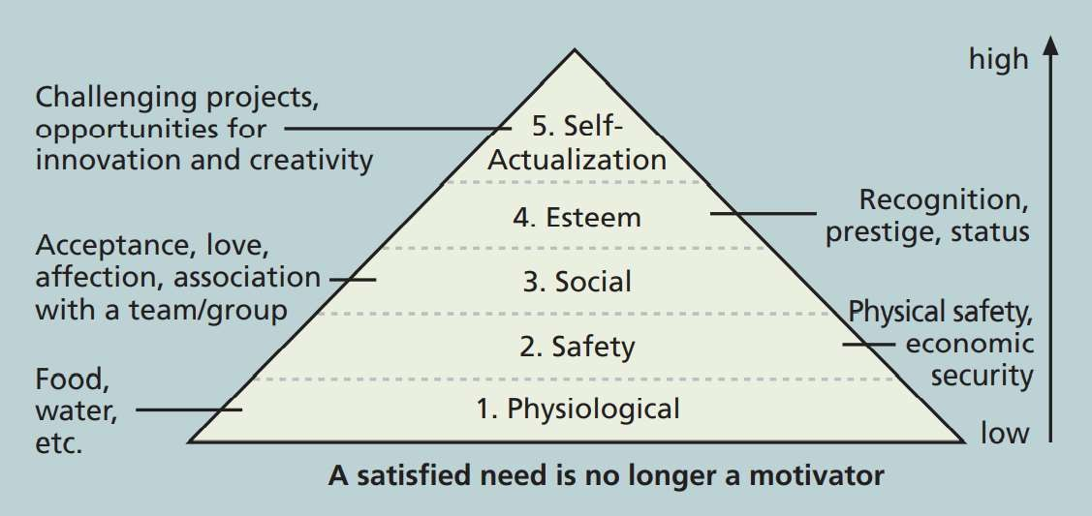
Keys to Managing and Leading People
Maslow’s Hierarchy of Needs

Slide 10
Keys to Managing and Leading People
Herzberg’s Motivation-Hygiene Theory
  Fredrick Herzberg is famous for factors from hygiene factors.
differentiating
motivational
Motivators refer to those factors that cause job satisfaction.
Hygiene factors refer to those factors that cause dissatisfaction if not available. However, their presence does not motivate a worker to do more work.
Table 9-1 highlights some examples of these factors.

Slide 11
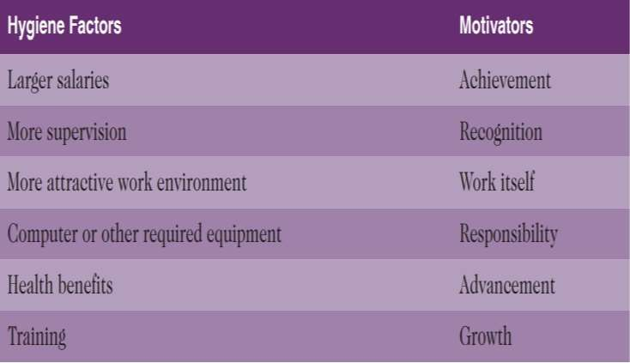
Keys to Managing and Leading People
Examples of Herzberg’s hygiene factors and motivators

Slide 12
Keys to Managing and Leading People
McClelland’s Acquired-Needs Theory
  According to David McClelland, person’s particular needs are acquired or learned over time and
molded by life experiences. Acquired needs can be categorized as follows.
    Achievement: People with a high need for achievements tend to avoid low-risk as well as high-risk situations. High achievers should be assigned challenging projects with achievable goals and should be provided regular feedback about their performance.
    Affiliation: People who have a high need for affiliation have desires for harmonious relationships. They need to feel accepted by others. Managers should develop a cooperative work environment for such people.
Power: People
who have need for power desire to exercise either personal power or
institutional power. People who desire personal power are willing to show their power to others whereas those who desire for institutional power want to achieve organizational goals. Therefore, institutional power hungry people should be given opportunity of managing other people.

Slide 13
Keys to Managing and Leading People
McGregor’s Theory X and Theory Y
  The human relations approach to management is highlighted by Douglas
McGregor in 1960s, who developed Theory X and Theory Y.
  Theory X (classical system theory): Believers of this theory assume that workers do not like to work and avoid it if possible. Therefore, managers must use coercion, threats, and other control strategies to force workers in achieving goals.
  Theory Y (human relations theory): Believers of this theory assume that employees inherently like to work and consider it as natural as play or rest. The satisfaction of esteem and self-actualization needs

Slide 14
Keys to Managing and Leading People
Theory Z
  William Ouchi in 1981 introduced Theory Z that is inspired from a Japanese strategy of motivating workers emphasizing trust, quality, collective decision making, and cultural values.
Theory Z describes the perspective of management. According to this theory,
workers about workers can be
trusted to fulfil their jobs to the best of their abilities.

Slide 15
Keys to Managing and Leading People
Influence and Power
  Project Managers are unable to force project team members to work. Other way around, the team members can quit the job at any time or get transferred to other departments.

Slide 16
Keys to Managing and Leading People
Thamhain and Wilemon identified nine influence methods that can be used by Project Managers to get most out of the project team members.
  Authority signifies legitimate hierarchical right to issue orders.
  Assignment perceived ability of the project manager to influence a team member’s later work assignments
  Budget perceived ability of the project manager to authorize the use of discretionary funds for other purposes.
  Promotion the ability of a Project Manager to promote a worker.
  Money the ability of a Project Manager to raise a worker’s salary and other benefits.
  Penalty the ability of a Project Manager to cause punishment to a worker
  Work Challenge the ability of a Project Manager to assign tasks to a worker so that the pleasure of doing a particular work is capitalized
  Expertise the Project Manager’s special expert knowledge that others think significant
  Friendship the ability of establishing friendly personal relationship between the Project Manager and other team members.

Slide 17
Keys to Managing and Leading People
Projects may fail to when the team members are influenced with:
  Authority
  Money
  Penalty
On the other hand, projects may
influence the team members with:
  Work challenge
  Expertise
succeed when Project Managers

Slide 18
Keys to Managing and Leading People
Power refers to the ability of influencing people’s behavior to make people to do work
which they will no do otherwise.
Types of Power include:
  Coercive power people are punished or threatened for not doing their job.
  Legitimate power authority or position is used to force people do their job.
  Expert power personal expertise and knowledge are used to exploit the behavior of people at work.
  Reward power different incentives are used to encourage team members to do things.
  Referent power based on the Project Manager’s personal charisma, people obey them without any hesitation.

Slide 19
Keys to Managing and Leading People
Covey’s 7 habits can be applied by Project Managers to be more effective on Projects.
  Be proactive
  Begin with the end in mind
  Put first things first
  Think win/win
  Seek first to understand
  Synergize
  Sharpen the saw

Slide 20
Keys to Managing and Leading People
Empathic listening refers to the trait of listening with the intent of understanding.
Rapport refers to the relation of harmony, conformity, accord, or affinity with others. This kind of relationship helps in communication.
Mirroring refers to matching of certain behaviors of two people working in a team. This helps in establishing rapport.

Slide 21
Keys to Managing and Leading People
Emotional Intelligence refers to the concept of knowing and managing one’s own emotions and understanding the emotions of others for improved performance.
Emotion intelligence plays a key role when Project Managers work on team building, collaboration, negotiation, and relationship development.

Slide 22
Keys to Managing and Leading People
Leadership belongs to the category of soft skills. There are infinite many best ways to become a leader who inspires people to achieve long-term organizational goals.
Different leaders have different leadership styles. The best leaders have the ability to adapt their style according to the needs of a situation.
Daniel Goleman states that, “The goal for leaders should be to develop a solid understanding of the different styles of leadership and their implications, and reach the point where choosing the right

Slide 23
Developing the Resource Management Plan and Team Charter
Project resource management plan can be separated into a human resource management plan and a physical resource management plan.
Human resource plan includes information about roles and responsibilities, and also contains a staffing management plan.
Human resource plan consists of:
  Project organizational charts
  Responsibility assignment matrices
  Staffing management plans and Resource histograms

Slide 24
Developing the Resource Management Plan and Team Charter
Project Organizational Charts
  Providing organizational structure for a project is
important to manage people with diverse backgrounds.
very
The Project Manager with the consent of top management and after discussion with the staff members is responsible to develop organization chart for the project according to the skills and type of people in the project.

Slide 25
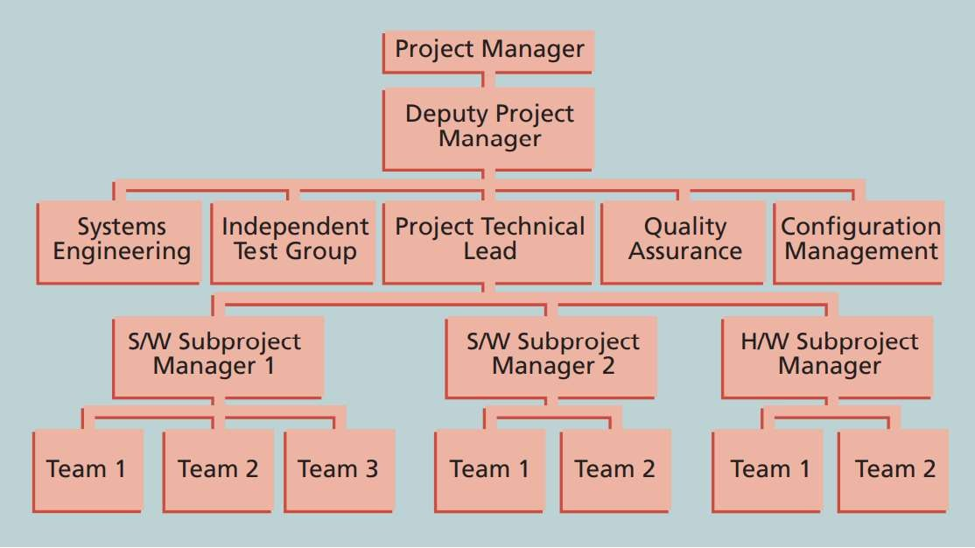
Developing the Resource Management Plan and Team Charter
Sample Organizational Chart for a Large IT project

Slide 26
Developing the Resource Management Plan and Team Charter
After the organization structure is defined, work definition and assignment process should also be followed that consists of four steps:
  Finalizing the project requirements
  Defining how the work will be accomplished
  Breaking down the work into manageable elements
  Assigning work responsibilities

Slide 27
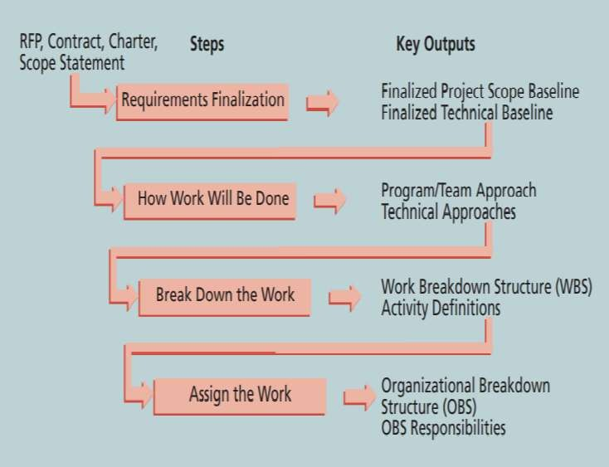
Developing the Resource Management Plan and Team Charter
Work Definition and Assignment Process

Slide 28
Developing the Resource Management Plan and Team Charter
Responsibility Assignment Matrix (RAM) is a matrix
that
shows the association of the project work, as described in the WBS, to the people responsible for that work.
Additionally, RAM can also be used to describe roles and responsibilities on projects where project stakeholders can also be included.

Slide 29
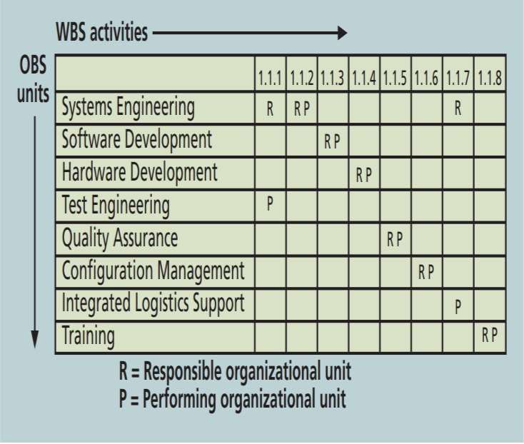
Developing the Resource Management Plan and Team Charter
Sample Responsibility Assignment Matrix

Slide 30
Developing the Resource Management Plan and Team Charter
RACI charts can also be used to show key roles for project stakeholders.
  Responsibility
  Accountability
  Consultation
  Informed

Slide 31
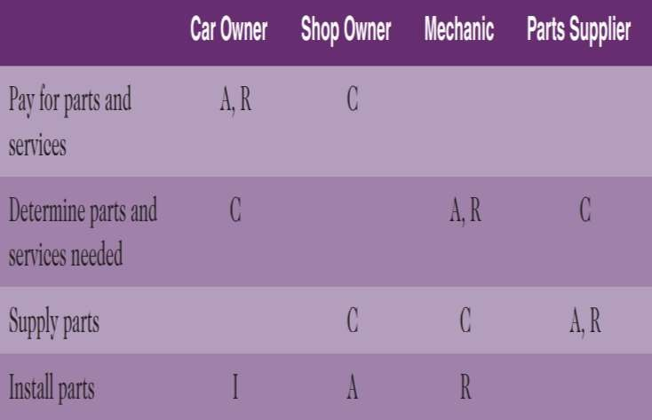
Developing the Resource Management Plan and Team Charter
Sample RACI Chart

Slide 32
Developing the Resource Management Plan and Team Charter
Staffing management plan provides details about when and how people will be added to or removed from a project team.
The number of resources assigned to a project over time is shown with the help of a Resource histogram.

Slide 33
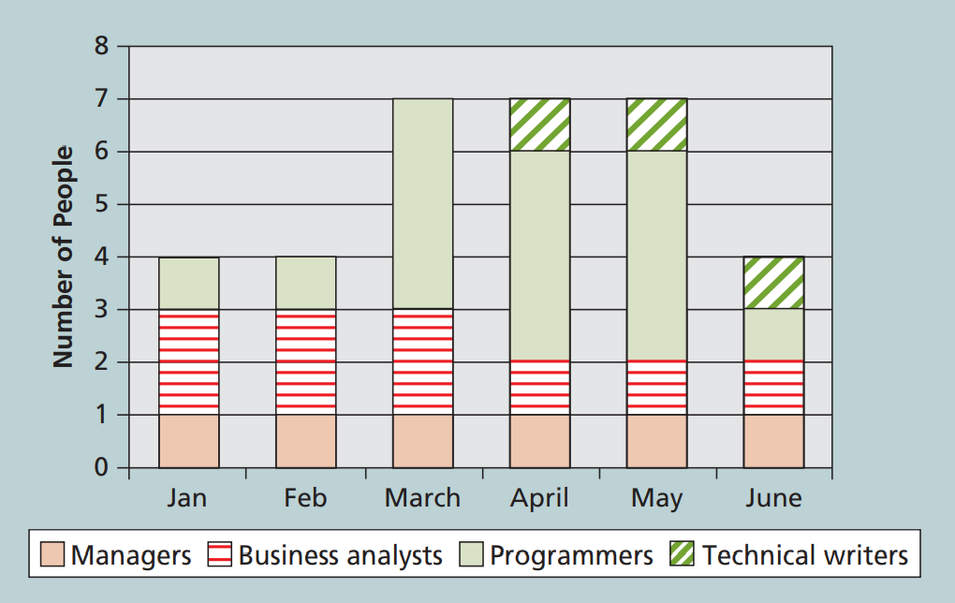
Developing the Resource Management Plan and Team Charter
Sample Resource Histogram

Slide 34
Developing the Resource Management Plan and Team Charter
The project team members meet after their selection to prepare a team charter.
Team charter is used to guide how the team will function.
Updates should be made to the team charter whenever needed.
Team charter may consist of:
  Team values
  Communication guidelines
  Decision-making criteria and process
  Conflict resolution process
  Meeting guidelines
  Team agreements

Slide 35
Estimating Activity Resources
The people involve in estimating resources must be experienced.
Brainstorming should be performed and alternatives should be evaluated to estimate resources.
Major costs related to human resources include salaries and benefits.
A resource breakdown structure refers to hierarchical
structure that highlights the project’s resources by category

Slide 36
Acquiring Resources
It is critical to acquire qualified IT professionals.
According to a saying “the project manager who is the smartest
person on the team has done a poor job of recruiting.”
To work on a project, assigning appropriate number of people with appropriate skills at appropriate times is crucial.

Slide 37
Acquiring Resources
Resource Assignment
  Project Manager is responsible to assign the team members to the project work.
  Organizations should maintain accurate record of employees’ skills.
  In case available expertise do not fulfil the needs of the current project, it is Project Manager’s job to work with top management and human resource managers to address staffing and training needs.

Slide 38
Acquiring Resources
Resource loading is the amount of individual resources that is required by an existing schedule during specific time periods.
With the help of this, Project Managers understand the project demands on the organization’s resources and on individual people’s schedule.
Overallocation means that sufficient resources are not available to accomplish the assigned work during a given time

Slide 39
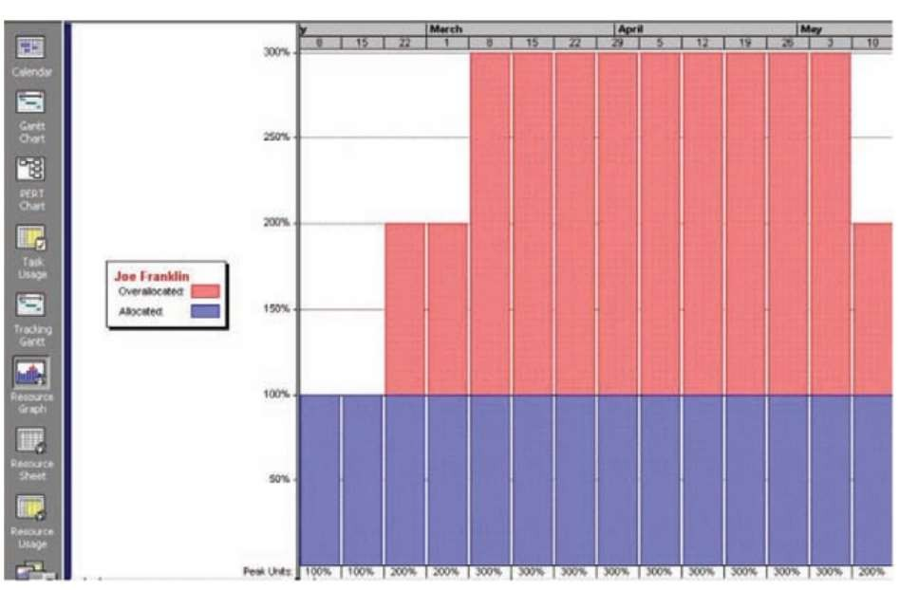
Acquiring Resources
Sample Showing
Histogram
an
Overallocated Person

Slide 40
Acquiring Resources
Resource leveling is used to resolve resource conflicts by delaying tasks.
This helps in creating a smoother distribution of resource usage and minimizing overallocation.
Network diagrams are examined for areas of slack or float and for identifying resource conflicts.

Slide 41
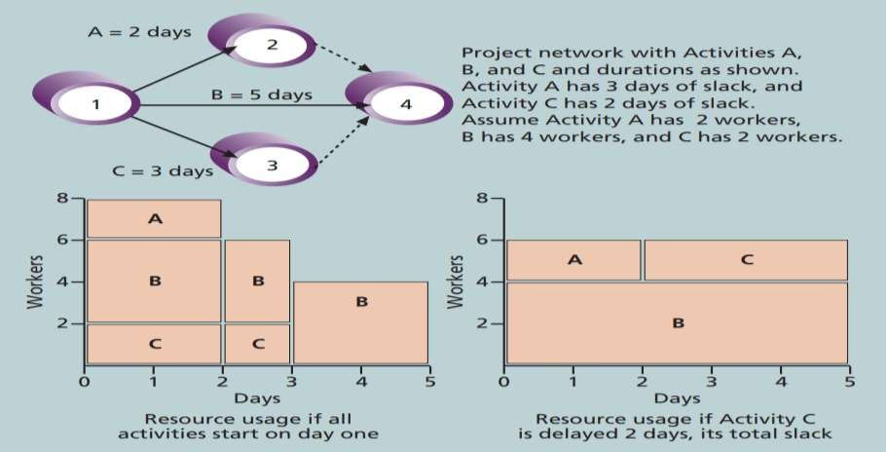
Acquiring Resources
Resource Example
Leveling

Slide 42
Developing the Project Team
The objective behind team development is to help people work together more effectively to enhance project performance.
In some situations, people working in a team guarantees the successful completion of the project.

Slide 43
Developing the Project Team
Tuckman model: Five stages of team development
  Forming refers to the introduction of team members
  Storming is performed by people to test each other
conflicts
when
they
have
Norming is a situation of cooperation and collaboration after conflicts have been resolved
Performing refers to the efforts of achieving the team’s goals rather
than discussing the team process.
Adjourning refers to the dissolving the team after successfully

Slide 44
Developing the Project Team
Trainings are usually recommended by Project Managers so that people working on the project improve their individual as well as team development.

Slide 45
Developing the Project Team
Team-building trainings can be provided in-house or by obtaining the services of other organizations who developed expertise in providing training programs.
Team-building activities include:
  Physical challenges
  Psychological preference indicator tools

Slide 46
Developing the Project Team
Military basic training or boot camps are examples of physically challenging activities.

Slide 47
Developing the Project Team
Psychological preference indicator tools
  Teams participate in mental team-building activities in
which
also
they learn about themselves as well as each other. learn how they can work as a team more effectively.
Common mental team building exercises
They
Myers-Briggs Type Indicator
Wilson Learning Social Styles Profile
The DISC Profile

Slide 48
Developing the Project Team
Myers-Briggs Type Indicator
personality preferences that
(MBTI) is a tool to determine helps individuals in a team
understand each other.
The four dimensions of psychological type MBTI:
  Extrovert/Introvert (E/I)
  Sensation/Intuition (S/N)
  Thinking/Feeling (T/F)
  Judgement/Perception (J/P)

Slide 49
Developing the Project Team
Social Styles Profile is also used by many organizations in team-building activities.
Based on their assertiveness or responsiveness, people fall into four approximate behavioral profiles or zones. People in opposite quadrants may have difficulties in working together.
  Drivers
  Expressives
  Analyticals
  Amiables

Slide 50
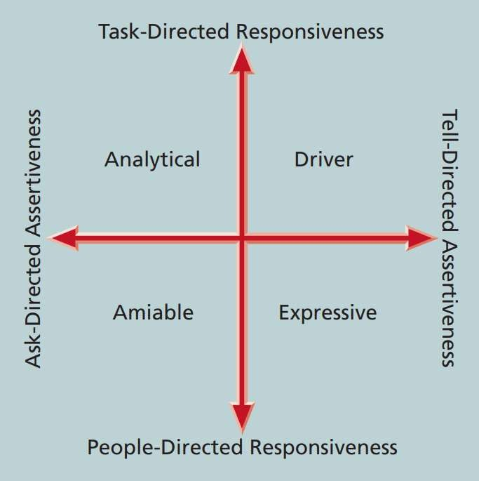
Developing the Project Team
Social Styles

Slide 51
Developing the Project Team
DISC profile uses four-dimensional model of normal behavior. It discloses people’s behavior under stress, in conflicts or
during communication. People falling in may have problems while working in a group.
Dominance
Influence
Steadiness
Compliance
opposite quadrants

Slide 52
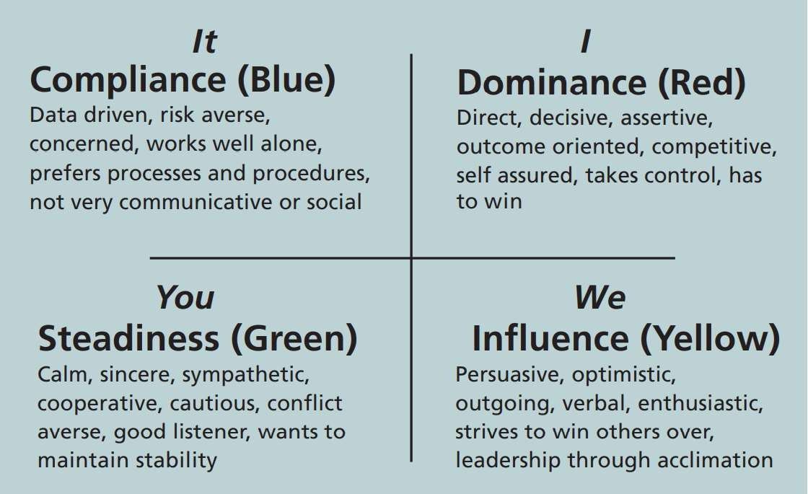
Developing the Project Team
The DISC Profile

Slide 53
Developing the Project Team
Team-based Reward and Recognition Systems can be used as a tool to promote teamwork.
Teams can be more effective when the rewards are given for teamwork.
Project Managers can also recognize and reward individuals who are willingly working overtime to help a teammate to meet a deadline.

Slide 54
Managing the Project Team
Project Manager is responsible to lead his/her team in executing the project activities.
Decision must be taken by Project Manager after analyzing the team performance and related information:
  If changes should be requested to the project
  If updates are needed to enterprise environmental factors, organizational process assets, or the project management plan

Slide 55
Managing the Project Team
A number of tools and techniques exist to help in managing teams.
  Conflict management
  Decision making
  Emotional intelligence
  Influencing
  Leadership
Project management information systems
Conflict management will be discussed in
already been discussed.
detail, the other topics have

Slide 56
Managing the Project Team
Project Managers should understand conflict handling strategies and should manage the
conflicts proactively.
Blake and Mouton five basic modes of conflict handling.
  Confrontation mode
  Compromise mode
  Smoothing mode
  Forcing mode
  Withdrawal mode
  Collaborating mode (this is recognized in recent studies)

Slide 57
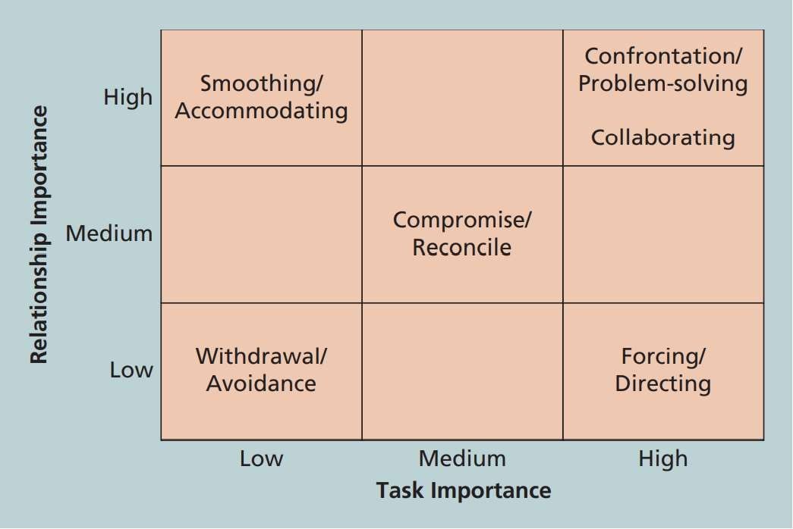
Managing the Project Team
Conflict Handling Modes

Slide 58
Managing the Project Team
Teams are subject to dysfunction, challenging.
The five dysfunctions of teams:
  Absence of trust
  Fear of conflict
  Lack of commitment
  Avoidance of accountability
  Inattention to results
maintaining teamwork is

Slide 59
Managing the Project Team
Do not assume that your team is lazy and careless; therefore, Be patient and kind with your team.
Instead of blaming people, fix the problem.
Conduct regular and effective meetings.
Do not expect highest performance, rather allow time for teams to go
through the basic team-building activities.
Limit the size of teams to 3 to 7 members Read more from book on page 411

Slide 60
Chapter summary
Key processes of Human Resource Management
  Plan resource management
  Acquire the resources
  Develop the project team
  Manage the project team

