Slide 1
Internet Technologies
MIS-341-4
Chapter 1

Slide 2
Internet and its uses
Internet: is a global network of inter-connected computers, where one computer can be connected to any other computer (or computerized device) in any portion of the world.
Evolution of Internet:
The concept of Internet was originated in 1969 and has undergone several technological & Infrastructural changes as discussed below:
The origin of Internet devised from the concept of Advanced Research Project Agency Network (ARPANET).
ARPANET was developed by United States Department of Defense.
Basic purpose of ARPANET was to provide communication among the various bodies of government.
Initially, there were only four nodes, formally called Hosts.
In 1972, the ARPANET spread over the globe with 23 nodes located at different countries and thus became known as Internet.
By the time, with invention of new technologies such as TCP/IP protocols, DNS, WWW, browsers, scripting languages etc., Internet provide a medium to publish and access information over the web.

Slide 3
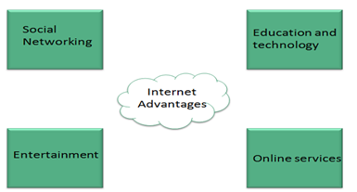
Advantages & Disadvantages of Internet
Advantages:
Internet covers almost every aspect of life, one can think of. Here, we will discuss some of the advantages of Internet.

Slide 4
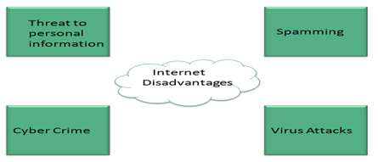
Disadvantages of Internet:
However, Internet has proved to be a powerful source of information in almost every field, yet there exists many disadvantages discussed below:

Slide 5
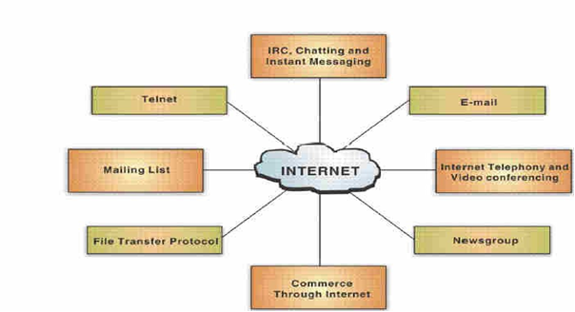
Internet Applications:

Slide 6
Internet Applications:
World Wide Web (WWW): It is a subset of the Internet, and it presents text, images, animation, video, sound, and other multimedia in a single interface. The operation of the Web relies primarily on hypertext, as it is a means of information retrieval.
Electronic Mail (E Mail): It is the process of exchanging messages electronically, via a communications network, using the computer.
File Transfer Protocol (FTP): It is a system of rules and a software program that enables a user to log on to another computer and transfer information between it and his/her computer.
Telnet: It connects one machine to another in such a way that a person may interact with another machine as if it is being used locally.

Slide 7
Internet Applications:
Internet Relay Chat (IRC): This service allows people to communicate in real time and carry on conversations via the computer with one or more people. It provides the user with the facility to engage in simultaneous (synchronous) online 'conversations' with other users from anywhere in the world.
Chatting and Instant Messaging: Chat programs allow users on the Internet to communicate with each other by typing in real time. Instant messaging allows a user on the Web to contact another user currently logged in and type a conversation.
Internet Telephony: It refers to the use of the Internet rather than the traditional telephone company infrastructure, to exchange spoken or other telephonic information.

Slide 8
Internet Applications:
Video Conferencing: It uses the same technology as IRC, but also provides sound and video pictures. It enables direct face to face communication across networks via web cameras, microphones, and other communication tools.
Commerce through Internet: It refers to buying and selling goods and services online.
Newsgroups (Usenet): It is an international discussion group that focuses on a particular topic and helps in gathering information about that topic.
Mailing Lists (List server): It refers to a large community of individuals who carry out active discussions, organized around topic oriented forums that are distributed via e mail and this method is known as mailing list

Slide 9
Network and Connectors:
A network is defined as a group of two or more computer systems linked together.
Local Area Network (LAN): LAN spans only a small geographical area such as an office, home, or building. In LAN one computer is designated as the file server, which stores all the software that controls the network and other computers connected are called workstations.
Metropolitan Area Network (MAN): MAN is a network of computers spread over a metropolitan area such as city and its suburbs. Operated by one organization (a corporate with several offices in one city), or be shared resources used by several organizations in the same city.
Wide Area Network (WAN): WAN is a system of interconnecting computers over a large geographical area such as cities, states, countries, or even the world. These kinds of networks use telephone lines, satellite links, and other long range communications technologies to connect.

Slide 10
Networks Characteristics & Topologies:
In addition to these types, the following characteristics are also used to categorize different types of networks:
LAN Network topologies:
Network topology is the name given to the way in which the devices (called nodes) are physically connected in a network.
There are three common network topologies, called ring, line (bus) and star.
Network Architecture: refers to how computers are organized in a system and how tasks are allocated between these computers. Networks can be broadly classified as using either a peer-to-peer or client/server architecture.
Nodes: Computers on a network are sometimes called nodes.

Slide 11
Servers, Internet Protocols:
Servers: Computers and devices that allocate resources for a network are called servers/ A server is a computer program or a device that provides functionality for other programs or devices, called "clients"
Internet Protocols: The protocol defines a common set of rules and signals that computers on the network use to communicate/The Internet Protocol(IP) is a method or protocol by which a data is sent from one computer to another on the internet.

Slide 12
TCP/IP:
Comparison of TCP and IP Protocols
TCP (Transmission Control Protocol) and IP (Internet Protocol) are two fundamental protocols that work together to enable communication over the internet. While they are often mentioned together as TCP/IP, they have distinct roles:
IP (Internet Protocol): It uniquely identifies each device connected to the Internet with a unique numerical address called an IP address. This address is what routes packets from one device to another across the network. IP is responsible for routing, i.e. determining the path a packet will take to reach its destination.
TCP (Transmission Control Protocol): It makes sure that data reaches its destination completely and in the same order in which it was sent. TCP divides data into small pieces called packets, then reassembles them in the correct order upon arrival. It also makes sure that all packets arrived successfully, and if any packet is lost, it requests it to be resent.

Slide 13
TCP/IP:
Feature | TCP | IP
Basic Function | Ensures reliable data delivery | Routing data packets
Service Type | Reliable | Unreliable
Data Segmentation | Divides data into segments and reassembles them | Doesn't segment data
Flow Control | Controls data flow to prevent network congestion | Doesn't control flow
Example | File transfers, video calls | Web browsing, email (in some cases)

Slide 14
File Transfer Protocol (FTP):
FTP is used to copy files from one host to another. FTP offers the mechanism for the same in following manner:
FTP creates two processes such as Control Process and Data Transfer Process at both ends i.e. at client as well as at server.
FTP establishes two different connections: one is for data transfer and other is for control information.
FTP uses port 21 for the control connection and Port 20 for the data connection.

Slide 15
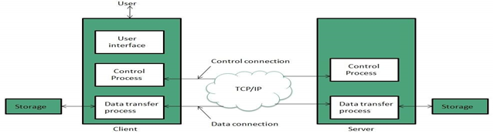
File Transfer Protocol (FTP):

