Slide 1
Internet Technologies
MIS341-4
Chapter 8
Emerging Internet Technologies

Slide 2
Topics:
Internet of Things (IoT)
Web 3.0 and Decentralization
Blockchain technologies
5G networks and implications for the Internet

Slide 3
Internet of Things (IoT)
IoT refers to a network of interconnected physical devices (such as sensors, appliances, vehicles, etc.) that communicate and exchange data over the internet. These devices are embedded with electronics, software, and connectivity to collect and share data with other systems, enabling smart applications in homes, industries, healthcare, and transportation.
Example: Smart thermostats that adjust room temperature based on user preferences or wearable devices that monitor health metrics.
Key Features: Real-time data collection, remote monitoring, automation, and data-driven decision-making.
IoT enables smarter systems that enhance efficiency, safety, and convenience across various sectors by providing insights from connected devices.

Slide 4
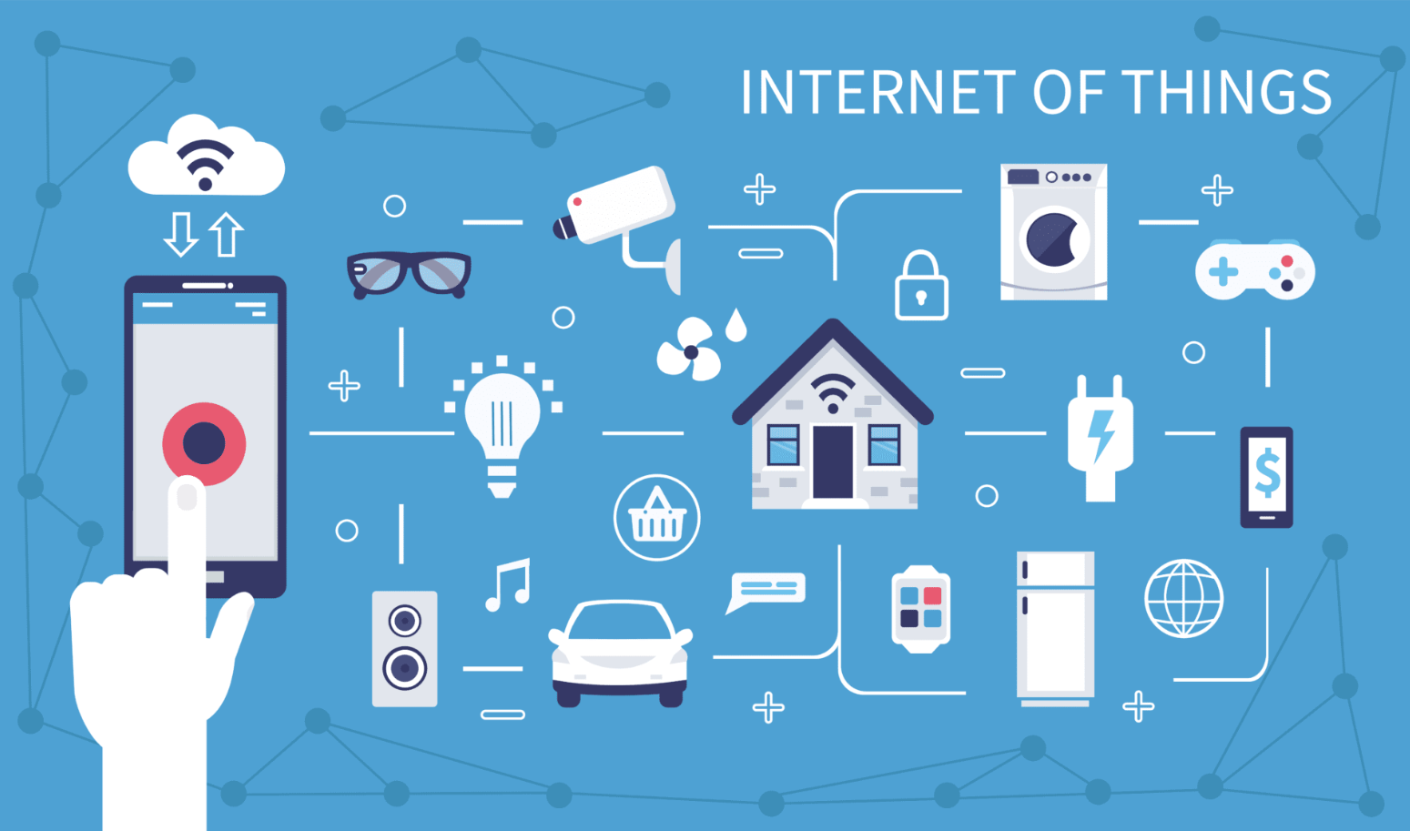
Internet of Things (IoT)

Slide 5
Web 3.0 and Decentralization:
Web 3.0 is the next phase of the internet, focused on creating a decentralized web where data and services are not controlled by a few large companies but distributed across a network of users. It leverages blockchain technology to create decentralized applications (dApps), offering greater privacy, transparency, and user control over data.
Decentralization: Refers to the removal of central authorities in data management and control. Instead of data being held by central entities (e.g., Google or Facebook), it is distributed across a blockchain, giving users ownership and control.
Example: Decentralized finance (DeFi) applications where users can conduct financial transactions without banks or intermediaries.
Web 3.0 promises a more user-centric internet with trustless interactions, where blockchain ensures secure and transparent transactions without intermediaries

Slide 6
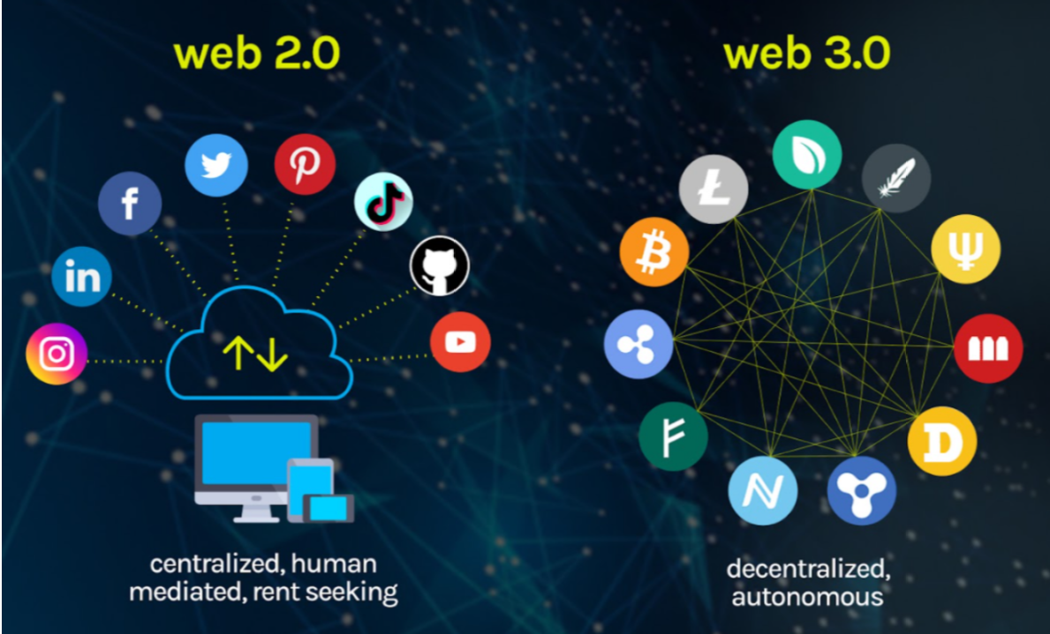
Web 3.0 and Decentralization:
.

Slide 7
Blockchain Technologies:
Blockchain is a distributed ledger technology that records transactions in blocks, which are linked together in a chain. It provides a secure, transparent, and tamper-proof system for recording data, making it ideal for applications like cryptocurrency (e.g., Bitcoin), smart contracts, and decentralized applications.
Key Features: Immutable data records, decentralized control, and cryptographic security.
Applications: Blockchain is widely used in cryptocurrency, supply chain management, digital identity verification, and voting systems.
Blockchain eliminates the need for intermediaries by providing a trustless, secure, and transparent way to store and verify data.

Slide 8
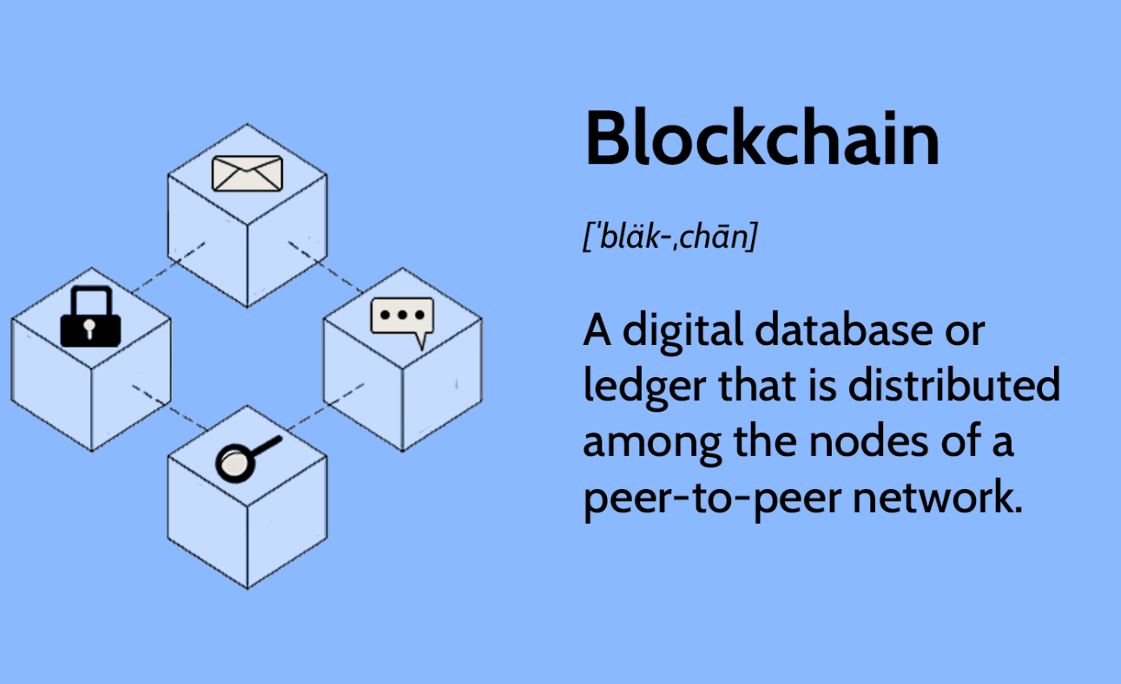
Blockchain:

Slide 9
5G Networks and Implications for the Internet
5G is the fifth generation of wireless communication technology, offering significantly faster data speeds, lower latency, and higher bandwidth compared to its predecessor, 4G. It supports a wider range of devices and allows for real-time communication between devices.
Implications for the Internet:
  IoT growth: 5G enables the massive deployment of IoT devices, supporting a vast number of connections simultaneously.
  Edge computing: 5G facilitates edge computing, where data is processed closer to the source, reducing latency and improving response times.
  Autonomous systems: 5G is essential for applications like self-driving cars and smart cities, where low latency and high reliability are critical.
The rollout of 5G will dramatically enhance internet capabilities, leading to new applications in healthcare, transportation, gaming, and entertainment.

Slide 10
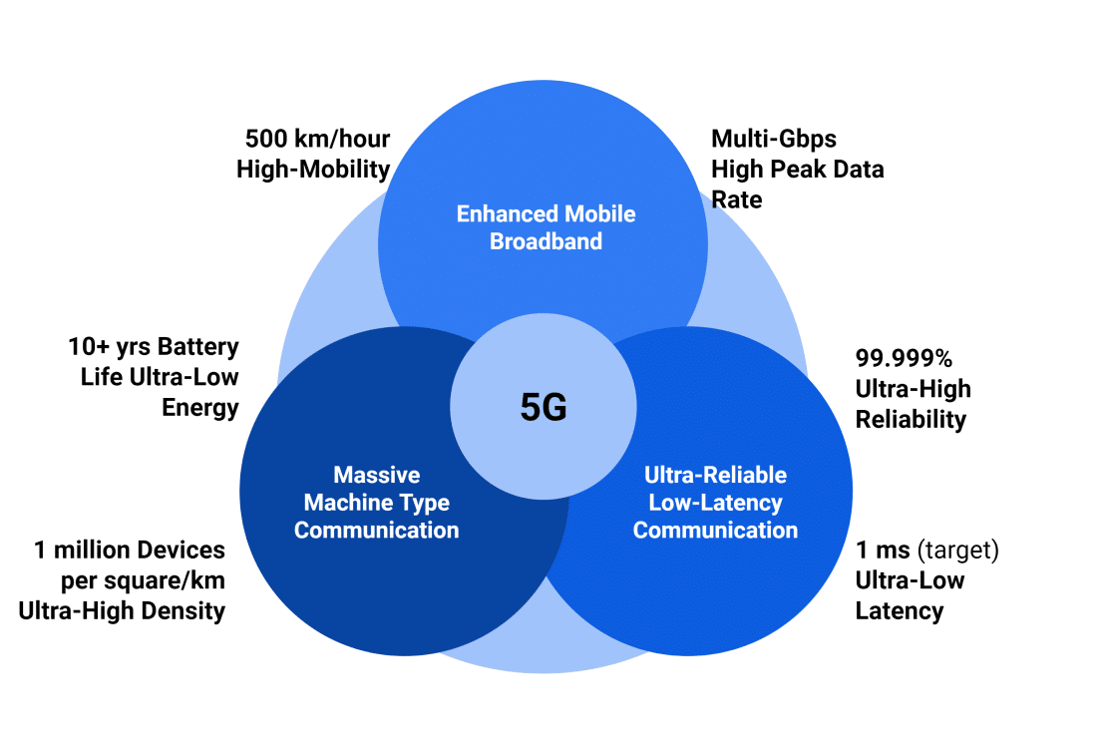
5G Networks and Implications for the Internet

