Slide 1

Software Design and Architecture [Quality Attributes] – Chapter 03, L01

Slide 2
Lecture Outlines
Architecture and Requirements
Quality Attribute Considerations
Quality Design Decisions
Major Quality Attributes

Slide 3
Architecture and Requirements
System requirements can be categorized as:
  Functional requirements:
    State what the system must do, usually in the form of “system shall do <requirements>”.
    Functional requirements define specific behavior or function
    The plan for implementing functional requirements is produced in the system detailed design.
  Non-functional requirements or Quality attributes (QA)):
    Specify criteria that can be used to judge the operation of the system as a whole rather than specific behavior
    The plan for implementing non-functional requirements is detailed in the system architecture

Slide 4
Architecture and Requirements
Achieving quality attributes must be considered throughout design, implementation, and deployment.
Architecture, by itself, is unable to achieve qualities. It provides the foundation for achieving quality, but this foundation will be to no use if attention is not paid to the details in later phases of software development.

Slide 5
Architecture and Requirements
Architectural documents are used by a variety of system stakeholders:
  E.g. Developers, managers, sales, testers, support, maintenance, and customers
Each stakeholder will have their own opinion about what non-functional requirement matters the most:
  e.g. The development team will care about maintainability more than the customer
  e.g. Quality assurance team will be more interested in the testability of the application
  What will the end user be interested in???

Slide 6
Quality Attribute Considerations
Quality attributes are constraints on the manner in which the system implements and delivers its functionality (how the system achieves its functionality).
  i.e. Eﬃciency, availability, scalability, adaptability, security, dependability, etc. …
Example: assume the following functional requirement “when the user presses the green button the Options dialog appears”:
  A performance QA might describe how quickly the dialog will appear
  An availability QA might describe how often this function will fail
  A usability QA might describe how easy it is to learn this function.

Slide 7
Quality Attribute Considerations – Scenarios
Quality attributes can have unstable definition or an overlapping concerns, Example:
Is a system failure due to a denial of service attack an aspect of availability, performance, security, or usability?
A solution for this is (unstable definitions and overlapping concerns) is to use quality attribute scenarios as a means of characterizing quality attributes. It turn a vague desire into a concrete, measurable requirement.
Notes:
Example 1: The "Slow Search" Dilemma
The Overlap: If a database search takes 30 seconds to return a result, which attribute is failing?
Performance: The response time is objectively slow.
Usability: The user becomes frustrated and thinks the app is broken.
Scalability: It might only be slow because there are 1,000 concurrent users.
The Scenario Solution:
"Under peak load (stimulus), the search engine (artifact) must return results within 2 seconds (measure) to maintain user engagement."
Why it works: It shifts the focus from a vague definition to a measurable requirement.
-----------------------------------------------------
Example 2: The "Automatic Update" Conflict
The Overlap: A system automatically pushes a security patch that requires a reboot.
Security: The system is now more secure.
Availability: The system is temporarily offline during the reboot.
Modifiability: The system was easy to update.
The Scenario Solution:
"A security patch is released (stimulus); the update module (artifact) must apply it without dropping active user sessions (measure)."
Why it works: This forces the architect to address the trade-off between security and availability directly.
----------------------------------------
Example 3: The "Data Encryption" Trade-off
The Overlap: Adding heavy AES-256 encryption to all database transactions.
Security: Data is highly protected.
Performance: The CPU overhead makes every transaction 20% slower.
Cost: You may need to buy more powerful servers to handle the load.
The Scenario Solution:
"During normal operations (environment), the encryption layer (artifact) must protect data such that latency increases by no more than 50ms (measure)."
Why it works: It sets a "performance budget" for a security feature.

Slide 8
Quality Attribute Considerations – Scenarios
A quality attribute scenario has the following parts:
  Stimulus – a condition that needs to be considered. What actually happened?
  Source of stimulus - (e.g., human, computer system, etc.) Who or what generated the fault?
  Environment - what are the conditions when the stimulus occurs? What state was the system in?
  Artifact – what elements of the system are stimulated. Which part of the system is affected?
  Response – the activity undertaken after arrival of the stimulus. How does the system react to the fault?
  Response measure – when the response occurs it should be measurable so that the requirement can be tested. How do we determine if the response was "good enough"

Slide 9
A Quality Attribute Scenario Template
A template for writing a quality attribute scenario which is commonly used is:
Some (source) generates some events (stimuli) that arrives at some artefact under some conditions (environment) and must be dealt with (response) in a satisfactory way (response measure)

Slide 10
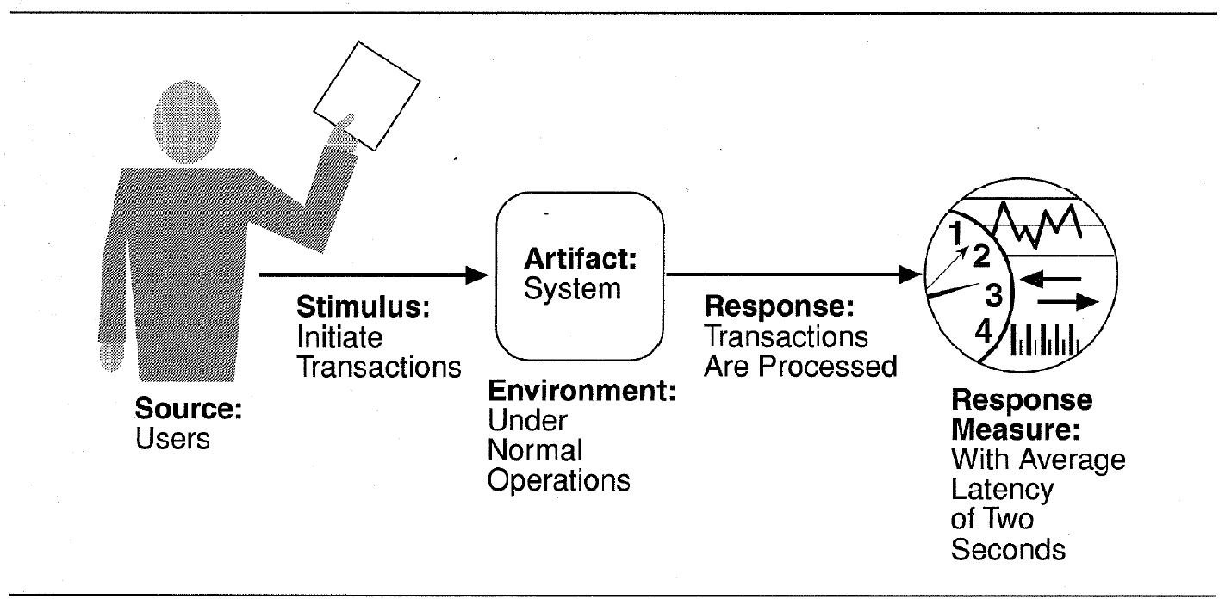
Quality Attribute Considerations – Scenarios
A Performance Scenario Example

Slide 11
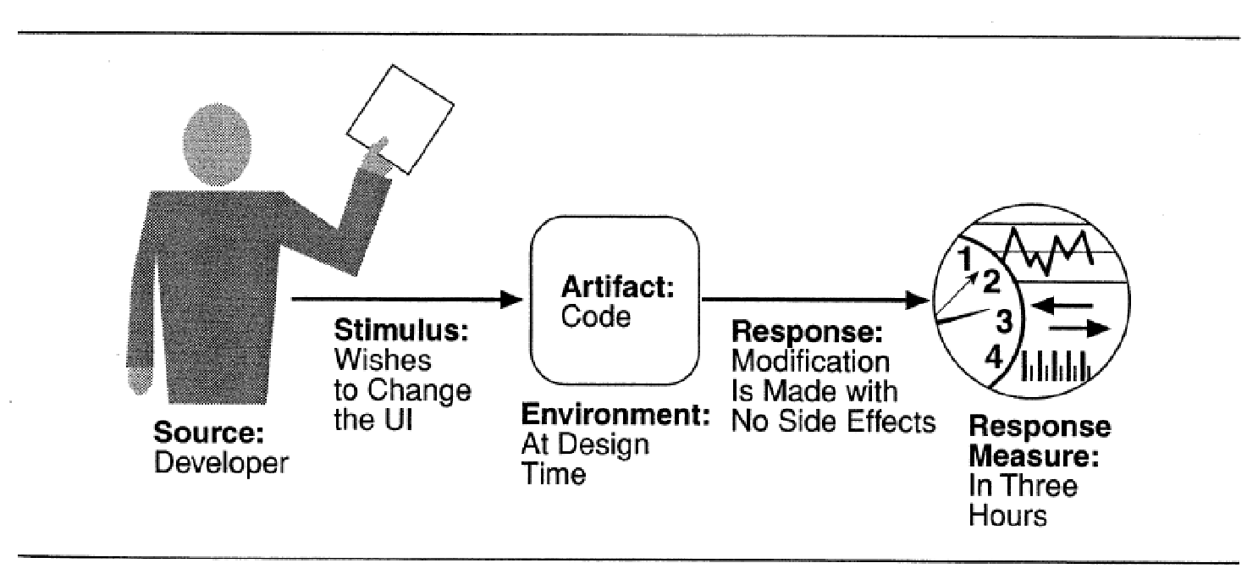
Quality Attribute Considerations – Scenarios
A maintainability Scenario Example

Slide 12
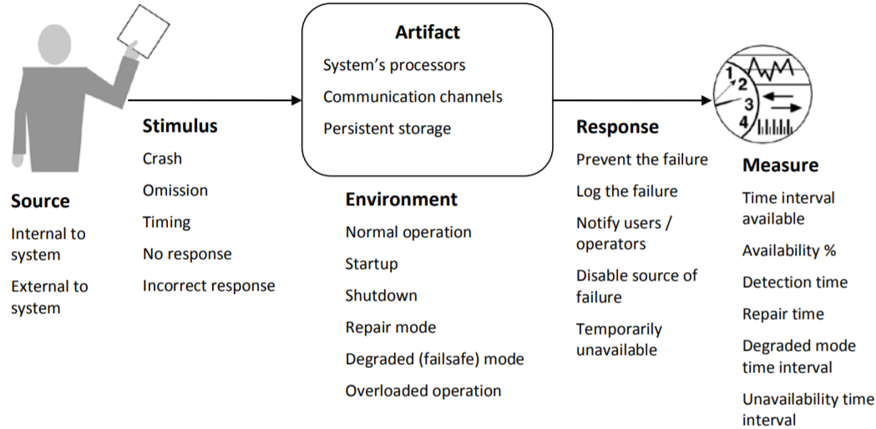
Quality Attribute Considerations – Scenario
Example: General Availability Scenario

Slide 13
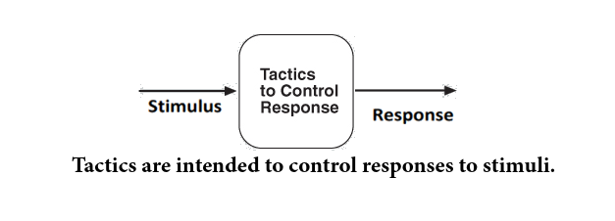
Quality Attribute Considerations – Tactics
There are a collection of primitive design techniques that an architect can use to achieve a quality attribute response.
We call these architectural design primitives tactics.
Tactics, like design patterns, are techniques that architects have been used for years by experienced architects that we can simply capture and apply in our designs.
We will show examples of tactics later in the following lecture.

Slide 14
Quality Design Decisions
Architecture design is a systematic approach to making design decisions. These decisions can be categorized into:
  Allocation of system responsibilities (responsibilities of system functions)
  Coordination model (coordination between system elements)
  Data model (identify data abstractions, their operations and properties)
  Management of resources
  Mapping among architectural elements (mapping of modules and runtime elements )
  Binding time decisions (Determine how and when architectural elements are bounded)
  Choice of technology

Slide 15
Summary
Architecture and Requirements
Quality Attribute Considerations
Quality Design Decisions
Next … Major Quality Attributes

