Slide 1

Software Design and Architecture [Quality Attributes] – Chapter 03, L02

Slide 2
Lecture Outlines
Major Quality Attributes
    Definition
    Example with scenario
    Tactics

Slide 3
Major Quality Attributes
Availability: is concerned with system failure and duration of system failures. (System failure means, when the system does not provide the service for which it was intended)
Modifiability: is about the cost of change, both in time and money.
Performance: is about timeliness. Events occur and the system must respond in a timely fashion.
Security: is the ability of the system to prevent or resist unauthorized access while providing access to legitimate users. An attack is an attempt to breach security.
Testability: refers to the ease with which the software can be made to demonstrate its faults. To be testable the system must control inputs and be able to observe outputs.
Usability: is how easy it is for the user to accomplish tasks and what support the system provides for the user to accomplish this.

Slide 4
1- Availability – Defined
Availability refers to a property of software that it is there and ready to carry out its task when you need it to be.
Fundamentally, availability is about minimizing service outage time by dealing with faults.

Slide 5
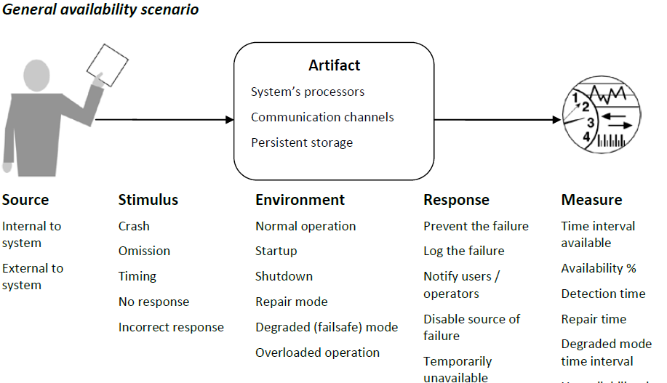
Availability – Scenario Example

Slide 6
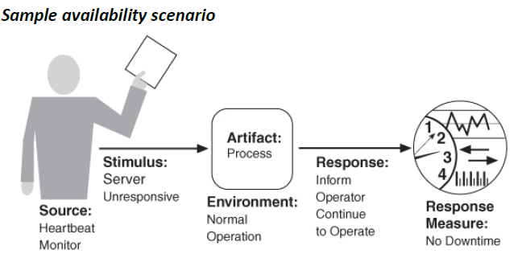
Availability – Scenario Example

Slide 7
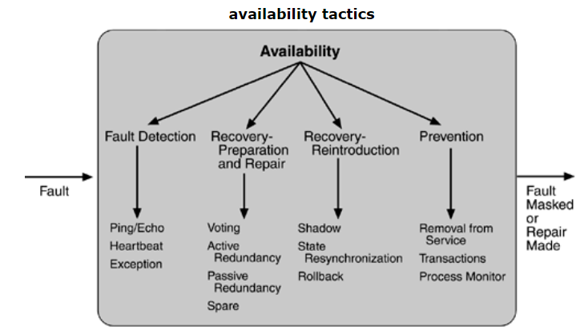
Availability – tactics
Notes:
https://people.ece.ubc.ca/matei/EECE417/BASS/ch05lev1sec2.html
In this scenario, we aren't just saying "the database shouldn't break." We are defining exactly what happens when it does.
Example: Database Server Failure
By filling in the blanks from your diagram, we create a concrete architectural requirement:
Source: External to the system (e.g., a power outage at the data center).
Stimulus: Crash (the database server goes offline).
Artifact: Persistent storage/Processors.
Environment: Normal operation (peak hours).
Response: The system automatically switches to a "Hot Standby" (backup) server and notifies the network administrator.
Measure: * Availability: $99.99\%$ uptime.
Detection time: Under 30 seconds.
Repair time: Failover completes in under 2 minutes.

Slide 8
2- Modifiability – Defined
Modifiability is about change and our interest in it is in the cost and risk of making changes.
To plan for modifiability, an architect has to consider three questions:
  What can change?
  What is the likelihood of the change?
  When is the change made and who makes it?

Slide 9
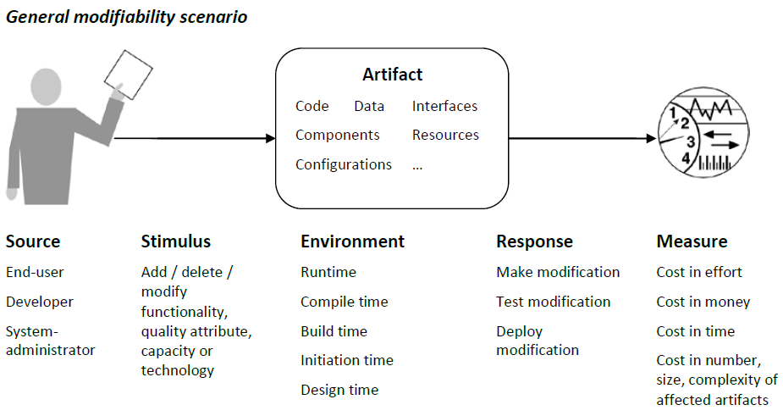
Modifiability – Scenario Example

Slide 10
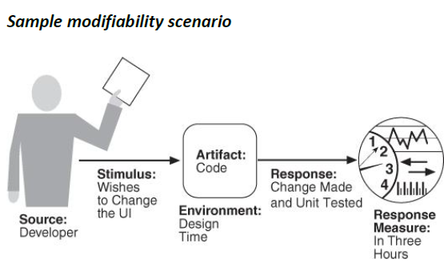
Modifiability – Scenario Example
More information about general and sample Modifiability scenarios can be found in:
https://people.ece.ubc.ca/matei/EECE417/BASS/ch05lev1sec3.html

Slide 11
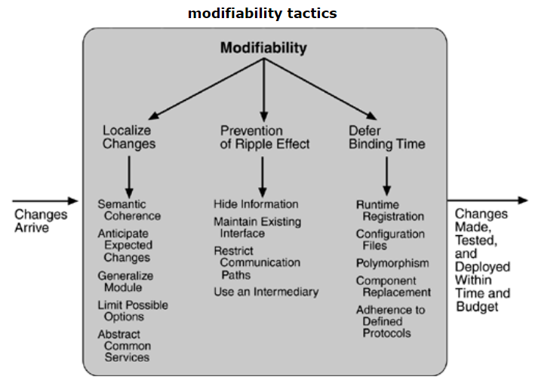
Modifiability – tactics

Slide 12
3- Performance – Defined
Performance is about time and the software system’s ability to meet timing requirements.
When events occur – interrupts, messages, requests from users or other systems, or clock events marking the passage of time – the system, or some element of the system, must respond to them in time.

Slide 13
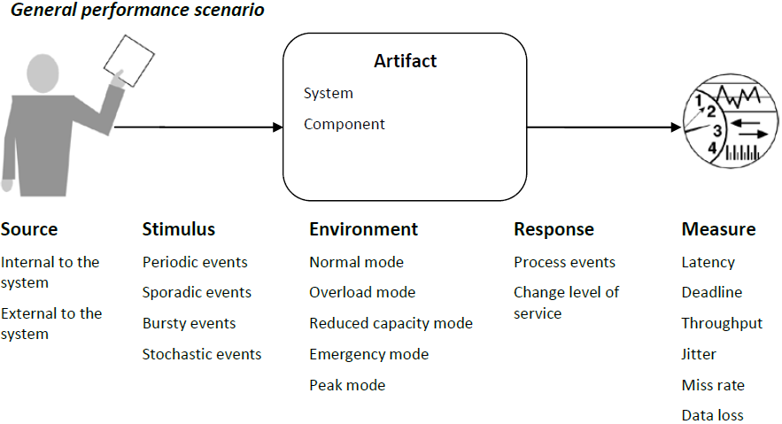
Performance – Scenario Example

Slide 14
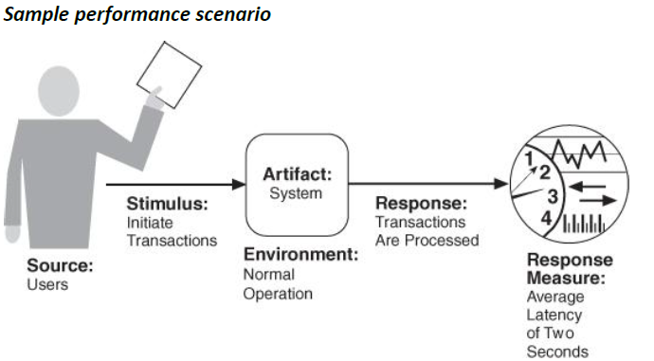
Performance – Scenario Example
More information about general and sample Performance scenarios can be found in:
https://people.ece.ubc.ca/matei/EECE417/BASS/ch05lev1sec4.html

Slide 15
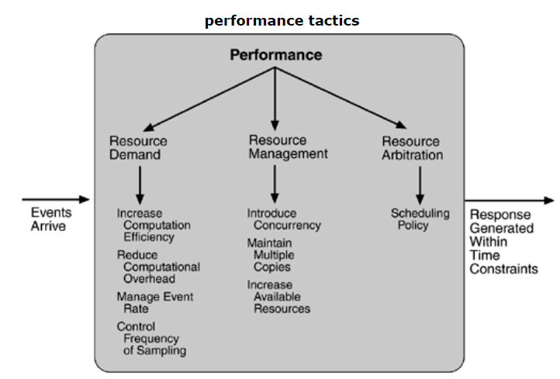
Performance – tactics

Slide 16
4- Security – Defined
Performance Tactics for achieving security can be divided into those concerned with resisting attacks, those concerned with detecting attacks, and those concerned with recovering from attacks.

Slide 17
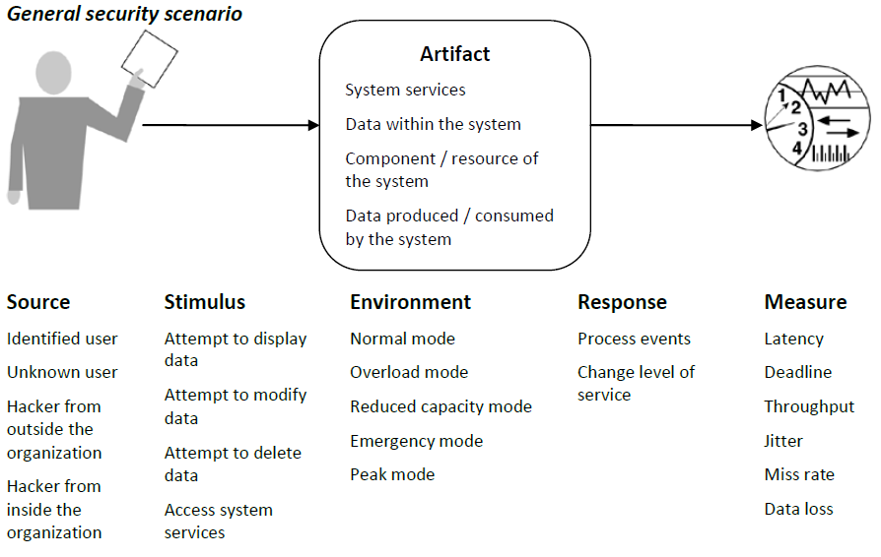
Security – Scenario Example

Slide 18
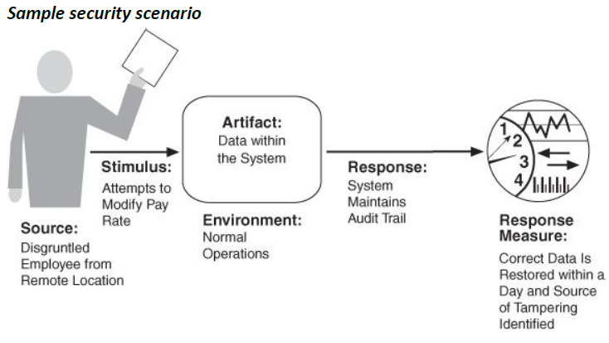
Security – Scenario Example

Slide 19
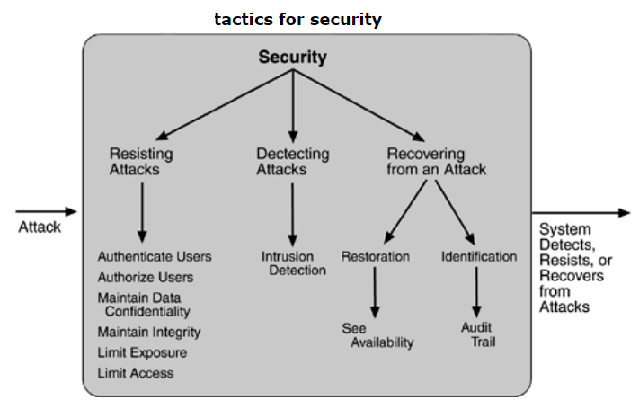
Security – tactics

Slide 20
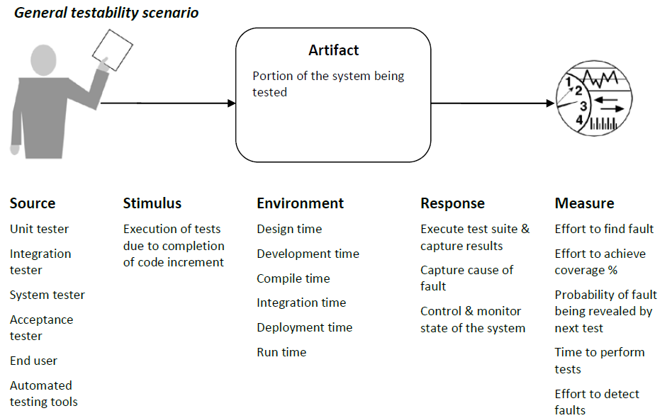
5- Testability – Scenario Example

Slide 21
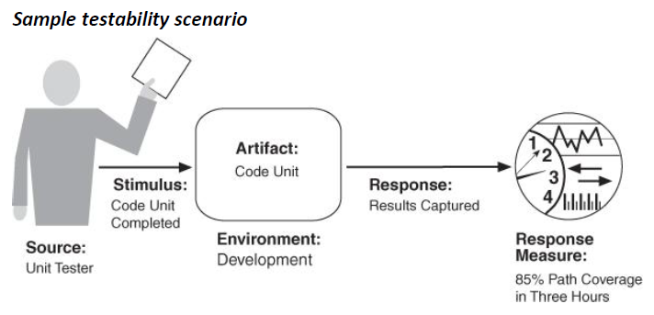
Testability – Scenario Example

Slide 22
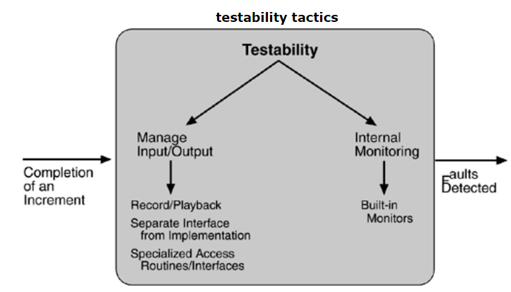
Testability – tactics

Slide 23
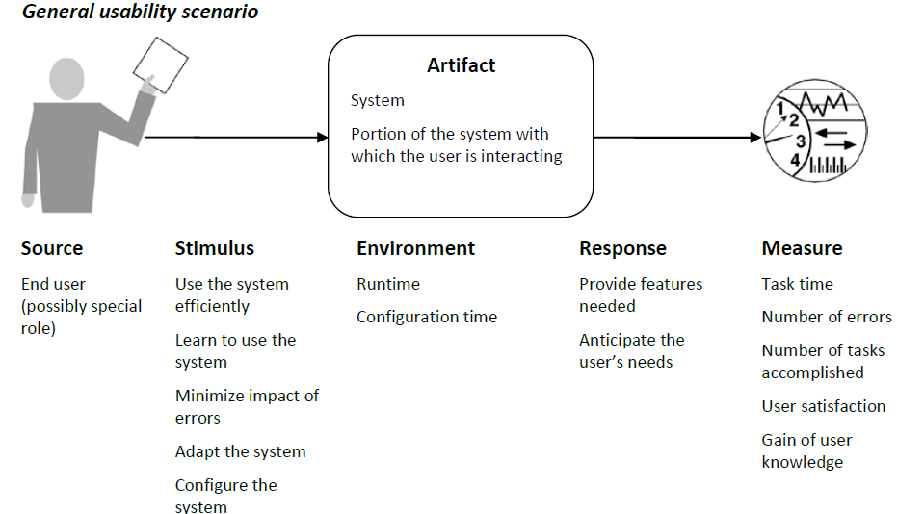
6- Usability – Scenario Example

Slide 24
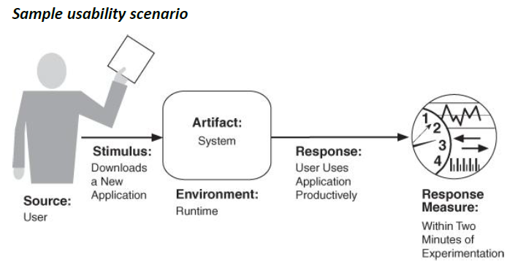
Usability – Scenario Example

Slide 25
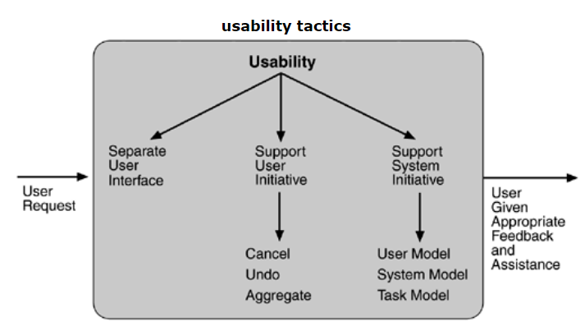
Usability – tactics

Slide 26
Summary
Major Quality Attributes
    Definition
    General and sample scenario examples
    Tactics
Next … Architecture Design Patterns

