Slide 1

Software Design and Architecture [Architecture Patterns] – Chapter 04, L01
HW: Serverless architecture

Slide 2
Lecture Outlines
Overview of Architecture Styles and Patterns
History of Architectural Styles and Patterns
  Origin of styles and patterns
Classification of Architectural Styles and Patterns
  Data-Centered
  Data flow
  Distributed
  Interactive
  Hierarchical

Slide 3
Overview
Software systems need to be carefully architected and evaluated from different perspectives.
  This is necessary to address multiple concerns that shape the quality of the system from different stakeholders with different backgrounds.
In this chapter, we pay special attention (mostly) on decomposing the software system into logical components that represent the structural integrity that supports functional and non-functional (quality) requirements.
When designing logical architectures, it is important to use past experience to discover overall strategies that have been used successfully in the development of software systems.
  To this end, the concepts of architectural styles and architectural patterns have emerged as mainstream approach for achieving reuse at the architectural level.

Slide 4
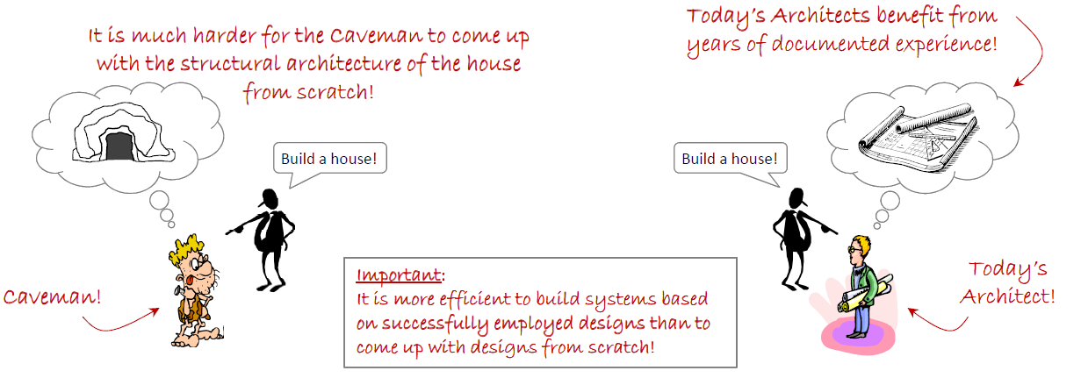
Overview

Slide 5
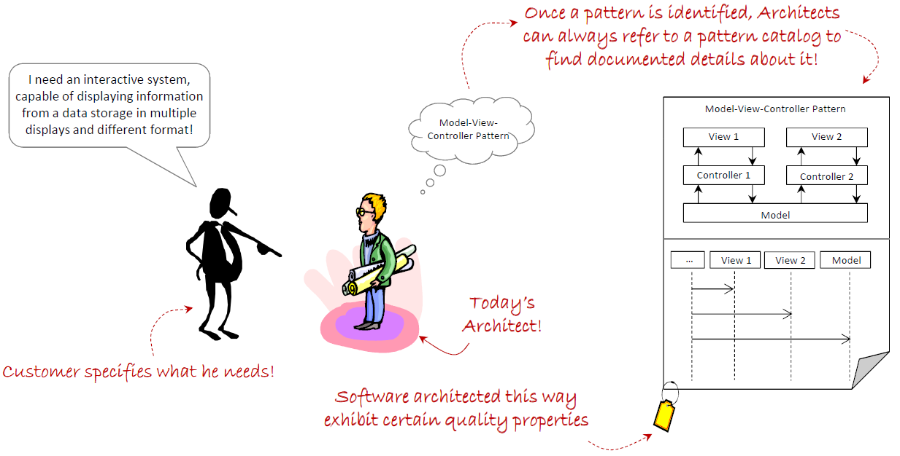
Overview
Similar to the previous example, today’s software architects can benefit from numerous documented styles and patterns for software architecture.

Slide 6
Overview
Architectural styles and patterns provide generic, reusable solutions that can be easily understood.
  These can be easily applied to new problems requiring similar architectural features.
  What is the benefit of this reuse???? (discuss)
Decisions based on architectural styles and patterns benefit from years of documented experience that highlights
  The solution approach to a given problem.
  The benefits of these approaches.
  The consequences of employing these approaches.

Slide 7
History of Software Architecture Styles and Patterns
In 1977, Christopher Alexander presented a language intended to help individuals, or teams, design quality structures of different sizes, shapes, and complexities. (i.e. this was for buildings)
Alexander’s work resulted in a catalogue of 253 patterns, each describing in detail the essential information required for documenting the patterns, including:
  Picture of the pattern
  Context of the pattern
  Problem that the pattern attempts to solve
  Evidence for its validity
  Related patterns

Slide 8
History of Software Architecture Styles and Patterns
In the 1990s, the software engineering community began researching and finding recurring high-level problem solutions in terms of specific elements and their relationships; these were originally referred to as architectural styles.
  Similar to Alexander’s work, Architectural Styles provided the means for software architects to reuse design solutions in different projects; that is, to use a “solution a million times over, without ever doing it the same way twice.” (its focus: solution)

Slide 9
History of Software Architecture Styles and Patterns
In 1994, Gamma, Helm, Johnson, and Vlissides—better known as the Gang of Four (GoF)—published their influential work that focused on a finer-grained set of object-oriented detailed design solutions that could be used in different problems “a million times over, without ever doing it the same way twice.”
  Influenced by Alexander’s work, they called these Design Patterns.
  Their work resulted in the creation of a catalogue of 23 (detailed design) patterns.
  Each pattern was described in detail, using a specific pattern specification format.
Notes:
“An architectural approach that can be applied repeatedly to similar problems, yet always adapted uniquely to its specific context.”
“A solution applied a million times, yet never the same twice.”

Slide 10
History of Software Architecture Styles and Patterns
In 1996, the work of Buschmann, Meunier, Rohnert, Sommerland, and Stal, integrated the work of architectural styles and design patterns by providing a set of well-known architectural styles using a pattern-like approach.
  They referred to these as Architectural Patterns. (its focus: context-problem-solution)
In their work, Buschmann et al. provided their views about architectural patterns vs. design patterns:
  “Architectural patterns … specify the system-wide structural properties of an application. They specify the system-wide structural properties of an application, and have an impact on the architecture of its subsystems.”
  “Design patterns are medium-scale patterns.”
  “The application of a design pattern has no effect on the fundamental structure of a software system, but may have a strong influence on the architecture of a subsystem.”

Slide 11
Architecture Patterns Classification
The choice of applying architectural patterns depend on the type of system, requirements, and desired quality attributes.
  These characteristics help guide the choice of selecting one particular pattern over another.
In some cases, more than one architectural pattern can be used in combination to collectively provide the appropriate architectural solution. (specially for large systems)
Architectural patterns can be classified depending on the type of system.

Slide 12
Architecture Patterns Classification
Major types of systems:
Type | Description | Common Real-Life Examples
Data-Centered | Systems that serve as a centralized repository for data, while allowing clients to access and perform work on the data. | Google Drive, Dropbox, OneDrive, GitHub
Data Flow | Systems oriented around the transport and transformation of a stream of data. | YouTube, Netflix (streaming pipelines), ETL tools (Apache NiFi, Talend)
Distributed | Systems primarily involve interaction between several independent processing units connected via a network. | WhatsApp, BitTorrent, Blockchain (Bitcoin, Ethereum), Google Cloud
Interactive | Systems that serve users or user-centric systems. | Facebook, Instagram, Online Banking, Video Games
Hierarchical | Systems where components can be structured as a hierarchy (vertically and horizontally) to reflect different levels of abstraction and responsibility. | Operating Systems (Windows, Linux), ERP Systems (SAP, Oracle), DNS

Slide 13
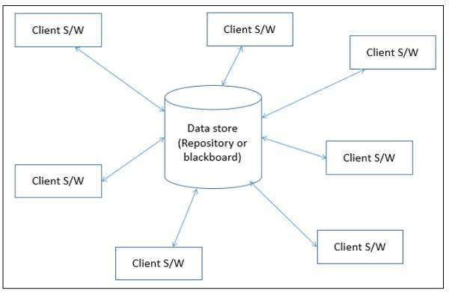
1- Data Centered Systems
Systems that serve as a centralized repository for data, while allowing clients to access and perform work on the data
Used in DBMS, library information system, the interface repository in CORBA, compilers and CASE tools, speech recognition, image recognition, security system, and business resource management systems

Slide 14
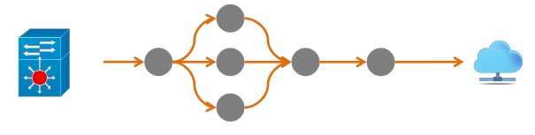
2- Data Flow Systems
Systems oriented around the transport and (or) transformation of a stream of data (Example: video streaming)

Slide 15
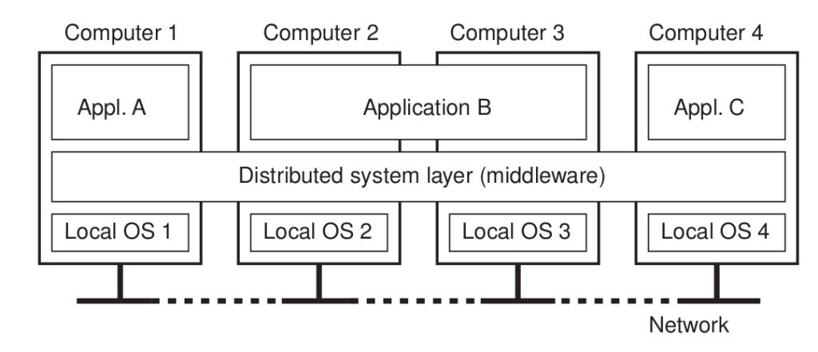
3- Distributed Systems
Systems primarily involved in interaction between several independent processing units connected via a network
Example: network applications like the world wide web (web applications)

Slide 16
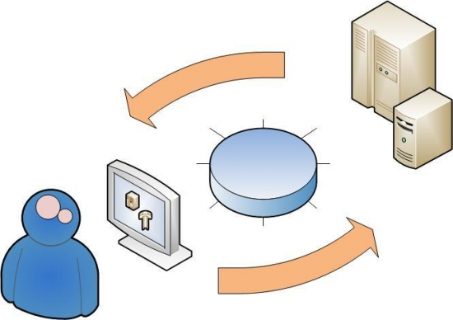
4- Interactive Systems
Systems that serve users (user-centric systems) and require heavy interaction between the user and the system.
Example: mobile applications

Slide 17
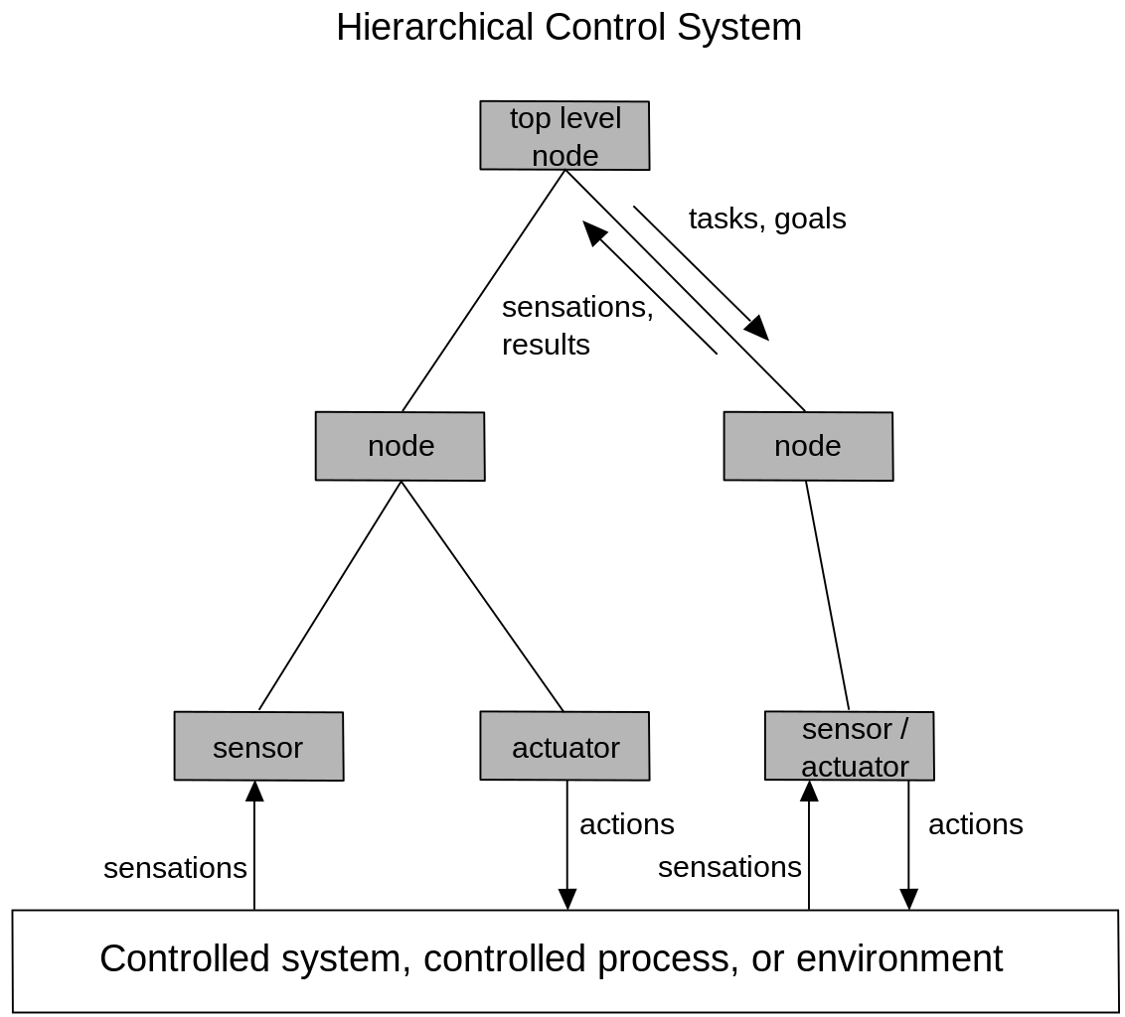
5- Hierarchal Systems
System where components can be structured as a hierarchy (vertically and horizontally) to reflect different levels of abstraction and responsibility
Example: control systems in manufacturing, robotics and vehicles

Slide 18
Summary
Overview of Architecture Styles and Patterns
History of Architectural Styles and Patterns
  Origin of styles and patterns
Classification of Architectural Styles and Patterns
  Data-Centered
  Data flow
  Distributed
  Interactive
  Hierarchical
Next …, we will discuss two types of systems: Data-centered and Data Flow, together with essential architectural patterns for these systems, including: Blackboard and Pipes-and-Filters

