Slide 1

Software Design and Architecture [Architecture Patterns] – Chapter 04, L02

Slide 2
Lecture Outlines
Data-Centered Systems
  Overview
  Patterns:
    Blackboard
Data Flow Systems
  Overview
  Patterns:
    Pipes-and-Filters
Distributed Systems
  Overview
  Patterns:
    Client Server
    Broker

Slide 3
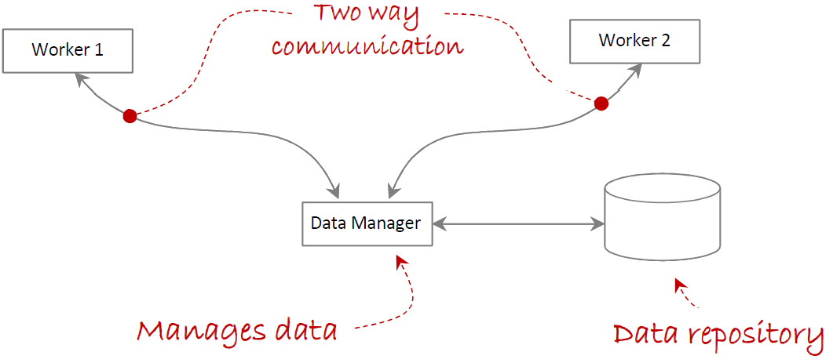
1- Data-Centered Systems – Overview
Data-centered systems are systems primarily decomposed around a main central repository of data. These include:
  Data management component: the data management component controls, provides, and manages access to the system’s data.
  Worker components: worker components execute operations and perform work based on the data.

Slide 4
Data-Centered Systems – Overview
Communication in data-centered systems is characterized by a one-to-one bidirectional communication between a worker component and the data management component.
Worker components do not interact with each other directly; all communication goes through the data management component.

Slide 5
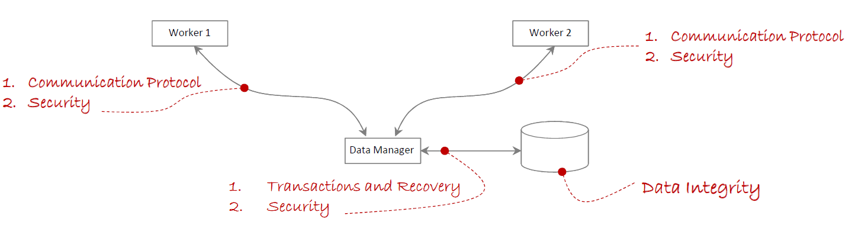
Data-Centered Systems – Overview
Because of the architecture of these systems, they must consider issues with:
  Data integrity
  Communication protocols between worker and data management
  Transactions and recovery
  (also known as roll-back)
  Security
A common architectural pattern for data-centered systems is the Blackboard style and repository architecture style.

Slide 6
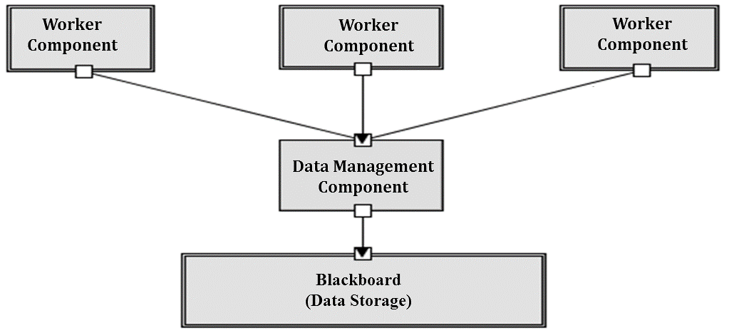
Blackboard Architectural Pattern
Blackboard decomposes systems into components that work around a central data component to provide solutions to complex problems.
  These components work independently from each other to provide partial solutions to problems using an opportunistic problem-solving approach.
  That is, there are no predetermined, or correct, sequences of operations for reaching the problem’s solution.

Slide 7
Blackboard Architectural Pattern
The Blackboard architectural pattern resembles the approach a group of scientists would employ to solve a complex problem.
  Consider a group of scientists at one location using a blackboard (chalkboard, whiteboard, or electronic blackboard) to solve a complex problem.
  Assume that to manage the problem-solving process, a mediator controls access to the blackboard.
  Once the mediator (or controller) assigns control to the blackboard, a scientist evaluates the current state of the problem and if possible, advances its solution before releasing control of the blackboard.
  With new knowledge obtained from the previous solution attempt, control is assigned to the next scientist who can further improve the problems’ state.
  This process continues until no more progress can be made, at which point the blackboard system reaches a solution.
This behavior is prevalent in expert systems, therefore, the Blackboard architectural pattern is a good choice for depicting the logical architecture of expert systems.

Slide 8
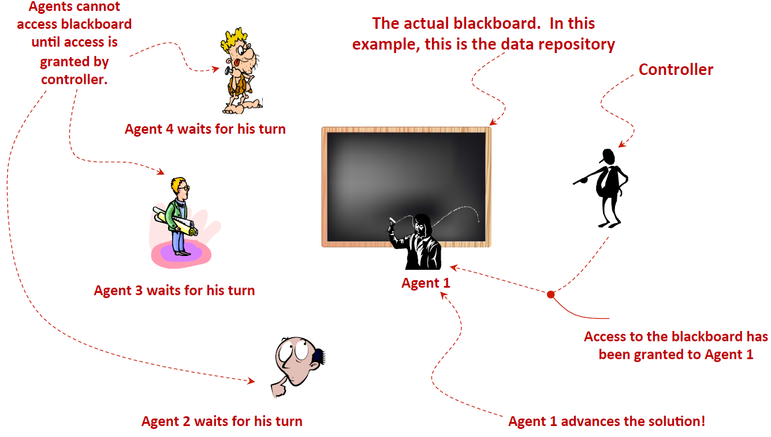
Blackboard Architectural Pattern

Slide 9
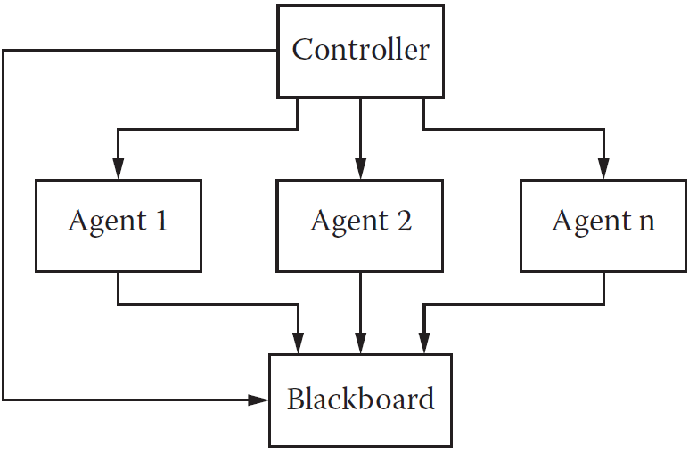
Blackboard Architectural Pattern
Used in speech recognition, image recognition, security system, and business resource management systems

Slide 10
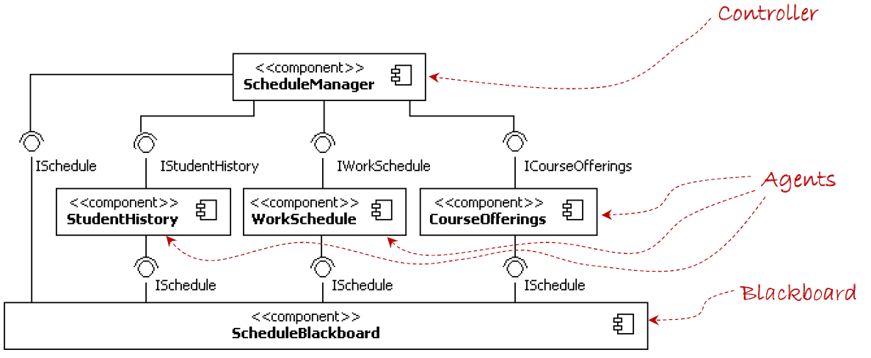
Blackboard Architectural Pattern
Consider a Students’ Scheduling System where the students need to enroll in courses and create a schedule based on the history of previous completed courses, his/her working schedule, and the courses offered by the university.
(component diagram)

Slide 11
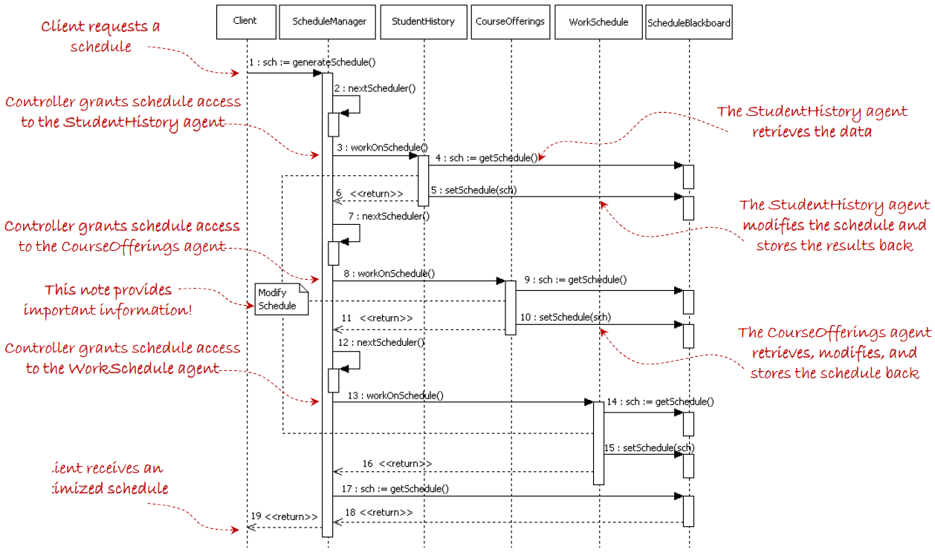
Blackboard Architectural Pattern

Slide 12
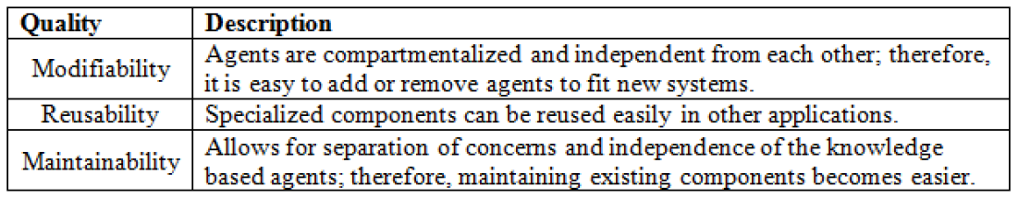
Blackboard Architectural Pattern
Quality properties of the Blackboard architectural pattern include the ones specified below.

Slide 13
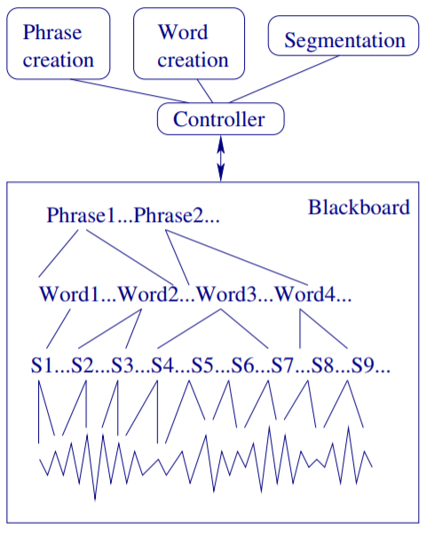
Blackboard Architectural Pattern - Exercise
Building a software system for speech recognition
Input is speech recorded in waveform in single words as well as whole sentences
Output is a text of English phrases printed on the screen
Use the system structure on the left as a guide.
Use the black board pattern to draw the component and sequence diagrams for the system based on the figure on the right.
Speech Recognition System

Slide 14
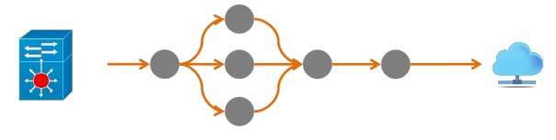
2- Data Flow Systems
Data flow systems are decomposed around the central theme of transporting data (or data streams) and transforming the data along the way to meet application-specific requirements.
Typical responsibilities found in components of data-flow systems include:
  Worker components, those that perform work on data
  Transport components, those that transporting data

Slide 15
Data Flow Systems
Worker components abstract data transformations and processing that need to take place before forwarding data streams in the system, e.g.,
  Encryption and decryption
  Compression and decompression
  Changing data format, e.g. ,from binary to XML, from raw data to information, etc.
  Enhancing, modifying, storing, etc. of the data
Transport components abstract the management and control of the data transport mechanisms.
An example of an architectural pattern for data flow systems is the
“Pipes-and-Filters” pattern

Slide 16
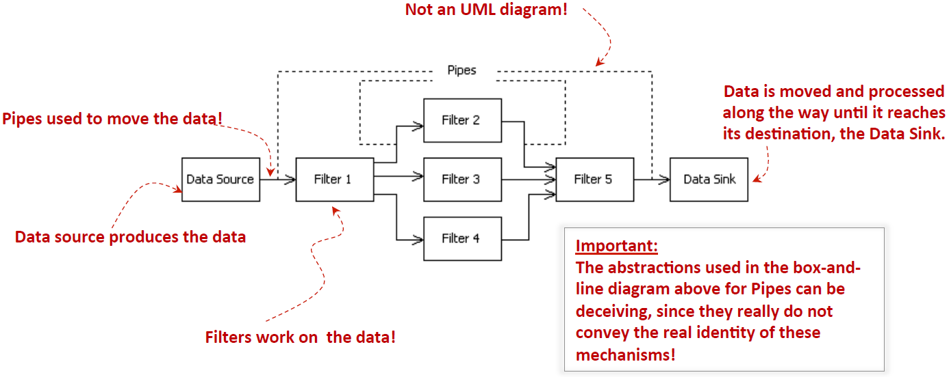
Pipes-and-Filters Architectural Pattern

Slide 17
Pipes-and-Filters Architectural Pattern
Pipes-and-Filters is composed of the following components:
  Data source - produces the data
  Filter - processes, enhances, modifies, etc. the data
  Pipes - Provide connections between data source and filter, filter to filter, and filter to data sink.
  Data Sink - data consumer

Slide 18
Pipes-and-Filters Architectural Pattern – Example1
A common example for the Pipes-and-Filters pattern: the architecture of a Language Processor system (e.g., compiler, interpreter)
The example is illustrated in the next slide

Slide 19
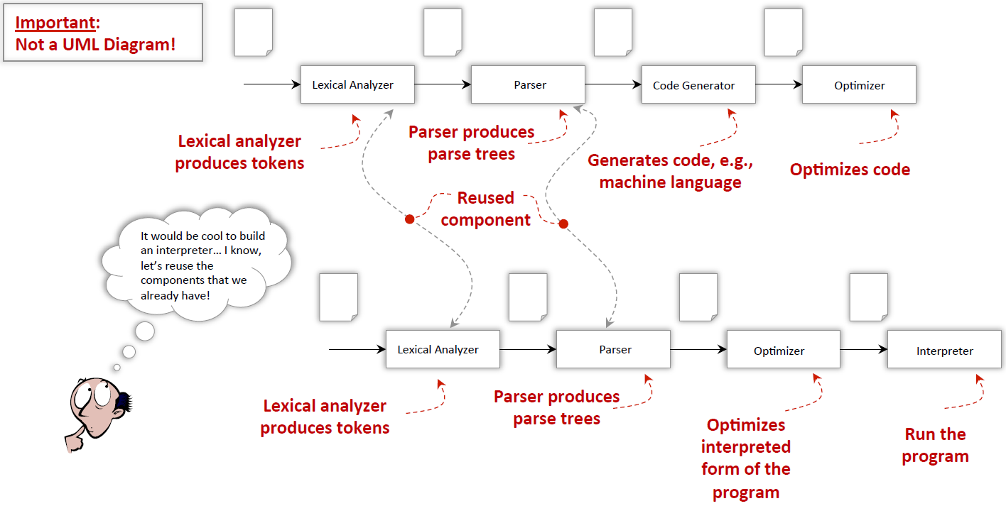
Pipes-and-Filters Architectural Pattern – Example1

Slide 20
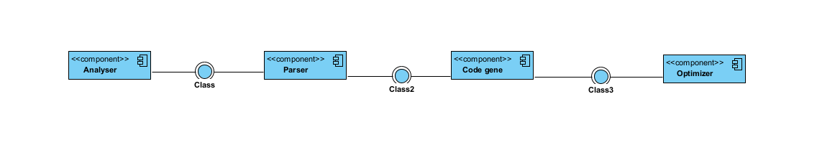

Slide 21
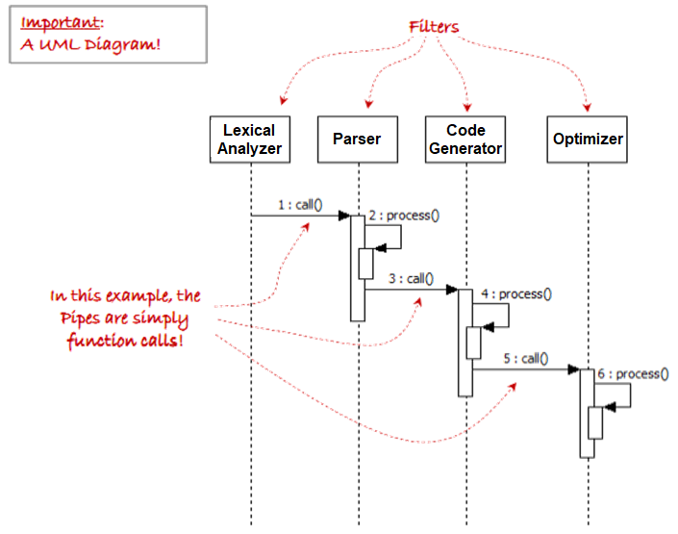
Pipes-and-Filters Architectural Pattern – Example1

Slide 22

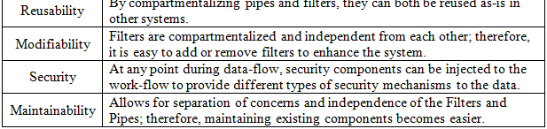
Pipes-and-Filters Architectural Pattern
Quality properties of the Pipes-and-Filters architectural pattern include the ones specified below.

Slide 23
Pipes-and-Filters Architectural Pattern – Exercises
Consider software that algorithms for automatically determining the identity of an individual:
  The software access videos (with audio) from YouTube
  The software detects faces of individuals in the video (Face detection is used to determine if a face is in the video)
  The software recognizes faces from the video (Face recognition is used to determine the identity of the person from the detected face).
  Based on detection and recognition, the software predicts the identity of individuals in the video
  Draw Component Diagram and Sequence Diagram

Slide 24
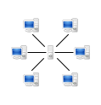
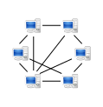
3- Distributed Systems
Distributed systems are decomposed into multiple processes that (typically) collaborate through the network.
  In some distributed systems, one or more distributed processes perform work on behalf of client users and provide a bridge to some server computer, typically located remotely and performing work delegated to it by the client part of the system. (client-server)
  Spotify or Apple Music → Client–Server architecture
    Songs are stored on central servers.
    Clients (apps) just request and stream from those servers.
  Other distributed systems may be composed of peer nodes, each with similar capabilities and collaborating together to provide enhanced services, such as music-sharing distributed applications. (peer-to-peer P2P)
Napster, BitTorrent-based sharing → Peer-to-Peer architecture
  - Songs are distributed across user devices.
  - Each user is both a consumer and a provider.
  client-server
  Peer-to-peer

Slide 25
Distributed Systems
Some examples of distributed systems include:
  Internet systems
  Web services
  File-or music-sharing systems
  High-performance systems, etc.
Common architectural patterns for distributed systems include:
  Client-Server Pattern
  P2P
  Broker Pattern

Slide 26
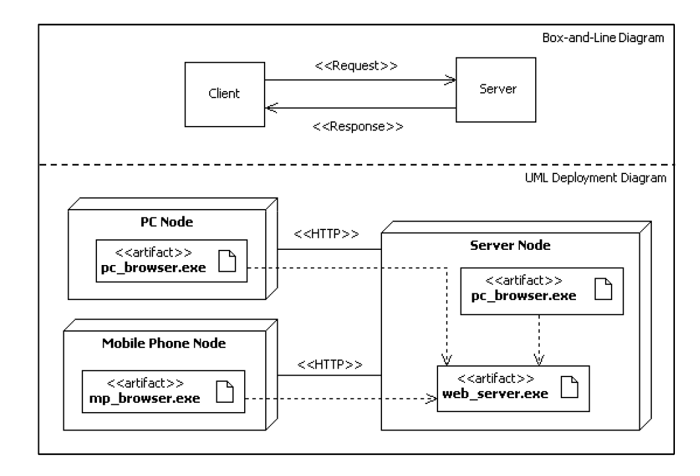
Client-Server Pattern
Server: a computer program or a device that provides functionality for other programs or devices, called "clients".
Client: is a piece of computer hardware or software that accesses a service made available by a “server”. (Note that multiple clients will communicate with the server. These clients are independent and do not communicate with each other)

Slide 27


Client-Server Pattern
Quality properties of the client-Server architectural pattern include the ones specified below.

Slide 28
Client-Server Pattern
Although Client-Server Pattern supports the quality attributed described in the previous slide it has the following problems:
  Clients are tightly coupled with servers.
  This leads to complexity for systems that need to provide services from multiple servers hosted at different locations.
To overcome this issue the Broker pattern was introduced.

Slide 29
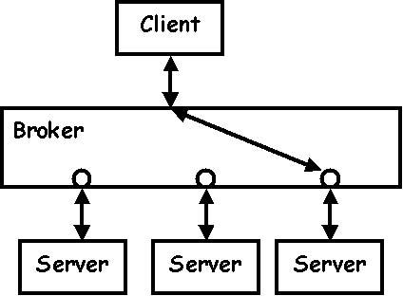
Broker Pattern
The Broker architectural pattern provides mechanisms for achieving better flexibility between clients and servers in a distributed environment by acting as an mediator between the two components.
The Broker pattern decreases coupling between client and servers by mediating between them so that one client can transparently access the services of multiple servers

Slide 30
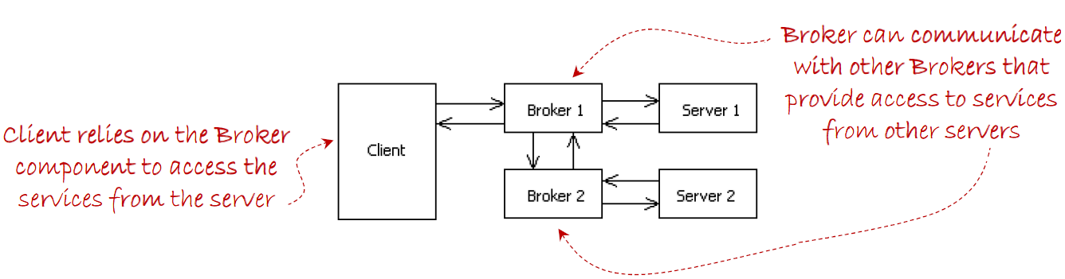
Broker Pattern
The broker component is responsible for coordinating communication between a client and server(s), such as forwarding requests, as well as for transmitting results and exceptions.
  Leads to systems that are more flexible and interoperable.

Slide 31
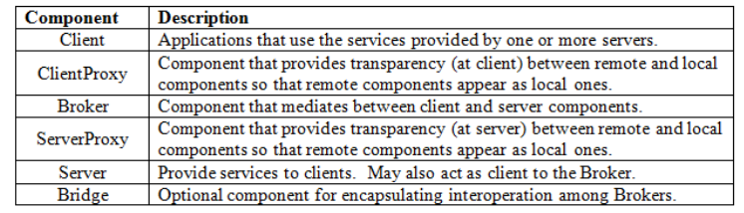
Broker Pattern
The Broker architectural pattern includes the following components:
Notes:
Prxies: hiding networkin, packing and unpacking, protocol details ..

Slide 32
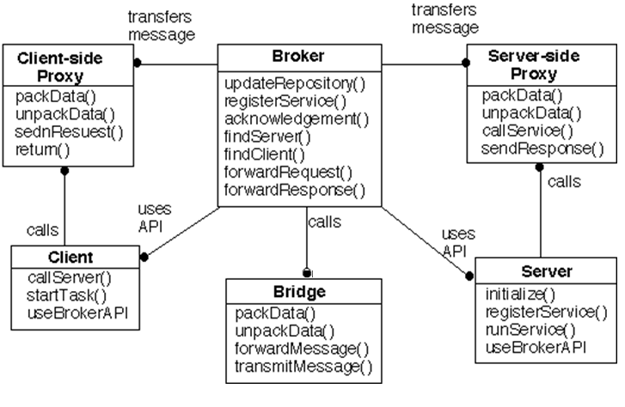
Broker Pattern
The client side proxy decides if the request can be resolved locally or to forward the request to the broker
Separates system communication functionality from the main application functionality by providing a broker that isolates communication-related concerns.
Detailed Broker Pattern

Slide 33
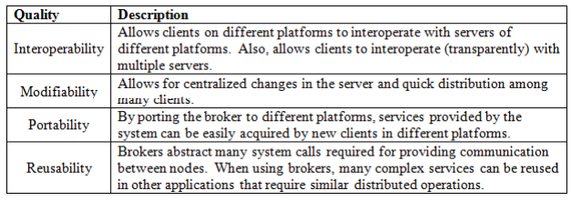
Broker Pattern
Quality properties of the Broker architectural pattern include the ones specified below.

Slide 34
Distributed System — Client–Server vs Broker Pattern - Exercise
Scenario:
A distributed online library system allows students to:
Search for books
Borrow books
Return books
The system is distributed across multiple servers.
Task for student: Draw the Client–Server pattern component diagram and Sequence digram
Task for student: Redraw the system, this time introducing a Broker Pattern

Slide 35
Summary
Data-Centered Systems
    Blackboard pattern
Data Flow Systems
    Pipes-and-Filters pattern
Distributed Systems
    Client Server pattern
    Broker pattern
What’s next…
    Interactive Systems
    Hierarchical Systems

