Slide 1

Software Design and Architecture [Architecture Patterns] – Chapter 04, L03

Slide 2
Lecture Outlines
Interactive Systems
  Overview
  Patterns:
    Model-View-Controller (MVC).
Hierarchical Systems
  Overview
  Patterns:
    Layered

Slide 3
4- Interactive Systems
Interactive systems support user interactions, typically through user interfaces.
  When designing these systems, two main quality attributes are of interest:
    Usability
    Modifiability
The mainstream architectural pattern employed in most interactive systems is the Model-View-Controller (MVC).

Slide 4
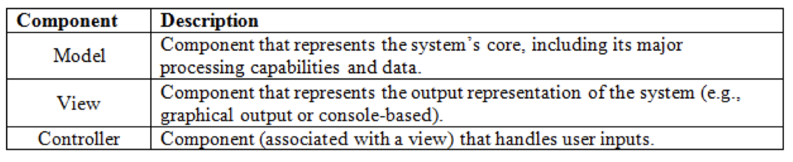
Interactive Systems
The MVC pattern is used in interactive applications that require flexible incorporation of human-computer interfaces. With the MVC, systems are decomposed into three main types of components:

Slide 5
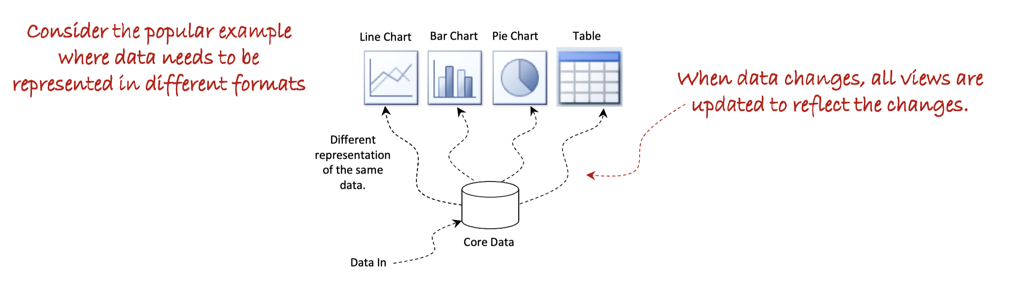
MODEL-VIEW-CONTROLLER ARCHITECTURAL PATTERN

Slide 6
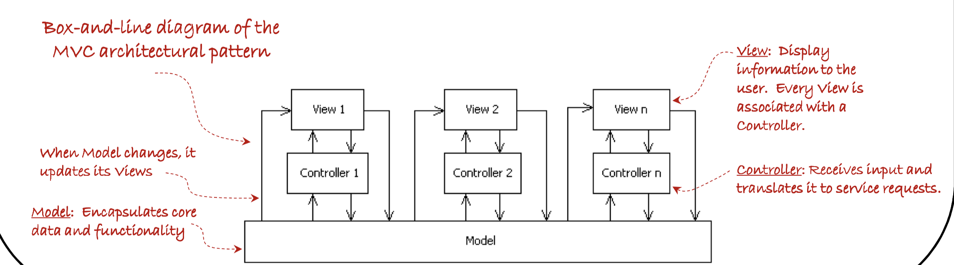
MODEL-VIEW-CONTROLLER ARCHITECTURAL PATTERN

Slide 7
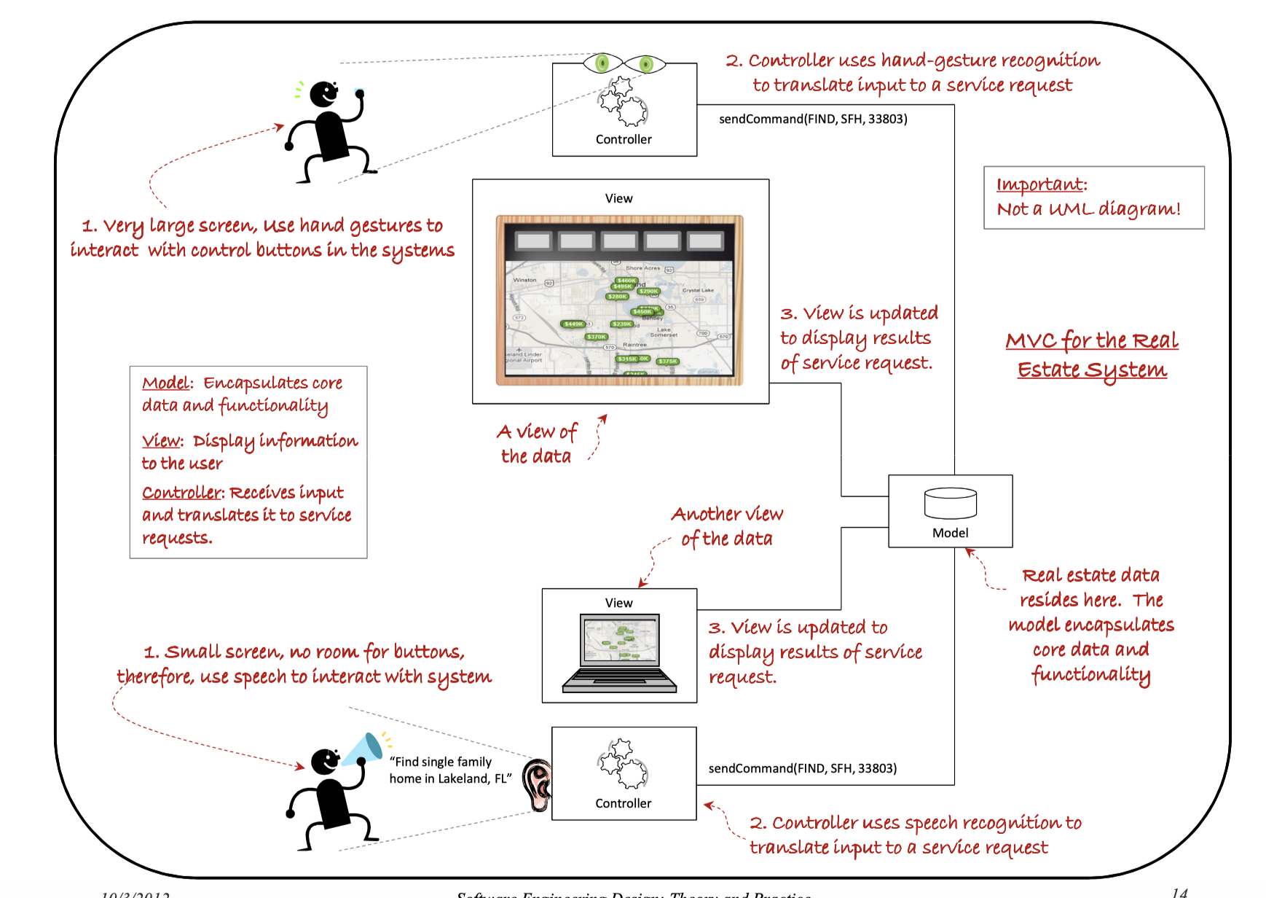

Slide 8
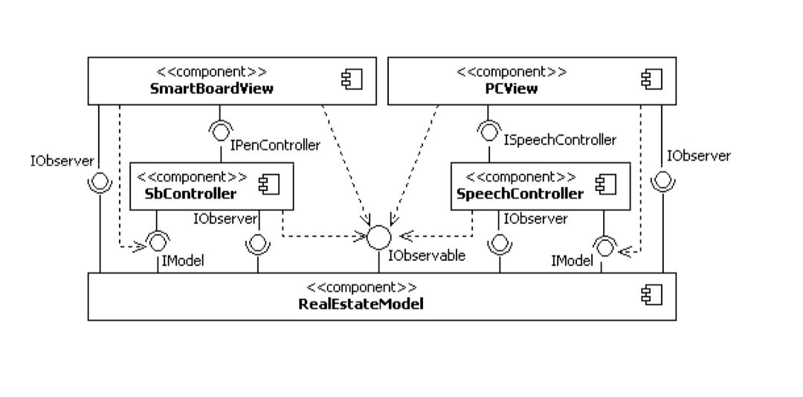
MODEL-VIEW-CONTROLLER ARCHITECTURAL PATTERN

Slide 9
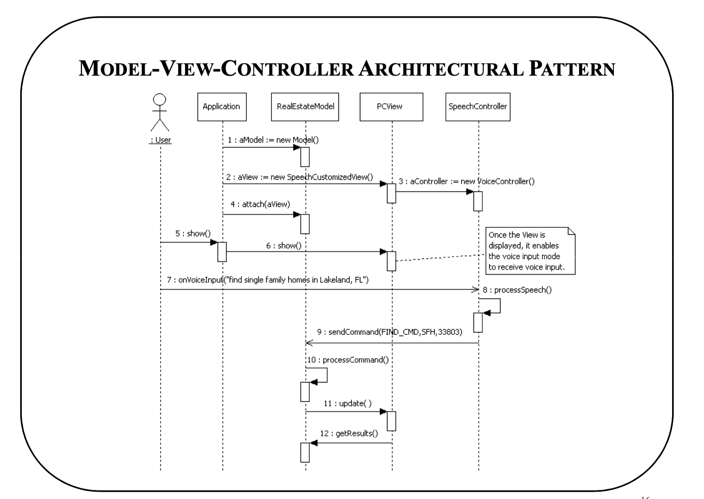

Slide 10
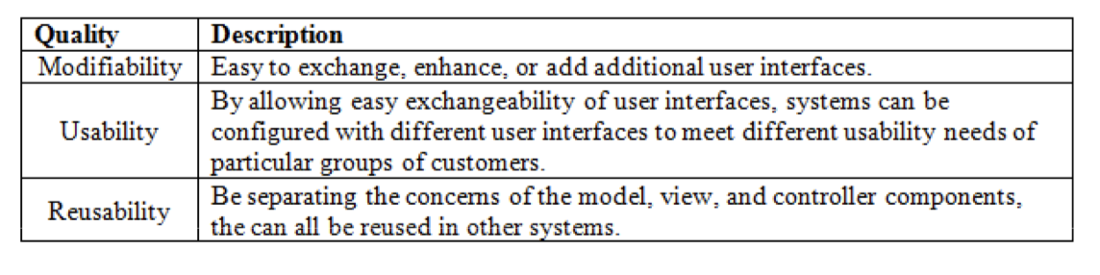
MODEL-VIEW-CONTROLLER ARCHITECTURAL PATTERN
Quality properties of the MVC architectural pattern include the ones specified below.
There are many variations of the MVC architectural pattern.
  One popular variation includes the fusion of views and controller components, as made famous in the 1990s by Microsoft’s Document-View architecture
  Other more extensive variations include the process-abstraction-controller pattern.

Slide 11
Exercise on MCV
Online Food Ordering System
Draw Component Diagram and Sequence Diagram of the above using MCV
Hint: MobileAppView, BrowserView OrderController, MenuModel, and PaymentController

Slide 12
5- Hierarchical Systems
Hierarchical systems can be decomposed and structured in hierarchical fashion. Two common architectural patterns for hierarchical systems are:
  Main program and subroutine
  Layered

Slide 13
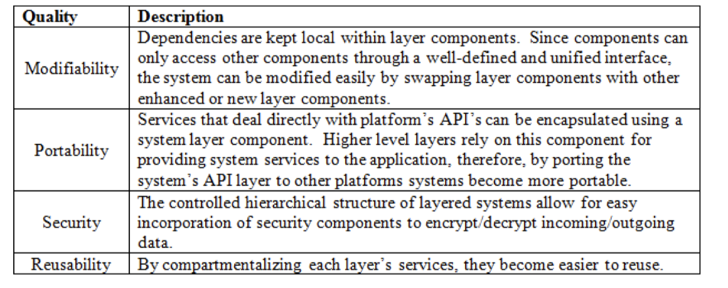
Layered Pattern
Quality properties of the Layered architectural pattern include the ones specified below.

Slide 14
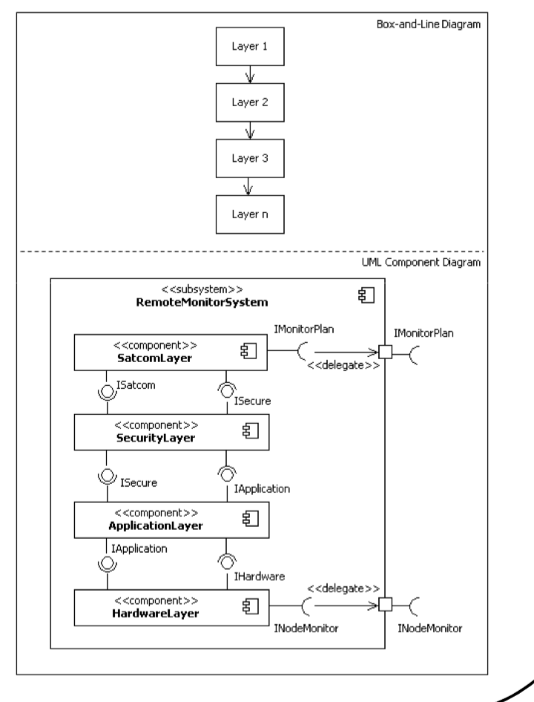
Layered Pattern

Slide 15
Exercise: Online Library Management System (Layered Architecture)
A university library has developed an online system for students to search, borrow, and return books. The system is built using a layered architecture with the following layers:
Presentation Layer – Handles user interactions (Web Interface / Mobile App).
Application Layer – Coordinates user requests (e.g., LibraryService).
Business Logic Layer – Implements core operations such as searching, borrowing, and returning (BookManager, UserManager).
Data Access Layer – Manages database operations (BookRepository, UserRepository).
Database Layer – Stores all book and user data.

