Slide 1

Software Design and Architecture [Principles of Detailed Design] – Chapter 05, L01

Slide 2
Lecture Outlines
Overview of Detailed Design
  What is detailed design?
  Where does it fit?
Key Tasks in Detailed Design
  Understanding architecture and requirements – (chapters 3 & 4)
  Creating detailed designs
  Evaluating detailed designs
  Documenting detailed designs
  Monitoring and controlling implementation

Slide 3
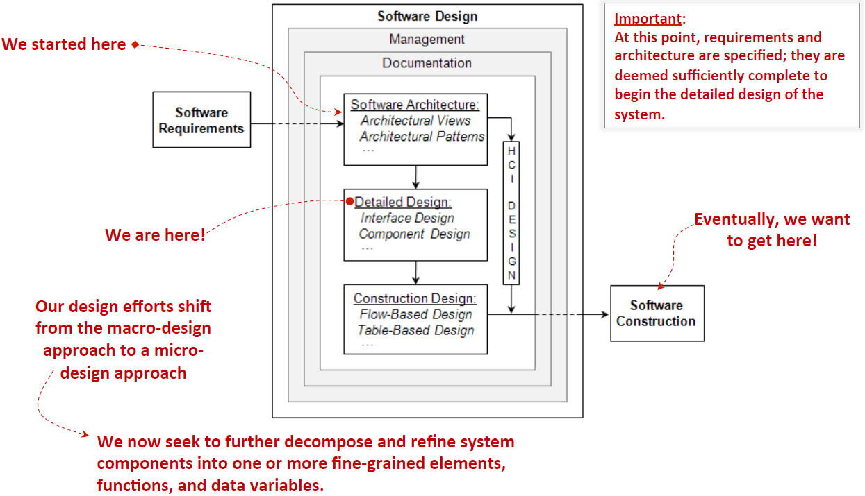
Lets think about, where we are …

Slide 4
What is Detailed Design?
Detailed design is:
  The process of refining and expanding the preliminary design phase software architecture of a system or component to the extent that the design is sufficiently complete to be implemented .
During Detailed Design designers go deep into each component to define its internal structure and behavioral capabilities, and the resulting design leads to natural and efficient construction of software.

Slide 5
What is Detailed Design?
Detailed design is closely related to architecture and construction; therefore successful designers (during detailed design) are required to have or acquire full understanding of the system’s requirements and architecture.
  Just as architecture provides the bridge between requirements and design, detailed design provides the bridge between design and code.
  They must also be proficient in particular design strategies (e.g., object-oriented), programming languages, and methods and processes for software quality control.

Slide 6
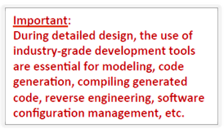
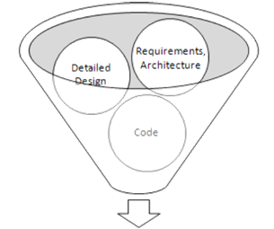
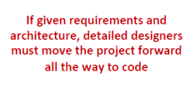
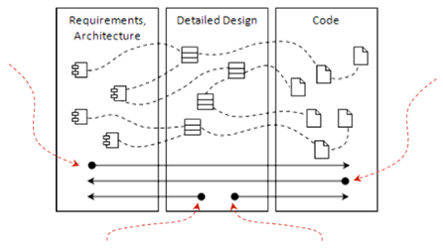


Designer’s Mental Model
During Detailed design

Slide 7
Key Tasks in Detailed Design
The major tasks identified for carrying out the detailed design activity include:
  Understanding the architecture and requirements
  Creating detailed designs
  Evaluating detailed designs
  Documenting software design
  Monitoring and controlling implementation

Slide 8
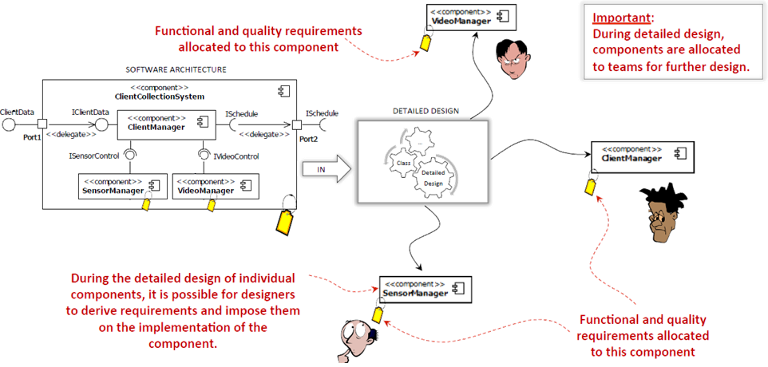
Understanding Architecture and Requirements
Unlike the software architecture, were the complete set of requirements are evaluated and well understood, designers during detailed design activity focus on requirements allocated to their specific components.
Software Architecture
Detailed Design

Slide 9
Creating Detailed Designs
After the architecture and requirements for assigned components are well understood, the detailed design of software components can begin.
(Detailed design consist of both structural and behavioral designs).
When creating detailed designs, focus is placed on the following:
  Interface Design - Internal & External
  Graphical User Interface (GUI) Design
  Internal Component Design
    Structural
    Behavioral
  Data Design ~ Database; data dictionary

Slide 10
3. Evaluating Detailed Designs
The most popular technique for evaluating detailed designs involves Technical Reviews. When conducting technical reviews, keep in mind the following:
  Send a review notice with enough time for others to have appropriate time to thoroughly review the design.
  Include a technical expert in the review team, as well as stakeholders of your design.
  Include a member of the software quality assurance or testing team in the review.
  During the review, focus on the important aspects of your designs; those that show how your design helps meet functional and non-functional requirements.
  Document the review process. (Make sure that any action items generated during the review are captured and assigned for processing)

Slide 11
4. Documenting Detailed Designs
Documentation of a project’s software design is mostly captured in the software design document (SDD), also known as software design description. The SDD is used widely throughout the development of the software. (Used by programmers, testers, maintainers, systems integrators, etc.)
Other forms of documentation include:
  Interface Control Document
    A document describes system’s interfaces and how the components of the system communicate.
  Version Control Document
    Contains information about what is included in a software release, including different files, scripts and executable. Different versions of the design depend on specific software release

Slide 12
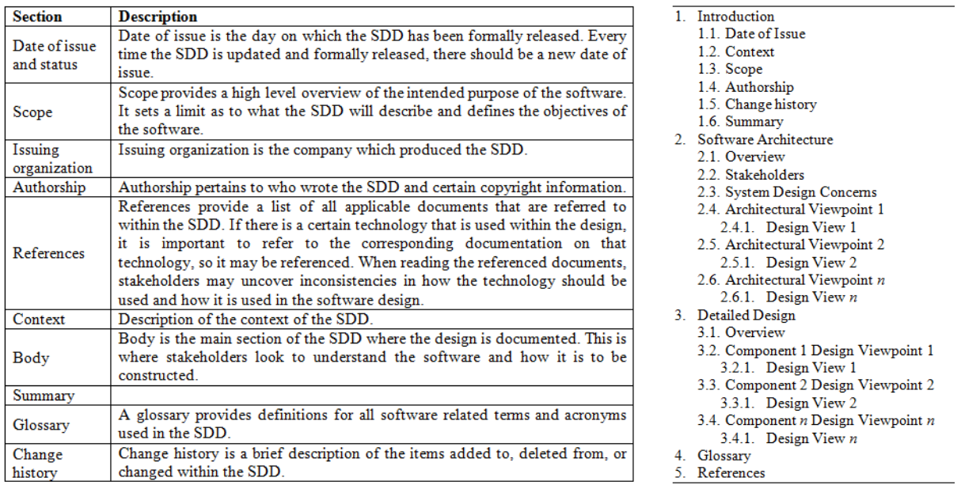
4. Documenting Detailed Designs
The sections of the SDD and sample table of contents:

Slide 13
5. Managing Implementation
Detailed design synchronicity is concerned with the degree of how well detailed designs adhere to the software architecture and how well software code adheres to the detailed design.
  Low degree of synchronicity points to a flaw in the process and can lead to software project failure.
Particular attention needs to be paid when projects enter the maintenance phase or when new engineers are brought into the project.
Processes must be in place to ensure that overall synchronicity is high

Slide 14
Summary
Overview of Detailed Design
  What is detailed design?
  Where does it fit?
Key Tasks in Detailed Design
  Understanding architecture and requirements – (chapters 3 & 4)
  Creating detailed designs
  Evaluating detailed designs
  Documenting detailed designs
  Monitoring and controlling implementation

