Slide 1

Software Design and Architecture [Principles of Detailed Design] – Chapter 05, L02

Slide 2
Lecture Outlines
Overview of Component Design
Designing Internal Structure of Components (OO Strategy)
Design Principles for Internal Component Design (SOLID)
  Single Responsibility Principle
  Open-Closed Principle
  Liskov Substitution Principle
  Interface-Segregation Principle
  Dependency-Inversion Principle
Designing Internal Behavior of Components

Slide 3
Overview of Component Design
Component design (also known as component-level design) refers to the detailed design task of defining the internal logical structure and behavior of components.
  Which components?
    The components identified during the architecture activity.
In object-oriented systems, the internal structure of components is typically modeled using UML through one or more class diagrams

Slide 4
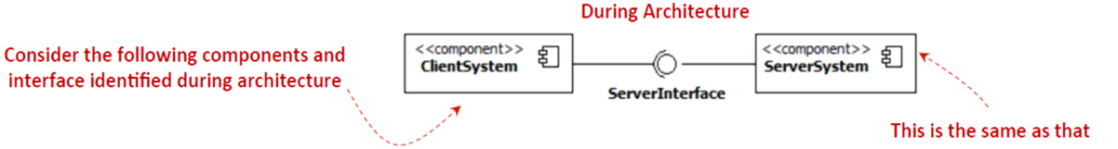
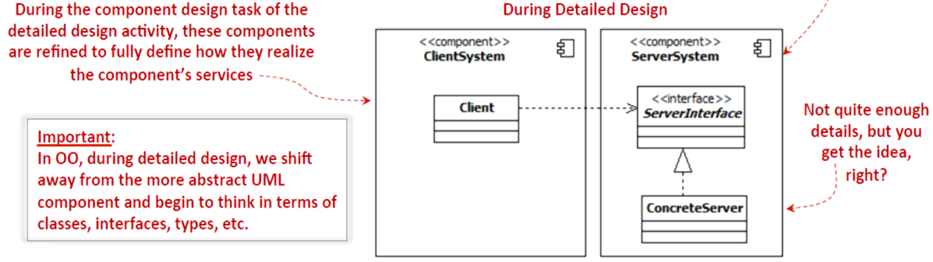
Overview of Component Design

Slide 5
Overview of Component Design
During component design, the internal data structures, algorithms, interface details, and communication mechanisms for all components are defined.
  For this reason, component design provides the most significant mechanism for determining the functional correctness of the software system
    If the requirement says “The payment system must correctly calculate total cost including tax and discount”, then functional correctness means that the designed components (e.g., TaxCalculator, DiscountManager, PaymentProcessor) must work together to always produce the right total, under all valid inputs.

Slide 6
Overview of Component Design
The work produced during component design contributes significantly to the functional success of the system.
In OO, before we can become a component designers, we must understand the following concepts:
  Classes / objects
  Abstract classes and Interfaces
  Inheritance
  Polymorphism

Slide 7
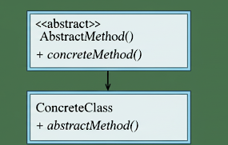
What Is Abstract Class?
A class which has the abstract keyword in its declaration is called abstract class. Abstract classes should have at least one abstract method. , i.e., methods without a body. It can have multiple concrete methods.
Abstract classes allow you to create blueprints for concrete classes. But the inheriting class should implement the abstract method.
Abstract classes cannot be instantiated.
Important Reasons For Using Abstract Class
  Abstract classes offer default functionality for the subclasses.
  Provides a template for future specific classes
  Helps you to define a common interface for its subclasses
  Abstract class allows code reusability.

Slide 8
What is Interface?
A special type of abstract classes
The interface is a blueprint that can be used to implement a class. The interface does not contain any concrete methods (methods that have code). All the methods of an interface are abstract methods.
An interface cannot be instantiated. However, classes that implement interfaces can be instantiated. Interfaces never contain instance variables but, they can contain public static final variables (i.e., constant class variables)
  Interfaces are used to achieve abstraction.
  Designed to support dynamic method resolution at run time
  It helps you to achieve loose coupling.
  Allows you to separate the definition of a method from the inheritance hierarchy

Slide 9
https://www.guru99.com/interface-vs-abstract-class-java.html
https://www.guru99.com/uml-relationships-with-example.html#4

Slide 10
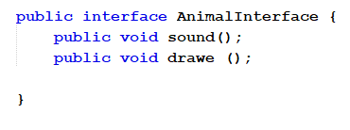
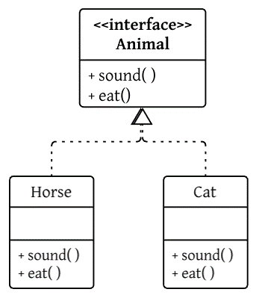
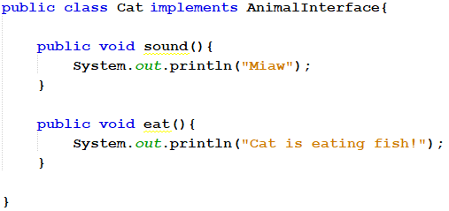
Refresh your memory … OOP concepts (Interface)
Use the <<interface>> word in UML
Use the implements reserved word in Java

Slide 11
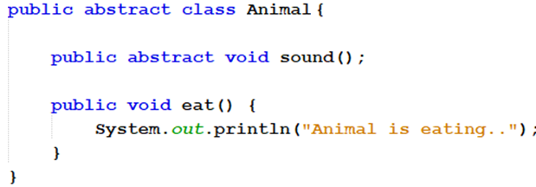
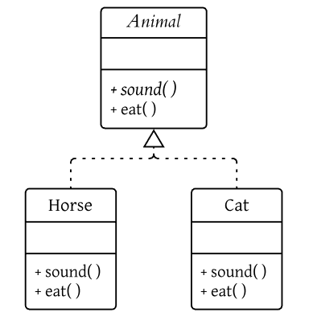
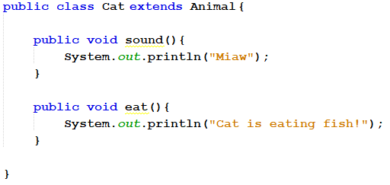
Refresh your memory … OOP concepts (Abstract Classes)
Abstract method is italic in UML
Abstract class is italic in UML
Use the extends reserved word in Java
Realization
Relationship

Slide 12
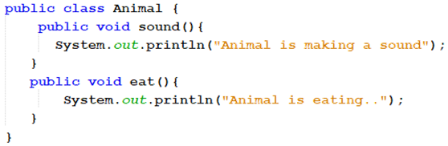
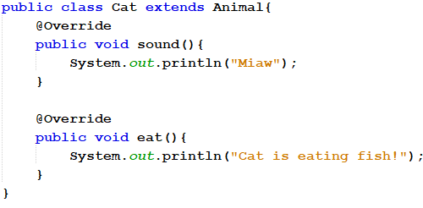
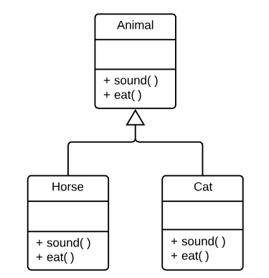
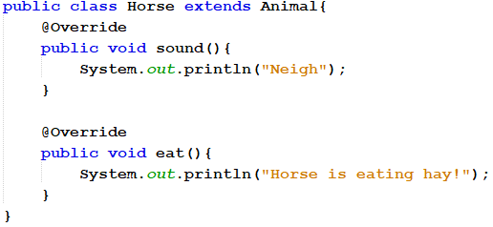
Refresh your memory … OOP concepts (Inheritance)
Generalization
Relationship

Slide 13
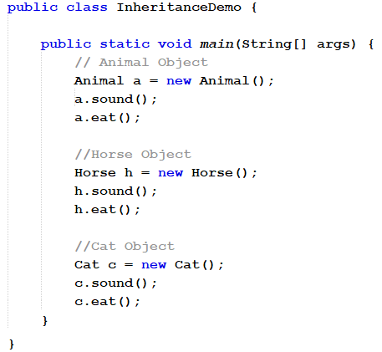
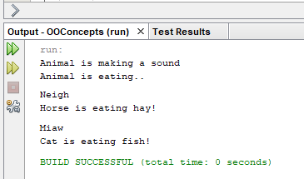
Refresh your memory … OOP concepts (Inheritance)

Slide 14
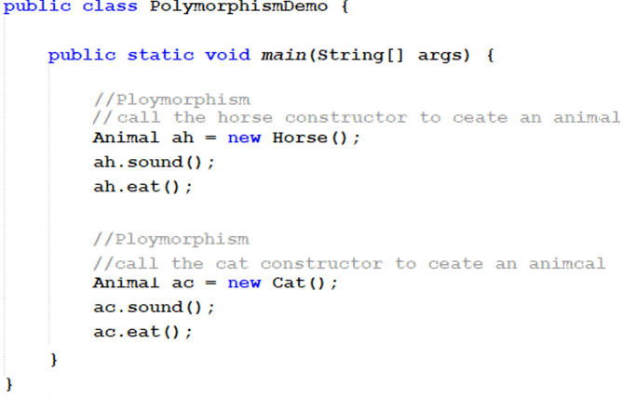
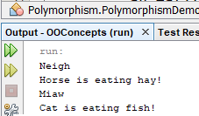
Refresh your memory … OOP concepts (Polymorphism )

Slide 15
Design Principles of Internal Component Design
When designing software at the component-level, several principles have to be followed to create designs that less complex, reusable, easier to modify, and easier to maintain.
Design principles for internal component design (SOLID):
  Single Responsibility Principle (SRP)
  Open-Closed Principle (OCP)
  Liskov Substitution Principle (LSP)
  Interface-Segregation Principle (ISP)
  Dependency-Inversion Principle (DIP)

Slide 16
1- Single Responsibility Principle (SRP)
The SRP might be the least well understood principle
Programmers usually assume that it means that every module should do just one thing.
However, SRP is described as:
  “A module should be responsible to one, and only one, user or stakeholder.”
  OR “A class should have only one reason to change.”

Slide 17
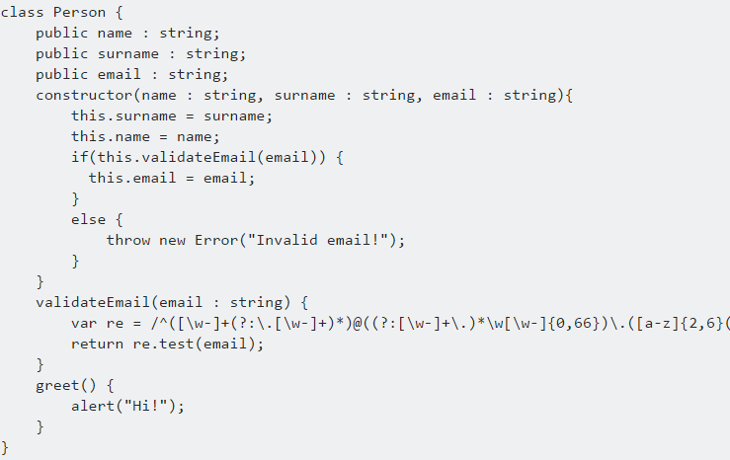
SRP - example
The following example is a class that defines a Person, this class should not include email validation because that is not related with a person behaviour:

Slide 18
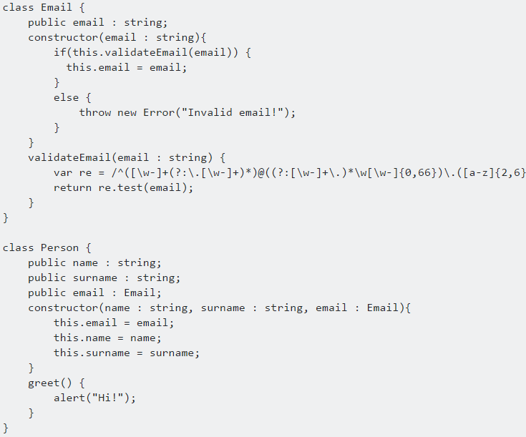
SRP - example
We can improve the Person class by removing the responsibility of email validation from the Person class and creating a new Email class
Making sure that a class has a single responsibility (for a single actor) makes it per default also easier to see what it does and how you can extend/improve it.

Slide 19
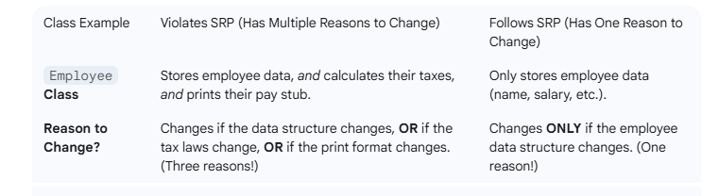
does it sound like now for every function i need to make one class??

Slide 20
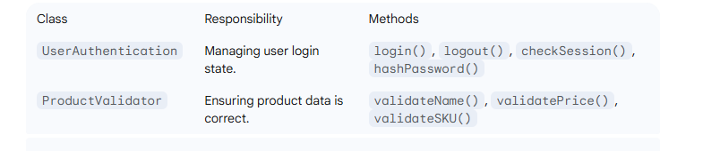
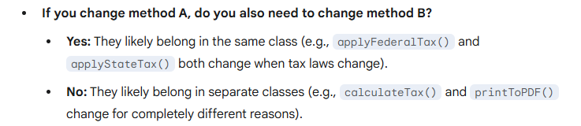
SRP Applies to Responsibilities, Not Methods
  A class should have one primary responsibility, which is usually accomplished by several related functions (methods) working together.
  Bad Example (Violation): A single class, ReportGenerator, has methods like calculateTax(), printToPDF(), and sendEmail(). These are three separate responsibilities (Calculation, Formatting, Communication).
  Good Example (Following SRP): A class, TaxCalculator, has methods like getGrossSalary(), applyFederalTax(), and applyStateTax(). All three methods work together to fulfill the single responsibility of tax calculation.
  When to Create a New Class:
    You should create a new class
    only when you identify a new,
    distinct reason for change

Slide 21
In Class Exercises
Design Exercise: Employee Payroll System, Principles to Apply, Single Responsibility Principle (SRP): Each class should have only one reason to change and
We need to design a class diagram for a simple Employee Payroll System.
The initial requirements are:
  The system needs to calculate the salary for an employee.
  The system needs to save the employee's data to a database.
  The system needs to generate a report (e.g., a simple printout) of the employee's details.
Questions:
1- Draw a class diagram that violates SRP.
2- Redraw to achieve SRP.

Slide 22
2- The Open-Closed Principle (OCP)
The Open-Closed principle (OCP) is an essential principle for creating reusable and modifiable systems that evolve gracefully with time.
The OCP states that “software designs should be open to extension but closed for modification.”
  The main idea behind the OCP is that code that works should remain untouched and that new additions should be extensions of the original work.
That sounds contradictory, how can that be?
  Being close to modifications does not mean that designs cannot be modified; it means that modifications should be done by adding new code, and incorporating this new code in the system in ways that does not require old code to be changed!

Slide 23
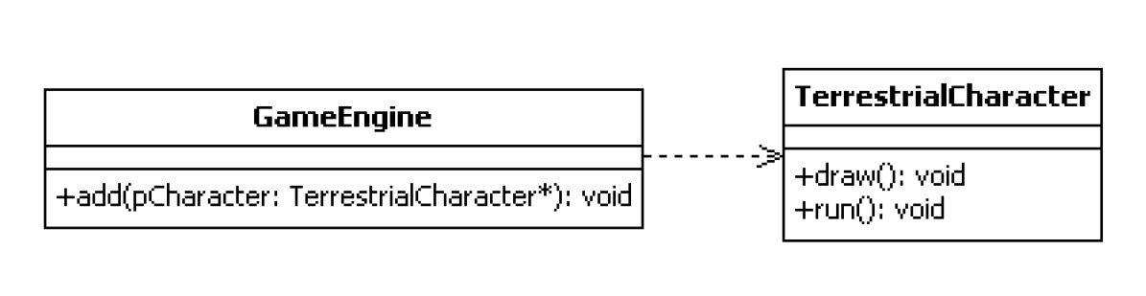
The Open-Close Principle
A gaming system Example
  Consider a fictional gaming system that includes several types of terrestrial characters, ones that can roam freely over land. It is anticipated that new characters will be added in the future.
This design violates the OCP principle … why?

Slide 24
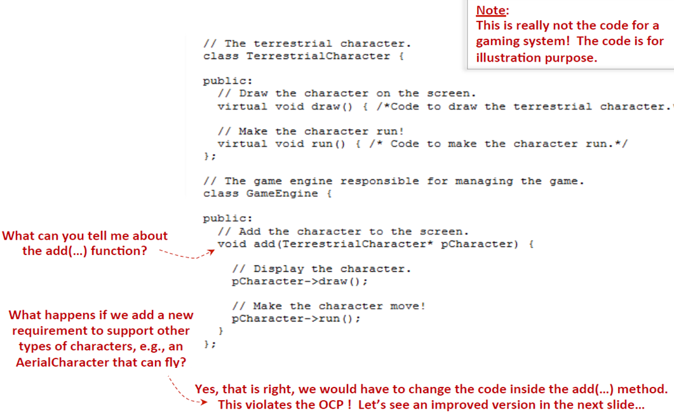
The Open-Close
Principle

Slide 25
The Open-Close Principle (OCP)
This design violates the OCP principle … why?
Do you have suggestions to fix it to allow adding new types of Characters without violating the OCP?

Slide 26
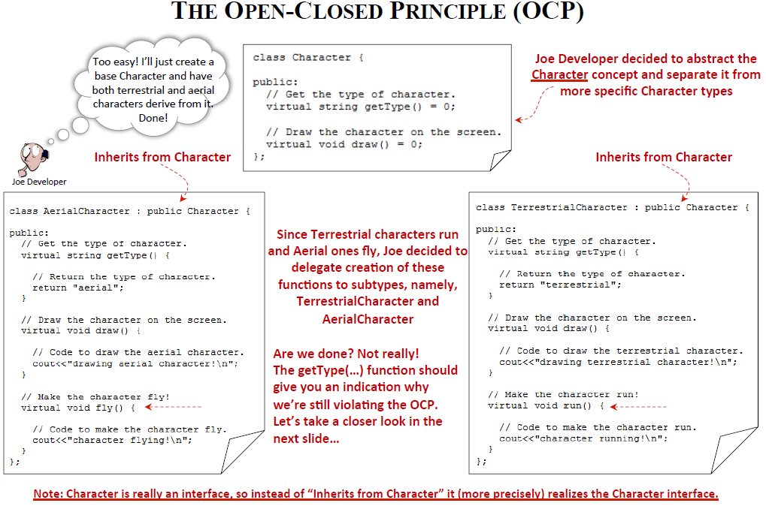

Slide 27
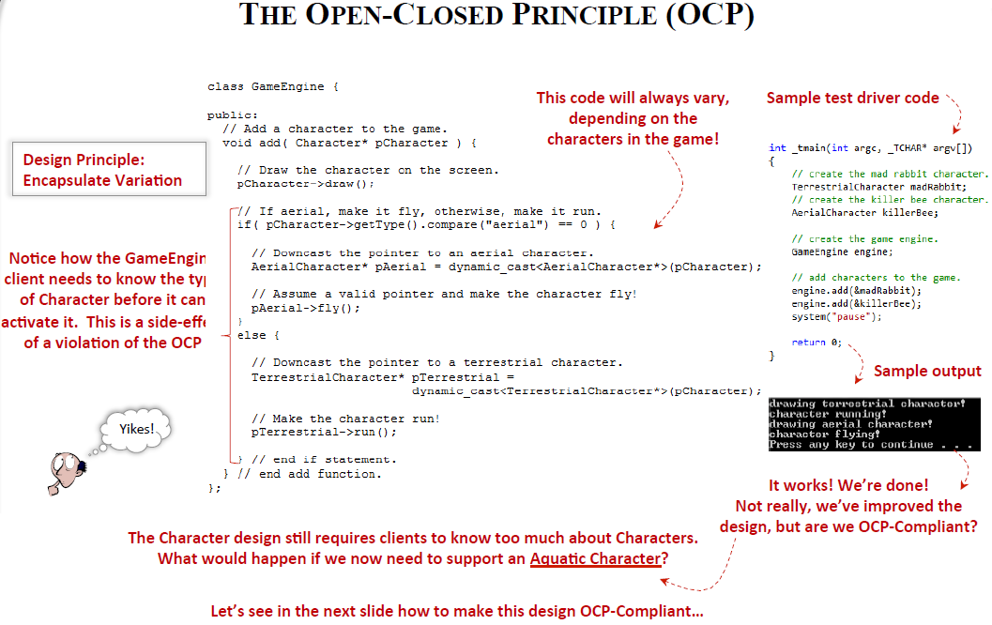

Slide 28
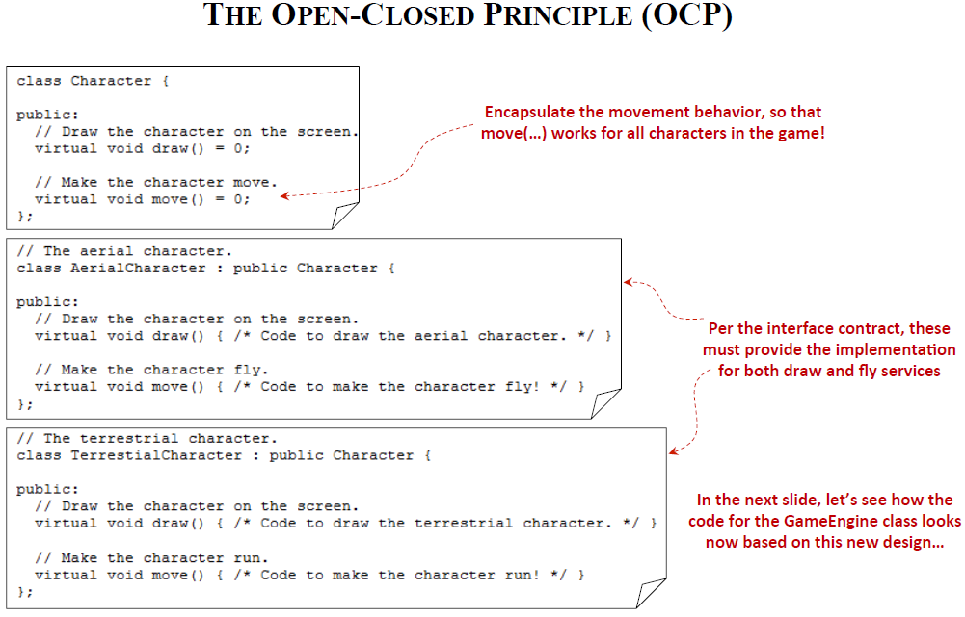

Slide 29
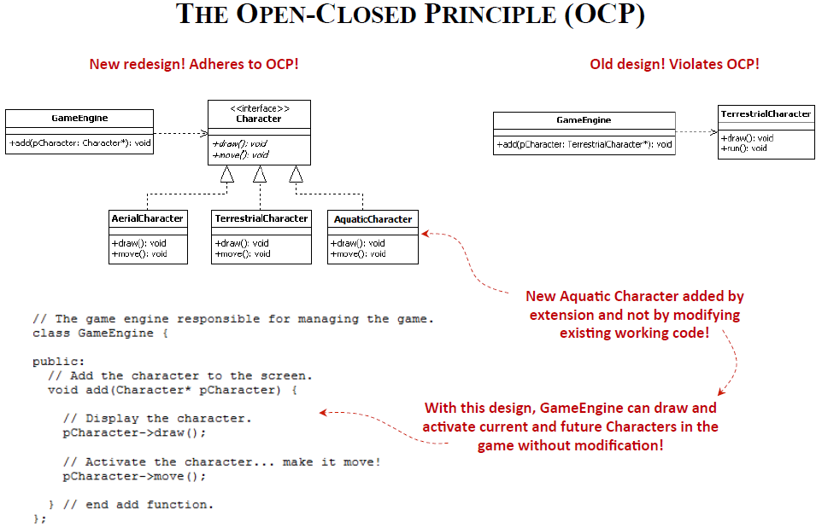

Slide 30
The Open-Closed Principle (OCP)
One final note about the OCP:
No design will be 100% closed for modification. At some point, some code has to be readily-available for tweaking in any software system. The idea of the OCP is to locate the areas of the software that are likely to vary and the variations can be encapsulated and implemented through polymorphism

Slide 31
Exercise
Open-Closed Principle (OCP): Software entities (classes, modules, functions, etc.) should be open for extension but closed for modification.
Going back to the pervious exercise on SRP, Specifically, the salary calculation logic must be designed so that adding new types of Salaries (e.g., Hourly or weekly salary..etc) doesn't require changing the main salary calculation class.
Open the same design you did and apply OCP in there .

Slide 32
3- The Liskov Substitution Principle (LSP)
LSP demands that “Any class derived from a base class must honor any implied contract between the base class and the components that use it.”
In other words: “Objects should be replaceable with instances of their subtypes without altering the correctness of that program” (The "Treat Alike" Rule)
The LSP requires:
  Signatures between base and derived classes to be maintained
  Subtype specification supports reasoning based on the super type specification

Slide 33
The Liskov Substitution Principle (LSP)
To adhere to the LSP, designs must conform to the following rules:
  The Signature Rule: ensures that if a program is type-correct based on the super type specification, it is also type-correct with respect to the subtype specification.
  The Methods Rule: ensures that reasoning about calls of super type methods is valid even though the calls actually go to code that implements a subtype.
Imagine you have a family of objects. The Liskov Substitution Principle (LSP) is just a fancy way of saying:
If a class is an extension of another class, you must be able to use the new class in place of the original class without anything breaking.

Slide 34
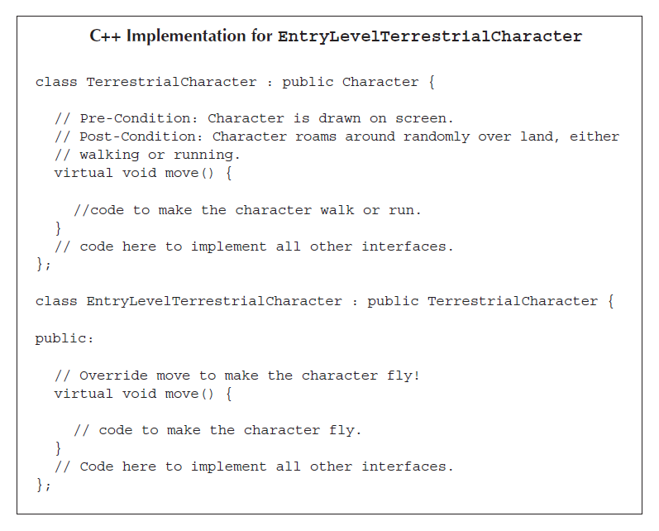
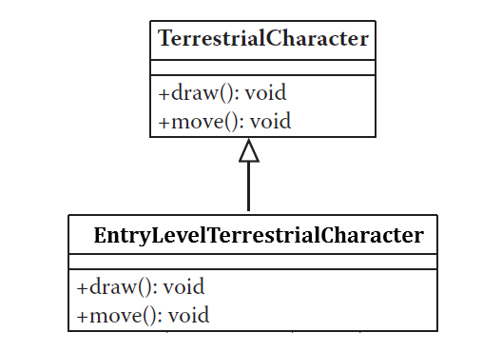
The Liskov Substitution Principle (LSP) - example
Does this example apply LSP?
In some cases, it can be seen that adhering to the OCP alone does not guarantee correct designs or designs that lead to reusability throughout the system.
Notes:
The parent class, TerrestrialCharacter, explicitly defines a Post-Condition in the comments:
"Character roams around randomly over land, either walking or running."
When EntryLevelTerrestrialCharacter overrides the move() method to make the character fly, it breaks that promise. A developer using a TerrestrialCharacter reference expects land-based movement; if they suddenly see a character flying, the logic of the game (e.g., gravity checks, collision with trees vs. clouds) could break.
The takeaway: Just because you can override a method doesn't mean you should change its fundamental nature. If a "Terrestrial" character starts flying, it’s no longer purely terrestrial!

Slide 35
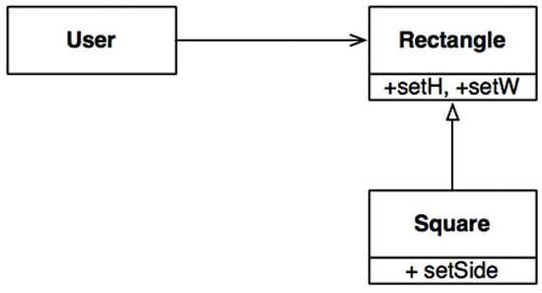
The Liskov Substitution Principle (LSP) – example 2
An example of a violation of the LSP is the famed square/rectangle problem
In this example, Square is not a proper subtype of Rectangle because the height and width of the Rectangle are independently mutable;
in contrast, the height and width of the Square must change together.
Since the User believes it is communicating with a Rectangle, it could easily get confused.

Slide 36
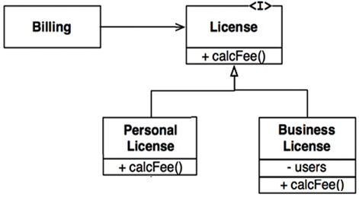
The Liskov Substitution Principle (LSP) – example 3
Imagine that we have a class named License. This class has a method named calcFee(), which is called by the Billing application.
There are two “subtypes” of License: PersonalLicense, and BusinessLicense. They use different algorithms to calculate the license fee.
This design conforms to the LSP because the behaviour of the Billing application does not depend, in any way, on which of the two subtypes it uses.
Both of the subtypes are substitutable for the License type.

Slide 37
The Liskov Substitution Principle is an important sanity check. It makes sure that your inheritance structure isn't just about reusing code, but about maintaining expected behavior

Slide 38
Exercise
Let's use the Fruit analogy, draw and tell if LSP is violated or me.
Base Class (Parent): Fruit
  It has a method: Peel()
  It has a method: MakeSmoothie()
Derived Class (Child 1): Orange
  Peel()
  MakeSmoothie()
  LSP is Applied ??
  Derived Class (Child 2): Coconut
  Peel()...
  MakeSmoothie()...
  LSP is Applied??

Slide 39
Lecture Outlines
Overview of Component Design
Designing Internal Structure of Components (OO Strategy)
Design Principles for Internal Component Design (SOLID)
  Single Responsibility Principle
  Open-Closed Principle
  Liskov Substitution Principle
  Interface-Segregation Principle (Next lecture)
  Dependency-Inversion Principle (next lecture)
Designing Internal Behavior of Components (next lecture)

