Slide 1

Software Design and Architecture [Creational Design Patterns] – Chapter 06, L01

Slide 2
Lecture Outlines
Patterns in Detailed Design
  Architectural vs. Design Patterns.
Classification of Design Patterns
  Purpose
  Scope
Documenting Design Patterns
Creational Design Patterns
  Abstract Factory
  Computer Store Example
What’s next…

Slide 3
Patterns in Detailed Design
Design patterns are recurring solutions to object-oriented design problems in a particular context. They are different than architectural patterns/styles!
In which way they are different?!!

Slide 4
Patterns in Detailed Design
Architecture vs. Design patterns
Architecture Patterns/style | Design Patterns
During the architecture design activity | During the detailed design activity
Identify the major components and interfaces of the system | Identify the inner structure of components identified during the architecture activity
Too abstract to be translated directly to working code | Provides the details necessary for creating working code
Have a direct effect on the architecture of software and are associated with specific system types (e.g., interactive systems) | Have no direct effect on the architecture of systems and are independent of the type of systems. (a specific design pattern, e.g., the observer, can be used within every component specified by all architectural patterns.)

Slide 5
Patterns in Detailed Design
Architecture vs. Design patterns
Architecture Patterns/style | Design Patterns
During the architecture design activity | During the detailed design activity
Identify the major components and interfaces of the system | Identify the inner structure of components identified during the architecture activity
Too abstract to be translated directly to working code | Provides the details necessary for creating working code
Have a direct effect on the architecture of software and are associated with specific system types (e.g., interactive systems) | Have no direct effect on the architecture of systems and are independent of the type of systems. (a specific design pattern, e.g., the observer, can be used within every component specified by all architectural patterns.)

Slide 6
Classifications of Design Patterns
Design patterns can be classified based on:
  Purpose
  Scope
The purpose of a design pattern identifies the essence of the pattern. The three types of purposes used for classification are:
  Creational: Patterns that deal with creation of objects.
  Structural: Patterns that deal with creation of structures form existing objects.
  Behavioral: Patterns that deal with how classes interact, the variation of behavior, and the assignment of responsibility between objects.

Slide 7
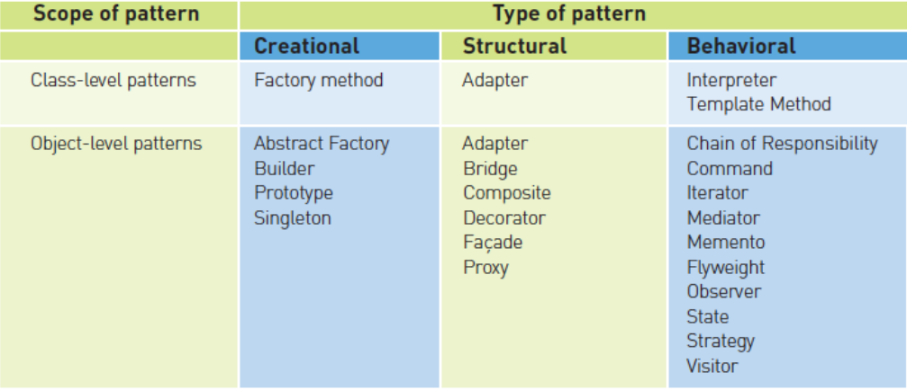
Classifications of Design Patterns
The scope criterion captures whether a design pattern primarily applies to classes (during design time) or objects (during run-time).
http://www.cs.unc.edu/~stotts/GOF/hires/chap1fso.htm

Slide 8
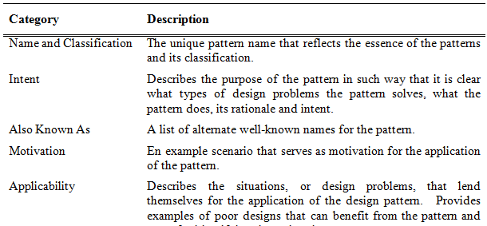
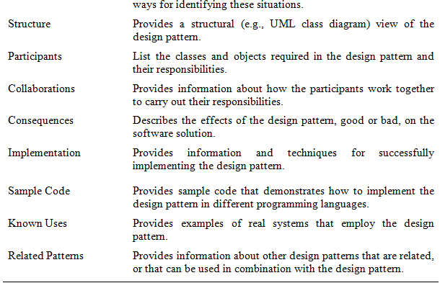
Documenting Design Patterns
Note:
In this course, we’re not concerned with presenting this extensive documentation for each pattern

Slide 9
Creational Design Patterns
Creational design patterns abstract and control the way objects are created in software applications.
  They do so by specifying a common creational interface.
Examples of creational patterns include:
  The Abstract Factory
  The Factory Method
  The Builder
  The Prototype
  The Singleton

Slide 10
Case Study Example
Consider a software system for a computer store, where the store carries only two types of computers for sale:
  Top of the line computer, we’ll call these advanced computers
  Inexpensive computers, we’ll call these standard computers
  Obviously, a computer store will need to carry more computers in the future!
Advanced computers are made up of “advanced computer products,” e.g. the latest multi-core CPU, wireless keyboard, advanced monitor (e.g., widescreen large 3D), advanced graphics & sound card, etc. For simplicity, we’ll only use CPU, keyboard, and Monitor for our example.
Standard computers are made up of “standard computer products,” e.g., single core CPU, wired keyboard, small screen monitor, low-grade graphics and sound, etc. ü For simplicity, we’ll only use CPU, keyboard, and Monitor for our example.
The system is designed so that it searches remote information sources, e.g. online websites, remote databases, etc. for product information, such as:
  Product reviews
  Customer’s comments from specific websites, e.g., Amazon.com
  Manufacturers’ comments
  …

Slide 11
1- The Abstract Factory Pattern
The Abstract Factory is an object-creational design pattern intended to manage and encapsulate the creation of a set of objects that conceptually belong together and that represent a specific family of products.
The intent of the Abstract Factory is to:
  Provide an interface for creating families of related objects without specifying their concrete classes.
Like all creational patterns, Abstract Factory is composed of creator classes and product classes.
  As it will be seen, some creational patterns fuse the creator and product into one class.

Slide 12
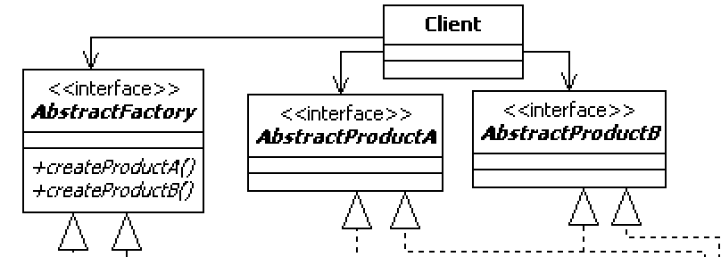
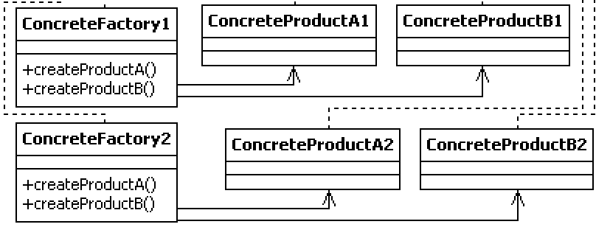
The Abstract Factory Pattern
Clients only know about creator and product interfaces! This allows us to vary behavior without changing client code!
Products need to obey the Product interface!
Factories need to obey the Factory interface!
Creator Classes
Product Classes
Important: Notice the Pattern!
Adding other products for existing families requires adding another AbstractProduct interface and concrete product classes!
Important: Notice the Pattern!
Adding a new family of products requires adding another Factory, and concrete product classes!

Slide 13
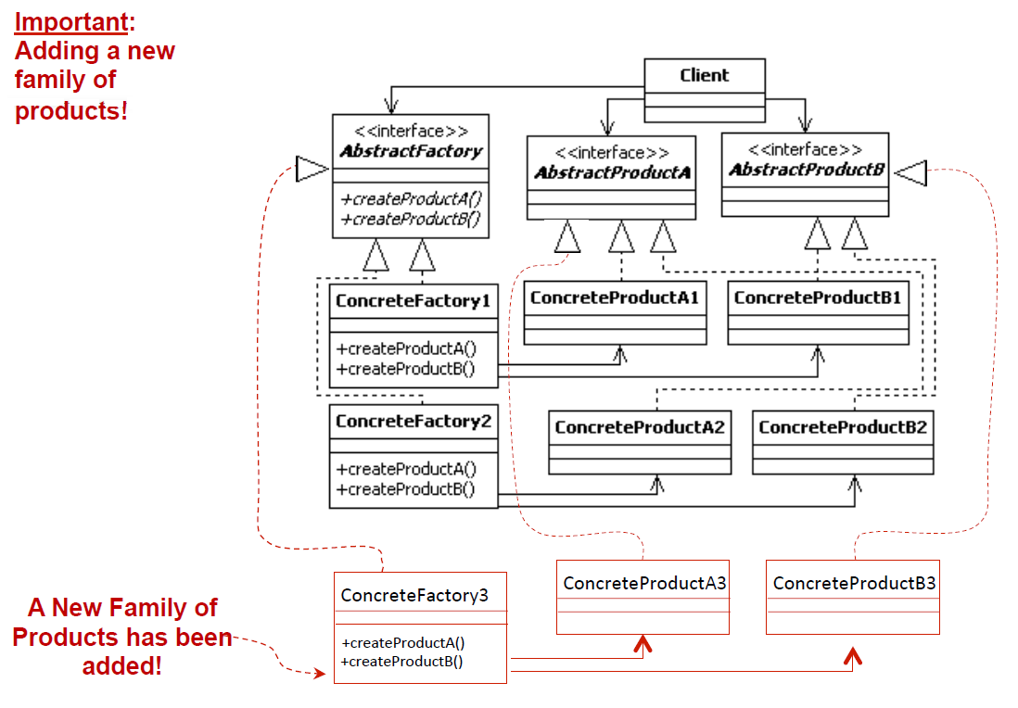
The Abstract Factory Pattern

Slide 14
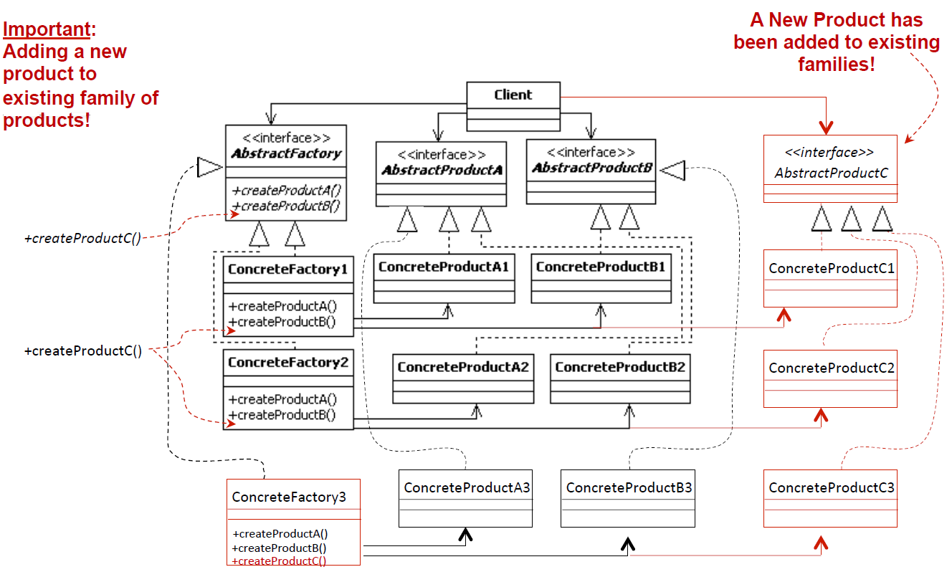
The Abstract Factory Pattern

Slide 15
The Abstract Factory Pattern - Example
Consider a software system for a computer store, where the store carries only two types of computers for sale:
  Top of the line computer, we’ll call these advanced computers
  Inexpensive computers, we’ll call these standard computers
  Obviously, a computer store will need to carry more computers in the future!
Advanced computers are made up of “advanced computer products,” e.g. the latest multi-core CPU, wireless keyboard, advanced monitor (e.g., widescreen large 3D), advanced graphics & sound card, etc. For simplicity, we’ll only use CPU, keyboard, and Monitor for our example.
Standard computers are made up of “standard computer products,” e.g., single core CPU, wired keyboard, small screen monitor, low-grade graphics and sound, etc. ü For simplicity, we’ll only use CPU, keyboard, and Monitor for our example.
The system is designed so that it searches remote information sources, e.g. online websites, remote databases, etc. for product information, such as:
  Product reviews
  Customer’s comments from specific websites, e.g., Amazon.com
  Manufacturers’ comments
  …

Slide 16
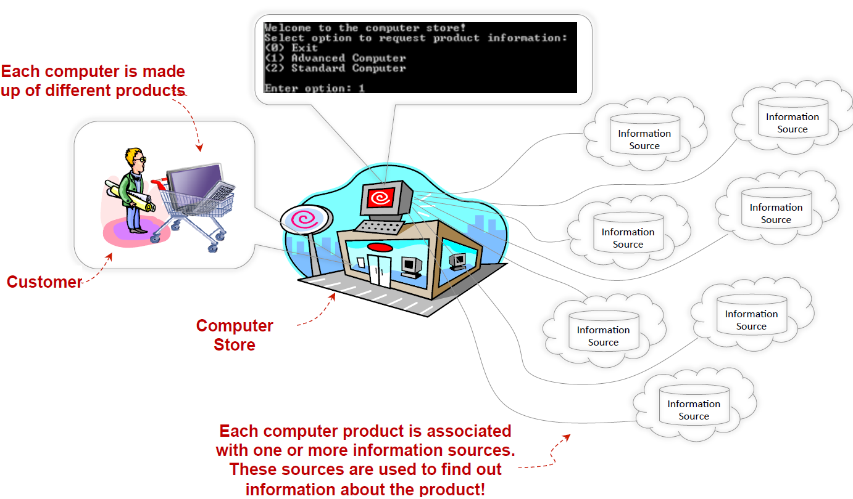
The Abstract Factory Pattern - Example

Slide 17
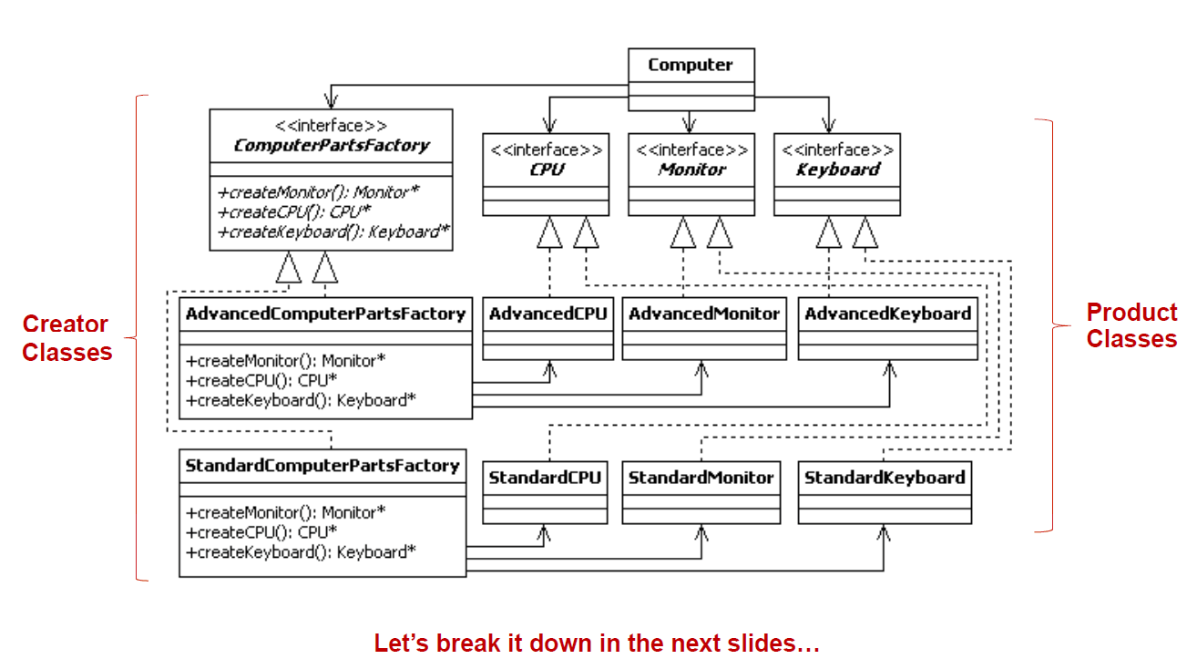
The Abstract Factory Pattern - Example

Slide 18
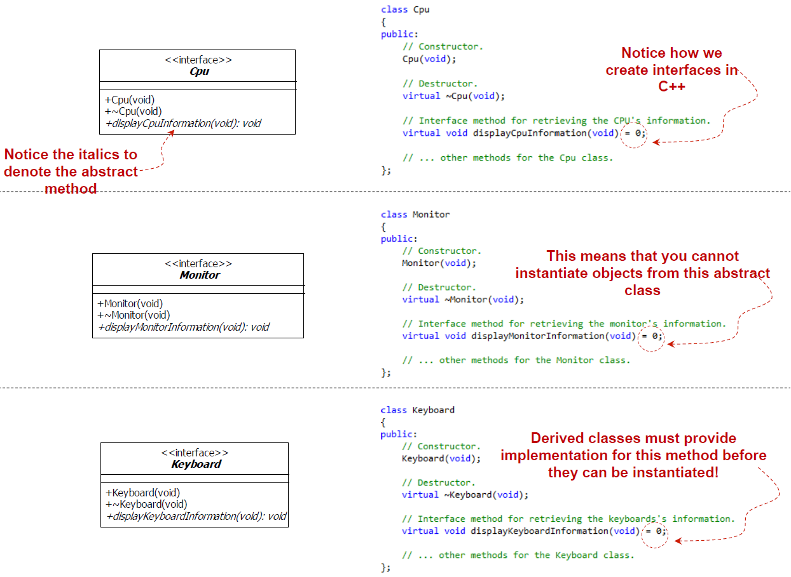
The Abstract Factory Pattern - Example

Slide 19
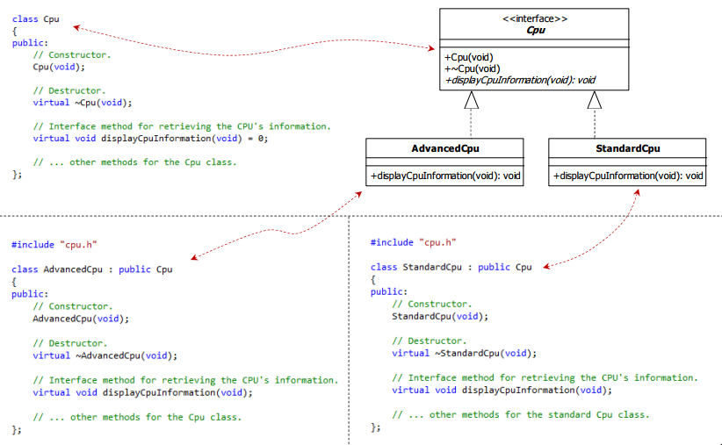
The CPU Product Design

Slide 20
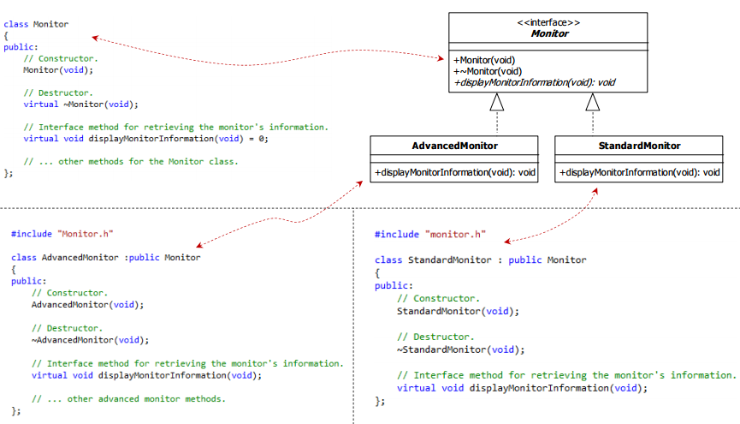
The monitor Product
Design

Slide 21
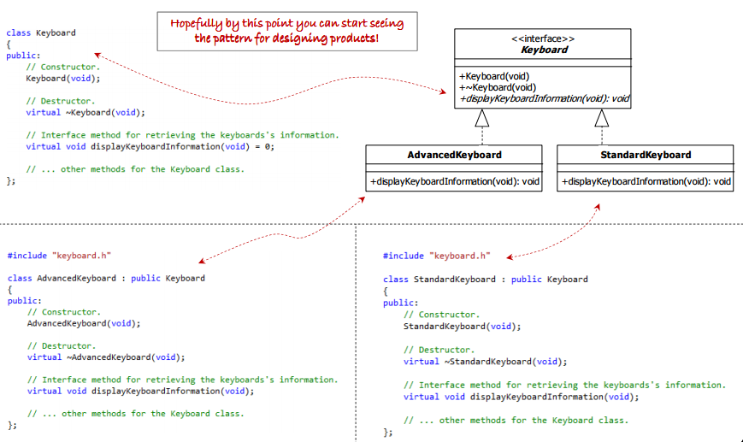
The keyboard Product
Design

Slide 22
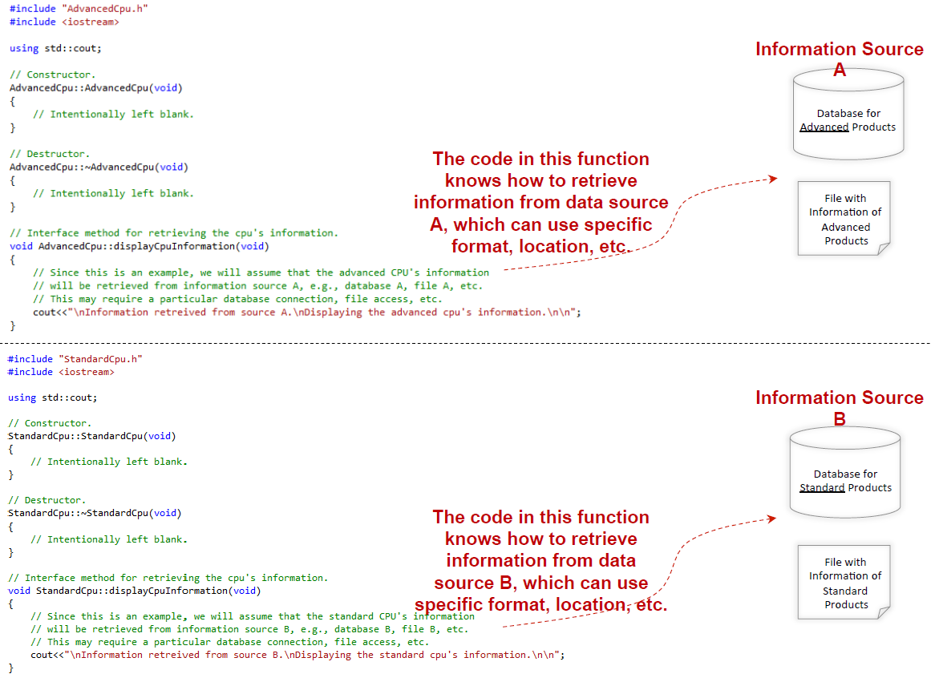
The CPU Product Implementation

Slide 23
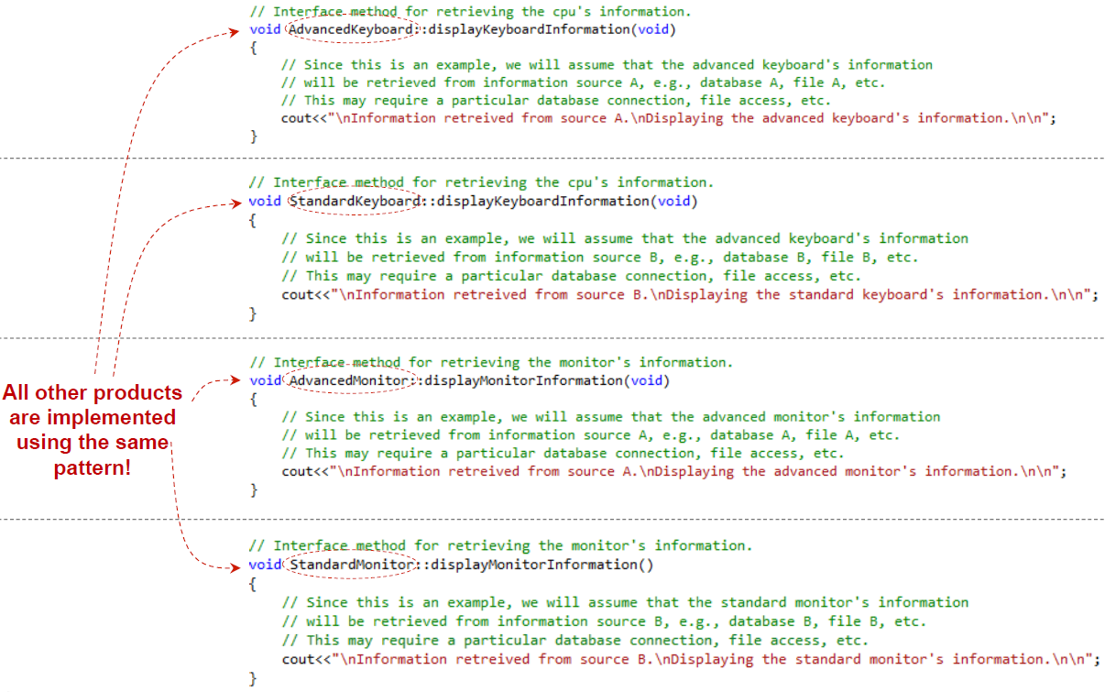
Other Product Implementation

Slide 24
The Abstract Factory Pattern - Example

Slide 25
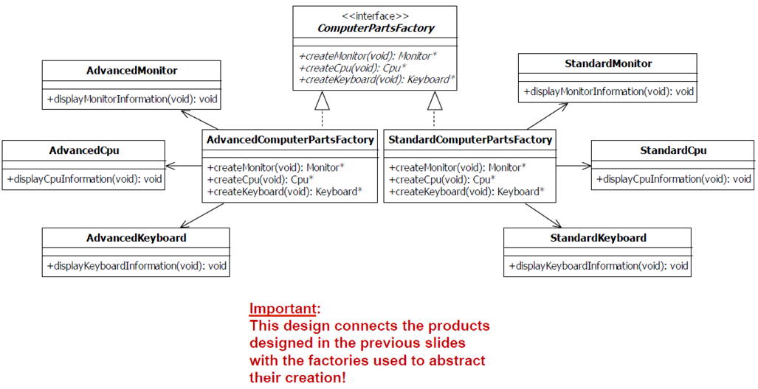
Factory Interfaces and Concrete Factories

Slide 26
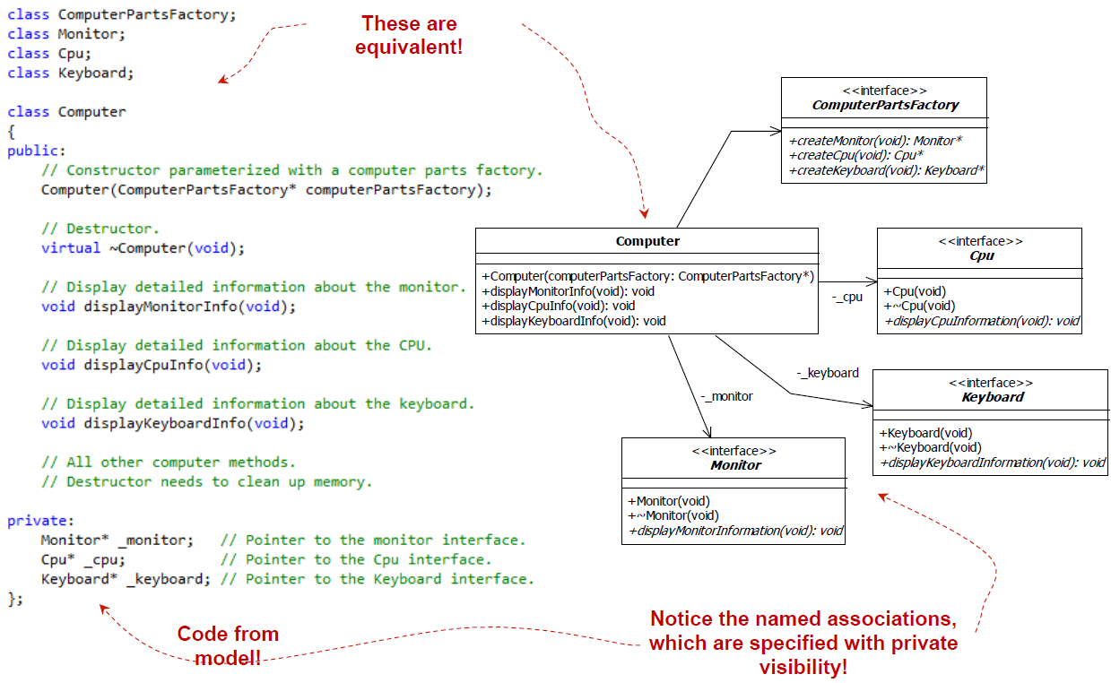
The Client Computer Design

Slide 27
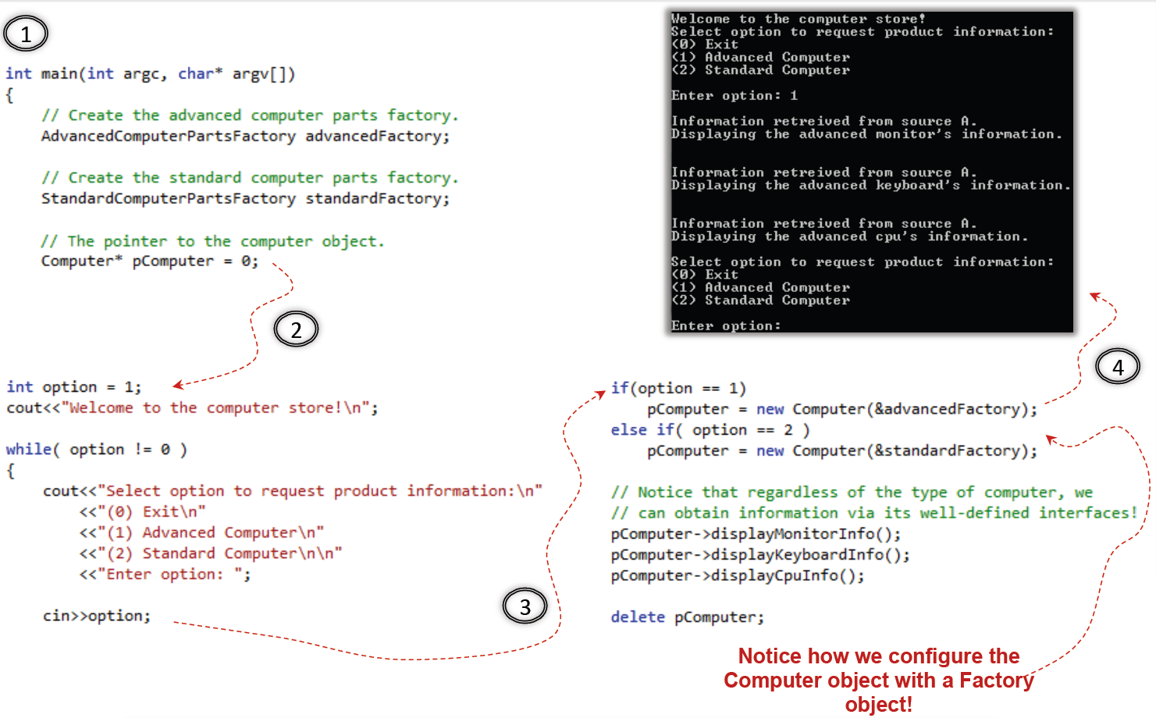
The Abstract Factory Example – Putting it all together

Slide 28
Abstract Factory – Step by Step Summary
As seen, the Abstract Factory pattern can be used over and over to support new family of products or to add new products to existing ones. When designing with the Abstract Factory, execute the following steps:
  Design the product interfaces (e.g., Cpu, Monitor, and Keyboard)
  Identify the different families or groups required for the problem (e.g., standard vs. advanced computers)
  For each product group identified in step 2, design concrete products that realize the respective product interfaces identified in step 1.
  Create the factory interface (e.g., ComputerPartsFactory). The factory interface contains n interface methods, one for each product interface identified in step 1.
  For each family or group identified in step 2, create concrete factories that realize the factory interface created in step 4.
  Associate each concrete factory from step 5 with their respective products from step 3.
  Create the Client (e.g., Computer) which is associated with both product and factory interfaces created in steps 1 and 4, respectively.

Slide 29
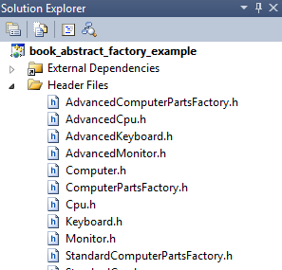
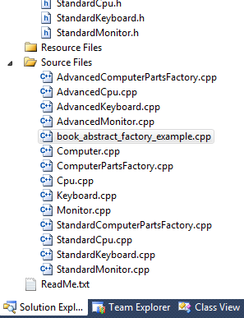
Cons & Pros of Abstract Factory
Cons
  Large number of classes are required
Pros
  Isolates concrete product classes so that reusing them becomes easier
  Promotes consistency within specific product families.
  Adding new families of products require no modification to existing code.
    Additions are made through extension, therefore, obeying the OCP.
  Increases modifiability

Slide 30
Watch this
https://www.youtube.com/watch?v=QNpwWkdFvgQ&t=80s

Slide 31
Summary
In this session, we presented fundamentals concepts of design patterns and creational design patterns, including:
  Abstract Factory
In the next sessions, we will continue the presentation on creational design patterns, including:
  Factory method
  Builder
  Singleton

