Slide 1

Software Design and Architecture [Creational Design Patterns] – Chapter 06, L02

Slide 2
Lecture Outlines
Factory Method Design Pattern
  Computer Store Example
Steps of Designing Factory Method Pattern
Benefits of Factory Method
What’s next…

Slide 3
2- Factory Method Design Pattern
The Factory Method design pattern is a class creational pattern used to encapsulate and defer object instantiation to derived classes.
The intent of the factory method is to:
  Define an interface for creating an object, but let subclasses decide which class to instantiate. Factory method lets a class defer instantiation to subclasses.

Slide 4
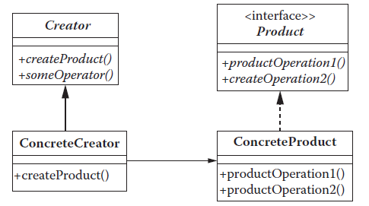
Factory Method Example
Structure
The generic and applied structure of the factory method design pattern is presented below. As seen, the pattern requires both creational and product classes, similar to the abstract factory design pattern. However, unlike the abstract factory design pattern, creator classes in the factory method design pattern require only one creational interface method for creating products that share the same interface.
Therefore, for each product in the system, the design incorporates concrete product and concrete creator classes.

Slide 5
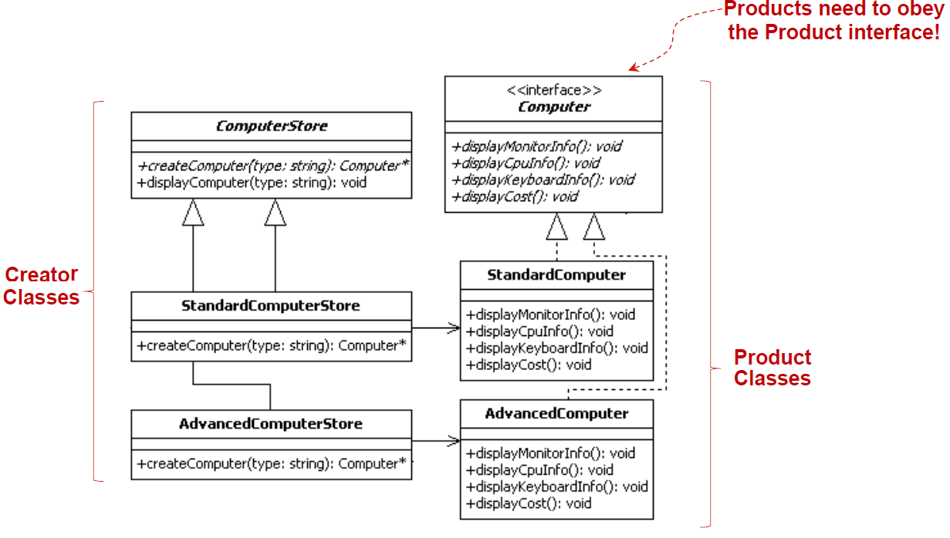
Factory Method Example

Slide 6
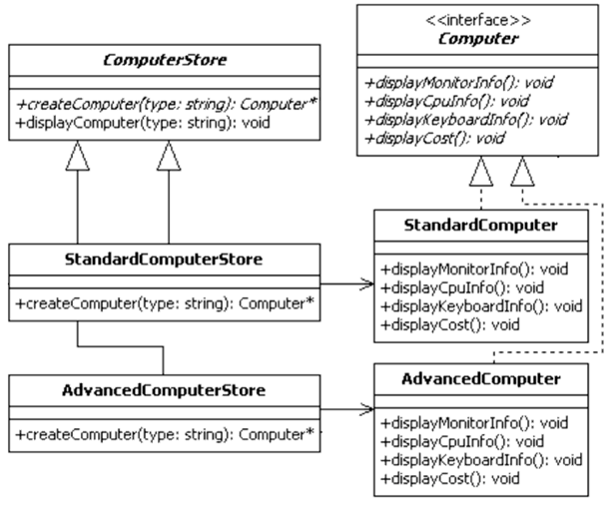
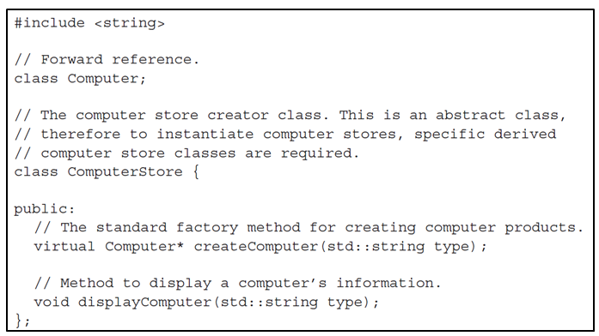
Factory Method Example
Sample code for the ComputerStore Factory:

Slide 7
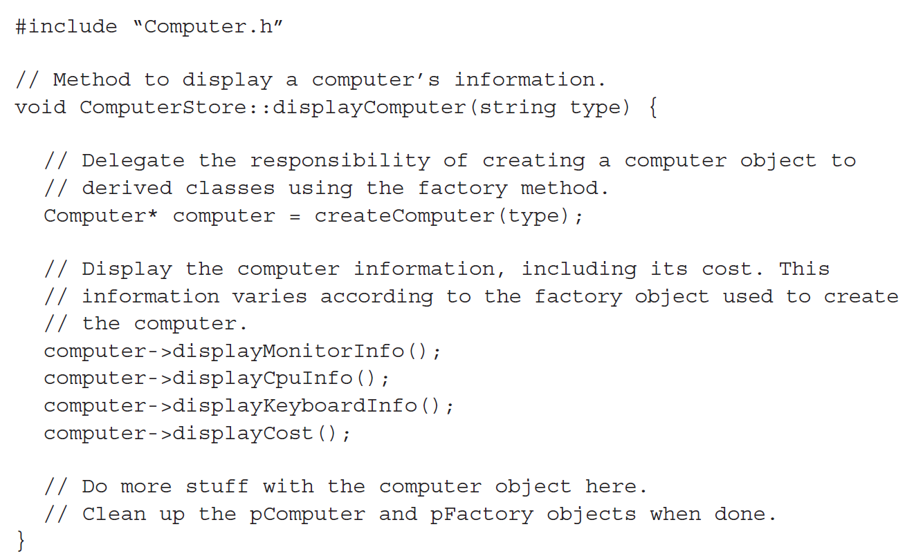
Factory Method Example
Sample code for the ComputerStore Factory:

Slide 8
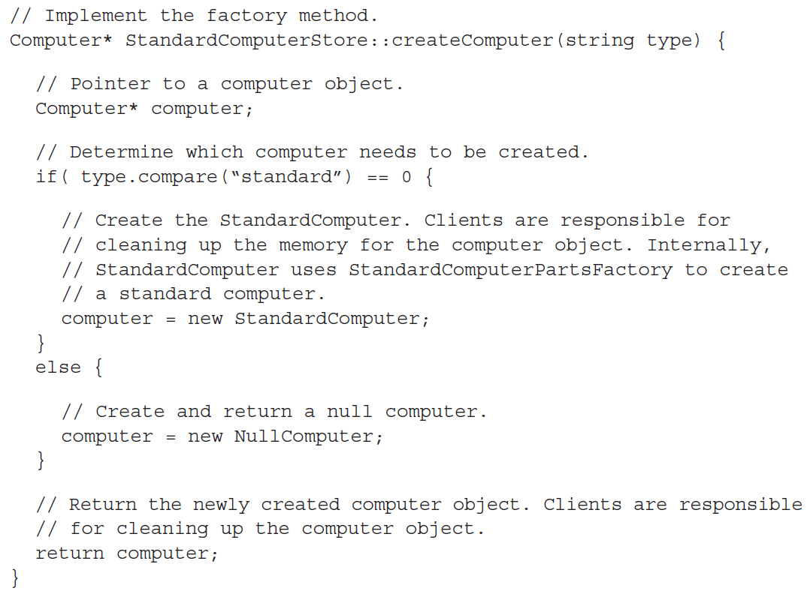
Factory Method Example
Sample code for the ComputerStore Factory:

Slide 9
Factory Method Example

Slide 10
Steps for designing with the Factory Method
Identify and design the product interface (e.g., Computer)
Identify and design the concrete products that realize the interface from step 1 (e.g., StandardComputer, AdvancedComputer, etc.)
Design the factory interface (e.g., ComputerStore), which contains one abstract factory interface method for delegating product creation to derived classes.
Design one or more concrete factories for each product identified in step 2.
Associate each factory from step 4 with its respective product from step 2.

Slide 11
Benefits of the Factory Method Pattern
Separates code from product-specific classes; therefore, the same code can work with various existing or newly created product classes.
The development becomes efficient, since different developers can work on the different parts of the project at the same time.
Easier to reuse specific parts of the code
Easier to maintain specific parts of the code.
Improve Testability.

Slide 12
Watch this
https://www.youtube.com/watch?v=DGILYRo6vW4

Slide 13
In class Excises
A pizza shop has different types of pizzas: Margherita, Pepperoni, and Veggie. Each pizza is prepared differently (e.g., different ingredients, different baking time). The shop wants a system where each pizza branch (e.g., NewYorkPizzaShop, ChicagoPizzaShop) can create its own style of these pizzas without modifying the main ordering logic. The main ordering process always calls a createPizza(type) method to get a pizza, then prepare(), bake(), and box() it.

Slide 14
Summary
In this session, we continued the discussion on creational design patterns, including:
  Factory Method
In the next sessions, we will finalize the presentation on creational design patterns. Specifically, we will cover:
  Builder
  Singleton

