Slide 1
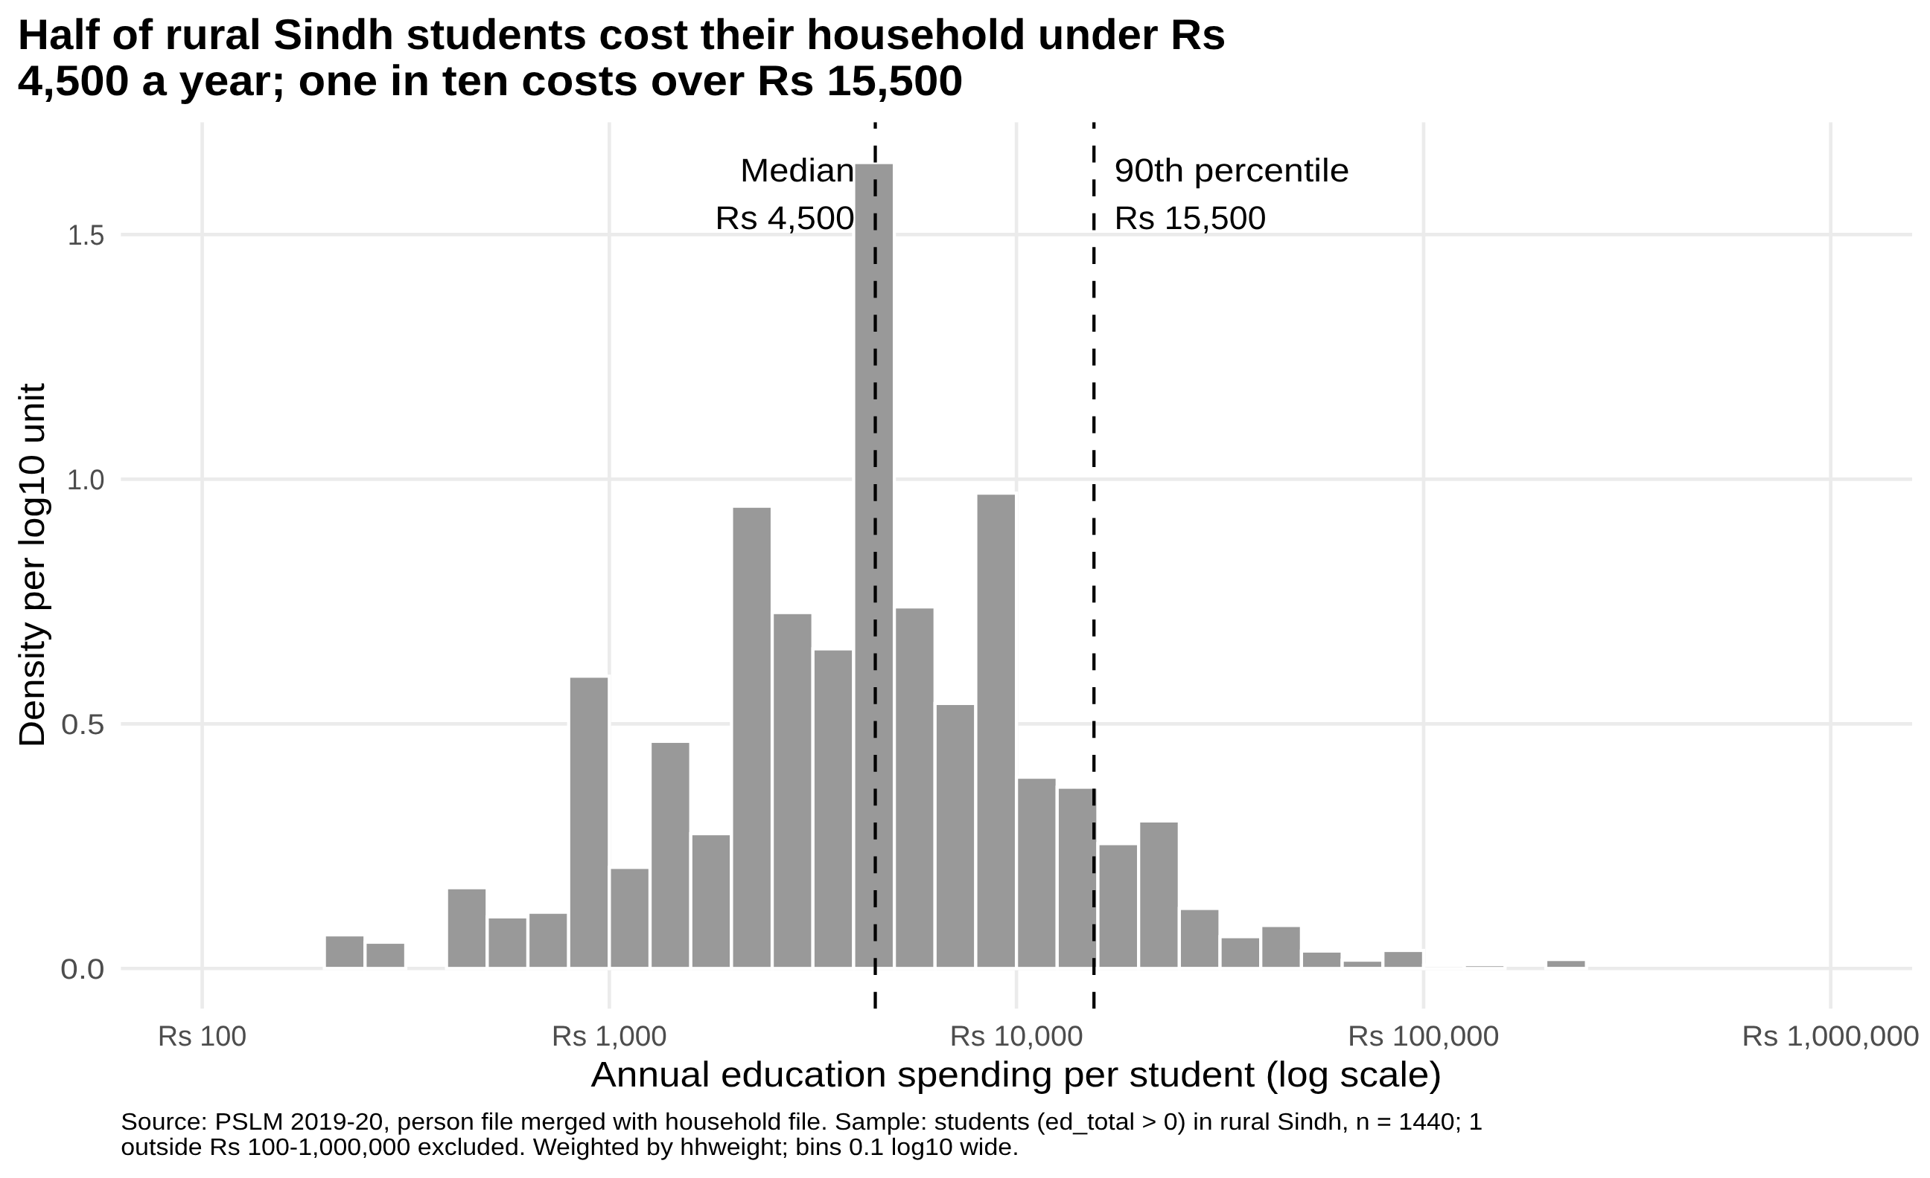
VARIANT 2 · SINDH RURAL · EDUCATION SPENDING
Most rural Sindh students cost their household a few thousand rupees a year, with a long right tail
Variant 2: Sindh rural
26 = 3 × 8 + 2 · prov_code 3, urban_rural 1
Rs 4,500
weighted median (unweighted: Rs 4,295)
Rs 1,000–15,500
10th to 90th percentile: a 15.50-fold spread
1,440
students; 1 outside Rs 100 to 1,000,000 excluded
Weighting lifts the median about 5%: low-weight households are over-represented in the sample.
ECO346 Assignment 1 · FA24-BEDS-026 · Section B · Source: PSLM 2019-20, weighted by hhweight
1 / 4
Notes:
Variant: registration ends in 26, 26 = 3x8+2, so variant 2, rural Sindh. Students = ed_total > 0, n = 1,440. Weighted median Rs 4,500, unweighted Rs 4,295, P10 Rs 1,000, P90 Rs 15,500, ratio 15.50. One student outside Rs 100 to 1,000,000 excluded. Weighted and unweighted medians differ by about 5% because the lowest-weight third of households is over-represented in the sample and has a median of Rs 4,000 against Rs 4,500 elsewhere.

Slide 2
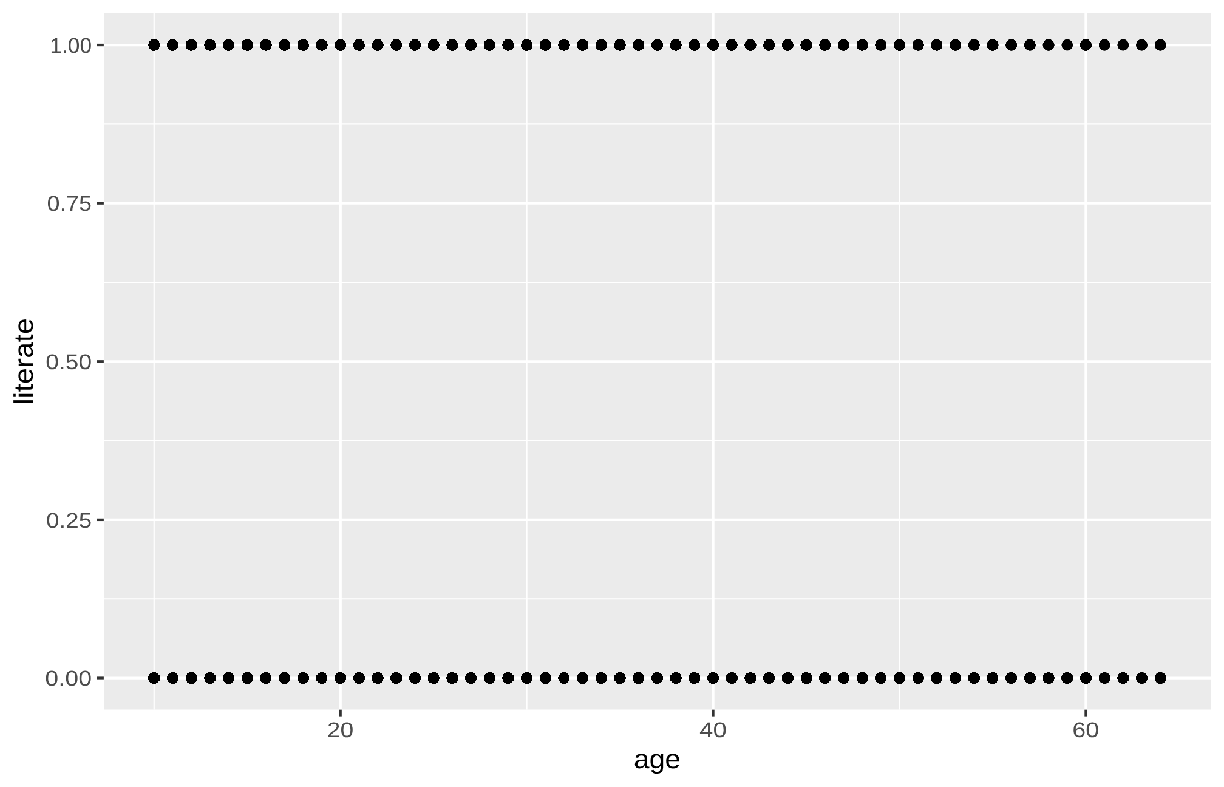
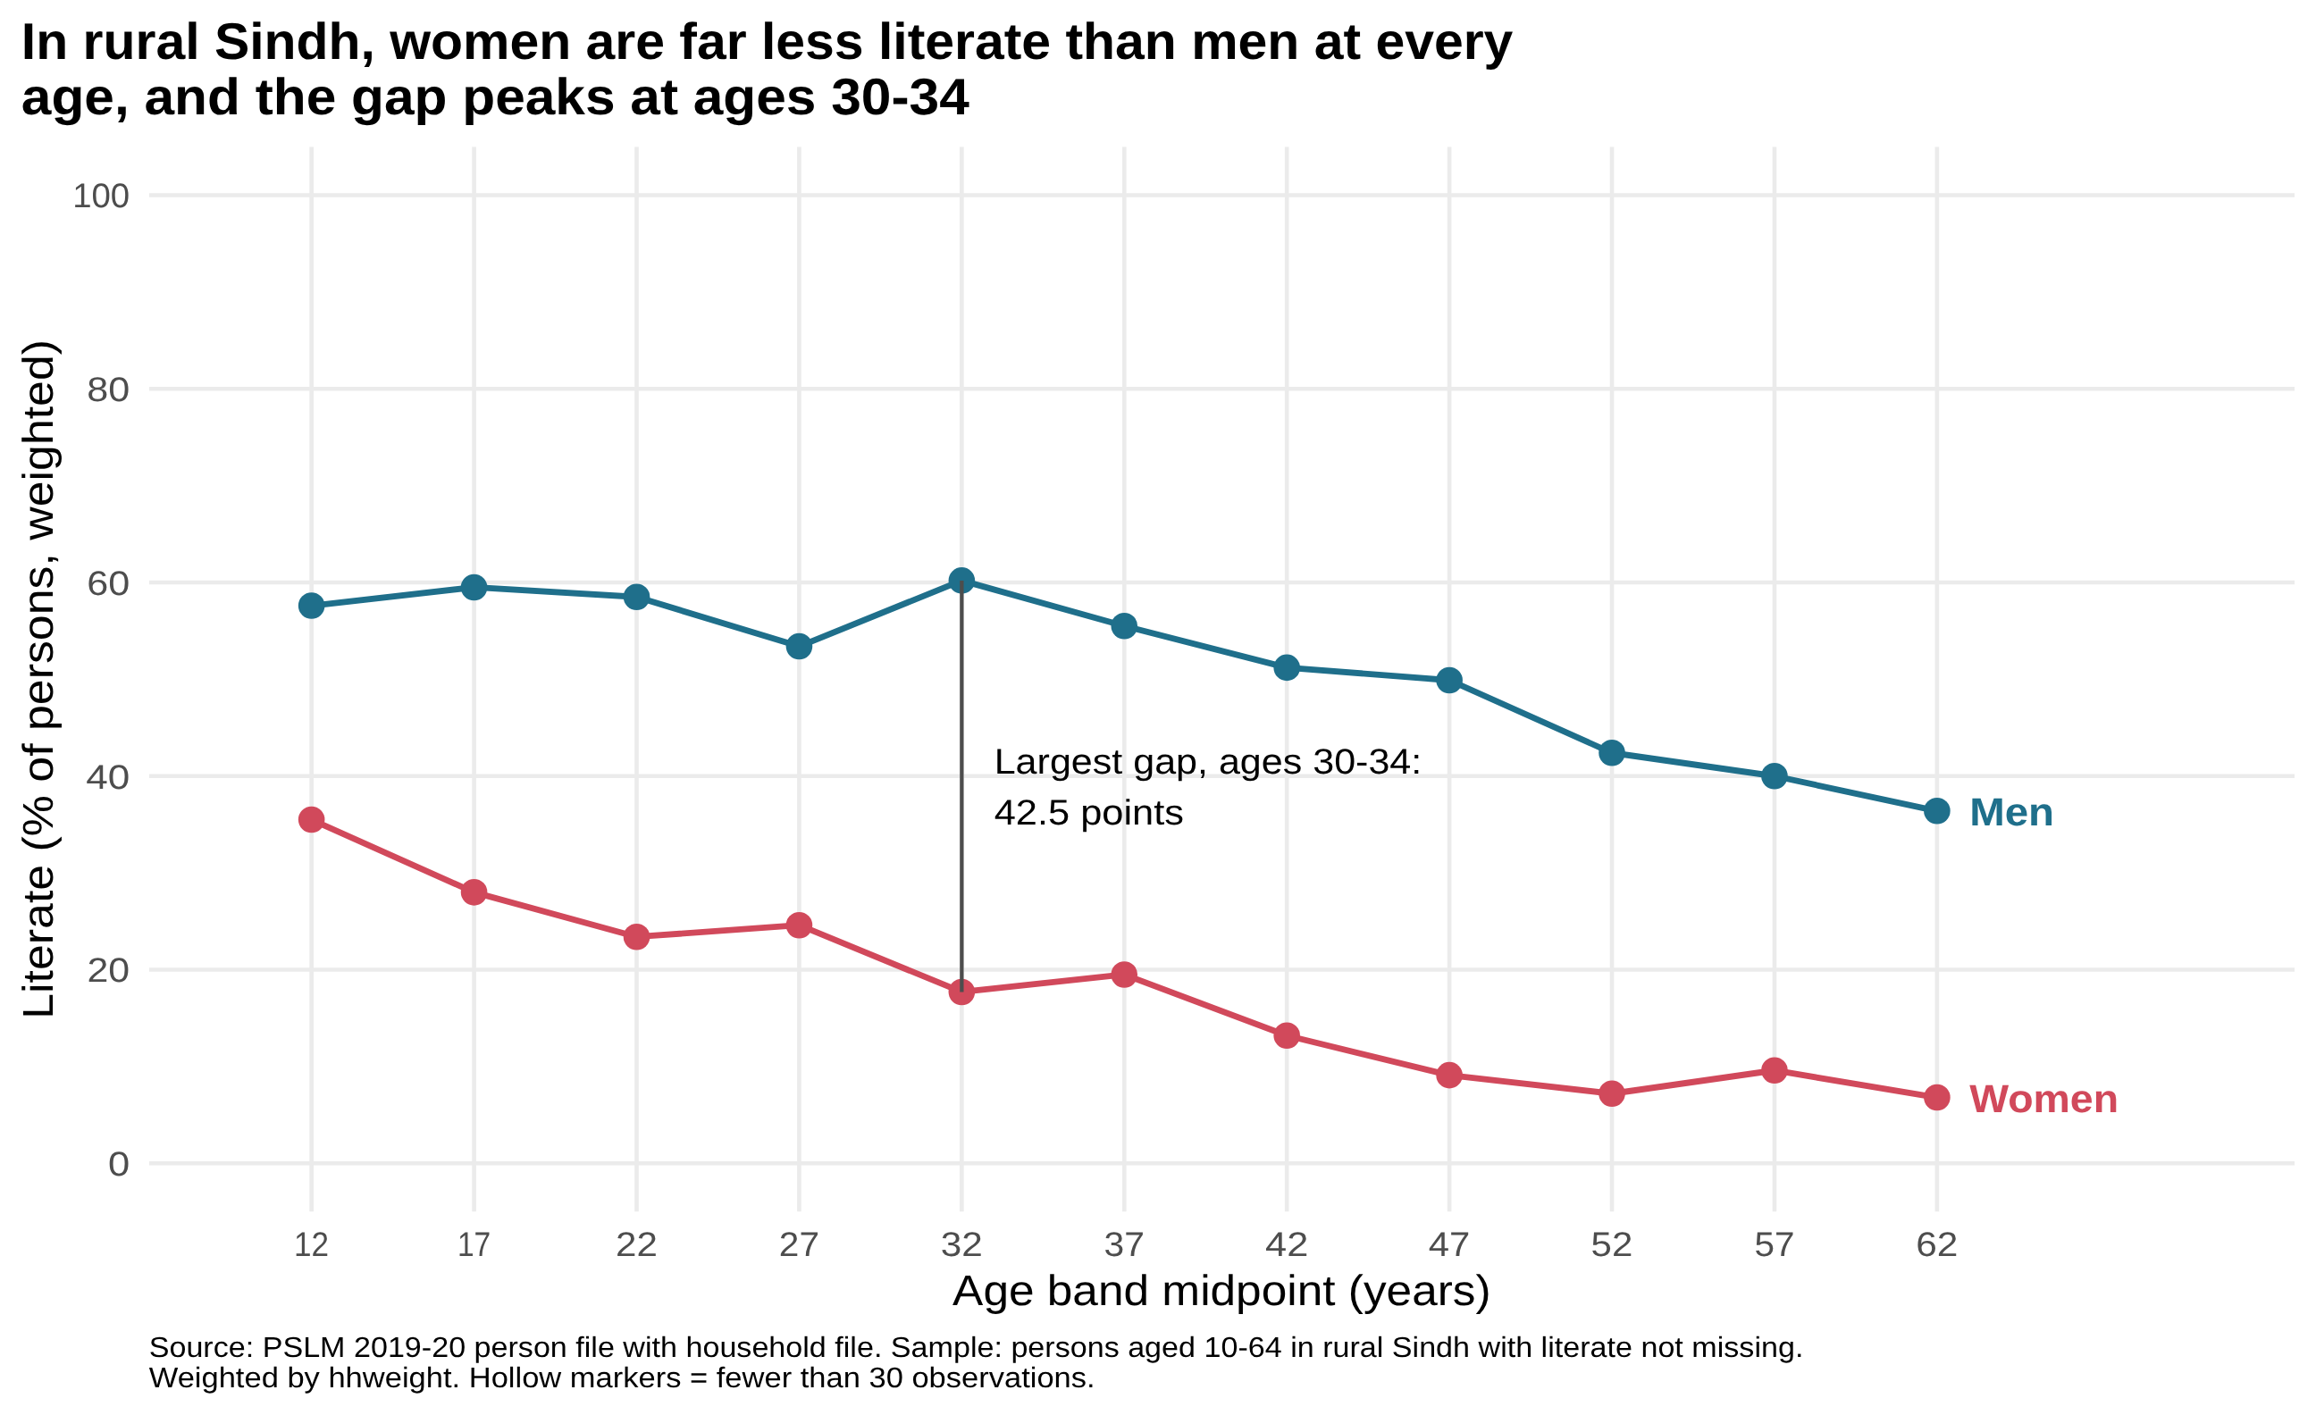
THE MAKEOVER
From 7,171 overplotted zeros and ones to two lines you can compare by position
Default: ggplot(data, aes(age, literate)) + geom_point()
Redesign: weighted literacy rate by age band and sex
1 Conditional means
Binary outcome becomes a proportion: the weighted mean of literate in each five-year band.
2 Perceptual ranking
One common 0-100% axis, judged by position. Lines labelled at their ends, no legend.
3 Data-ink and honesty
Grey panel removed, finding as title, source and weights in the caption, hollow markers for thin cells.
ECO346 Assignment 1 · FA24-BEDS-026 · Section B · Source: PSLM 2019-20, weighted by hhweight
2 / 4
Notes:
Default shows individual observations at single years of age but overplots 7,171 points on two rows. The redesign plots weighted conditional means by five-year band, compares women and men by position on one axis, labels lines directly, and states the finding in the title. What the default shows that the redesign hides: the spread within each band.

Slide 3
THE FINDING I CONSIDER MOST IMPORTANT
At 15-19, 28.0% of rural Sindh women are literate against 59.5% of men, and the gap is widest at 30-34
AGED 15-19
28.0%
59.5%
women
men
AGED 55-59
9.6%
40.0%
LARGEST GAP, AGES 30-34
42.5 points
Women trail men in every band, by at least 22 points. One cross-section: older bands are older birth cohorts, so the slope mixes ageing with generational change. It shows the outcome, not the cause.
ECO346 Assignment 1 · FA24-BEDS-026 · Section B · Source: PSLM 2019-20, weighted by hhweight
3 / 4
Notes:
Women trail men in every age band: 31.5 points at 15-19, 30.4 at 55-59, peak 42.5 at 30-34. Women fall from 28.0% to 9.6% between late teens and late fifties; men from 59.5% to 40.0%. Smallest cell has 77 observations, so no band is thin. Caveat: cross-section, cohorts and ageing are mixed; the figure shows the outcome, not why.

Slide 4
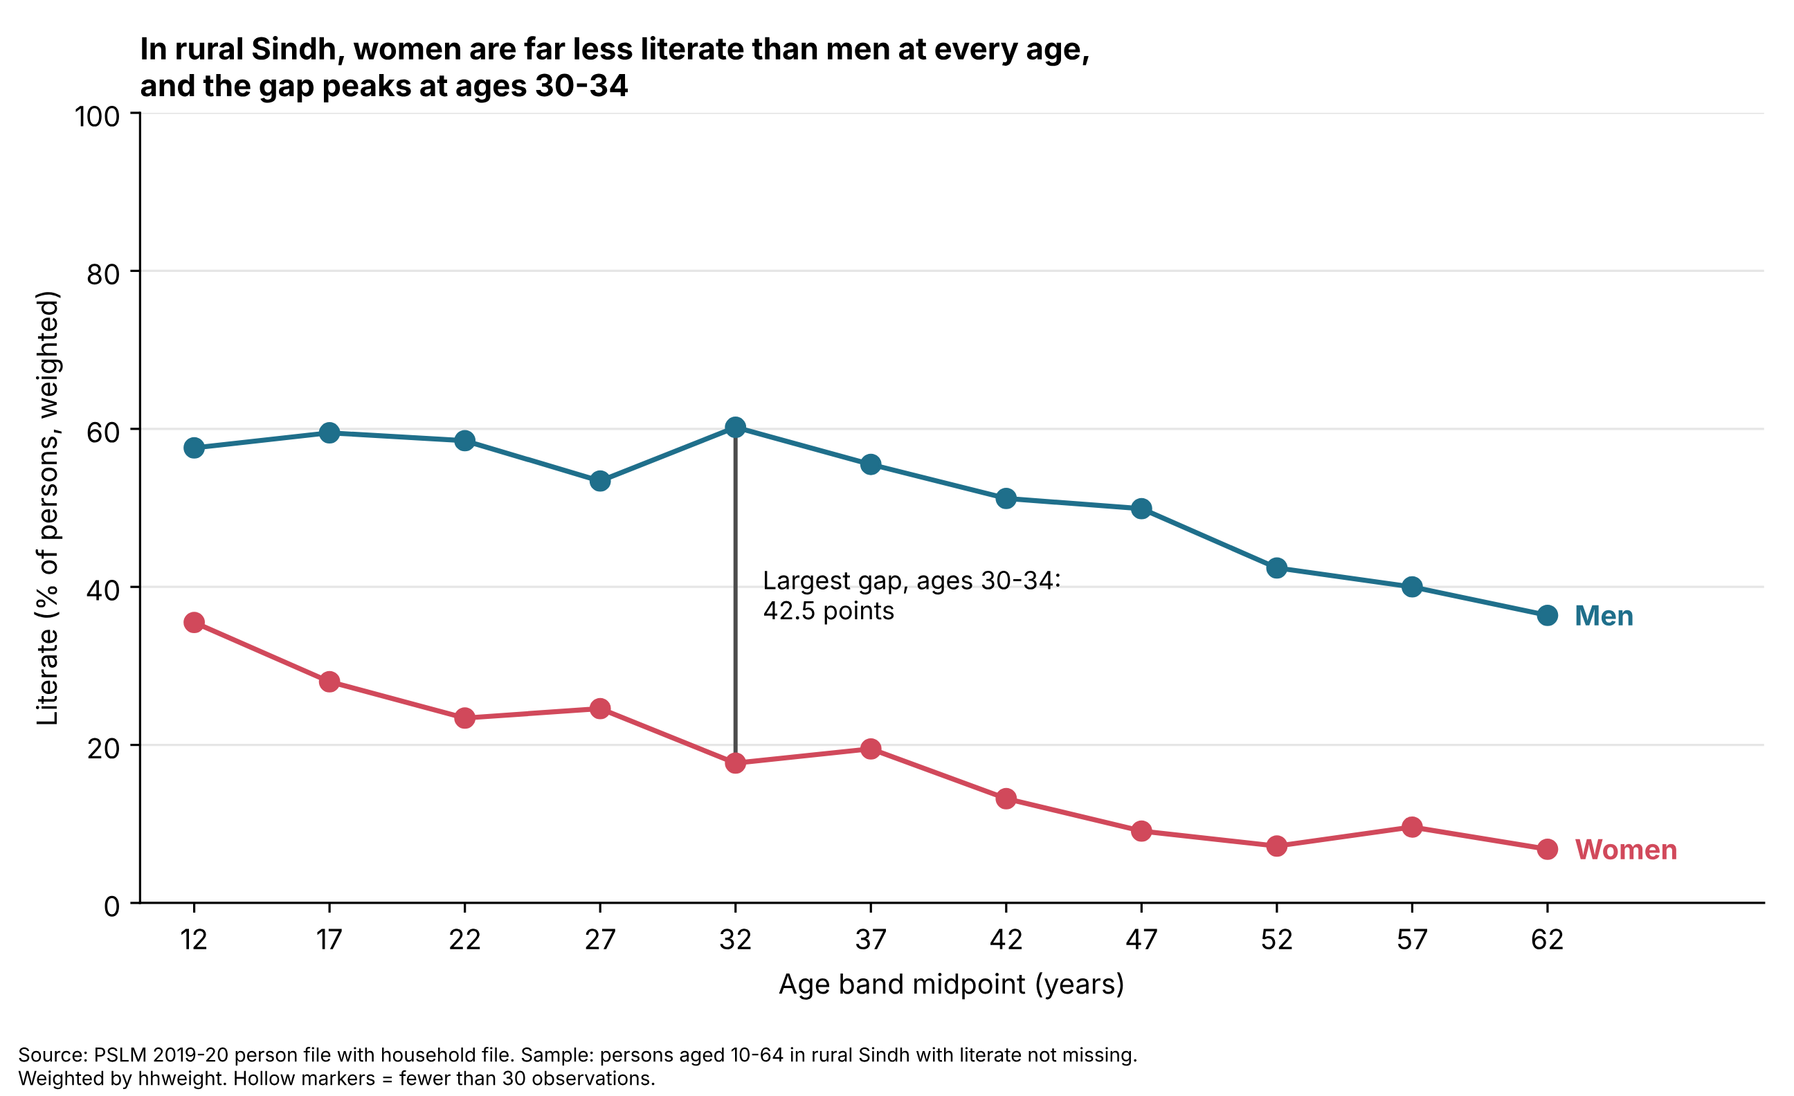
A SECOND LANGUAGE: PYTHON
Python reproduces the R band table to one decimal place
WOMEN AGED 15-19
28.0%
28.0%
from R
from Python
A default that differed
ggplot2 pads each axis by 5%, matplotlib does not, so the Python panel looked tighter. I set ylim(-5, 105) and matched limits, ticks and labels.
Bands are built by integer division in both languages, because pd.cut closes intervals on the right by default.
ECO346 Assignment 1 · FA24-BEDS-026 · Section B · Source: PSLM 2019-20, weighted by hhweight
4 / 4
Notes:
Python recomputes the band table and redraws the figure. Women 15-19 is 28.0% in both. The axis padding and the band construction were the two defaults that differed.

