Slide 1
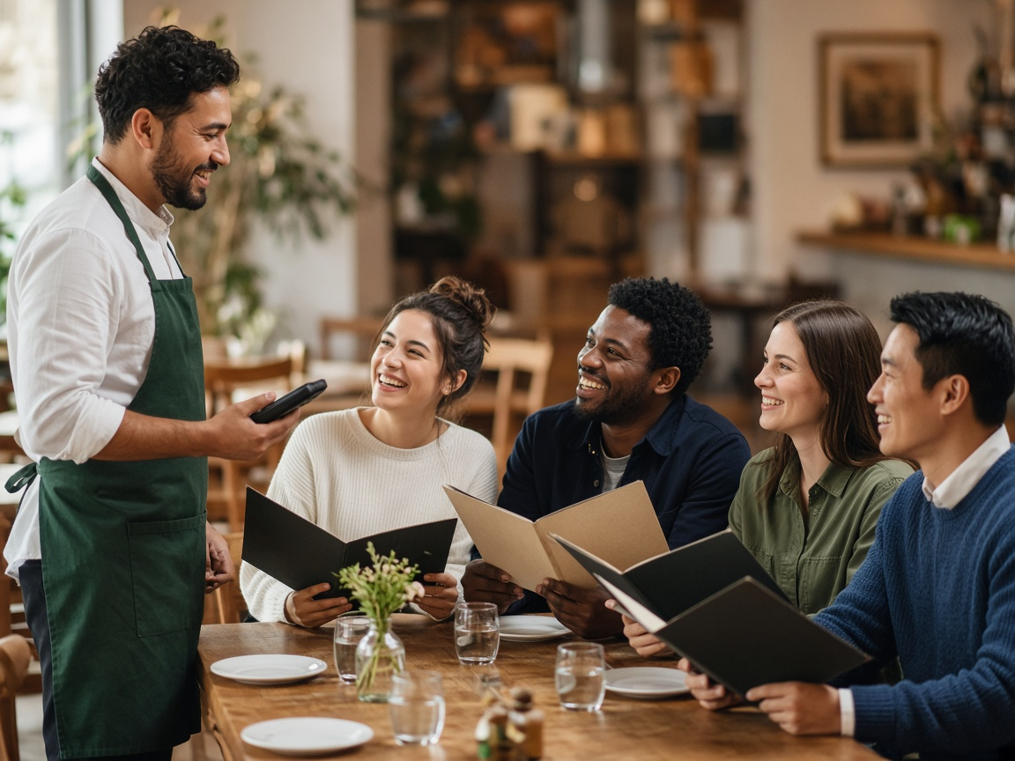
IDEA 2 OF 3 | STANDARD SPLIT QUESTION
CheckFirst: the restaurant asks, so no friend has to
Need Asking for separate checks sounds cheap when a friend brings it up, but it is just logistics when the restaurant asks every table.
1 Asked at every table
Table 12 · New order
When the server takes the drink order, they ask "One check, split evenly, or separate checks?" Every table hears it, every time.
How is this table paying?
One check
2 Built into the order
Split evenly
The server's handheld will not send the first order until a check style is picked, so no table gets skipped.
Separate checks
Decide later
3 The bill arrives ready
Asked at the start of every meal, as routinely as "still or sparkling water?"
Separate checks are already set up when the meal ends. Nobody at the table had to be the one to bring it up.
Pick one to send the first order
7

Slide 2
IDEA 2 OF 3 | CHECKFIRST
Positioning statement
FOR
friends who eat out together on different budgets
THE ONE BENEFIT
WHO
accept an even split because being the one to ask for separate checks feels cheap
Separate checks become a normal choice, not a personal request.
CHECKFIRST IS
a restaurant service routine built into the server's ordering step
THAT
asks every table how they are paying before anyone orders
UNLIKE
waiting for a friend to ask the server when the bill comes, or splitting it later on Splitwise or Venmo
OUR PRODUCT
makes the split a question the restaurant asks everyone, so no friend has to raise it
8

Slide 3
IDEA 2 OF 3 | CHECKFIRST
Perceptual map
Every table, every time
Why these axes
• X: who carries the social cost of raising the split.
• Y: consistency. A question only feels like normal logistics if every table gets it.
One card, split evenly
CheckFirst
A friend has
to raise it
The restaurant
raises it
Asking the server for separate checks
Some servers ask "together or separate?"
Takeaway: Some servers already ask, but only sometimes, so asking still looks unusual. CheckFirst asks every table, every time, which is what turns the split into logistics.
Splitwise / Venmo later
QR pay at the table
Only if someone brings it up
9

Slide 4
REVERSE INTERVIEWING
What an LLM asked us and how we answered
SplitSeat
Q: How do shared appetizers get charged?
A: Servers tag shared items to "table," and those split evenly across everyone.
Q: Why would restaurants adopt it?
A: Faster table turns: no server time spent running five cards.
Q: What if a server forgets to tag a seat?
A: The POS asks for a seat number before an item can be sent to the kitchen.
CheckFirst
Q: Won't the person who picks "separate" still feel singled out?
A: The server asks the whole table, with separate checks as an ordinary option, like still or sparkling.
Q: What if the group is not sure yet?
A: "Decide later" is an option, and the answer can change with one tap before the bill prints.
Q: Why would restaurants adopt it?
A: It costs nothing to start, and servers stop rerunning bills when a table asks to split at the end.
SplitSense
Q: In a group of two, is it really anonymous?
A: No, so it activates only at tables of three or more.
Q: Why would a diner bother setting a limit?
A: It is one tap at check-in with a smart default already set.
Q: How is this different from CheckFirst?
A: CheckFirst makes the question normal for everyone. SplitSense protects people who still would not say it.
13

