Slide 1
PRESERVE MY WORLD
AI & 3D Reconstruction Internship
Curated footage, exploratory ML/AR pipelines, and a first capture-to-3D pass — progress review for the team.
AI & 3D Reconstruction Team — Progress Presentation

Slide 2
What we'll cover
Four checkpoints from source material to a first 3D view.
01
Reconstruction method landscape
What we compared, and why it shapes the pipeline choice
02
Case study: Rohtas Fort
Sourcing and curating multi-angle footage for a real heritage site
03
ML visualization & AR line overlays
Depth estimation and structural line detection, tried end-to-end
04
First capture-to-3D view
Unprojecting a single frame into a coloured point cloud
PRESERVE MY WORLD · AI & 3D RECONSTRUCTION
02

Slide 3

Reconstruction method landscape
Five approaches evaluated in the methods comparison doc — each with a different accuracy / speed / hardware trade-off.
Method
Output
Speed
Best fit
COLMAP / SfM
Sparse point cloud + camera poses
Slow
Camera calibration, foundation for MVS
MVS
Dense point cloud / mesh
Slow–medium
High-fidelity static geometry
NeRF
Volumetric radiance field
Slow to train
Photoreal novel views, small scenes
3D Gaussian Splatting
Explicit splat cloud
Fast render
Real-time viewing, large sites
Monocular Depth Est.
Per-frame depth map
Fast
Single-frame preview, no calibration needed
Highlighted below: monocular depth estimation and a Gaussian-Splat-style explicit point cloud are the two approaches exercised hands-on in this module (slides 6–8).
PRESERVE MY WORLD · AI & 3D RECONSTRUCTION
03

Slide 4

Case study: Rohtas Fort
UNESCO World Heritage Site, Jhelum District, Punjab — chosen as the multi-angle sourcing subject
1541
4 km
12
1997
Construction began, under Sher Shah Suri
of fortified walls, 68 bastion towers
monumental gates, each distinct in style
Inscribed as a UNESCO World Heritage Site
Curation approach
Paired aerial drone coverage (full wall circuit, scale/context) with ground-level walkthroughs (gate detail, masonry, tilework)
Prioritised openly-licensed Wikimedia Commons stills (CC BY-SA, Wiki Loves Monuments 2016) — organised by gate, reliably attributable
Flagged and excluded mismatched stock results (a same-named but unrelated fort in Bihar, India)
Logged a shooting gap: no footage yet of the Talaqi/Gatali gate weather damage — useful for a conservation-angle follow-up
PRESERVE MY WORLD · AI & 3D RECONSTRUCTION
04

Slide 5


From raw sourcing to strongest material
Source
›
Curate
›
Verify
›
Deliver
Drone footage, ground walkthroughs, open-licensed stills, references
Filter by license, location accuracy, and gate/angle coverage
Cross-check against UNESCO record and Wikipedia sourcing
Sourced, cited piece + a footage/reference set the team can reuse
Deliverable produced this stage: a sourced write-up with cited references, curated footage links, and explicit notes on what to skip and what's still missing.
PRESERVE MY WORLD · AI & 3D RECONSTRUCTION
05

Slide 6

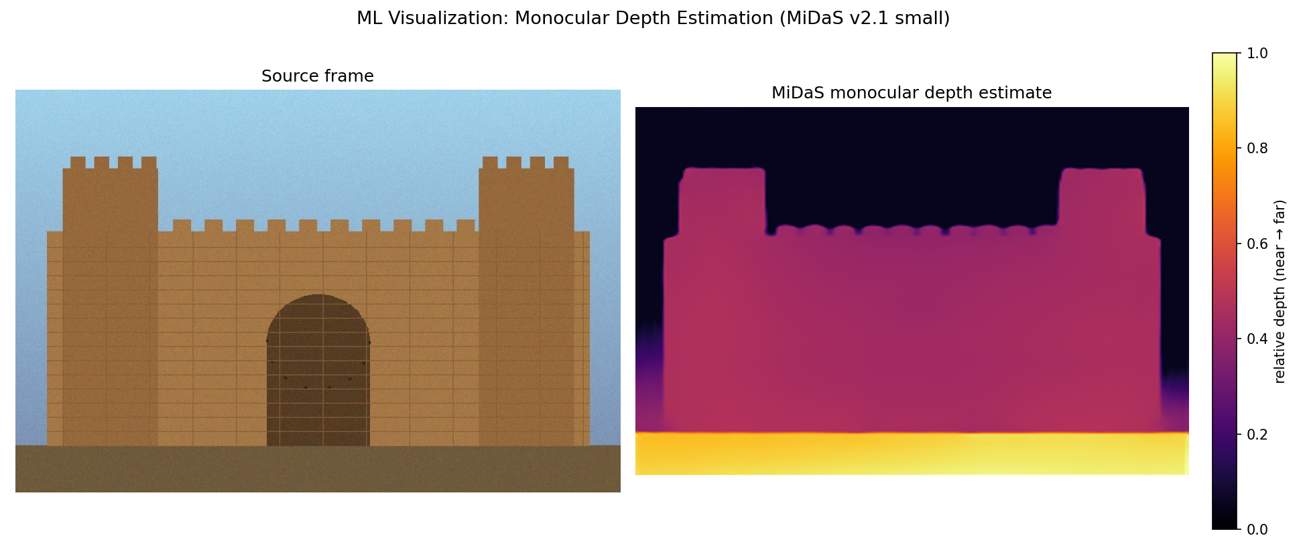
ML visualization: monocular depth
What we ran
Model: MiDaS v2.1 (small), CPU inference
Weights pulled from the official GitHub release, not torch.hub auto-fetch
Output: per-pixel relative depth, upsampled to source resolution
Gate reads nearest, wall mid-depth, sky farthest — matches expected geometry
Run on a synthetic proxy frame (this sandbox can't reach image/video hosts) — script is unmodified and ready for a real PMW capture frame.
PRESERVE MY WORLD · AI & 3D RECONSTRUCTION
06

Slide 7

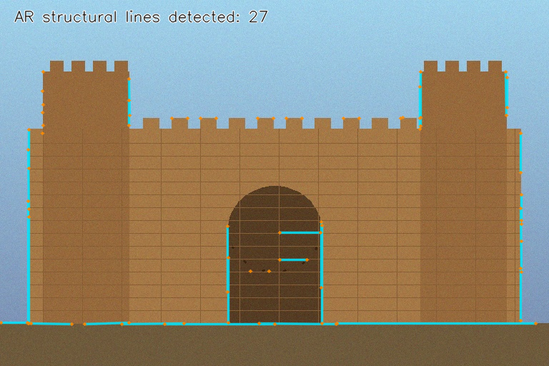
AR line overlays: structural edges
Pipeline
Bilateral filter — denoise while preserving edges
Canny edge detection
Probabilistic Hough transform — straight segments
Filtered by length, drawn as AR-style guide lines
27
structural lines detected after tuning thresholds — up from 7 on the first pass
Single-frame detection only — a live AR overlay would need per-frame tracking so lines don't swim between frames.
PRESERVE MY WORLD · AI & 3D RECONSTRUCTION
07

Slide 8

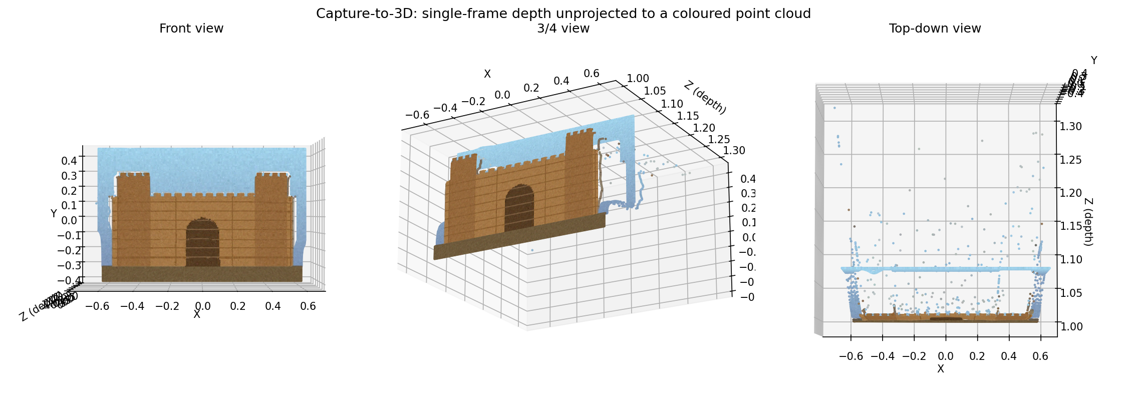
First capture-to-3D view
Depth map (slide 6) unprojected into camera space via a pinhole model — front / 3-quarter / top-down renders of the same coloured point cloud, plus an exportable .ply.
PRESERVE MY WORLD · AI & 3D RECONSTRUCTION
08

Slide 9

What's next
Real capture pass
Swap the synthetic proxy frame for an actual PMW-captured Rohtas Fort image across all three scripts
Camera calibration
Replace the assumed 60° FOV with measured intrinsics for an accurate unprojection
Multi-view fusion
Move from single-frame depth to COLMAP/SfM → MVS across the curated multi-angle set
AR line tracking
Add optical-flow or SLAM-anchored tracking so overlay lines hold steady across frames
PRESERVE MY WORLD · AI & 3D RECONSTRUCTION
09

Slide 10
Thank you
Questions and feedback welcome — code, screenshots, and source notes for every slide are in the accompanying repo.
AI & 3D Reconstruction Internship · Preserve My World

