Slide 1
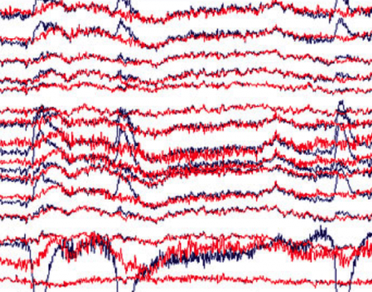
Feature Extraction for EEG Epileptic Seizure Detection and Classification
FUNDAMENTALS OF MACHINE LEARNING
Presented to:
Prof. Dr. Shahzad Ahmad Qureshi
Team Members:
Amina Akbar
Anza Arooj
Fatima Rehman
Fatima Shahid

Slide 2
INTRODUCTION
Epileptic seizure forecasting systems have emerged as a critical area of research due to their potential to significantly improve the quality of life for individuals suffering from epilepsy.
Electroencephalography (EEG) is a noninvasive neurophysiological monitoring technique that utilizes an array of electrodes placed on the scalp to record the brain's electrical activity.
Manually detecting and interpreting epileptic seizures from long-duration EEG recordings is highly labor-intensive and subjective. It typically requires skilled neurophysiologists to visually inspect EEG traces and identify abnormal patterns.

Slide 3
OBJECTIVES
To develop an efficient and automated seizure detection and classification system based on EEG signal processing.
To address the inefficiencies associated with manual detection by providing real-time, objective insights into a patient's neurological status.

Slide 4
DATASET DESCRIPTION
Dataset: Epileptic Seizure Recognition (derived from the Bonn University EEG database).
Dimensions: 11,500 rows (samples) and 179 columns.
Features (X1 to X178): Represent raw EEG time-series data. Each row contains 178 electrical amplitude readings sampled at 178 Hz over exactly 1 second.
Target Variable (y): Contains 5 balanced classes (2,300 samples each):
Class 1: Epileptic seizure activity (Target class).
Classes 2-5: Various baseline/normal states (e.g., tumor area,healthy area, eyes closed, eyes open).

Slide 5
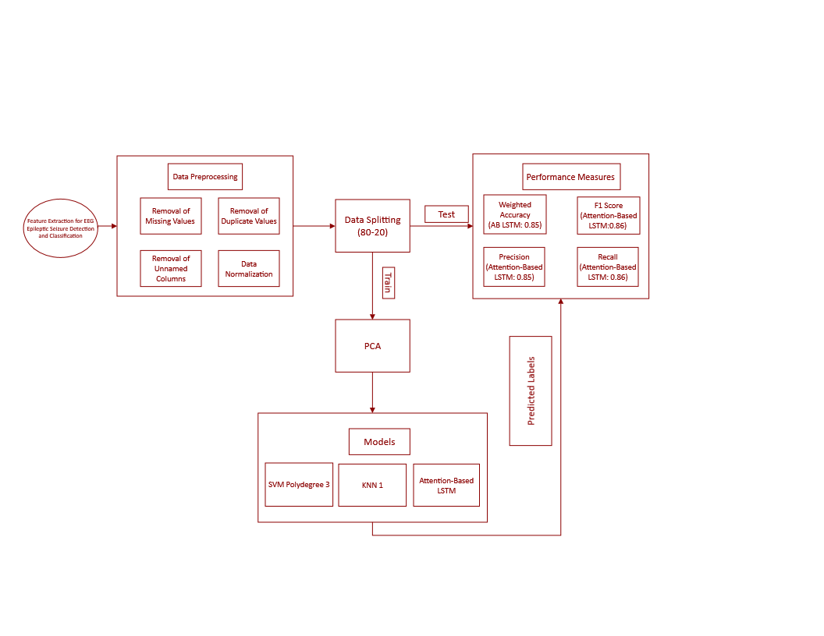
FLOWCHART

Slide 6
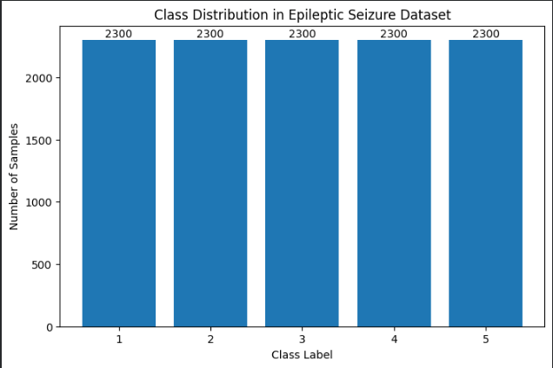
Dataset Description Graph(s)

Slide 7
Data Preprocessing
Load EEG dataset into a data frame
Each row equals one EEG signal sample
Columns contain X and Y, where X is the number of features and Y is the target.
Removed an extra index unnamed column.
Removed missing and duplicate values for data cleaning.

Slide 8

Data Normalization & Data Splitting
Normalized data for making range of 0-1.
Z = $\frac{x −\text{μ}}{\text{σ}}$
Train-test ratio is 80:20, whereas training set equals to 80% and test set equals to 20%

Slide 9
RESULTS

Slide 10
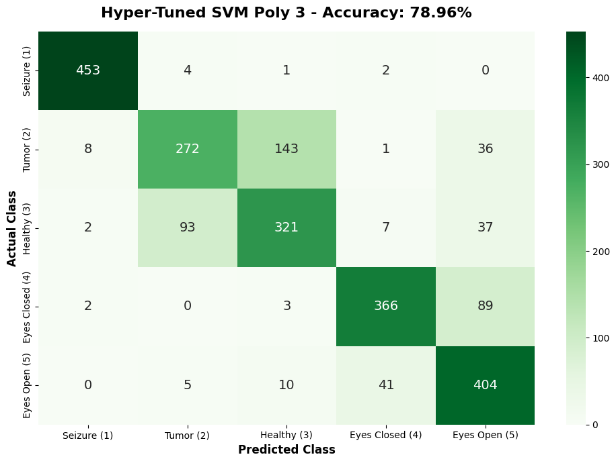
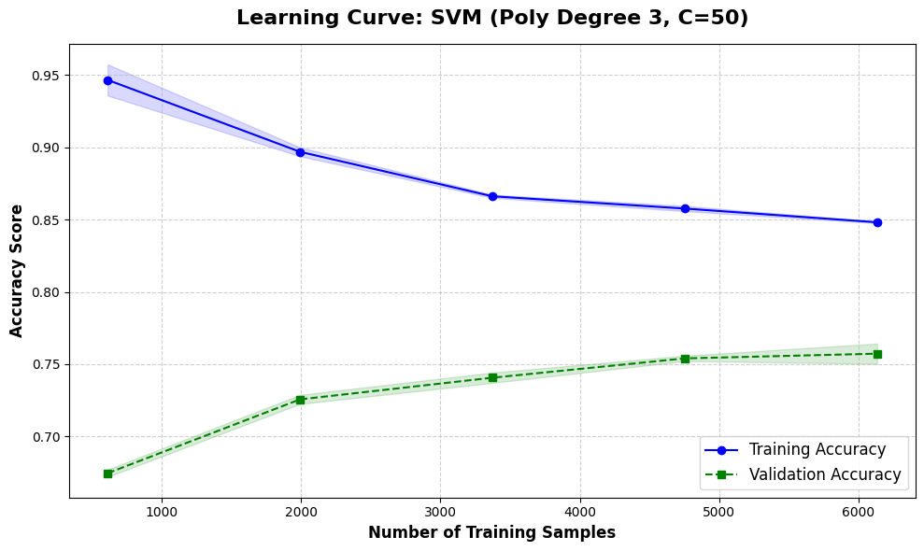
SVM Polydegree 3

Slide 11
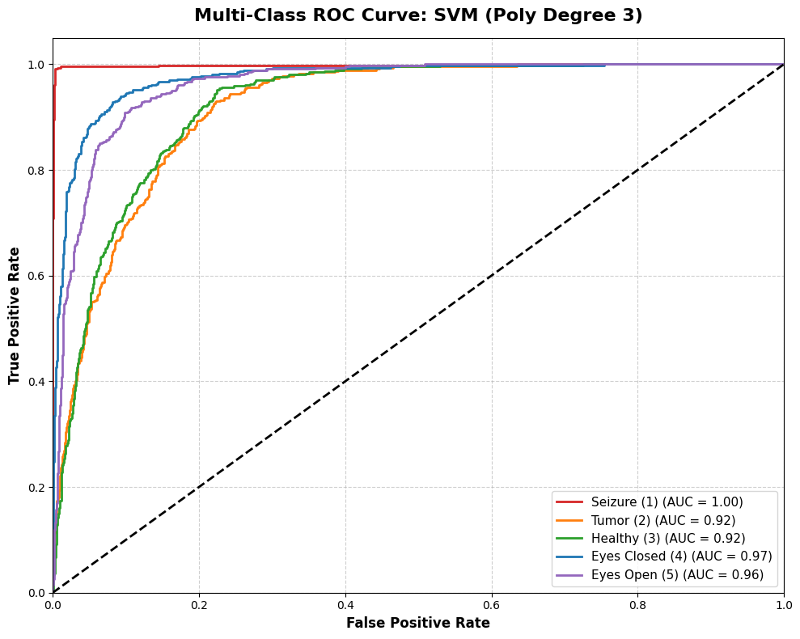
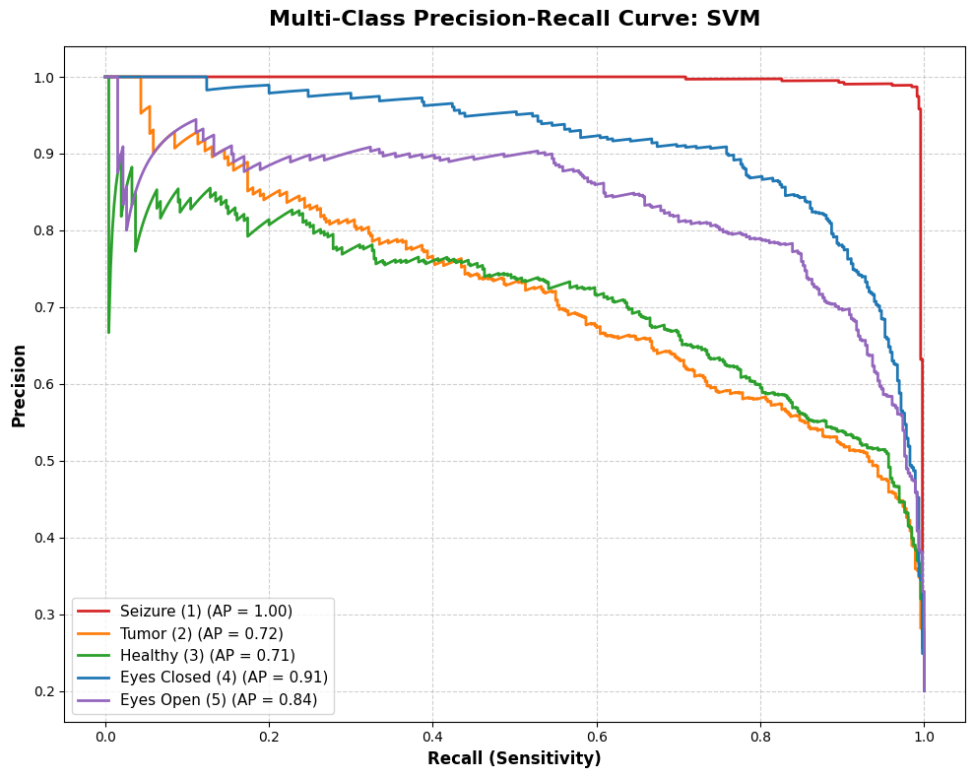
SVM Polydegree 3

Slide 12
SVM Polydegree
Overall Accuracy | 78.96%
Weighted Precision | 0.7929
Weighted Recall | 0.7896
Weighted F1 Score | 0.7877

Slide 13
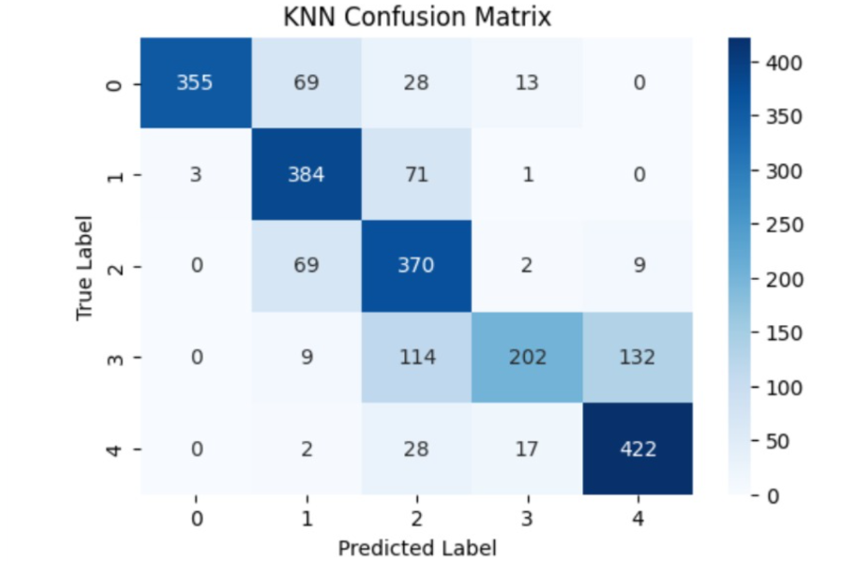
KNN 1

Slide 14
KNN 1
Overall Accuracy | 75%
Weighted Precision | 0.79
Weighted Recall | 0.76
Weighted F1 Score | 0.75

Slide 15
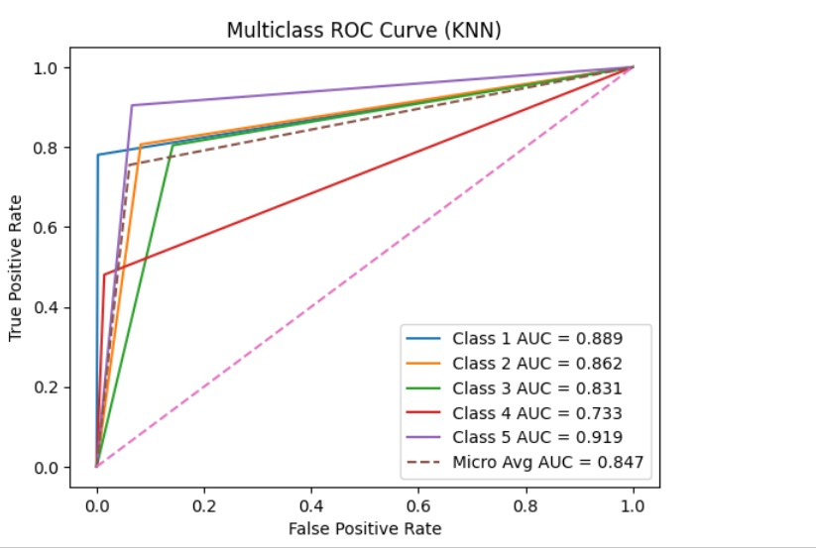
KNN 1

Slide 16
Attention-Based LSTM
All machine learning models are tried according to given training pipeline for the project.
The results of machine learning show that machine learning models are not efficient for time series data.
The deep learning model is used for effective learning of EEG data.
An LSTM (Long Short-Term Memory network) is designed for:
Sequential memory
Time dependencies
Pattern evolution

Slide 17
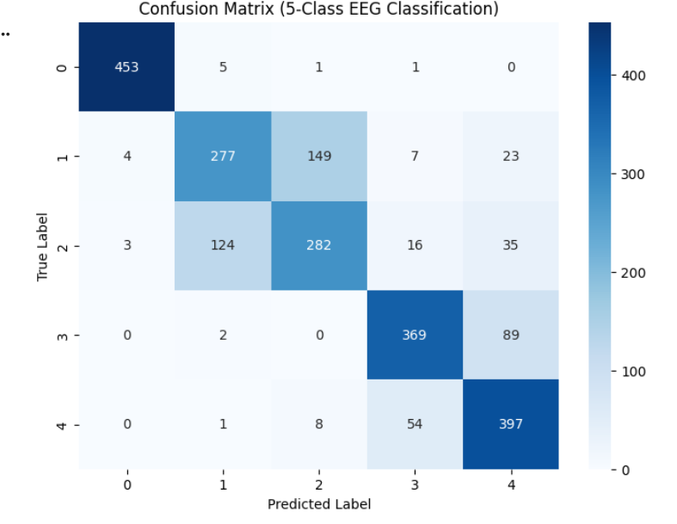
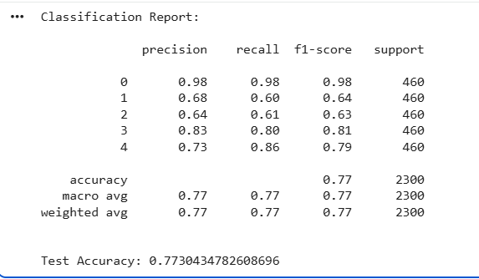
Multilayer LSTM + Attention Layer

Slide 18
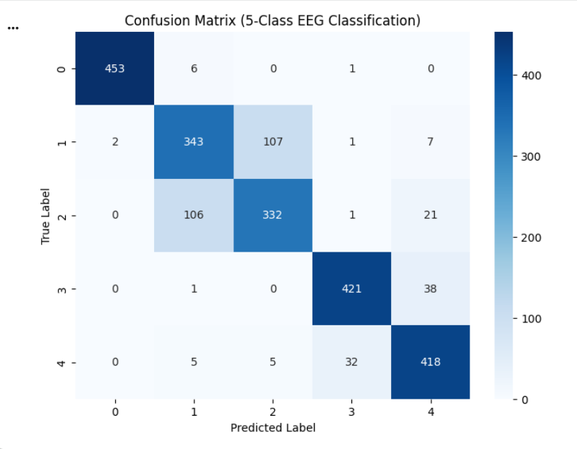
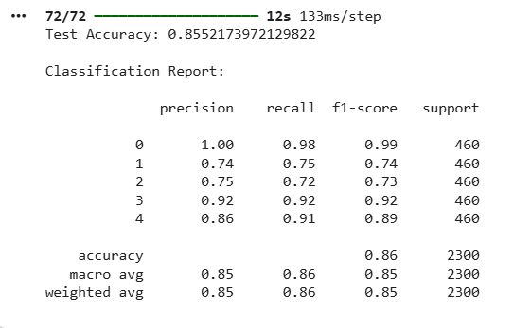
CNN+ BiLSTM

Slide 19
Attention-Based LSTM
Overall Accuracy | 85%
Weighted Precision | 0.85
Weighted Recall | 0.86
Weighted F1 Score | 0.85

Slide 20
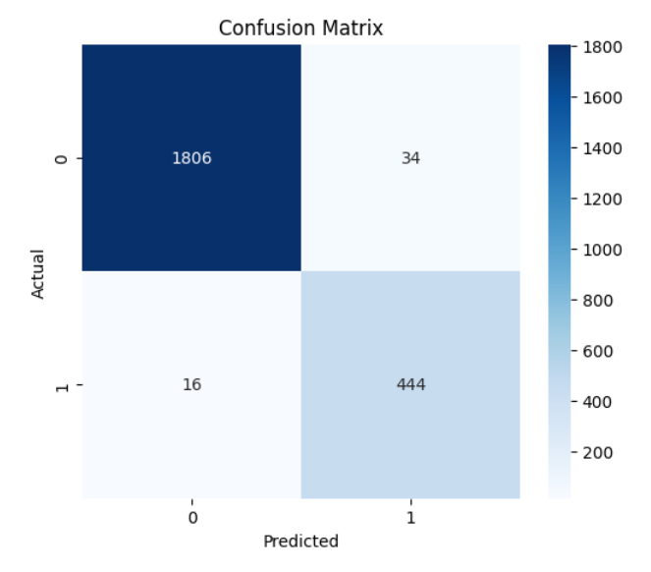
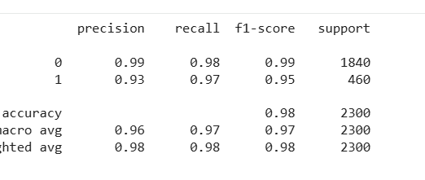
Attention-Based LSTM

Slide 21
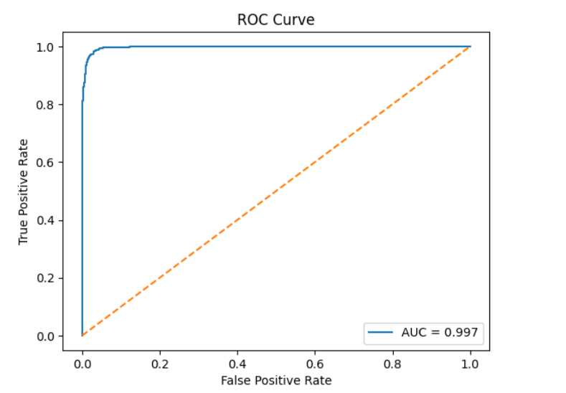
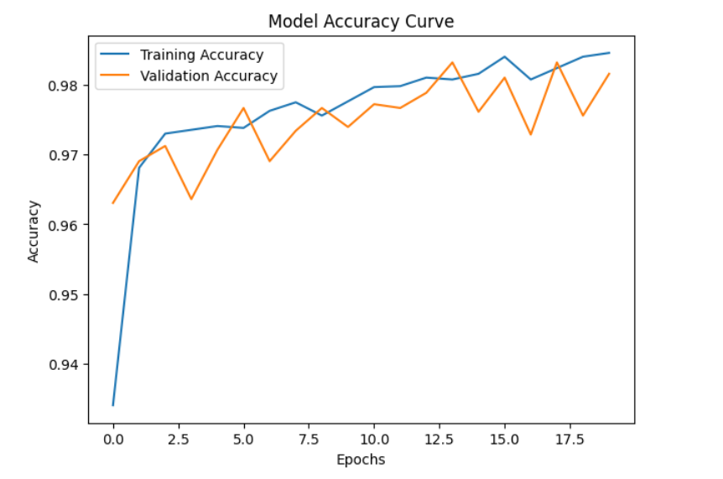
Graphical Analysis

Slide 22
CONCLUSION
By combining robust preprocessing, advanced signal analysis, discriminative feature extraction, and reliable classification techniques, the proposed framework aims to support clinical decision-making.
Ultimately, this automated classification system can support more accurate and timely diagnosis and intervention, enhancing the overall management of epilepsy.

Slide 23

TEAM MEMBERS
Thank You

Slide 24
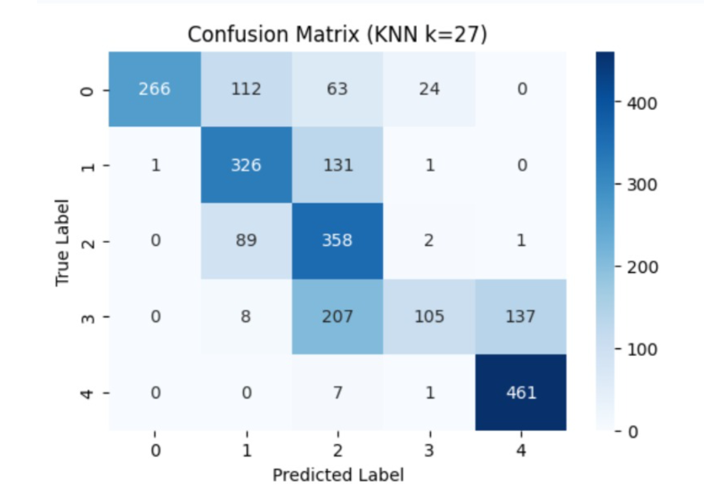
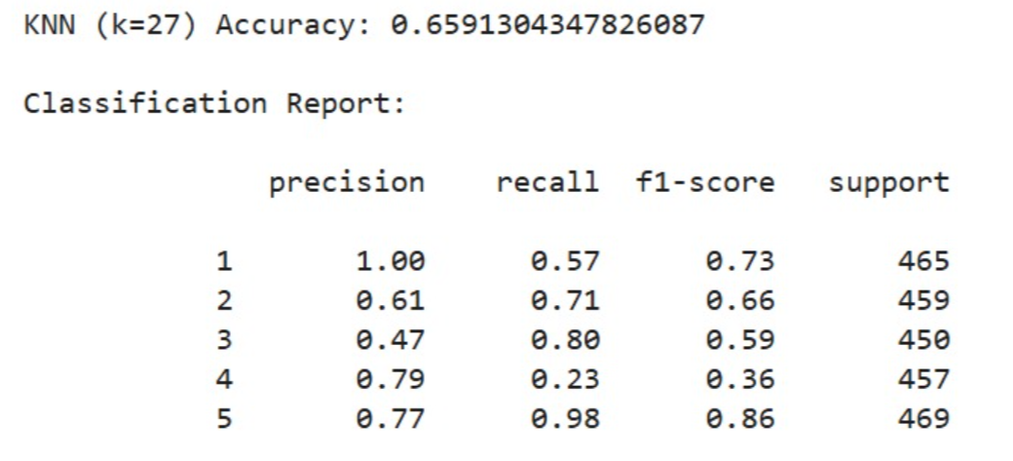
KNN 27

Slide 25
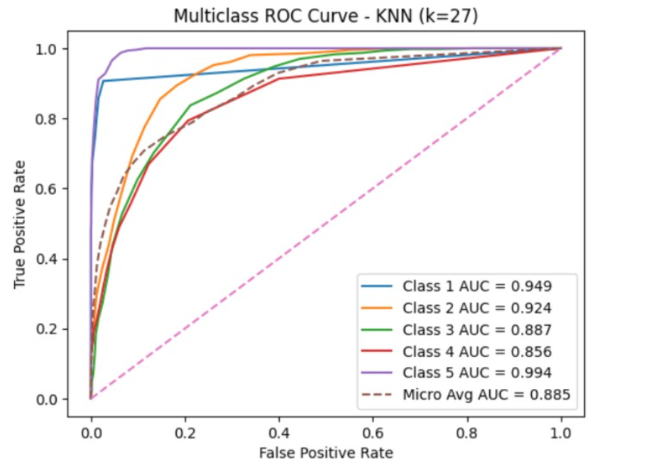
KNN 27

