Slide 1
Grace Fatima Tswanya
Algorithms

Slide 2
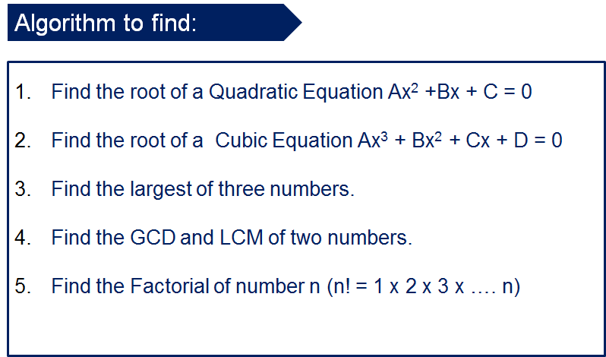
Algorithms(Pseudocode and flowcharts)

Slide 3
Exercise 1-Algorithm to find the roots of a quadratic equation
FLOWCHART
PSUEDOCODE
START
INPUT a b and c
COMPUTE f=-b+(sqrt(b^2-(4*a*c)))
COMPUTE m=-b-(sqrt(b^2-(4*a*c)))
COMPUTE x₁ =f/2*a
COMPUTE x₂ =m/2*a
PRINT x₁ and x₂
Input a, b,c
f=-b+(sqrt(b**2-(4*a*c)))
m=-b-(sqrt(b**2-(4*a*c)))
x₁ =f/2*a
x₂ =m/2*a
Print x₁ and x₂
STOP

Slide 4
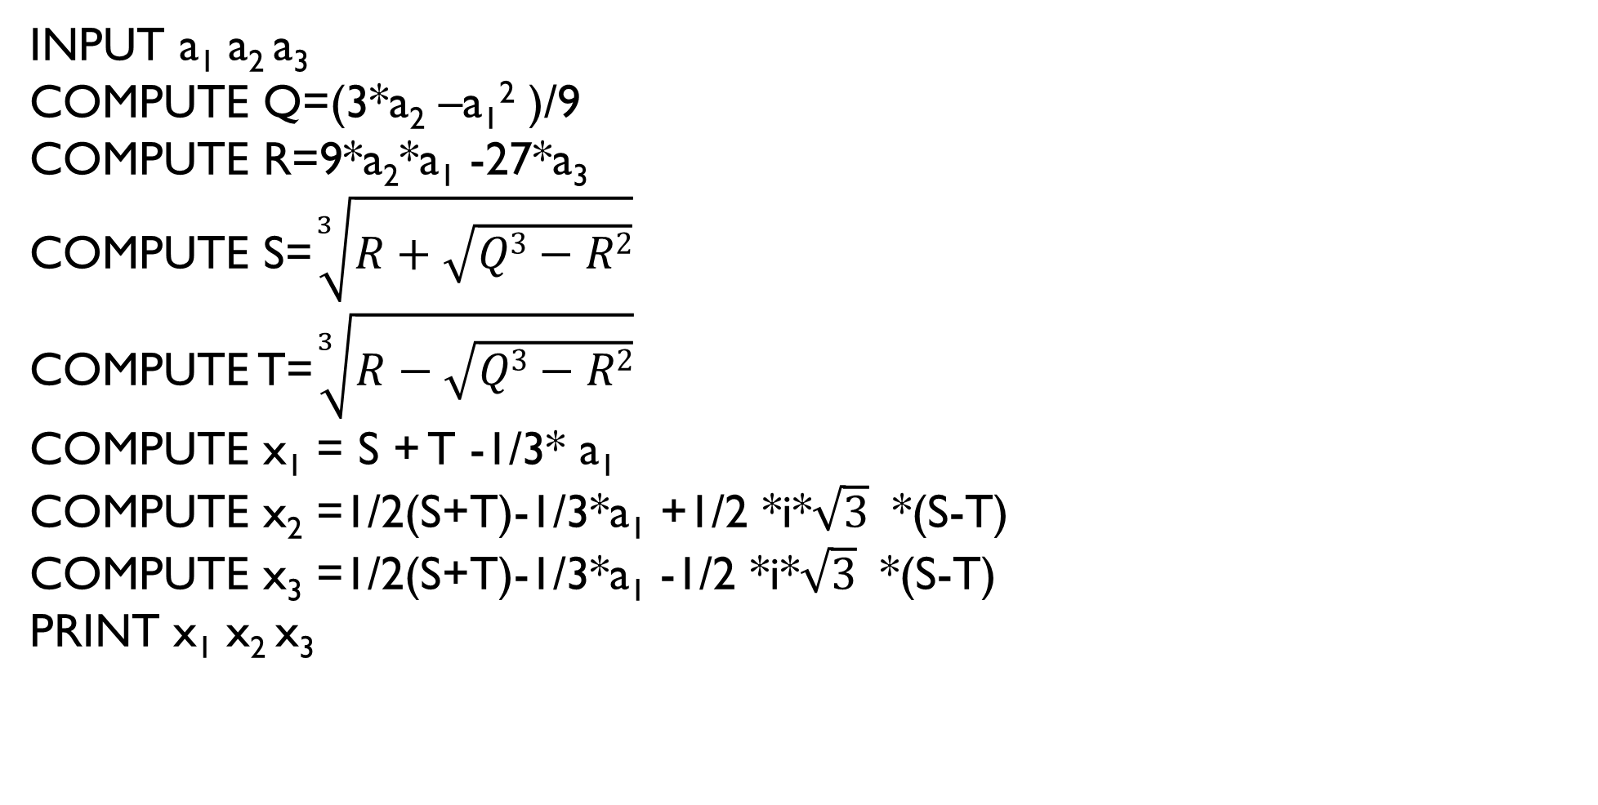
Exercise 2-algorithm to find the roots of a cubic equation
PSEUDOCODE
INPUT a₁ a₂ a₃
COMPUTE Q=(3*a₂ –a₁² )/9
COMPUTE R=9*a₂*a₁ -27*a₃
COMPUTE S=$\sqrt[3]{R+\sqrt{Q3−R2}}$
COMPUTE T=$\sqrt[3]{R−\sqrt{Q3−R2}}$
COMPUTE x₁ = S + T -1/3* a₁
COMPUTE x₂ =1/2(S+T)-1/3*a₁ +1/2 *i*$\sqrt{3}$ *(S-T)
COMPUTE x₃ =1/2(S+T)-1/3*a₁ -1/2 *i*$\sqrt{3}$ *(S-T)
PRINT x₁ x₂ x₃

Slide 5


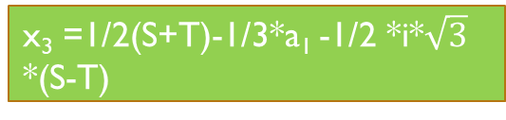
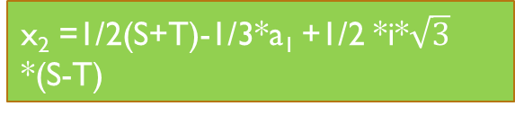
Flowchart
START
T=$\sqrt[3]{R−\sqrt{Q3−R2}}$
input a₁ a₂ a₃
x₁ = S + T -1/3* a₁
Q=(3*a₂ –a₁² )/9
x₂ =1/2(S+T)-1/3*a₁ +1/2 *i*$\sqrt{3}$ *(S-T)
R=9*a₂*a₁ -27*a₃
x₃ =1/2(S+T)-1/3*a₁ -1/2 *i*$\sqrt{3}$ *(S-T)
S=$\sqrt[3]{R+\sqrt{Q3−R2}}$
print x₁ x₂ x₃
STOP

Slide 6
Exercise 3-algorithm to find the largest of three numbers
FLOWCHART
START
PSEUDOCODE
Input a,b,c
INPUT a,b,c
COMPUTE IF a>b and a>c
PRINT a is the largest number
COMPUTE IF b>a and b>c
PRINT b is the largest number
COMPUTE IF c>a and c>b
PRINT c is the largest number
IF a>b and a>c
YES
print a is the largest number
NO
IF b>a and b>c
YES
print b is the largest number
NO
NO
IF c>a and c>b
YES
print c is the largest number
STOP

Slide 7
Exercise 4-algorithm to find the gCD and Lcm of two numbers
PSEUDOCODE
INPUT a,b
IF a>b SET CounterLimit =A
ELSE SET CounterLimit =B
Loop:Counter i in range (1, CounterLimit +1)
IF a%i=0 and b%i=0
PRINT GCD

Slide 8
fLOWCHART
START
Input a,b
FALSE
IF a>b
TRUE
SET CounterLimit =B
SET CounterLimit =A
Loop:Counter i in range (1, CounterLimit +1)
IF a%i=0 and b%i=0
PRINT GCD
STOP

Slide 9
Exercise 5-algorithm to find the factorial of numbern(n!=1x2x3x…n)
PSEUDOCODE
INPUT n
INPUT factorial
COMPUTE IF n<0
PRINT error
If num =0
PRINT the factorial of 0 is 1
ELSE
COMPUTE loop: counter i =(1,n+1)
COMPUTE factorial * 1
PRINT the factorial of num is factorial

Slide 10
Flowchart
START
IF num<0
Print error
Input n and factorial
If num =0
Print The factorial of 0 is 1
loop: counter i =(1,n+1)
Factorial *1
Print the factorial of num is factorial
STOP

