Slide 1
TDMClassroom

Slide 2
TDMClassroom
Write
(SQL DML)
App
BDD
Nom | Prenom | ville | photo
Read
(SQL DIL)

Slide 3
Table Student
Create table student (num int not null primary key auto_increment,
Nom varchar(22),prenom varchar(22),ville varchar(22), photo text)

Slide 4

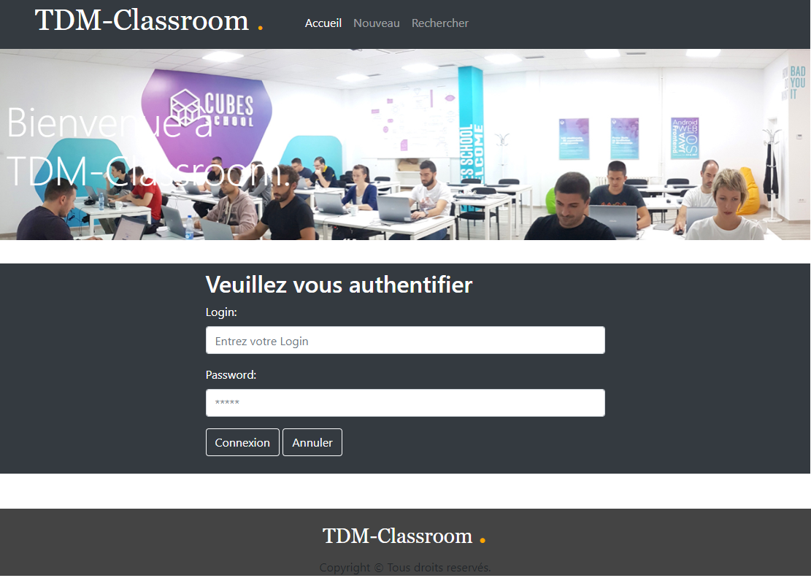
accueil

Slide 5
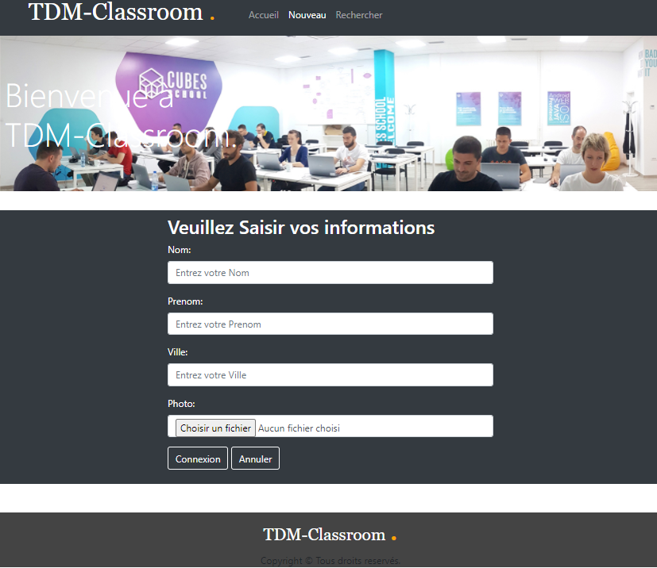
Nouveau

Slide 6
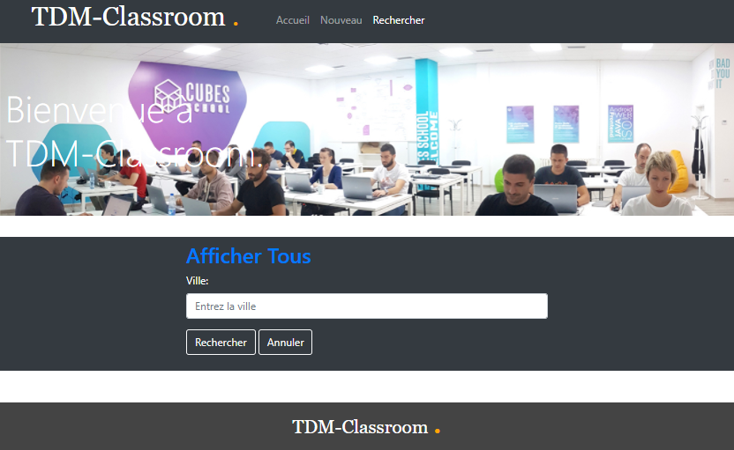
Recherche

Slide 7
barème
ACC (5pts)
SAVE(5pst)
SEARCH(10pts)
Total (20pts)

