Slide 1
Dev101Classroom

Slide 2
Dev101Classroom
Write
TextFile
(students .txt)
App
Read

Slide 3


accueil

Slide 4
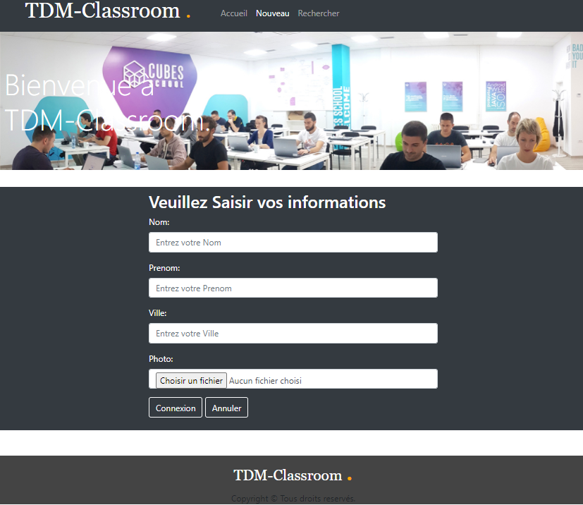
Nouveau

Slide 5
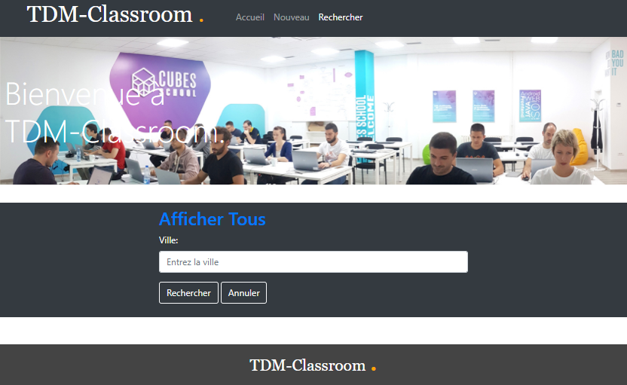
Recherche

Slide 6
barème
ACC (5pts)
SAVE(5pst)
SEARCH(10pts)
Total (20pts)

