Slide 1

SikLemau
Sik lemau, sik mau lemau. Township health agent prototype.
Team name: Alpha-5
Team leader: Nur Fatin binti Shadi
University: Universiti Malaysia Sarawak (UNIMAS)
Members:
Charmaine Zafira Toh binti Mohammad Christopher Toh
Shaneryn Shanon Samson
Jawa Jubin Denis
Melanie Bernida anak Bernard
Email: 117757@siswa.unimas.my Contact: 013-699 6851
Sime Darby Property University Hackathon 2026 · People track
Notes:
Open with the name: SikLemau is Sarawak Malay for not weak.

Slide 2
1. The Problem
Who is affected and why it matters
Unnoticed in a crisis
Passive, individual apps
No township signal
Residents who live alone, especially seniors, can go unnoticed for hours after a fall or health event.
Health apps wait to be opened and ignore neighbours, parks, clinics and guardhouses.
Management cannot see who is isolated or where shade, lighting and benches are missing.
Malaysia is ageing, so more households with older residents are coming to every township.
SikLemau
Notes:
Seniors living alone can go unnoticed. Malaysia is ageing; add a source if you have one.

Slide 3
2. Target User
Who benefits, and their challenges
Older residents
Families
Neighbours and staff
Busy residents
People living alone, like Pak Cik Ahmad, 72. Want help without losing independence.
Worry from afar. Need clear, timely alerts.
Volunteers, guardhouse and management who can respond.
Want affordable healthy meals, short workouts and stress breaks.
Challenges: low digital confidence and language needs (BM, English, Mandarin, Tamil).
SikLemau
Notes:
Lead with Pak Cik Ahmad, 72.

Slide 4
3. Our Solution
An AI health agent that uses the township itself as the health system
Check-in Circle
Daily Wellbeing
Neighbour matching
Agentic actions
Township Insights
Daily check-in; escalates to neighbour, guardhouse, family if missed
Eat, Move, Mind, using local food stalls, parks and tracks
Walking buddies and caregiver circles, opt-in
Reminders, clinic request, report a broken light
Anonymised data shows where to add shade, lighting, programmes
SikLemau
Notes:
The agent acts and escalates, not just answers.

Slide 5
4. Innovation
What makes it different
Proactive
Township-aware
Community-based
The agent checks in, acts and escalates. It does not wait to be asked.
Uses real parks, tracks, food stalls, clinics and guardhouses of one community.
Neighbours are part of the solution, with consent at every step.
Closes the loop for the developer: resident behaviour becomes facility decisions. Builds on MOH guidance (MyNutriDiari 2, Malaysian Healthy Plate) with a conversational layer.
SikLemau
Notes:
Contrast with MyNutriDiari 2 and generic health chatbots.

Slide 6
5. How it Works
Resident
AI agent
Scheduler and data
Insights dashboard
Telegram (WhatsApp or township app later)
Tools: check_in, escalate, find_buddy, report_issue, get_air_quality
Escalation timers, consent, circles, events
Anonymised heatmap and recommended actions
→
→
→
Check-in ladder: 08:00 check-in → 08:05 reminder → 08:20 neighbour → 08:35 guardhouse → 08:40 family
Every contact is chosen by the resident and has consented. Each township is a configuration pack (map, facilities, volunteers).
SikLemau
Notes:
Prototype simulates the flow with synthetic data. Production is a Telegram bot with an AI agent.

Slide 7
6. Impact
Who benefits and what outcomes we aim for
Residents
Families
Management
Sime Darby Property
Earlier help, healthier routines, less loneliness.
Peace of mind with contextual alerts.
Faster, better-informed response with existing staff.
Higher liveability and retention; facilities placed using data.
Proposed measures: check-in response time, weekly active participants, loneliness (UCLA 3-item), facility actions taken.
SikLemau
Notes:
Targets are proposed measures, not results.

Slide 8
7. Feasibility
Can it realistically be implemented?
Low cost
Safe and private
Risks handled
Prototype built on free tools. Uses existing guardhouse and management staff.
No diagnosis. Red flags go to 999. Opt-in, revocable consent. Designed for PDPA.
Tunable timing for false alarms, family-assisted setup, rotating volunteers.
Stakeholders: Sime Darby Property township team, guardhouse, resident volunteers, partner clinics.
SikLemau
Notes:
Be ready on false alarms, privacy and WhatsApp.

Slide 9
8. Implementation
Pilot: 500 households, 3 months, one township agreed with Sime Darby Property
Weeks 1–3: Onboard
Weeks 4–10: Run live
Weeks 11–12: Evaluate
QR codes at guardhouses and halls. Train volunteers. Set township configuration pack.
Check-ins and escalation live. Weekly review of alerts and feedback.
Measure response time, participation, loneliness. Report to Sime Darby Property.
Scale: bundle into township management services; clinic and pharmacy partners as optional revenue. Next build step: working Telegram bot.
SikLemau
Notes:
Targets are proposals to be agreed.

Slide 10
Why Our Team Should Win
SikLemau turns a township into a health system. Instead of another passive app, it checks on residents, escalates when something is wrong, and connects neighbours through shared health goals. It is practical: it uses existing guardhouse staff, free tools and a configuration pack for each township. It is safe and private by design, and gives Sime Darby Property anonymised insights to place shade, lighting and programmes where residents need them. Our prototype demonstrates the full journey, and our pilot plan is ready to start.
SikLemau
Notes:
About 85 words.

Slide 11
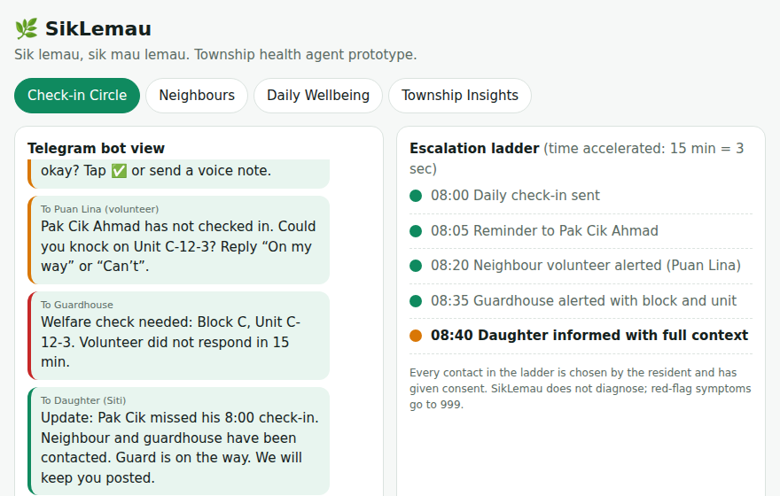
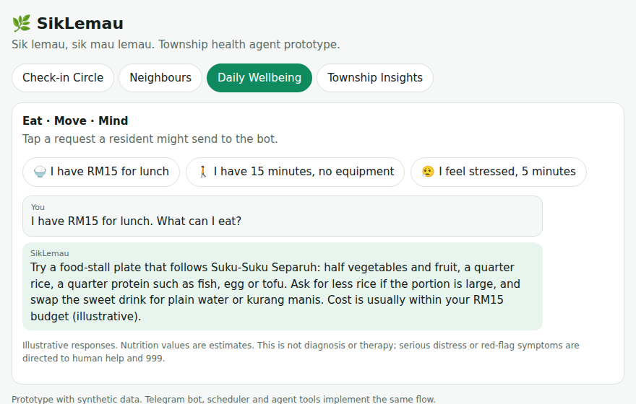
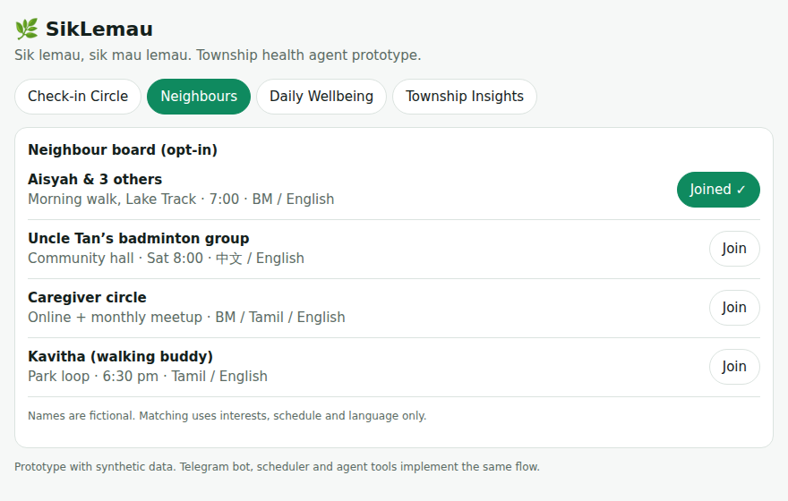
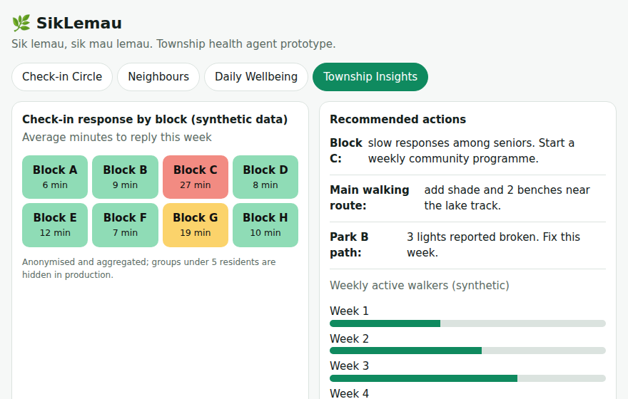
Appendix: Visual Concept (prototype screens)
SikLemau
Notes:
Synthetic data. Prototype simulates the flow.

