Slide 1
Dhaka Route Finder
Shortest and fastest routes in Dhaka with BFS, UCS and A* search
CSE 440 Artificial Intelligence, Section 1 | Project Group 9
Abdullah Al Galib
Map data
Pakeezah Tajwar Wafa
BFS and UCS
Fatin Sadab Sinan
A* and GitHub
Nawrose Naomi
Visuals and experiments
Notes:
Start by introducing every member by full name, as the course manual requires.

Slide 2
The best route depends on what you want
Shortest
Fastest
7.7 km
25 min
Gulshan 1 → Mohakhali → Farmgate → Dhanmondi 27
Gulshan 1 → Kawran Bazar → Dhanmondi 27 (via Hatirjheel)
A state is a place, an action is driving one road, and each road costs km or minutes.

Slide 3
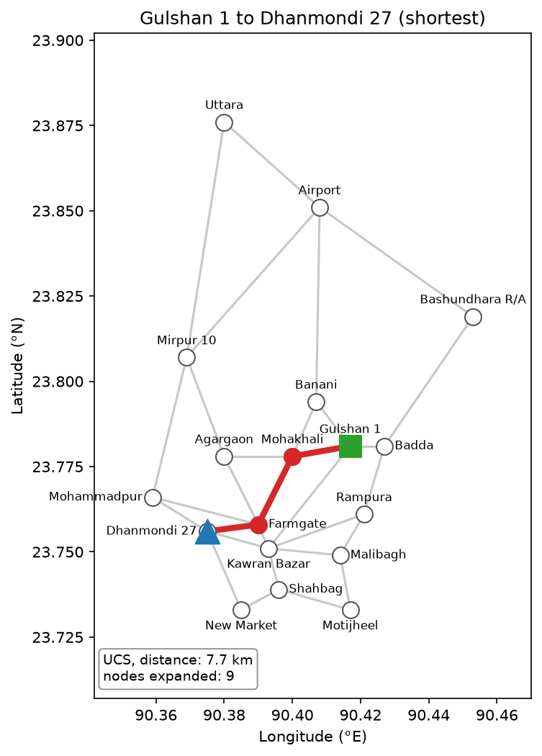
Our map: 18 places, 30 roads
Places drawn at real latitude and longitude
Each road stores distance (km) and time (min)
Red: route found by UCS; green: start; blue: goal
A* finds the same cost and expands about half as many nodes (all 306 pairs)

Slide 4
Progress and next steps
Week 1
Week 2
Week 3
Week 4
Topic, roles, repo, designs
Data, BFS, UCS, A*, map drawing
Both objectives, text menu
Project update (class 12)

