Slide 1
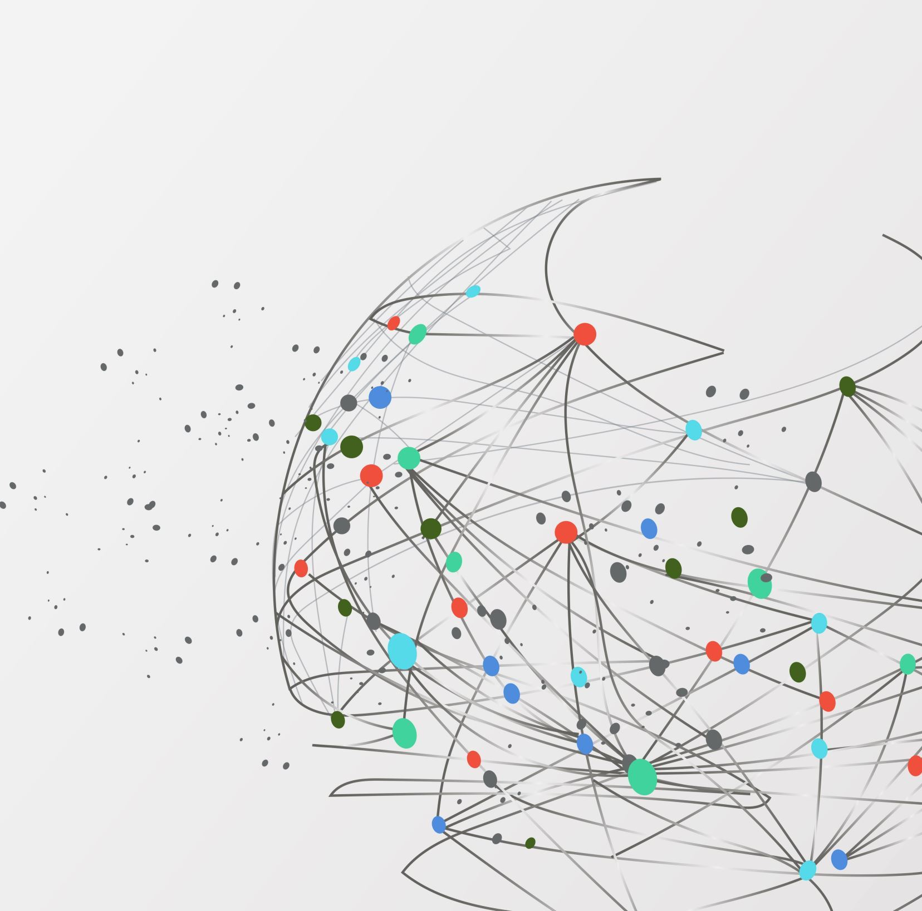
Predicting Appointment No-Shows Using Deep Neural Networks
Fatkhullakh Turakhonov, 192066

Slide 2
Problem Formulation
No-shows cause financial loss and scheduling inefficiency.
Objective: predict whether a booked patient will attend their appointment.
Model output: probability ∈ [0, 1] → interpreted as risk of no-show.
Goal metric: maximize AUC-ROC and F1 score.

Slide 3
Dataset Overview
Source: Kaggle – Medical Appointment No-Shows Rows: 110 527 Columns: 14 Size: ≈ 4 MB Target column: No-show → “Yes” = did not come, “No” = attended Label ratio: ≈ 20 % no-shows / 80 % shows

Slide 4
Dataset Features
Patient Demographics
Gender: Male/Female
Age: Patient age in years
Neighbourhood: Patient location (81 unique areas)
Medical Conditions
Hypertension: Binary (Yes/No)
Diabetes: Binary (Yes/No)
Alcoholism: Binary (Yes/No)
Handicap: Disability level (0-4)
Appointment Details
ScheduledDay: When appointment was scheduled
AppointmentDay: Actual appointment date
Waiting Time: Days between scheduling and appointment
SMS_received: Whether reminder SMS was sent
Scholarship: Enrollment in welfare program

Slide 5
Planned Data Splits
Training Set: 70% (~77,369 samples)
Validation Set: 15% (~16,579 samples)
Test Set: 15% (~16,579 samples)

Slide 6
Most Important Predictors
Past no-show history: Strongest predictor across all studies
Waiting time: Days between scheduling and appointment
SMS reminders: Significant impact on attendance
Age and medical conditions: Moderate predictive power
Day of week and time: Appointment scheduling factors

Slide 7
Related Work (Quick Review)
Joni Arroba et al., 2016 (Kaggle) – Decision Trees and Logistic Regression achieved ~75 % accuracy.
Fernandes et al., 2020 – Gradient Boosted Trees (AUC ≈ 0.79).
Wang et al., 2021 – Feed-Forward Neural Network improved calibration (Brier score ↓ 20 %).

Slide 8
Data Preprocessing & Feature Engineering
Data cleaning:
Remove invalid ages (Age < 0 or unrealistic).
Convert dates (ScheduledDay, AppointmentDay) → extract useful features:
waiting_days = (AppointmentDay - ScheduledDay)
appointment_weekday
Encoding:
Convert Gender, Neighbourhood, Scholarship, SMS_received, etc. into numeric form.
Normalization:
Scale continuous features (e.g., Age, waiting_days) to [0, 1].
Target definition:
No-show: Yes → 1 (did not come)
No-show: No → 0 (came)

Slide 9
Potential Application in Real Systems
When doctor views upcoming appointments: → Display No-Show Risk: 82% (High) → Color indicators (Green–Yellow–Red).
Automation examples:
High-risk → extra reminder or require deposit.
Medium-risk → notify doctor or send confirmation request.
Business impact:
Reduces lost time and revenue.
Builds trust by improving schedule reliability.

