Slide 1
System for an Educational Center
The first electronic system for an educational Center .

Slide 2

Frist Gui
The idea of the project depends on creating a system for educational center that is used by one of the workers in the center , where the interface of the program is a welcome screen represented by welcome to the center .

Slide 3
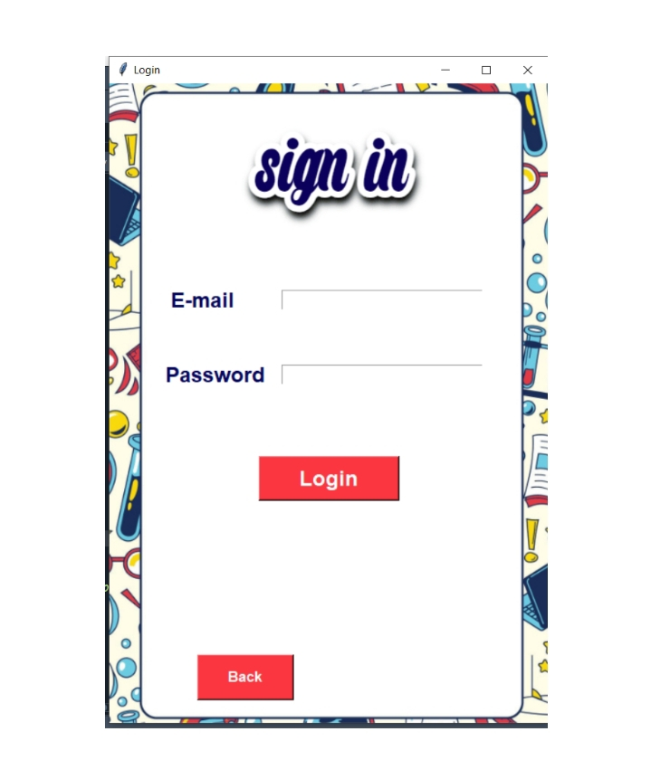
Second GUi
Then it appears to the user the possibility of logging in to the system, so that no one can easily access the system , as it appears to him that he can enter through the password and email .

Slide 4
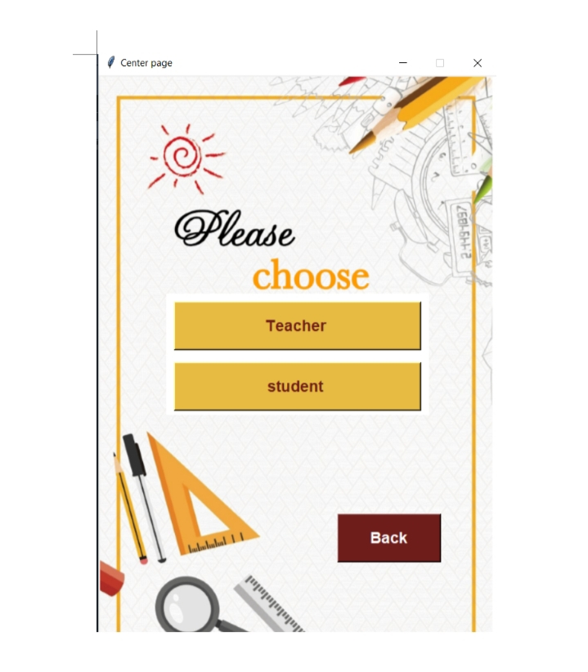
Third Gui
And when he enters the password and username correctly , he enters a new framework that gives him the right to choose between two options the frist is either to choose the teacher or student button .

Slide 5
Fourth Gui
If he choose the teacher button , anther frame opens for him ,it consists of six buttons :
The frist button to add, and that button gives him the right to add the new teacher data by filling in the data such as name , age , id, gender ,name of the subject he is studying ,and phone number .
The other button is modification button and he can modify any data a teacher only by putting his id .
The third button is the search button , in which he can search for the data of any teacher
The fourth button is the delete button ,and he can delete the data of any teacher .
Either the select all button selects the data of all the teachers registered in the database .
And there is a back button , and that floats to last page .

Slide 6
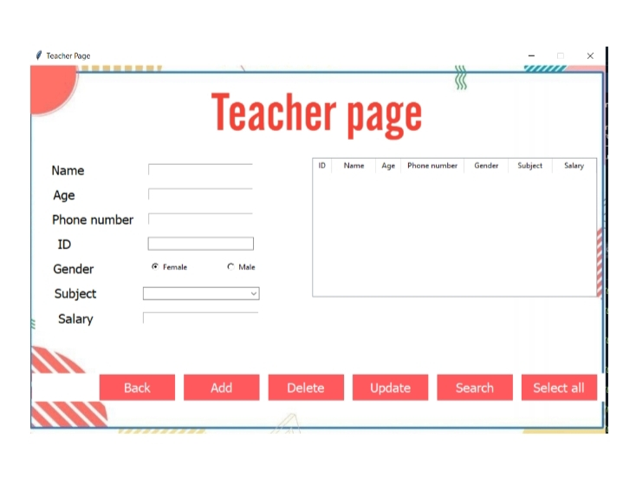
Teacher Button

Slide 7
Fifth Gui
If he choose the student button , anther frame opens for him ,it consists of six buttons:
The Frist button to add, and that button gives him the right to add the new student data by filling in the data such as name , age , id, gender ,name of the subject he is studying ,and phone number .
The other button is modification button and he can modify any data a student only by putting his id .
And the third button is the search button , in which he can search for the data of any student.
The fourth button is the delete button ,and he can delete the data of any student .
Either the select all button selects the data of all the students registered in the database .
And there is a back button , and that floats to last page .

Slide 8
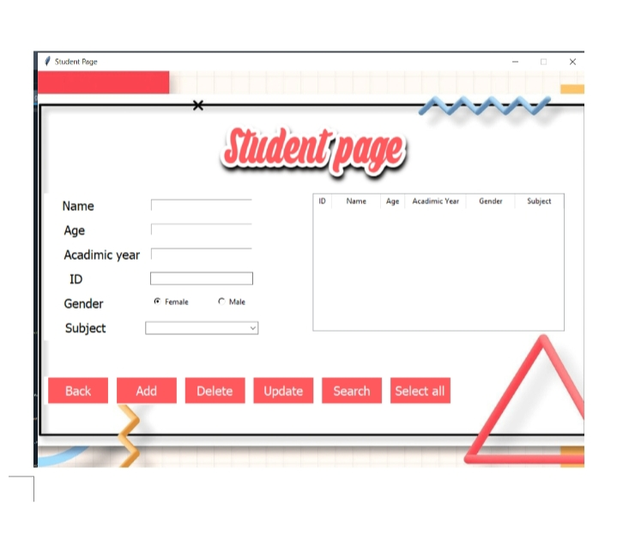
Student Button

Slide 9
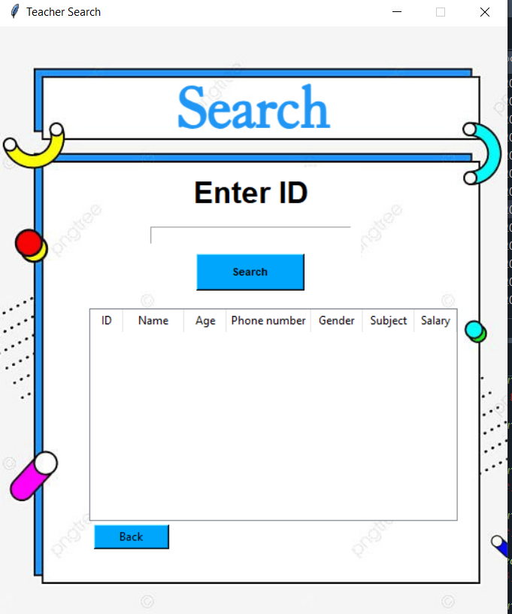
Sixth Gui
If you choose the search button in teacher gui , anther frame opens for him , it consists :
Enter ID to find teacher information .
Table to display this information .
And back button to allow you move back .

Slide 10
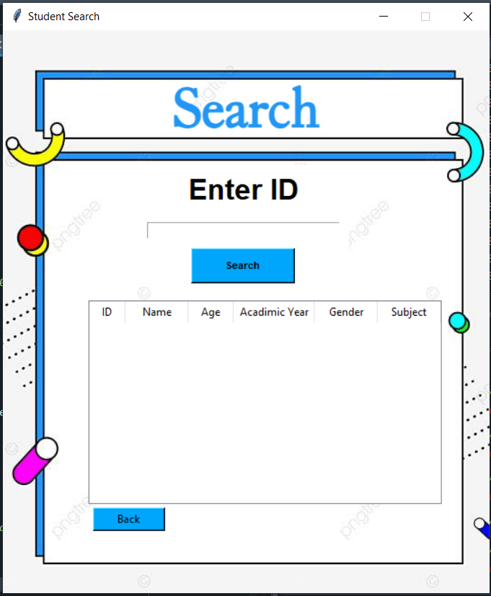
Seventh Gui
If you choose the search button in teacher gui , anther frame opens for him , it consists :
Enter ID to find teacher information .
Table to display this information .
And back button to allow you move back .

