Slide 1
Arabic Sentiment Analysis
Team 9

Slide 2
Members
Ahmed Mostafa Fahmy
1
Mahmoud Ashraf Nabeh
2
Mona Magdy Hassan
3
Fatma Ahmed Mohamed
4

Slide 3
Introduction
3
The " Arabic Sentiment Analysis (NLP) " project aims to improve sentiment analysis for Arabic company reviews using advanced Neural Networks (NN) and Natural Language Processing (NLP). By addressing linguistic complexities, the project seeks to enhance accuracy in evaluating sentiments, providing valuable insights for business communication and market analysis within the unique context of Arabic.

Slide 4
Data Preprocessing

Slide 5
Preprocessing
3
In the preprocessing phase, the project begins by:
Textual data in the 'review_description' column undergoes a series of transformations:
Emoticon-to-emoji.
Replacement and subsequent conversion to text.
Arabic stop words are removed.
Cleaning involves eliminating repeating characters.
Normalizing Arabic text.
Removing emojis, hashtags, and punctuations.
Employs a Snowball stemmer for lemmatization.
This meticulous preprocessing pipeline ensures a refined and standardized textual dataset, setting the stage for accurate sentiment analysis on Arabic company reviews.

Slide 6
Preprocessing
3
Tokenization:
This preprocessing step prepares the textual data for training a neural network model for sentiment analysis on Arabic company reviews.

Slide 7
NN Models

Slide 8
LSTM model
The model includes an Embedding layer, LSTM layer, and a Dense layer for classification. With 2,395,907 trainable parameters, the model is compiled with the Adam optimizer and categorical crossentropy loss. Training for 5 epochs with a batch size of 16 achieves 91.39% accuracy on the training set and 81.59% on the validation set.

Slide 9
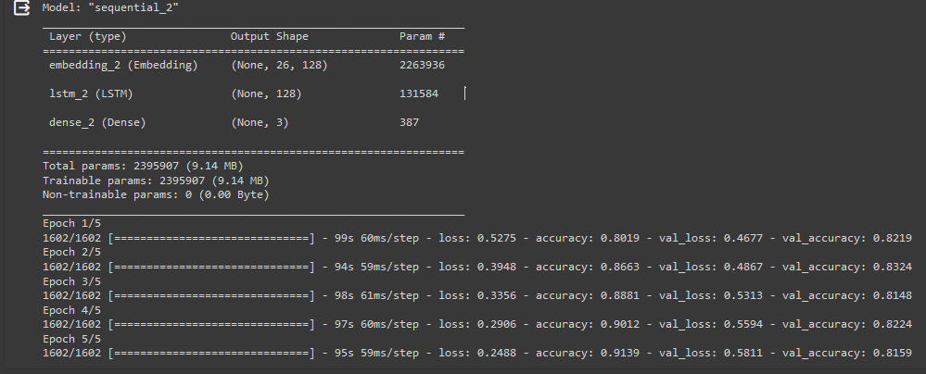
LSTM model

Slide 10
Transformer model
The model architecture, established by function, encompasses crucial parameters like maximum sequence length, vocabulary size, attention heads, feed-forward dimension, and dropout rate. Comprising embedding layers, multiple transformer blocks, and global average pooling, the model leverages self-attention mechanisms for nuanced sequential data analysis. The transformer blocks employ multi-head attention and feed-forward networks, contributing to effective feature extraction. The model's potential for contextual understanding aligns with the intricacies of sentiment analysis. Rigorous parameter tuning and evaluation on relevant datasets are essential for optimizing the model's performance in practical applications.

Slide 11
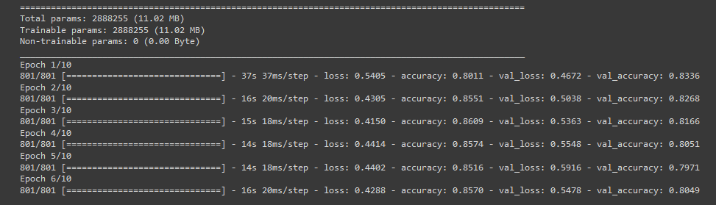
Transformer model

Slide 12
Summary
The code encompasses a comprehensive pipeline for sentiment analysis on Arabic company reviews. It begins by preprocessing the data through a series of operations, including text cleaning, normalization, and stemming. The subsequent steps involve tokenization and padding for input into both LSTM and transformer-based sentiment analysis models. The LSTM model consists of embedding and LSTM layers, while the transformer model leverages self-attention mechanisms within multiple blocks. The transformer model, with its capacity for capturing complex relationships in sequential data, is meticulously trained and evaluated. The code reflects a systematic and versatile approach to sentiment analysis, combining traditional and advanced modeling techniques for robust insights into Arabic company reviews.

Slide 13
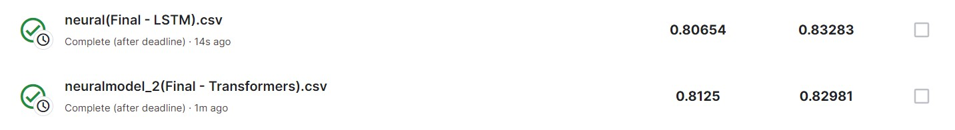
Accuracy of two models

Slide 14
Thank you

