Slide 1
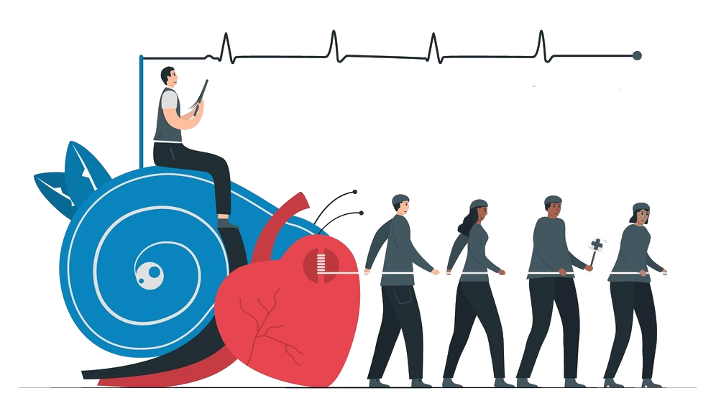
Heart Rhythm
UNDER SUPERVISION OF
Dr. Mahomed Fawzy
Eng. Ahmed Yosry

Slide 2
Our team
Amany Kamer
Fatma Nabil
Omnia Nasser
Safaa Elsyed
Ghada Fares
Fatma Hamdy
Rana Abdallh

Slide 3
Introduction
ECGs are important biomedical signals, which are reflective of an electric activity of the heart. They form a subject of intensive research for over 100 years.
ECG signals are one of the best-understood signals being at the same time an important source of diagnostic information.
Because of this, in the recent years there has been a steady
and intensive research with intent of developing efficient and effective methods of processing and analysis of ECG signals with emphasis on the discovery of essential and novel diagnostic information

Slide 4
Problem definition
Any change from the normal sequence of electrical impulses,
causing abnormal ECG Arrhythmias can take place in a healthy heart and be of minimal
consequence, but they may also indicate a serious problem and lead to
heart disease, stroke or sudden cardiac death.
Symptoms of arrhythmias include:
Fast or slow heart beat
Skipping beats
Lightheadedness or dizziness
Chest pain
Shortness of breath
Sweating

Slide 5
Solution
Electrocardiogram (ECG or EKG). During an ECG, sensors (electrodes) that can detect the electrical activity of the heart are attached to the chest and sometimes to the arms or legs. An ECG measures the timing and duration of each electrical phase in the heartbeat.

Slide 6
Thank You

