Slide 1

Database Management Systems

Slide 2
Introduction
Databases are logically modelled clusters of information, or data. A database management system (DBMS), on the other hand, is a computer program that interacts with a database. A DBMS allows you to control access to a database, write data, run queries, and perform any other tasks related to database management.

Slide 3
This article compares and contrasts three of the most widely implemented open-source RDBMSs:
MySQL
PostgreSQL
SQL SERVER

Slide 4

MySQL
According to the DB-Engines Ranking, MySQL has been the most popular open-source RDBMS since the site began tracking database popularity in 2012.
It is a feature-rich product that powers many of the world’s largest websites and applications, including Twitter, Facebook, Netflix, and Spotify.
Getting started with MySQL is relatively straightforward, thanks in large part to its exhaustive documentation and large community of developers, as well as the abundance of MySQL-related resources online.

Slide 5

PostgreSQL
PostgreSQL, also known as Postgres, bills itself as “the most advanced open-source relational database in the world.” It was created with the goal of being highly extensible and standards compliant.
PostgreSQL is an object-relational database, meaning that although it’s primarily a relational database it also includes features like table inheritance and function overloading that are more often associated with object databases.
Postgres is capable of efficiently handling multiple tasks at the same time, a characteristic known as concurrency.

Slide 6

SQL SERVER
The SQL SERVER project’s website describes it as a “serverless” database,
Most relational database engines are implemented as a server process in which programs communicate with the host server through an interposes communication that relays requests.
With SQL SERVER , though, any process that accesses the database reads from and writes to the database disk file directly.

Slide 7
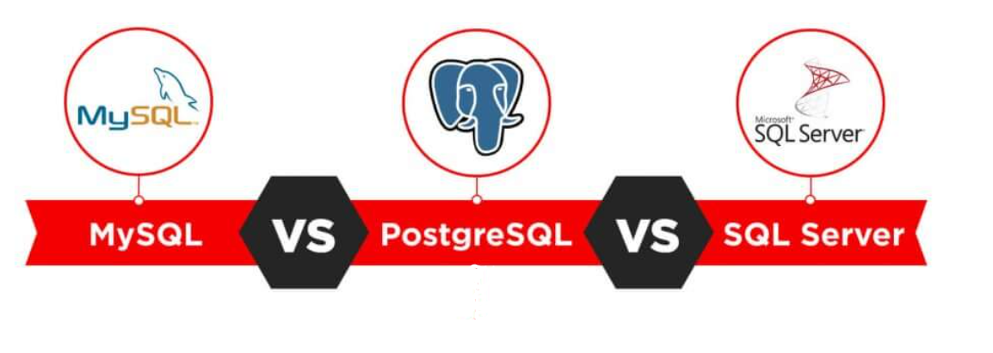
Comparaison

Slide 8
MySQL allows partitioning databases with hashing functions in order to distribute data among several nodes. Developers can generate a specific partition key that will define the data location. Hashing permits avoiding bottlenecks and simplifying maintenance.
PostgreSQL allows making LIST and RANGE partitions where the index of a partition is created manually. Developers need to identify children and parent column before assigning a partition for them.
SQL Server also provides access to RANGE partitioning, where the partition is assigned to all values that fall into a particular range. If the data lies within the threshold, it will be moved to the partition.

