Slide 1


CLINIC MANAGEMENT SYSTEM DATABASE
PRESENTATION BY FATMA ELWARRAKY
CAROL HANY
MAYA SHAHIN
FUNDAMENTAL OF DATABASE
CBIO 204

Slide 2


PROJECT OVERVIEW
What is this system?
Database for a multi-department clinic
Manages departments, clinics, doctors, patients
Tracks appointments and medical history
Handles scheduling and patient diagnoses

Slide 3
ENTITIES
Department
Clinic
Doctor
Patient
Appointment

Slide 4

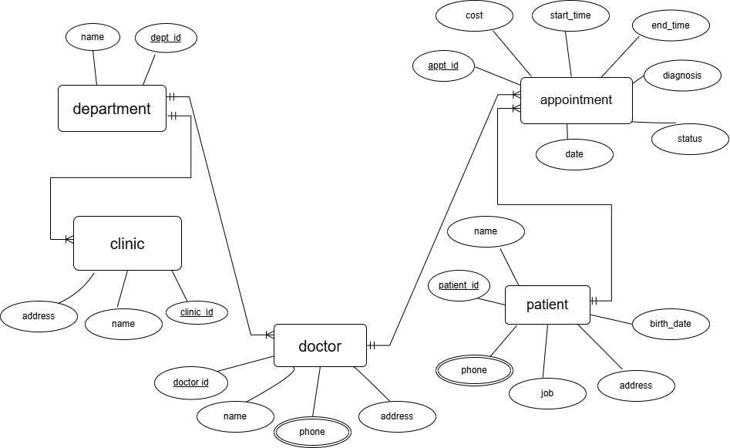

ER DIAGRAM

Slide 5
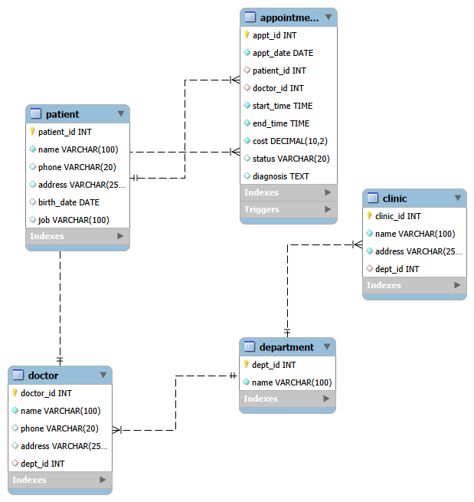
RELATIONAL SCHEMA

Slide 6

DDL
CODES
KEYPOINTS
CREATE DATABASE clinc;
USE clinc;
DDL = Data Definition Language
PRIMARY KEY ensures unique IDs
NOT NULL prevents empty names
CREATE TABLE Department (
dept_id INT PRIMARY KEY,
name VARCHAR(100) NOT NULL
);

Slide 7
DDL
CODES
KEYPOINTS
Foreign Keys create relationships
AUTO_INCREMENT generates IDs automatically
CHECK constraint limits status values
Appointment table connects doctors & patients
FOREIGN KEY (dept_id)
REFERENCES Department(dept_id)
patient_id INT PRIMARY KEY AUTO_INCREMENT
CHECK (status IN
('scheduled','in progress','postponed'))

Slide 8
DML
INSERT INTO Department VALUES ...
INSERT INTO Clinic VALUES ...
INSERT INTO Doctor VALUES ...
INSERT INTO Patient VALUES ...
Inserted Records:
10 Departments, 10 Clinics, 10 Doctors, 10 Patients

Slide 9
DML
INSERT INTO Appointment VALUES ...
Appointment Data Includes:
Appointment dates, start & end times, consultation cost, status, diagnosis
Example Diagnoses:
Headache, cough, back pain, skin rash

Slide 10

QUERIES
Query 1
Query 2
Query 3
Patients diagnosed with fatty liver disease
Addresses of cardiology clinics
Total payments in last 3 years

Slide 11
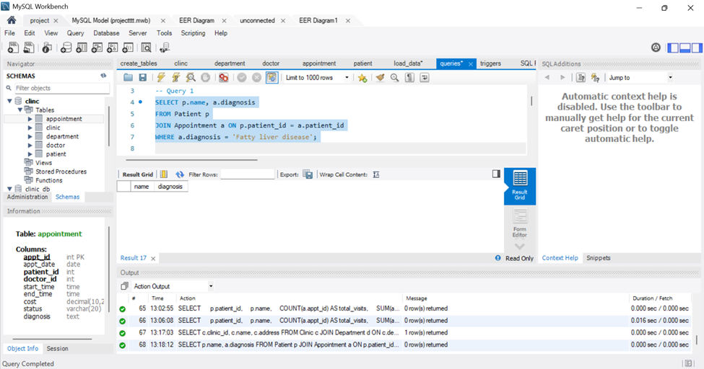
QUERY 1
Purpose :
Finds patients diagnosed with fatty liver disease during the last year.
Tables Used :
Patient
Appointment
Result :
No matching patients were found in the current dataset.

Slide 12
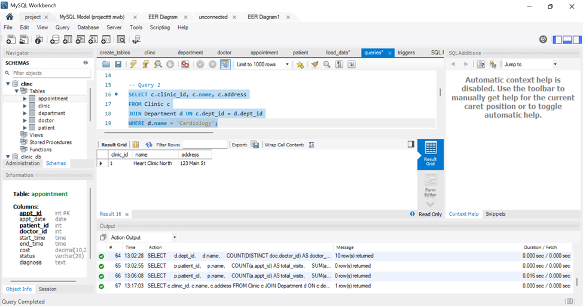
QUERY 2
Purpose :
Displays addresses of clinics that have a Cardiology department.
Tables Used :
Clinic
Department
Result :
Heart Clinic North → 123 Main St.

Slide 13
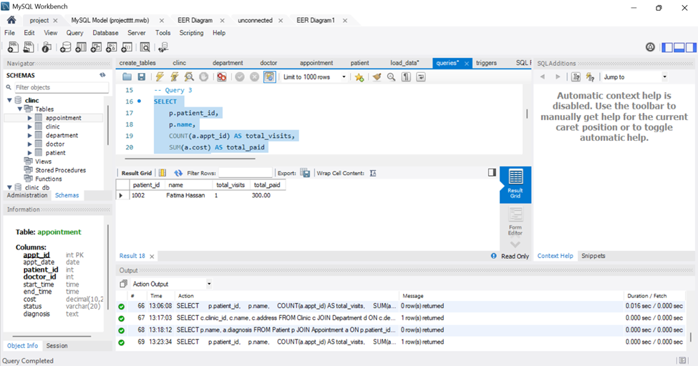
QUERY 3
Purpose :
Calculates the total amount paid by a patient in the last three years.
Tables Used :
Appointment
Result :
Patient 1002 paid $300.

Slide 14
TRIGGERS
prevent past appointments
Prevents scheduling appointments in previous dates
check appointment time
Ensures start time comes before end time
require diagnosis on completion
Requires diagnosis before marking appointment as completed
prevent double booking
Prevents overlapping appointments for doctors

Slide 15
TRIGGER LOGIC EXAMPLE
CREATE TRIGGER PREVENT_DOUBLE_BOOKING
BEFORE INSERT ON APPOINTMENT
FOR EACH ROW
BEGIN
SELECT COUNT(*) INTO conflict_count
FROM Appointment
WHERE doctor_id = NEW.doctor_id
AND appt_date = NEW.appt_date
AND (
(NEW.start_time BETWEEN start_time AND end_time) OR
(NEW.end_time BETWEEN start_time AND end_time) OR
(start_time BETWEEN NEW.start_time AND NEW.end_time)
);
IF conflict_count > 0 THEN
SIGNAL SQLSTATE '45000'
SET MESSAGE_TEXT =
'Doctor already has an appointment';
END IF;
END;

Slide 16
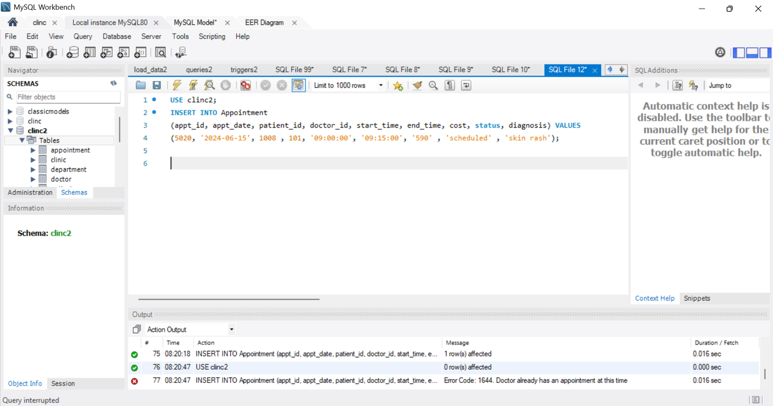
TRIGGER LOGIC EXAMPLE
HOW IT WORKS
CHECKS EXISTING APPOINTMENTS FOR THE SAME DOCTOR
DETECTS SCHEDULING CONFLICTS AUTOMATICALLY
PREVENTS DUPLICATE BOOKINGS BEFORE INSERTION
DISPLAYS AN ERROR MESSAGE IF CONFLICT EXISTS
EXAMPLE SCENARIO
DR. AHMED HAS APPOINTMENT AT 9:00 PM
ANOTHER PATIENT BOOKS AT THE SAME TIME
TRIGGER BLOCKS THE NEW APPOINTMENT AUTOMATICALLY

Slide 17
GRAPHICAL USER INTERFACE
Demonstration of the Clinic Management System interface and functionality

Slide 18
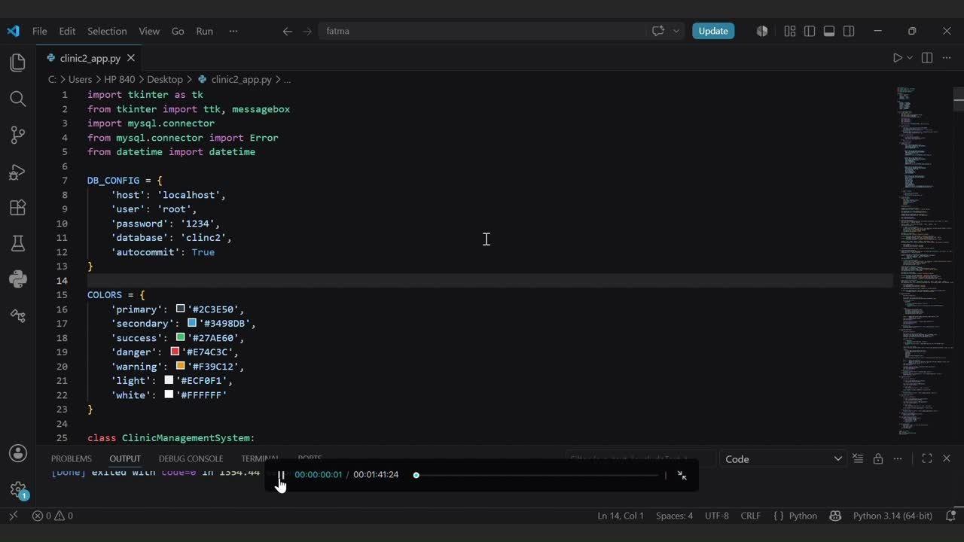

Slide 19
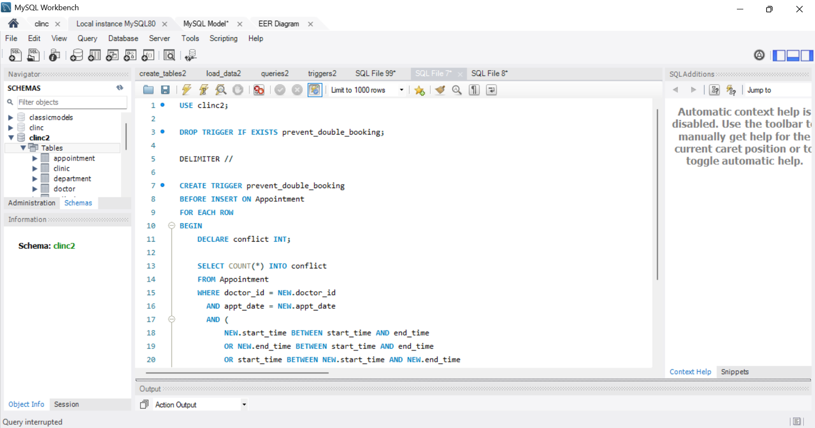
QUESTION 1
prevent two appointments for the same doctor from overlapping

Slide 20
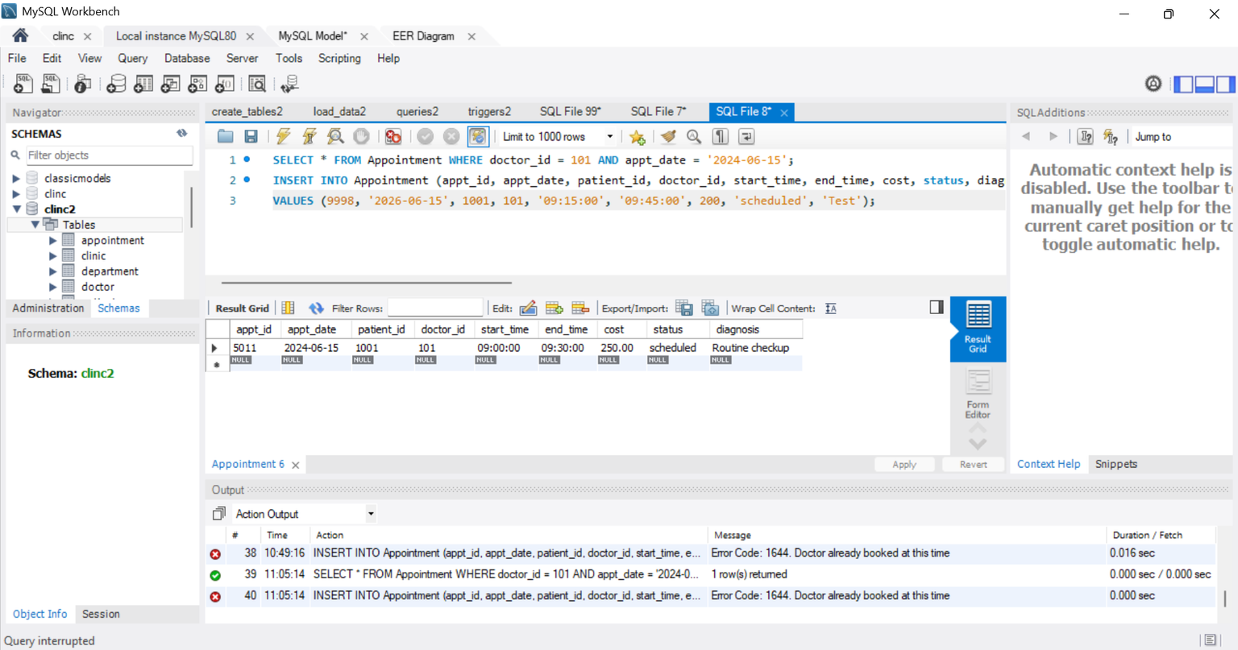
QUESTION 1 - RESULT
prevent two appointments for the same doctor from overlapping

Slide 21
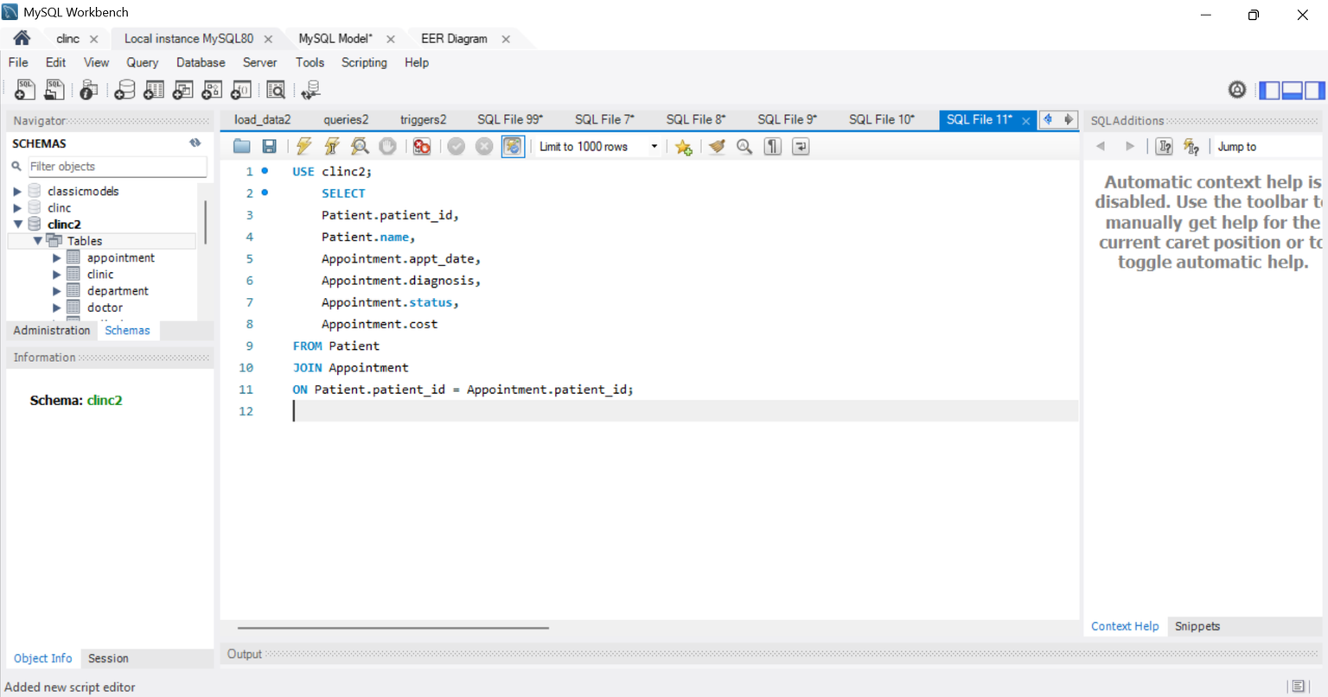
QUESTION 2
Description for query to fetch each patient’s plus their

Slide 22
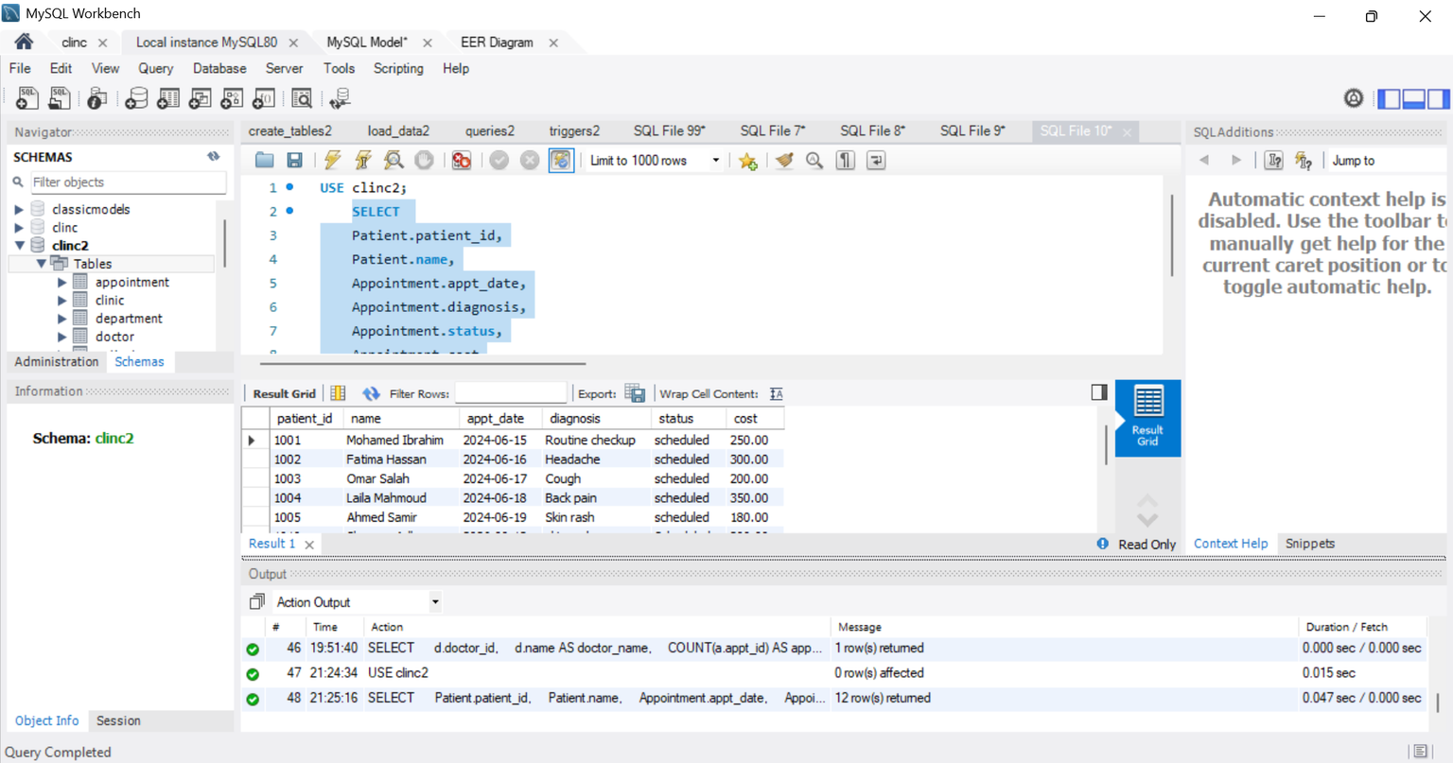
QUESTION 2 - RESULT
Description for query to fetch each patient’s plus their

Slide 23
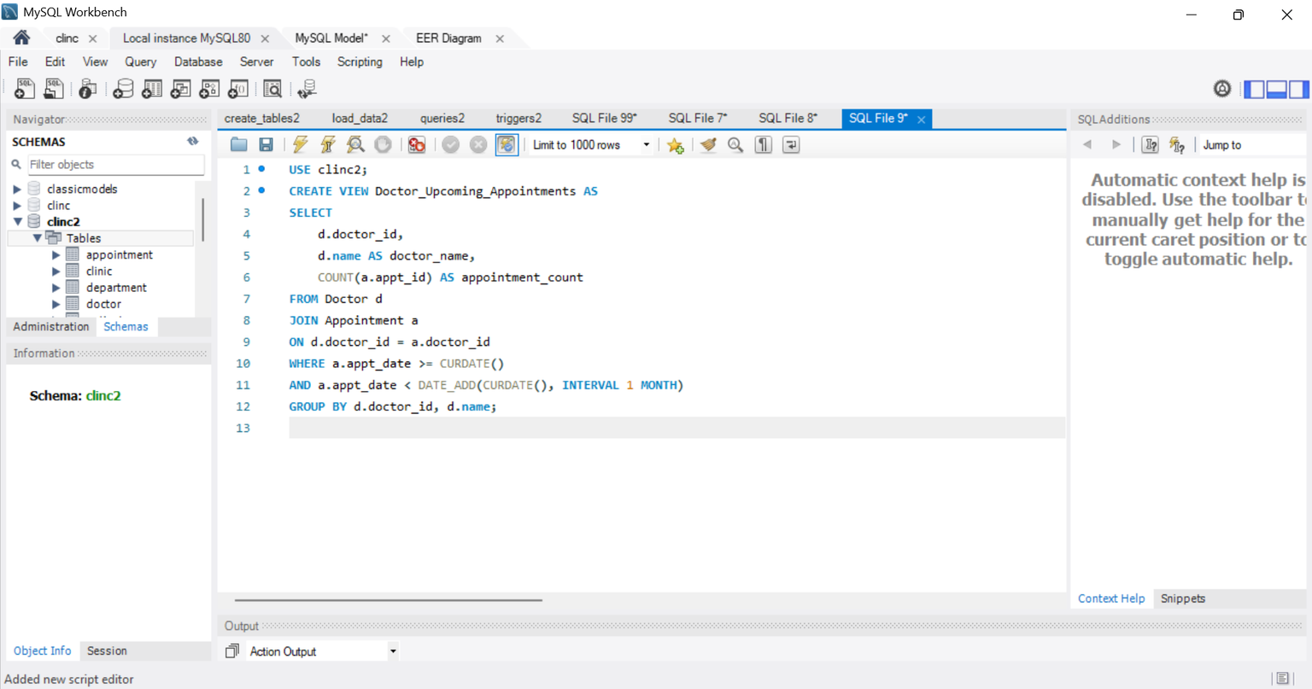
QUESTION 3
view for showing each doctor’s upcoming appointment count for next month

Slide 24
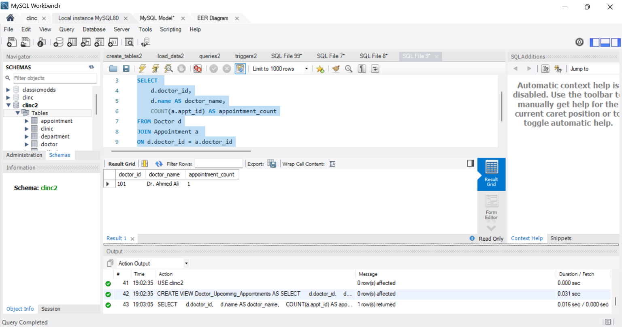
QUESTION 3 - RESULT
view for showing each doctor’s upcoming appointment count for next month

Slide 25
CONCLUSION
Developed a clinic management system using Python and MySQL
Implemented database tables, SQL queries, and GUI interface
Managed patient records and appointments efficiently
Improved data organization and usability through the system

Slide 26
THANKYOU

