Slide 1
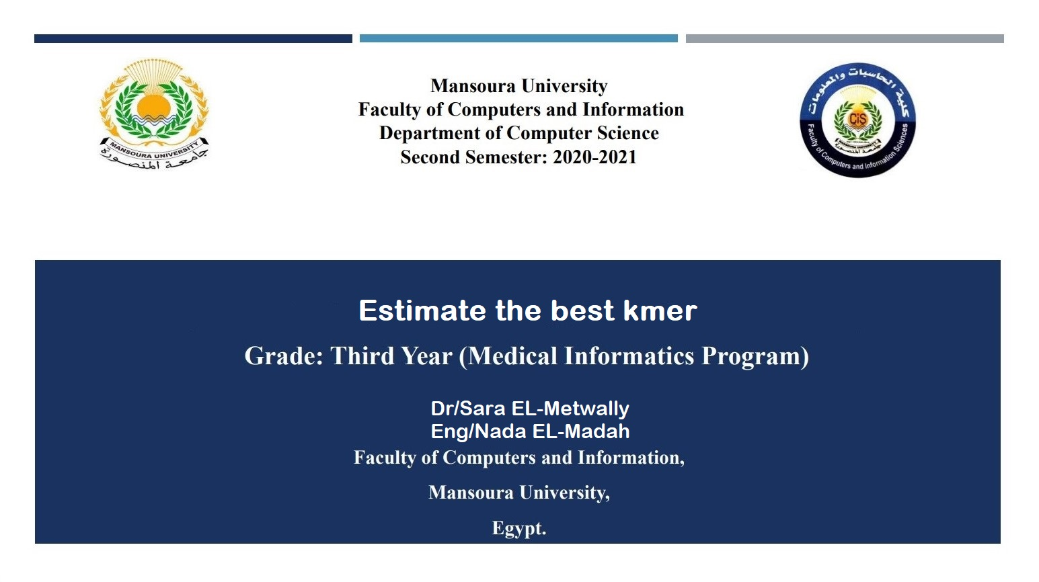

Slide 2
Introduction
k-mers : substrings of length k in DNA sequence data.
Counting k-mers is an essential component of many methods in bioinformatics, including for genome and transcriptome assembly, for metagenomic sequencing, and for error correction of sequence reads.
Although simple in principle, counting k-mers in large modern sequence data sets can easily overwhelm the memory capacity of standard computers. In current data sets, a large fraction-often more than 50%-of the storage capacity may be spent on storing k-mers that contain sequencing errors and which are typically observed only a single time in the data. These singleton k-mers are uninformative for many algorithms without some kind of error correction.

Slide 3
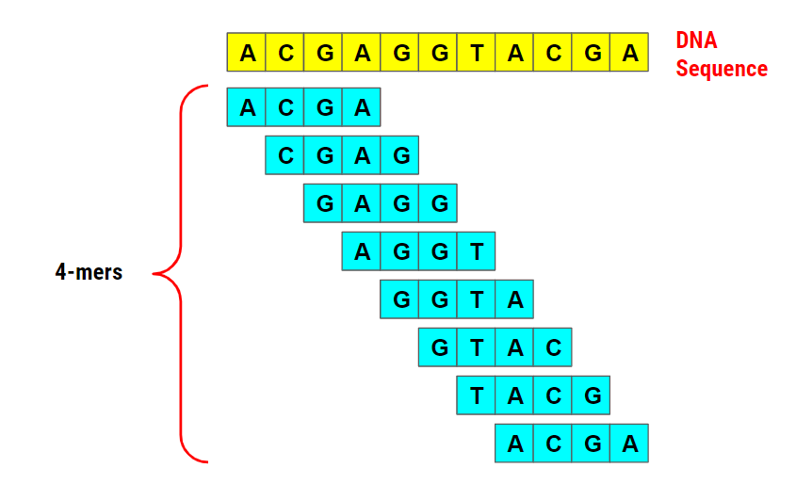
Introduction (Cont)

Slide 4

problems
A remaining problem is that the number of distinct k-mers is typically not known. However, memory- and time-efficient algorithms for calculating do exist and we plan to implement this in k-mer in the future.

Slide 5
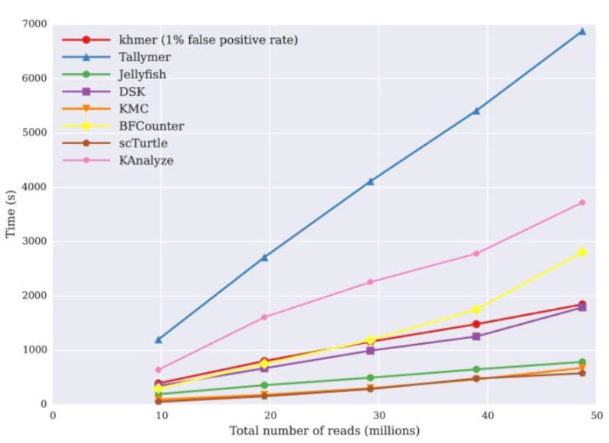
Problems(cont)
Figure 1: shows that the time usage of the k-mer approach is comparable to DSK and BFCounter, and, as expected, increases linearly with data set size. Tallymer is the slowest of the four tools in this testing, while KMC, Turtle, and Jellyfish are the fastest.

Slide 6
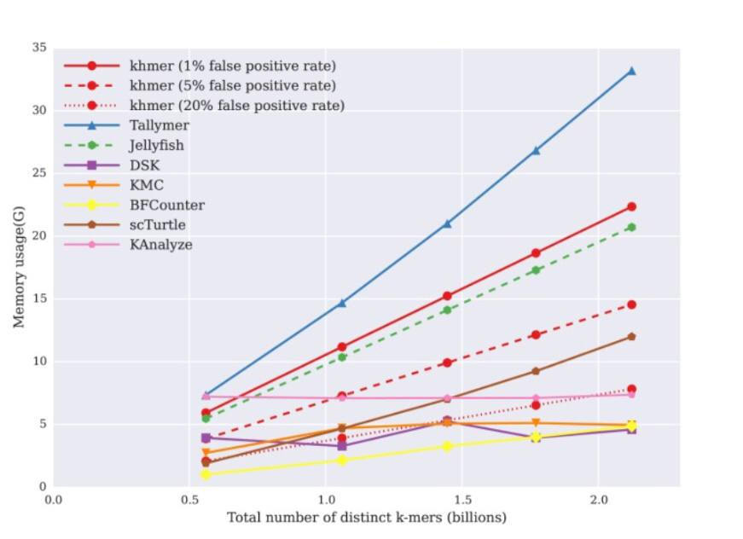
Problems(cont)
Figure 2 : we see that the memory usage of Jellyfish, Tallymer, BFCounter, and Turtle increases linearly with data set size. Tallymer uses more memory than Jellyfish generally, while BFCounter and Turtle have considerably lower memory usage. DSK, KMC, and KAnalyze use constant memory across the data sets, but at the cost of more limited functionality .

Slide 7
Solution(Jellyfish)
Jellyfish is a tool for fast, memory-efficient counting of k-mers in DNA.
JELLYFISH can count k-mers quickly by using an efficient encoding of a hash table and by exploiting the "compare-and-swap" CPU instruction to increase parallelism.

Slide 8
Solution(KMC):
KMC : [K-mer Counter] is a utility designed for counting k-mers in a set of reads from genome sequencing projects. K-mer counting is important for many bioinformatics applications, e.g., developing de Bruijn graph assemblers. Building de Bruijn graphs is a commonly used approach for genome assembly with data from second-generation sequencer. Unfortunately, sequencing errors (frequent in practice) results in huge memory requirements for de Bruijn graphs, as well as long build time. One of the popular approaches to handle this problem is filtering the input reads in such a way that unique k-mers (very likely obtained as a result of an error) are discarded.

Slide 9
Solution(dsk):
DSK is a k-mer counting software, similar to Jellyfish . DSK can be executed on any machine (only 1 GB memory required for a mammalian dataset) with reasonably low temporary disk usage, and supports any value of k. DSK can count k-mers of large Illumina datasets on laptops and desktop computers.

Slide 10

Competitor and differences
In an attempt from us to facilitate the extraction of the best k-mer through a mobile application so that its extraction is not limited to computer science graduates by using a simplified phone interface, as the use of the Python language is considered difficult to deal with through the chemist by integrating a set of tools with each other such as jellyfish ,KMC and DSK

Slide 11


END

