Slide 1







the rule of three
Level : 2A
Team C++
AY: 2020/2021
Notes:
Logo EUR-ACE

Slide 2
Outline of the chapter
Redefining the destructor
Redefinition of the assignment operator
Redefinition of the copy constructor
Reminder: Collection of polymorphic objects
To remember

Slide 3

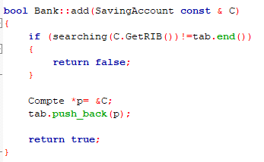
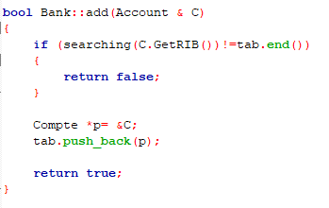
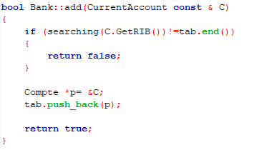
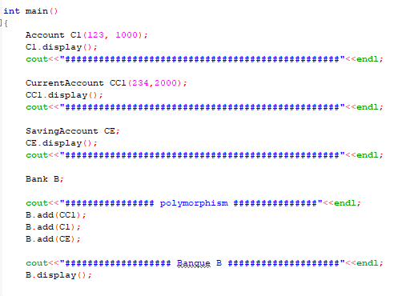
Reminder: Collection of polymorphic objects
main.cpp
Main and object B must not manipulate the same variables!
C1
CC1
CE
➔ The variables of the main added in the bank B
3

Slide 4
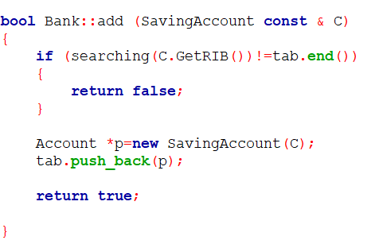
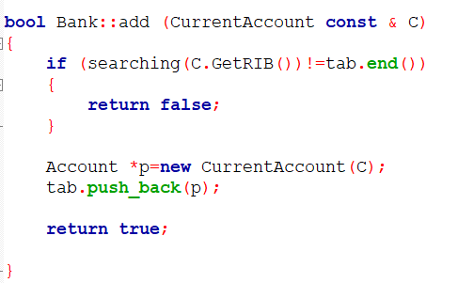
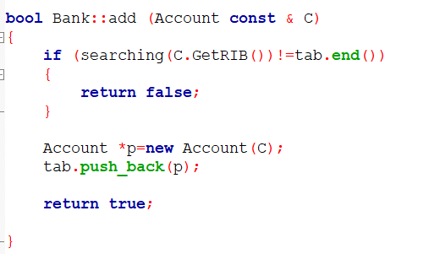
Reminder: Collection of polymorphic objects
main.cpp
Copy C1
CopyCC1
Copy CE
C11
CC11
CE1
Add copies of C1, CC1 and CE (variables of the main) in object B (C11, CC11, CE1)
4

Slide 5
Redefinition of the destructor
main.cpp
Bank B; // Instantiation of the object B
B
Name : « »
Adress : « »
tab :
@C11
@CC11
@CE1
C11
CC11
CE1
Static Allocation
Call to the destructor of the Bank class
These are copies of C1, CC1 and CE

Slide 6

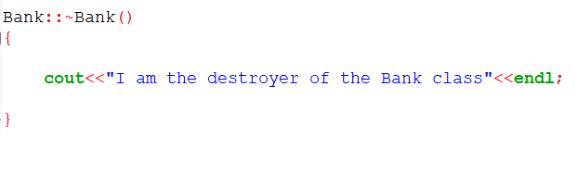

Redefinition of the destructor
bank.h
bank.cpp
main.cpp

Slide 7
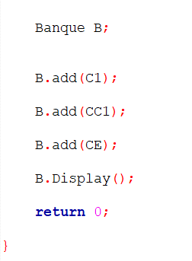


Redefinition of the destructor
Call of the destructor of the class String
Call of the destructor of the class String
Call of the destructor of the class Vector
Call to the destructor of the Bank class
This memory space will not be released!
B
Name : « »
Adress : « »
tab :
@C11
@CC11
@CE1
Free this space in the destructor of the Bank class
C11
CC11
CE1

Slide 8
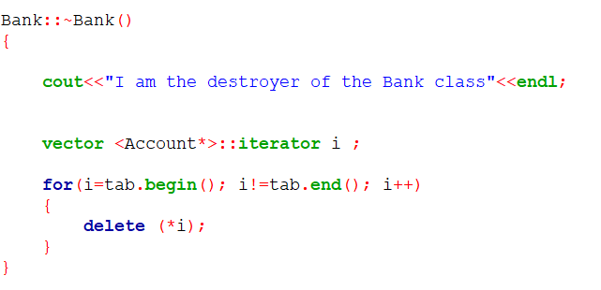
Redefinition of the destructor
bank.h
bank.cpp

Slide 9

Redefinition of the destructor
bank.cpp
main.cpp

Slide 10
Redefinition of the destructor
delete (*i);
Call of the destructor of the class String
Call of the destructor of the class String
Call of the destructor of the class Vector
Call of the destructor of the class Bank
B
Name : « »
Adress : « »
tab :
@C11
@CC11
@CE1
C11
CC11
CE1

Slide 11
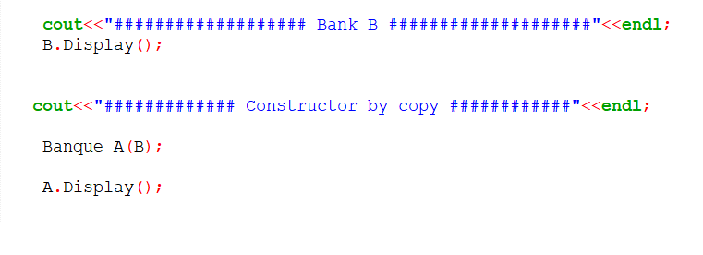
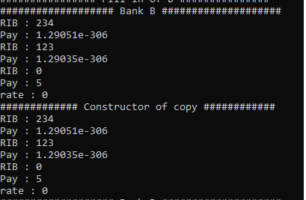
Redefinition of the copy constructor
main.cpp
Call to the copy constructor of the Bank class
Original
COPy

Slide 12
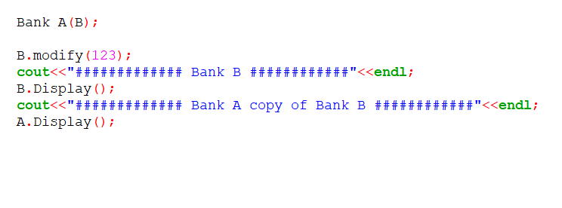
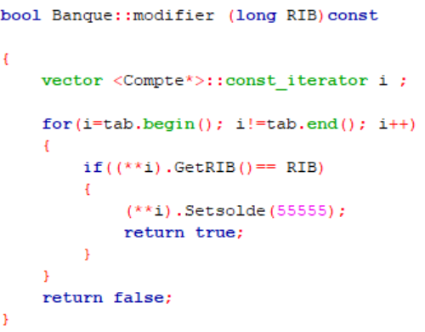
Redefinition of the copy constructor
main.cpp
Modification of the content of Bank B
bank.cpp

Slide 13
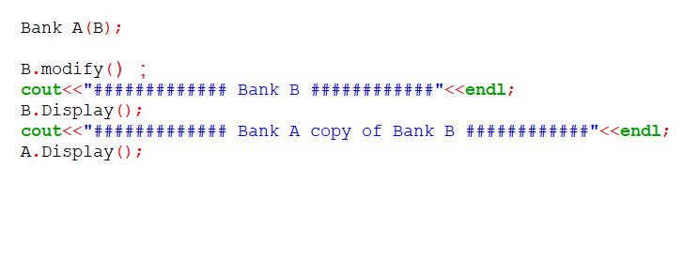
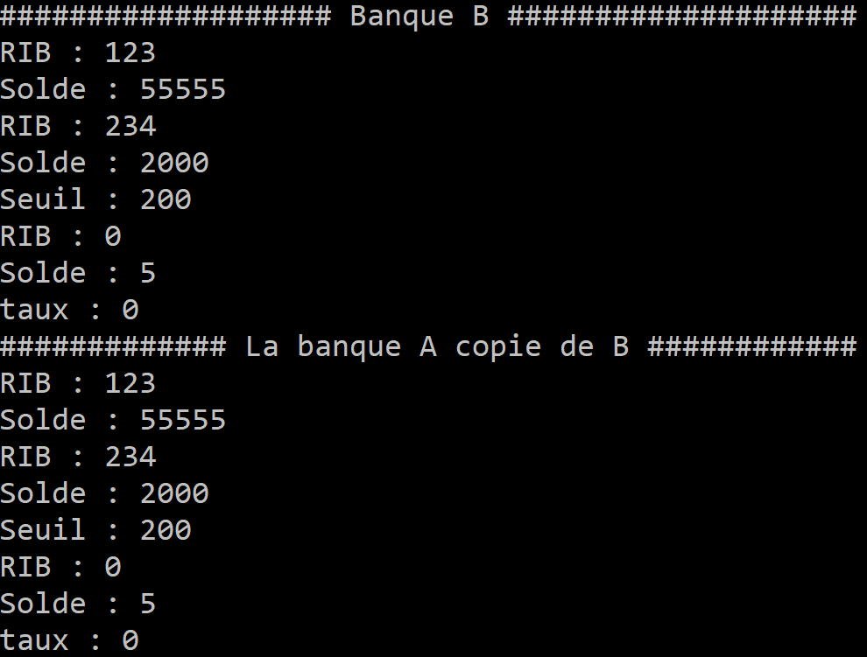

Redefinition of the copy constructor
main.cpp
Modification of the content of Bank B
B.modify();
Original Modified
Copy Modified !!!

Slide 14
Redefinition of the copy constructor
Original
COPy
B
A
Name: « »
Name : « »
Adress : « »
Adress : « »
tab :
tab :
@C11
@CC11
@CE1
@C11
@CC11
@CE1
Copy the address ➔ Pointing to the same objects
C11
CC11
CE1
The balance of the C1 account (RIB =123) is modified ➔ the contents of A and B are modified

Slide 15
Redefinition of the copy constructor
Original
COPY
B
A
Name: « »
Name : « »
Adress : « »
Adress : « »
tab :
tab :
@C11
@CC11
@CE1
@C11
@CC11
@CE1
The two copies must be independent!!!!
C11
CC11
CE1
Create a new copy of each object pointed to in the copied object

Slide 16
Redefinition of the assignment operator
Original
Result of the assignment
A
D
D=A
Name: « »
Name : « »
Adress : « »
Adress : « »
tab :
tab :
@C11
@CC11
@CE1
@copyC11
@copyCC11
@copyCE1
C11
CC11
CE1
copyC11
copyCC11
CopyCE1

Slide 17

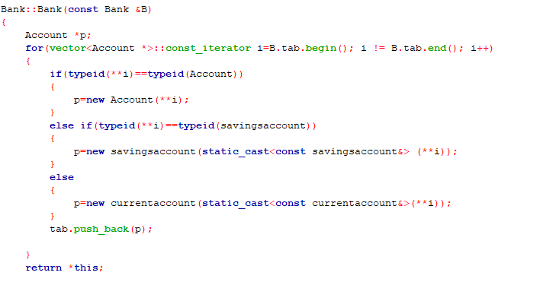
Redefinition of the assignment operator
bank.h
bank.cpp
Creation of new copies
Constructor by copy
Expl : A = B =C ;

Slide 18
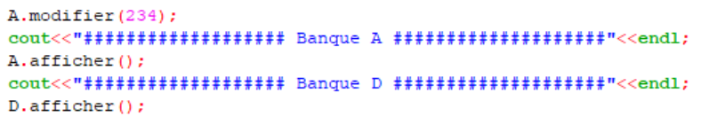
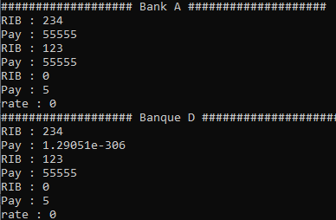
Redefinition of the assignment operator
Modification of the content of Bank A
main.cpp
Original
A.modifier();
Result of the assignment
Bank D contents NOT modified

Slide 19
Redefinition of the assignment operator
If D already references other objects … !!
A
D
Result of the assignment
Origina
Name : « »
Name : « »
Adress : « »
Adress : « »
tab :
tab :
@C11
@CC11
@CE1
@x
@y
@z
C11
CC11
CE1
X
Y
Z

Slide 20
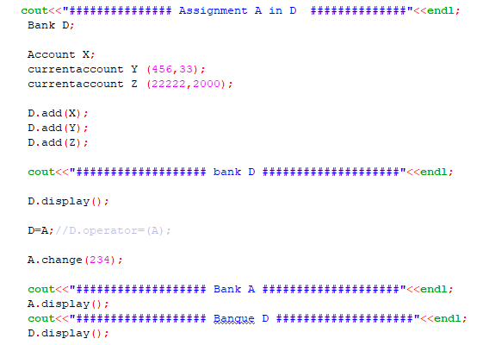
Redefinition of the assignment operator
main.cpp
D contains copies of objects X, Y et Z
assign A in D

Slide 21
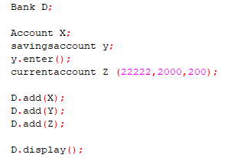
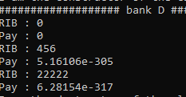
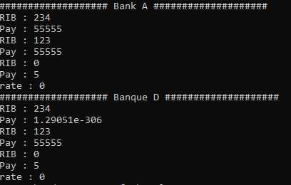
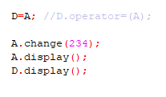
Redefinition of the assignment operator
D contains copies of objects X, Y et Z
Original
Result of the assignment
Result of the assignment A in D
D contains copies of
X, Y , Z C11, CC11, CE1 !!!

Slide 22

Redefinition of the assignment operator
This memory space will not be released!
A
D
Originale
D = A
Name : « »
Name : « »
Result of the assignment
Adress : « »
Adress : « »
tab :
tab :
@C11
@CC11
@CE1
@x
@y
@z
@copyC11
@copyCC11
@copyCE1
copyX
copyY
CopyZ
C11
CC11
CE1
copyC11
copyCC11
Copy CE1

Slide 23
Redefinition of the assignment operator
Delete the old content of D before making the assignment
A
D
Name : « »
Original
Name : « »
Result of the assignment
Adress : « »
Adress : « »
tab :
tab :
@C11
@CC11
@CE1
@x
@y
@z
@copyC11
@copy CC11
@copy CE1
copy X
copyY
copyZ
C11
CC11
CE1
copyC11
copyCC11
Copy CE1

Slide 24
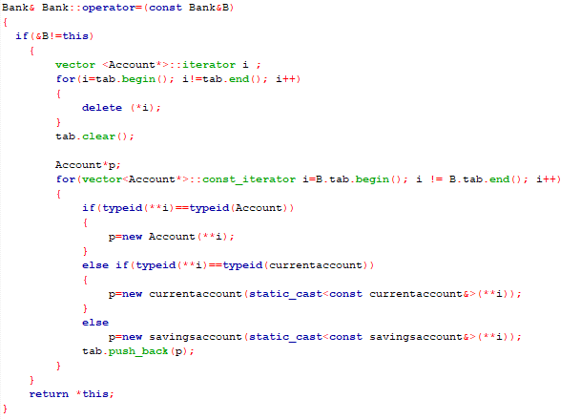
Redefinition of the assignment operator
bank.cpp
Destructor

Slide 25
Redefinition of the assignment operator
bank.cpp
Avoid assigning an object to itself
Expl : A = A !!!
Destructor
Constructor of copy
Expl : A = B =C ;

Slide 26
To remember
« Defining a copy constructor for a class usually means that the copy constructor, destructor and assignment operator provided by default by the compiler are not suitable for this class. Therefore, all three methods will have to be systematically redefined as soon as one of them is. » Course of C/C++, Christian Casteyde
« This rule, called the rule of three, will allow you to avoid bugs easily. » Course of C/C++, Christian Casteyde
« This will be the case when some of the data of the objects have been dynamically allocated. A brutal copy of the fields of one object into another would only copy the pointers, not the pointed data. Thus, changing the data for one object would change the data for the other object, which would probably not be the desired effect. » Course of C/C++, Christian Casteyde

Slide 27
THANK YOU
Any Questions ?

