Slide 1


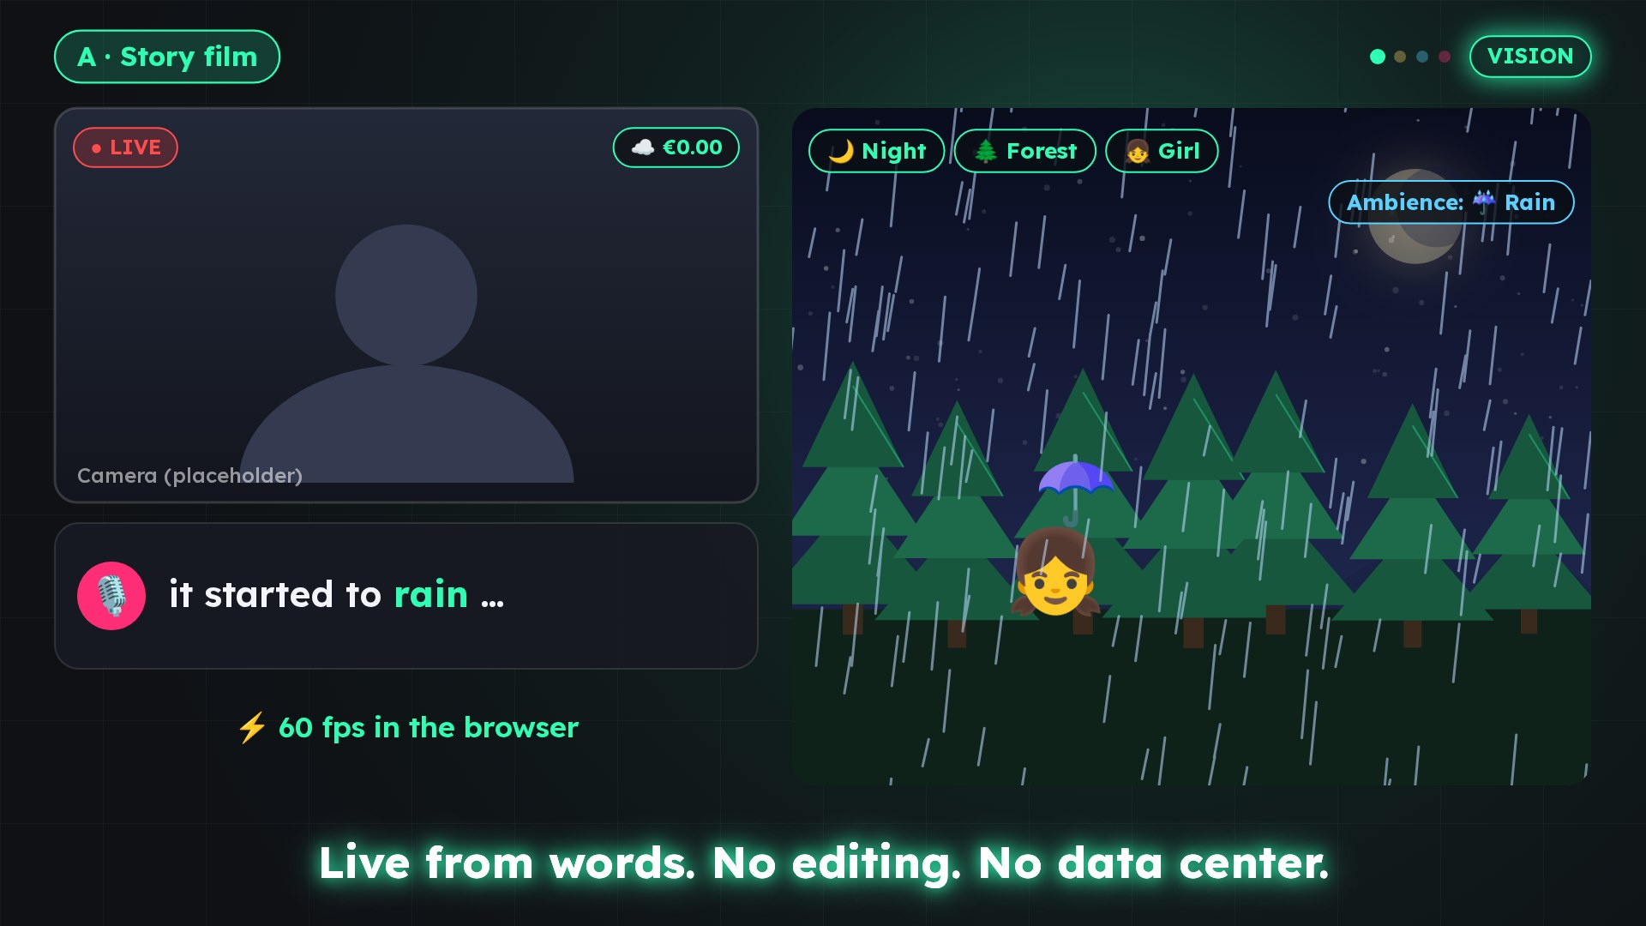
One voice,
three products
PORTFOLIO INVESTMENT · OCTOBER 2026
LIVEFX
Aybal · LiveFX · the “My Neurodivergent Compass” book series – voice technology for families, education and creators in German, Turkish and English
TOTAL ROUND
FOUNDER & INVENTOR (AYBAL)
Tuncay Sancak
€500,000
INVESTOR RELATIONS
Gönül Demet
AYBAL
Notes:
One voice, three products – Aybal · LiveFX · the “My Neurodivergent Compass” book series – voice technology for families, education and creators in German, Turkish and English

Slide 2
One voice, three products
PORTFOLIO / THESIS
1
2
3
Voice technology
Three languages
Family · education · creators
Read-aloud with natural and personal voices (Aybal) and speech → live effect in under a second (LiveFX).
German, Turkish and English from day one: Aybal with 3 interface and 13 voice languages, LiveFX with automatic DE/TR/EN recognition.
One audience, three entry points: families read (Aybal), creators and teachers stream (LiveFX), children learn with their own stories (book series).
One investment, one shared voice and content stack, three revenue paths.
Notes:
One investment, one shared voice and content stack, three revenue paths.

Slide 3
The portfolio at a glance
PORTFOLIO / OVERVIEW
AYBAL
LIVEFX
BOOK SERIES
Family reading with voice
Voice → live effect
Content IP on neurodiversity
Platform built · closed beta from 12 Oct 2026 · Germany launch 20 Nov 2026
Version 2.0 working · no revenue yet · Turkish launch Q4 2026
5 books in TR/DE/EN · trailers in 3 languages · teen spin-off in progress
1,779
automated tests
238
triggers in 5 packs
5
books
13
voice languages
13
animated scenes
3
languages
101M
families in target markets
240+
automated tests
4
teen titles
Source: aybal-show/Aybal_Investor_Deck.pptx
Source: live-fx/business/BUSINESSPLAN.md, PITCH-DECK.md
Source: deniz-trailer/, deniz-teen/books.js

Slide 4
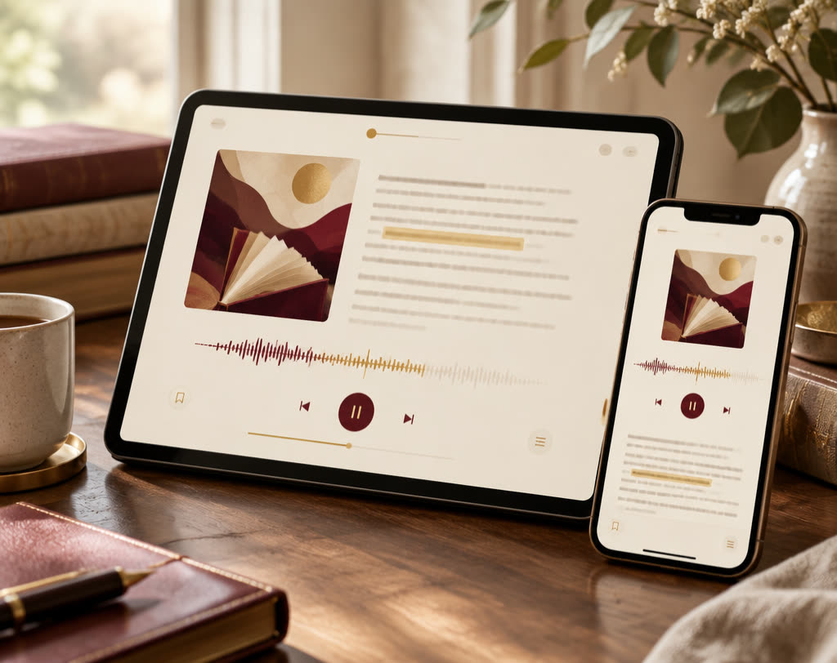
Aybal: the voice of family reading
PORTFOLIO / AYBAL
Families upload PDFs, EPUBs, Word files, text or photos of pages – Aybal reads them aloud with word-by-word highlighting.
€7.6B
TAM: family reading spend in target markets
€1.14B
SAM: 15% assumed willingness to pay
€38M
SOM: directional, not a forecast
Pricing: Plus €9.99/month · Family €24.99/month · web margin 75–77%
Measured intelligibility: German 98% · Turkish 97%
Break-even (scenario): strong case Aug 2030 · venture case Oct 2031
Own round: €250,000 pre-seed · valuation cap €1.30M pre-money · planned close March 2027
Source: Aybal_Investor_Deck.pptx, slides 3–12

Slide 5
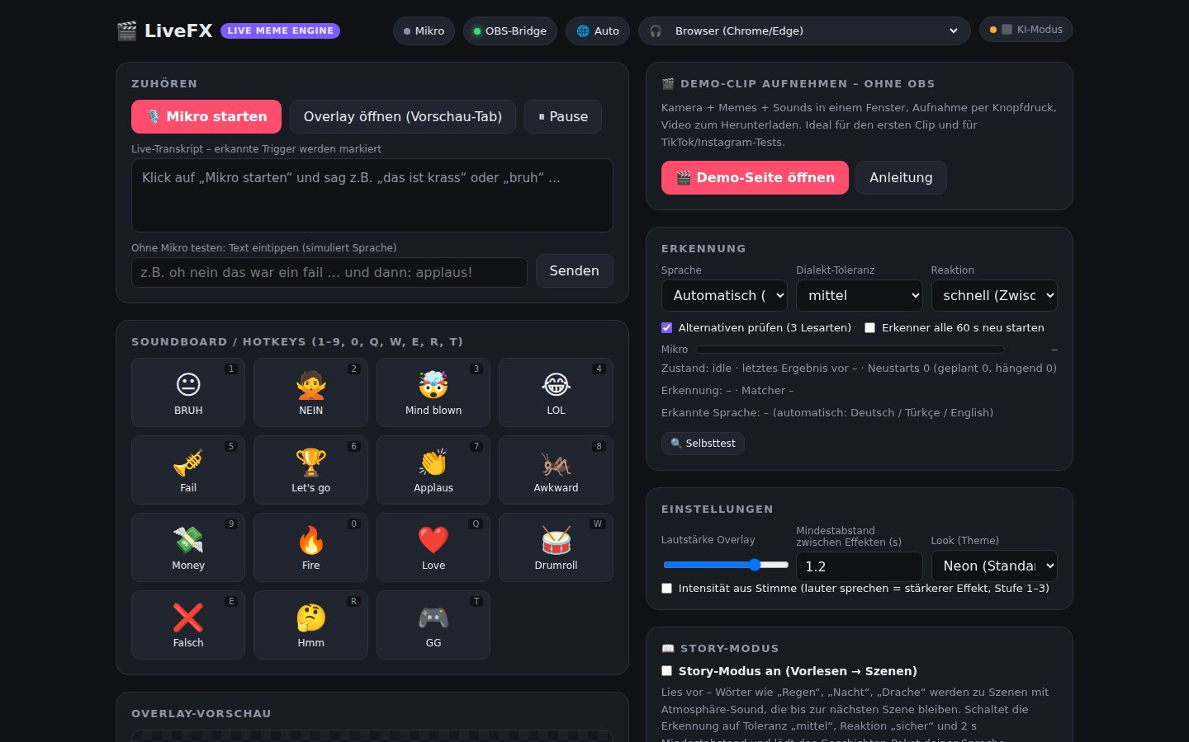

LiveFX: live streams that listen
PORTFOLIO / LIVEFX
The creator speaks – in under a second a meme, a sound or an animated scene appears in the stream. Story mode for reading aloud, viewer triggers via chat and gifts.
$97–157B
global live-streaming market 2026
1–3M
creators in the TR/DE/EN space (SAM, estimate)
5,000–15,000
paying users in year 3 (SOM, estimate)
Pricing: Free · Pro €9.99/month or €79/year · packs €2.99–4.99
Base case (estimate): revenue €51k / €336k / €1,039k in Y1–Y3
Need per business plan: €250–350k seed for 18–24 months
Source: live-fx/business/BUSINESSPLAN.md (sections 1, 6, 9, 11), market data there [Source 1, 2]

Slide 6
One book series, three languages
PORTFOLIO / CONTENT IP
TR
Benim Nörofarklı Pusulam
DE
Mein neurodiverser Kompass
EN
My Neurodivergent Compass
1
My Neurodivergent Compass
2
Deniz and the Secret Messages of His Body
3
Deniz Finds His Own Way at School
4
Deniz and the Friendship Compass
LiveFX story film (vision trailer)
5
Deniz and the Island of Changes
→ Aybal
→ LiveFX
Gift book “İyi ki Varsın / Gut, dass es dich gibt / Good That You Exist” · teen spin-off with 4 Deniz titles
Read-aloud titles with voice in three languages
Story mode, world packs, first publisher pilot
Available: 5 book trailers (TR), series videos in DE/TR/EN, gift-book trailer in 3 languages
Source: file names in deniz-trailer/, deniz-teen/books.js

Slide 7
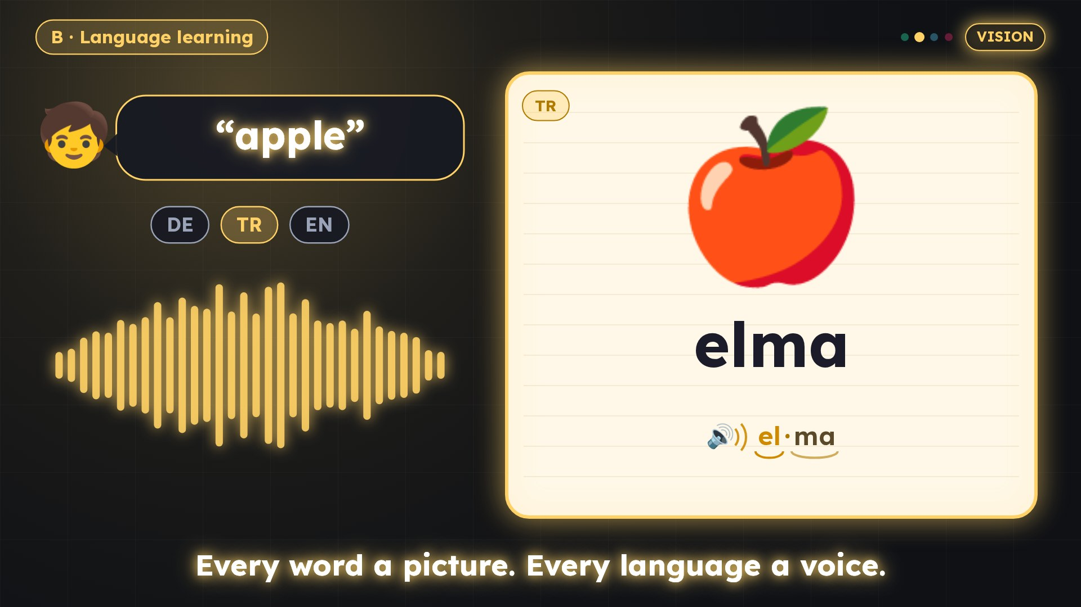
Synergies: one stack, one audience
PORTFOLIO / SYNERGIES
A
Speech and voice stack
B
Shared content IP
Recognition, speech output and word timing power both products: read-aloud with word highlighting (Aybal), scenes and pronunciation (LiveFX).
The book series supplies read-aloud titles for Aybal and story packs for LiveFX story mode.
LiveFX WortBild (vision trailer)
C
DE/TR/EN markets
D
Cross-selling
Both start in the German-Turkish community: Aybal with its Germany launch, LiveFX with Turkish creators.
Read-aloud streams lead families to Aybal; Aybal families are the target group for LiveFX WortBild (language learning).
Synergies are hypotheses and not yet measured.

Slide 8
€500,000 for three projects
THE OFFER / ROUND
PROPOSAL – PLEASE CONFIRM
Aybal
€250,000
as in the Aybal deck
Split (proposal)
LiveFX
€200,000
€500,000
part of the seed range in its business plan
Book series / content
€50,000
audio editions, print, rights
Aybal terms per its own deck: €1.30M pre-money cap, ~16% at cap, planned close March 2027. Terms for LiveFX and content: [open].
Notes:
Aybal terms per its own deck: €1.30M pre-money cap, ~16% at cap, planned close March 2027. Terms for LiveFX and content: [open].

Slide 9
Use of funds by project
THE OFFER / USE OF FUNDS
Aybal · €250,000 (per Aybal deck)
LiveFX · €200,000
Book series · €50,000
PROPOSAL – PLEASE CONFIRM
PROPOSAL – PLEASE CONFIRM
Covers the year-1 base-case costs (€165k) plus a buffer. The business plan names €250–350k; the rest from revenue, grants or a follow-on round.
DE/TR/EN audio editions for Aybal
Editing, translation, print editions
Rights, licences, ISBNs
Mobile developer (first hire)
Creator partner programme, marketing
Platform and education pilots
Team: €125,000 · Marketing: €62,500 · EU voice ops + store app: €37,500 · Legal / trust: €25,000
Sources: Aybal_Investor_Deck.pptx slide 12; BUSINESSPLAN.md sections 11.3–11.4

Slide 10
24 months: milestones by project
THE OFFER / MILESTONES
Q4 26
Q1 27
Q2 27
Q3 27
Q4 27
Q1 28
Q2 28
Q3 28
Beta (50 families) · Germany launch
Close March 2027
Gate 1: activation
Gate 2: retention
Market expansion 2027–28
Aybal
Turkish launch
Pro plan, DE/EN
Mobile app
Pro+, platform pilot
School licence
Scene SDK v1 (2028)
LiveFX
Audio editions in Aybal
Publisher pilot in LiveFX
Teen spin-off [date]
Books
Aybal and LiveFX per project documents; book series: proposal – please confirm.

Slide 11
Structure options and risks
THE OFFER / STRUCTURE & RISKS
Structure – neutral, legal review required
Key risks
A · One holding
One entry point, pooled IP; in exchange a new valuation of all parts and transfer of the Aybal terms.
!
Demand and retention unproven
!
Key-person risk in every project
B · Separate SPVs
Valuation and risk per project, Aybal round unchanged; in exchange more contracts and IP licences.
!
Focus: three projects, small team
C · Hybrid
!
Voice, copyright, children's data
Aybal round as planned; LiveFX and content in a second company under a licence agreement.
!
Platform dependency, TRY exchange rate
Not a recommendation – legal and tax advice required.

Slide 12
Team and contact
CLOSE
TS
Tuncay Sancak
GD
Gönül Demet
?
[Name]
Founder & Inventor · Managing Director (Aybal)
Investor Relations & Fundraising (Aybal)
Founder of LiveFX · author of the book series
After the round: technical co-founder & growth (Aybal), mobile developer (LiveFX), community TR/DE
One voice for families, classrooms and live streams.
Contact: Gönül Demet · [email] · [phone]
Scenarios and forward-looking statements, not forecasts. An investment may result in total loss.

