Slide 1
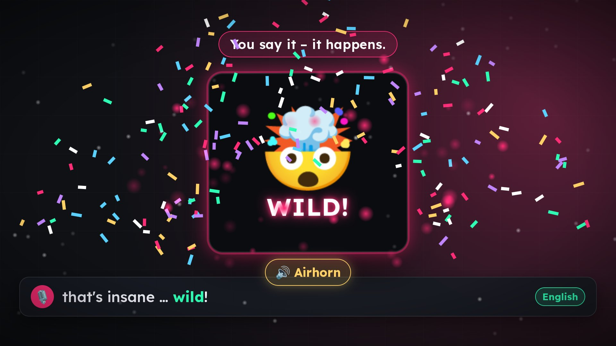
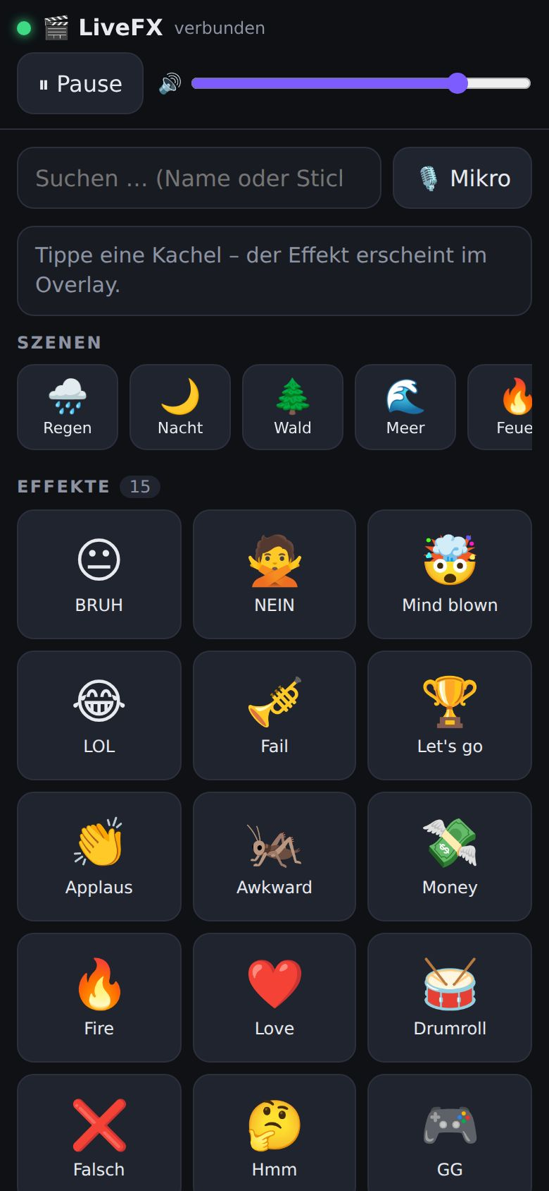
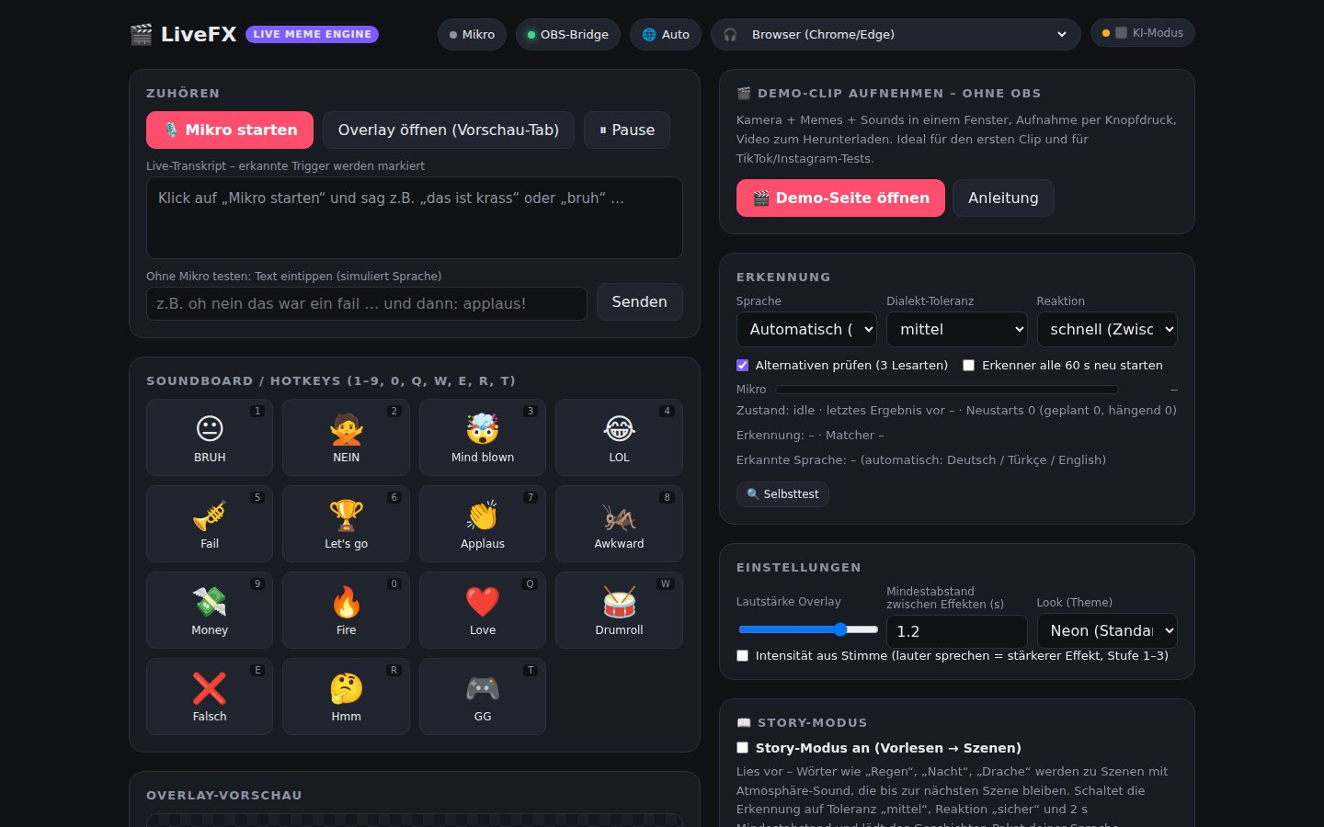
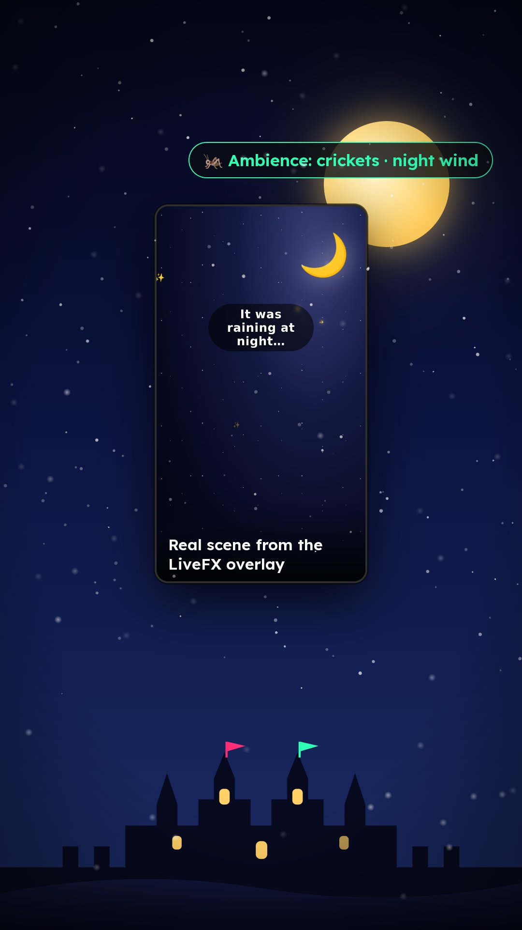
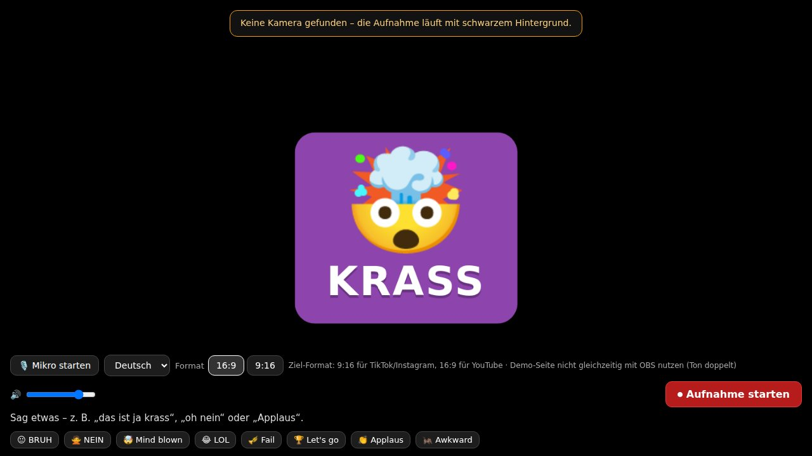
LIVE MEME ENGINE · v2.0
LiveFX
Your voice becomes the effect.
Memes, sounds and scenes in real time – triggered by what the creator says. In under a second, hands-free, on TikTok LIVE, Instagram, YouTube and Twitch.
And tomorrow: You talk. It becomes a scene.
Tuncay Sancak · Founder & Inventor, Managing Director
Investor Relations: Gönül Demet · [Email] · October 2026 · Confidential
Notes:
Quick intro: I stream myself, I write books, and I built LiveFX because my live streams were missing exactly what every short video has. What you see today runs in my own streams. At the end I'll show where this is going: from a meme overlay to a visual language for everything spoken. Thirty seconds, then straight to the problem.

Slide 2
THE PROBLEM
Live is raw. The edit comes too late.
✂
Everything that makes short videos go viral happens afterwards
Nobody reacts to the spoken word.
Memes, sounds, zooms, stickers – added in the edit, after recording. Live, you get none of it.
🎛
The creator is host, director and editor at once
With two hands, one camera and a chat that won't wait.
Auto-captions proved it: real-time text from speech works. Real-time effects from speech don't exist yet.
🔔
Existing tools react to viewers or to keys
Alerts for donations and follows, soundboards on hotkeys. Both need a click.
“I say ‘wild’ – and nothing happens, except me reaching for the keyboard.” – Tuncay Sancak, from his own stream
Confidential · October 2026 · LiveFX · 2
Notes:
Auto-captions proved that real-time text from speech works – and that platforms build it in natively. Real-time effects from speech don't exist. That's exactly the gap we fill. An example from my stream: I say “wild” – and nothing happens, except me reaching for the keyboard.

Slide 3
THE SOLUTION
Voice → effect in under a second
🎙
🧠
⚡
🖥
📺
›
›
›
›
Mic
Recognition
Matcher
Overlay
Stream
Creator speaks
DE / TR / EN, automatic
Dialect-tolerant, instant
Browser source in OBS
TikTok · IG · YouTube · Twitch
“Wild”
“Yok artık”
“It was raining…”
🤯 Neon text + airhorn
Meme card + vine boom
Rain scene + ambience loop
< 1 s reaction – matches fire on interim recognition results
Hands-free – no key, no click, no second monitor
Runs locally on the creator's own computer – privacy built in
AI mode (optional) catches sentences without a keyword: “that was so embarrassing” → Awkward
Confidential · October 2026 · LiveFX · 3
Notes:
Key point: keyword matching is instant (it works on interim recognition results) and needs no cloud. The optional AI mode catches sentences without a keyword (“that was so embarrassing for him” → Awkward). Everything runs on the creator's own computer – privacy is built in, not bolted on.

Slide 4
WHAT IT LOOKS LIKE IN A STREAM
Demo
Overlay 16:9 – “Wild!” → neon text + confetti
Portrait 9:16 – story mode: “It was raining at night…”
Phone remote (PWA)
▶ Trailer (30 s): video/LiveFX_Trailer_en_16x9.mp4 · Live demo: start the mic and say “that's wild” – or switch on story mode and read a paragraph aloud.
Confidential · October 2026 · LiveFX · 4
Notes:
If possible, show it live: start the mic, say “that's wild”, the effect appears. Second take: switch on story mode and read a paragraph aloud – “it was raining”, “at night”, “the dragon” – and the scenes change. The trailer is the fallback. The line that sticks: the first video in which memes reacted to my voice convinced me more than any slide.

Slide 5
NOT A PROTOTYPE
The product today – version 2.0
🎙
✨
📖
📦
Recognition
Effect engine v2
Story mode
Packs
Browser ASR, auto language DE/TR/EN, dialect tolerance, learning mode, self-test; external via Whisper/Deepgram, offline Whisper (experimental)
Canvas particles with physics (60 fps), neon/glitch text, lower thirds, combos, 4 themes
13 full-screen scenes, 12 ambience loops, story packs DE/TR/EN
Türkçe 85 · Deutsch 49 · English 50 · Family & Kids 27 · Gaming 27 – plus GIF search
🔊
💬
📱
🔌
Sound engine
Viewer triggers
Phone & platforms
Open API
38 synthesized sounds (no license fees), mixer with limiter, ducking, stereo, reverb
Twitch chat, YouTube chat, gift webhook (TikTok via TikFinity / Streamer.bot)
Phone remote (PWA), OBS/Streamlabs, TikTok LIVE Studio, IG Live Producer, demo without OBS
Token-secured HTTP API (Stream Deck, chat bots, external ASR), 240+ automated tests
Confidential · October 2026 · LiveFX · 5
Notes:
This is no longer a prototype: releases from 0.1 to 2.0, unit and end-to-end tests, guides in German and Turkish. Version 2.0 was a hardening release for stage use and sales. Stress two things: (1) our own sounds and packs mean no copyright strikes, (2) viewer triggers are the bridge to monetization – a gift can already trigger an effect today.

Slide 6
TIMING
Why now
~50%
> 100M
≈ 14%
of live streamers' income comes from gifts; 20–100K followers: $500–3,000/month [Source 5, 6]
creators went live on TikTok in 2025 in Southeast Asia, the Caucasus and Central Asia alone, +77% [Source 2]
of the creator economy (~$216–260B in 2026) is live [Source 3, 4]
Live is a revenue channel
The tech is ready
Platforms compete on creator tools
Live commerce and gifting (TikTok LIVE, IG Badges, Super Chat) turn live into a business – not a side format.
Streaming ASR < 300 ms, models in the browser, WebGPU in all major browsers [Source 27], AI classification for < $1/hour.
CapCut ↔ TikTok, Edits ↔ Instagram. Live tools are the next step – and nobody has voice-driven effects.
Sources: QUELLEN.md (research 09/30/2026 and 10/03/2026) – [Source 2–6, 27]
Confidential · October 2026 · LiveFX · 6
Notes:
Live is no longer a side channel – it's a revenue channel. And Turkey is a young, meme-loving TikTok market with hardly any localized tools – our biggest pack is the Turkish one, and that's no accident. Tech: what needed a server three years ago now runs in the browser – and that's also the foundation of the vision from slide 12 on.

Slide 7
TAM · SAM · SOM · ADJACENT MARKETS
Market – ranges, not point estimates
TAM
Live streaming market [Source 1, 2]
$97–157B (2026) → $250–345B (2030), CAGR ~27%
SAM
Live creator tools · estimate
$1–3B – derived from Streamlabs / StreamYard / Voicemod prices × active live creators
SOM
Year 3 · estimate
5,000–15,000 paying Pro users × €9.99/month ≈ €0.6–1.8M ARR (as in the business plan; DACH + Turkey + EN niche)
Adjacent markets of the vision (slides 12–15)
$3.67B
$1.54B
$2.68B
€374M
AI video generation and editing, 2026 [Source 23]
Language-learning apps, in-app revenue 2025 [Source 33]
Video editing software, 2026 [Source 51]
German audiobook market 2025, +13% [Source 19]
Sources: QUELLEN.md [Source 1–4, 19, 23, 33, 51] · SAM/SOM are our own estimates, not a study.
Confidential · October 2026 · LiveFX · 7
Notes:
Be upfront: the TAM comes from secondary sources with a wide range; SAM and SOM are our estimates, not a study. The point isn't the exact number – it's that even a small share of paying live creators sustains a team, and the real lever is platform integration, not the subscription. New at the bottom: the vision opens adjacent markets – AI video $3.67B [Source 23], language-learning apps $1.54B [Source 33], video editing $2.68B [Source 51], German audiobooks €374M [Source 19]. We don't count any of them in the SOM. The SOM matches the business plan (section 6): 5,000–15,000 paying users in year 3; the base scenario assumes an average of 7,500 Pro users.

Slide 8
FREE → PRO → PACKS → B2B
Business model
Free
Pro
Creator packs
B2B license
€0
€9.99/month
70 / 30
on request
Core features, standard packs, OBS overlay. Reach and community.
›
AI mode, all scenes and themes, phone remote, cloud sync, priority support.
›
Marketplace for meme and story packs made by creators for creators. Users become suppliers.
›
SDK / white label for streaming software, agencies, platform integration.
Price anchors in the market
Streamlabs Ultra $27/month · StreamYard Core $35/month · Restream $16/month · Voicemod Pro $10/month [Source 11, 12, 13]
Pro sits deliberately at Voicemod level, well below Streamlabs. Vision (estimate): Pro+ “Studio & Scenes” €14.99, WortBild Family €4.99, school and publisher licenses – see slides 13–15.
Confidential · October 2026 · LiveFX · 8
Notes:
€9.99 is deliberately below Streamlabs Ultra and on par with Voicemod – creators know this price point. The marketplace turns users into suppliers: whoever builds a Turkish meme pack sells it. B2B is the path to the platform: the same engine runs as a browser source in TikTok LIVE Studio. The vision adds Pro+ and education licenses – all prices there are estimates.

Slide 9
MATURED IN REAL STREAMS
Traction
[Number]
2.0
238
[Number]
own live streams with LiveFX since [month/year] – [Number] hours
current version (releases 0.1 → 2.0), 240+ automated tests, guides in DE/TR
triggers in 5 packs, 3 story packs, 38 sounds, 13 scenes – in 3 languages
followers · [Number] creators on the waitlist · [Number] downloads
What came from practice
Echo problem (panel + OBS) → muted preview, sound-check card
Dialects (“grass” → krass, “helal olsn”) → tolerance + learning mode
TikTok/IG chat covers the lower third → portrait safe zones
Reading aloud on stream → story mode with scenes and ambience
Next 60 days: 10 creator tests TR/DE · landing page + trailer · community launch · first Pro subscriptions
Confidential · October 2026 · LiveFX · 9
Notes:
Fill in the numbers before the meeting – real ones only. The story: the product matured in real streams (the echo problem, dialects and portrait safe zones all came from practice). Now it's about the first 10 external creators and measurable watch-time effects.

Slide 10
2×2
Competition – the empty quadrant
manual
automatic
Native platform effects
sticker gifting
Streamlabs / StreamElements
alerts for donations & follows
Only with LiveFX
Viewer-driven
Reacts to the spoken word
Turkish packs (85 triggers) + story packs
Story scenes with ambience loops
Voicemod · soundboards
Stream Deck (hotkey)
LiveFX
Open API for viewer & external triggers
Voice-driven
Runs locally – no cloud, no login
Own sounds – no copyright strikes
the only player
Operation →
Confidential · October 2026 · LiveFX · 10
Notes:
The bottom-right quadrant is empty – for now. The ones who could fill it are the platforms themselves, which is why we're talking to them. Streamlabs and co. aren't rivals but hosts: LiveFX runs as a browser source in every one of them.

Slide 11
ORDERED BY LEVERAGE
Roadmap
Q4 2026
Q1 2027
Q2 2027
Q3–Q4 2027
Native mobile SDK
Platform integration
AI understanding v2
Story engine
Effects right in the camera app, not just OBS · stable offline recognition · 10 creator tests
TikTok LIVE Studio plug-in / Instagram Live Producer · installer · marketplace beta · highlight finder
Mood, context, irony · multiple triggers per sentence · Pro subscription · live-commerce triggers
Whole stories as scene sequences · procedurally drawn scenes (Story Film) · viewer-gifted effects · platform pilot
The mobile SDK solves the biggest problem (phone streamers without OBS). Platform integration is the ask of this deck. AI understanding and the story engine are the technical edge – and the entry into the 2027–2029 vision.
Confidential · October 2026 · LiveFX · 11
Notes:
Ordered by leverage: the mobile SDK solves the biggest problem (phone streamers without OBS). Platform integration is the ask of this deck. AI understanding and the story engine are our technical edge. Important: the scenes are drawn procedurally, not generated by a video AI – that's the bridge to the next four slides.

Slide 12
THE VISION
✦ VISION
Live video from words: You talk. It becomes a scene.
🎙
Voice
🧠
Understand
🎬
Scene
📺
Video
Mic, reading aloud or a finished video file
Lexicon DE/TR/EN, dialect-tolerant, AI optional
World state ≤ 1 KB, one shared timeline
Drawn in the browser, 60 fps, on your own device
🌳
Story Film
🍎
WortBild
🥽
Spaces
✂
Studio
Every sentence grows a continuous picture-book film – below or beside the live image.
Spoken word → picture, the word in the target language and its pronunciation. Learning and reading aid.
Stage, classroom, audiobook with pictures, AR on the phone, VR and display glasses.
Live editor and auto-edit: video in, fully edited out – no upload.
TODAY
TOMORROW
Voice becomes a meme, sound or scene in under a second – in use in the founder's own streams.
Voice becomes a film, a word picture with pronunciation or a finished clip – on stream, in school, on stage, in your glasses.
Draw, don't generate – on the compute budget of a caption, not a data center.
Confidential · October 2026 · LiveFX · 12
Notes:
Live captions showed that platforms want to process speech in real time – for free, on billions of devices. We're the next step: pictures instead of text. One engine, one timeline, four lines: Story Film, WortBild, Spaces, Studio. Everything runs in the browser on your own device: a sentence becomes a state delta of a few hundred bytes, drawn in a single canvas. No video diffusion model, no GPU server. To be honest: this is the vision for 2027–2029 – hence the badge. It builds on code that already runs today (story mode, effect engine, offline recognition). WebGPU is now available in all major browsers [Source 27] – we only use it optionally.

Slide 13
LINE A · STORY FILM
✦ VISION
Generative Scene Engine: live video from words
“It was night … a girl walked into the forest … it started to rain … suddenly, a dragon!”
Every sentence changes the world state:
Place
Time
Weather
Character
Object
Action
Mood
🐉
The streamer reads aloud or tells a story – below, an animated film builds sentence by sentence: night, forest, rain, dragon.
Runs at 60 fps in the browser next to OBS, offline and deterministic: same timeline, same picture – every story instantly becomes a clip.
240 to over 10,000 times cheaper than video AI – and the only way to do it live.
For read-aloud, audiobook and podcast formats: German audiobooks €374M, +13% [Source 19]; YouTube > 1B podcast viewers a month [Source 21].
👧
🌧 Ambience: rain
{place: "forest", time: "night", weather: "rain", characters: [👧, 🐉], mood: "tense"}
Cost per hour of companion video
Video AI
$180–2,700
Picture book on purpose, not photorealism
LiveFX with text AI
$0.25–0.75
A stylized world of emoji/SVG and particles – which is exactly why it's live, cheap and child-friendly. Optional AI only picks the scene; it never generates images.
LiveFX without AI
€0
log scale · video AI at list price $0.05–0.75/s [Source 24, 25] · LiveFX AI cost: project measurement
Confidential · October 2026 · LiveFX · 13
Notes:
Here's how it looks: the streamer does nothing but talk. “It was night” – the sky goes dark. “A girl walked into the forest” – trees grow, the character walks in. “It started to rain” – rain, the ambience loop switches. “Suddenly, a dragon” – lightning, a camera jolt, the dragon. Technically: one sentence produces a delta of 200–500 bytes, scenes change 1 to 3 times a minute, and everything is drawn in one canvas with at most 1,200 particles – a budget our effect engine already handles next to OBS today. Cost: at list price, video AI costs $0.05 (Veo 3.1 Lite, 720p) to $0.75 per second [Source 24, 25] – $180–2,700 per hour, and it can't run live at all. LiveFX: €0 without AI, $0.25–0.75 per hour with optional text AI. Market: German audiobooks €374M [Source 19], 23.8M people in Germany listen to podcasts weekly [Source 20], YouTube has over 1B podcast viewers [Source 21]; AI video grows from $3.67B to $24.89B by 2036 [Source 23]. Timeline: German MVP in Q2 2027, TR/EN and world packs in Q3 2027. First publisher case: the founder's own children's book series.

Slide 14
LINE B · WORTBILD
✦ VISION
Language learning & education: every word a picture
🍎
A child says “apple” – instantly: 🍎, “elma” in the target language, “der Apfel” with a color-coded article, and the pronunciation. No click.
Reading aid in your own language: for pre-readers, German as a second language, integration courses and neurodivergent learners.
Local, no account, offline – school-grade privacy as a selling point. Pronunciation via the device's system voices [Source 29].
elma
el · ma
apple · der Apfel
12.7M
307,000
€5B
🔊
“elma” – tr-TR
paying Duolingo subscribers, Q2 2026 [Source 32]
new integration-course participants in Germany, 2025 [Source 36]
DigitalPakt 2.0 over five years, launched 9/1/2026 [Source 40]
DE
TR
EN
Three modes
Revenue (estimate): WortBild Family €4.99/month · school license €300–800/year · course license €49 per teacher per year · publisher edition for bilingual books
Translate
Reading aid
Repeat after me
Confidential · October 2026 · LiveFX · 14
Notes:
The most personal part: I write children's books about neurodiversity, and I'm German-Turkish. The teacher sets three things – “I speak: German”, “Show: Türkçe”, and the mode – and reads aloud. Every word from the learning list becomes picture, word and pronunciation. Repeat-after-me is deliberately not pronunciation scoring, just a green check mark. Tech: word → picture is a table lookup, the operating system provides the pronunciation (speechSynthesis) [Source 29], a school tablet is enough, server cost per child: zero. Market: Duolingo has 58.7M daily users and 12.7M paying subscribers [Source 32], language-learning apps make $1.54B in-app [Source 33], 20.4% of pupils under 16 in Germany mainly speak another language at home [Source 37], 2.65M people in Germany have a migration background from Turkey [Source 38], 25% of fourth-graders fall below the minimum reading standard [Source 39]. Price anchor: ANTON school license €250–700 [Source 41]. Honestly: integration is small in euro terms; it brings credibility and funding. The volume lies with families, publishers and platforms. We say “supports vocabulary learning”, not “twice as fast”.

Slide 15
LINES D + C · STUDIO AND SPACES
✦ VISION
Auto-edit, editor, VR/AR – and a bigger market
LiveFX Studio: live editing and auto-edit
Expanded market
Live → highlights
File in → finished out
Segment | Size
Video editing software 2026 | $2.68B [Source 51]
AI video (generation + editing) 2026 | $3.67B [Source 23]
Language-learning apps (in-app) 2025 | $1.54B [Source 33]
German audiobooks 2025 | €374M [Source 19]
Smart glasses 2026 | 13.6M units / $5.1B [Source 45]
Live streaming (core) 2026 | $97–157B [Source 1, 2]
After the stream, 3–5 clips in 9:16 – where memes, gifts and chat were densest. No upload.
Drop a video → local transcript → effects, scenes, cuts as chips → MP4 via hardware encoder [Source 57, 59].
🎞 Video.mp4
“Listening … (local)”
Meme
Scene
Zoom
Cut
LiveFX Spaces: one state, many screens
🎤 Stage & events
🏫 Classroom
🎧 Audiobook with pictures
works today
works today
2027
Price anchors: OpusClip $15–29, Descript $16–65 per month [Source 54, 55]. LiveFX Pro+ €14.99 (estimate) – no cloud costs, no minute caps. XR and glasses: a showcase, not a revenue line.
📱 AR on the phone
🥽 WebXR / VR
👓 Display glasses
2027
Vision 2028
Vision 2028
Confidential · October 2026 · LiveFX · 15
Notes:
Two doors into the same tool. First, live → highlights: our server already knows every trigger, every gift and every chat message with a timestamp – that yields 3–5 clips per stream. Second, auto-edit: drag a 20-minute MP4 into the window, Whisper transcribes it locally in the browser [Source 60], LiveFX places effects, scenes and cuts as movable chips, and export runs through WebCodecs and the device's hardware encoder [Source 57, 58, 59]. The file never leaves the computer; the marginal cost per video is zero. Spaces: stage and classroom already work today (full screen, phone as the control desk). Audiobook with pictures and AR on the phone come in 2027. WebXR [Source 47, 48] and display glasses like Meta Ray-Ban Display [Source 46] are vision – IDC expects 13.6M smart glasses in 2026 [Source 45], and display glasses are only a small share of that. Competition, honestly: CapCut has 736M MAU [Source 52]; we're not competing as a universal editor but through voice → effect, scenes, TR/DE and local processing. Buyer signal: in 2026 Canva acquired Cavalry and MangoAI [Source 56].

Slide 16
FOUNDER, INVENTOR, USER
Team
TS
+
[Open position] – Tech lead
Tuncay Sancak
Audio / real-time, mobile SDK, Canvas/WebGPU
Founder & Inventor · Managing Director · German-Turkish author & live streamer
Product, content, community – with his own streams as the test lab
Meme and story packs in TR / DE / EN, first-hand
Children's book series on neurodiversity – the bridge to WortBild and Story Film
Books: [Title] · Streams: [Platform / @handle] · [Email]
[Open position] – Creator partnerships
+
Growth TR + DACH, creator program, education sales
★
Advisory board / partners
GD
Gönül Demet
Investor Relations
Wanted: creator management TR · former platform “Live” product lead · EdTech/didactics
Contact for investors and the pre-seed round
Confidential · October 2026 · LiveFX · 16
Notes:
The founder is user, content supplier and product owner in one person – that's why the product works with dialects, in portrait and in Turkish. And as a children's book author, he brings the first publishing and education case himself. Gönül Demet leads investor relations and is the contact for the pre-seed round. The pre-seed round (€500,000) funds two hires; for WortBild, an EdTech advisory board provides expert review.

Slide 17
THE ASK
Let's make live streams listen.
Platform pilot
Education & language pilot
Partners
Pre-seed: €500,000
LiveFX as a feature in TikTok LIVE Studio, Instagram Live Producer or YouTube Live. The browser source works today. 8 weeks, 20 creators, measured watch time, gifts and clips.
Education providers, integration courses, schools, language platforms and publishers: test WortBild and Story Film in [Number] courses/classes or with [Number] titles.
Streaming software (OBS plug-in, Streamlabs), creator agencies TR / DACH, audio and ASR vendors, editor vendors (Studio SDK).
For LiveFX 2.0 and vision lines A–D (WortBild and the story engine first), 24 months. In parallel, open to acquisition talks (technology + team).
€500,000 pre-seed · 24 months · use of funds – Proposal – please confirm
Product & engineering
Vision lines A–D
Go-to-market & pilots
Legal, trademark, data protection
Reserve
€250k · 50%
€100k · 20%
€75k · 15%
€50k · 10%
€25k · 5%
Tuncay Sancak, Founder & Managing Director · Investor Relations: Gönül Demet · [Email] · Demo: [Link]
This deck is also available in German and Turkish: LiveFX_Pitch.pptx · LiveFX_Pitch_TR.pptx
Confidential · October 2026 · LiveFX · 17
Notes:
End concretely: what we need is a contact on the live team and an 8-week pilot with 20 creators. We deliver the overlay, packs, support and the measurement (watch time, gifts, clips from lives). New: for WortBild and Story Film we're looking for a second pilot with education providers, language-learning platforms or publishers – the first publisher case is the founder's own children's book series. On the round: €500,000 pre-seed for LiveFX and all its projects, 24 months. Proposed use of funds: team €250k, vision lines €100k (WortBild/language learning and the story engine first), go-to-market €75k, legal/trademark/data protection €50k, reserve €25k. With no revenue at all that lasts about 22 months; the conservative scenario is covered for three years (business plan 11.6). Investor contact: Gönül Demet. This deck is also available in German and Turkish.

