Slide 1


PRE-SEED INVESTMENT OPPORTUNITY
Aybal:
The Voice of
Family Reading
FOUNDER & INVENTOR
Tuncay Sancak
INVESTOR RELATIONS
Gönül
DECK
Pre-Seed · Sept 2026
CONFIDENTIAL • PRE-SEED • SEPTEMBER 2026
01 / 17
Notes:
Open on the mission. Introduce yourself as founder and inventor of Aybal, and Gönül as investor relations.

Slide 2
AYBAL / INVESTMENT THESIS
A focused bet on family voice technology
01
Built & tested
Working platform; 1,779 automated tests passed.
02
Multilingual edge
3 interfaces, 13 voice languages; strong measured intelligibility.
03
Large family market
101M families across priority Western markets and Türkiye.
04
Credible economics
Subscription model; venture case reaches break-even in Oct 2031.
05
Focused validation
€250k to prove conversion, retention and acquisition efficiency.
Investment thesis: prove family engagement before scaling spend.
CONFIDENTIAL • PRE-SEED • SEPTEMBER 2026
02 / 17
Notes:
Five reasons in one line each. Stress: built and tested before financing.

Slide 3

AYBAL / THE MARKET GAP
Reading is available. Relevance is not.
101M
Families need audio that feels personal, speaks their language and works with books they already own.
families with children across Germany, Türkiye, the UK, the rest of the EU and the US
Today’s offer is fragmented: fixed catalogues, limited personalization, weak family controls and little word-level interactivity.
EACH DOT ≈ 1 MILLION FAMILIES
CONFIDENTIAL • PRE-SEED • SEPTEMBER 2026
03 / 17
Notes:
The market is huge and underserved: audio that is personal, multilingual and works with the family’s own books.

Slide 4
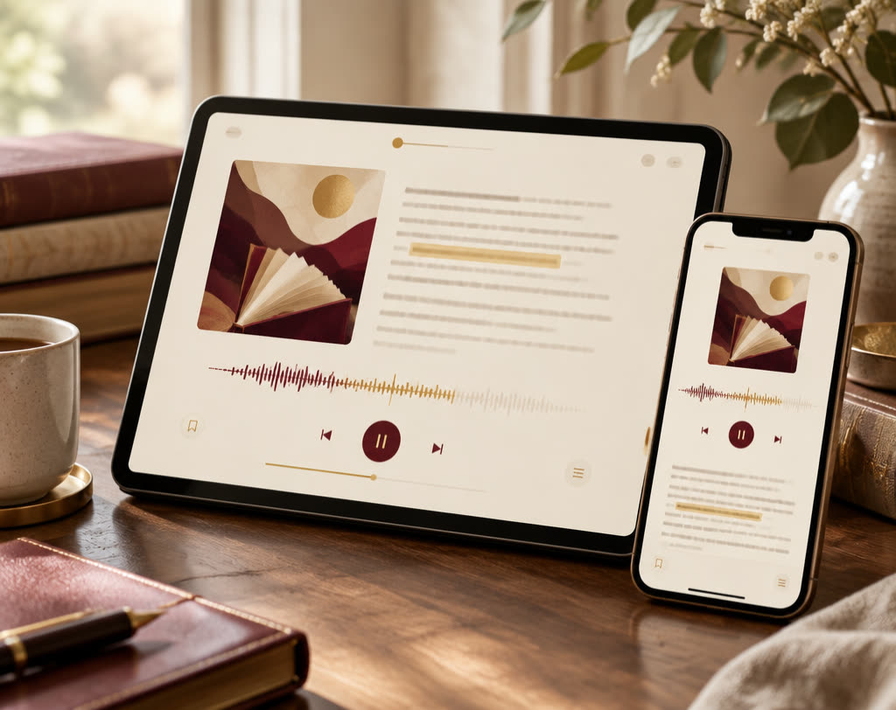
AYBAL / VALIDATED BUILD
From a family’s book to a shared listening moment
1,779
automated tests passed
Upload PDFs, EPUBs, Word files, text or photos of pages. Aybal converts them into read-aloud audio with word-by-word highlighting.
3 interface languages
13 voice languages
≥94% measured intelligibility
Once upon a time, a little fox found a book that could read itself aloud — in her grandmother’s voice.
▶ READING ALOUD · WORD-BY-WORD
Closed beta 12 Oct 2026 → Germany launch 20 Nov 2026
CONFIDENTIAL • PRE-SEED • SEPTEMBER 2026
04 / 17
Notes:
Show the product: any book becomes read-aloud audio with word-by-word highlighting.

Slide 5
AYBAL / ANNUAL MARKET OPPORTUNITY
A €7.6B category with a disciplined entry wedge
TAM
€7.6B
Gross family reading spend in target markets
TAM
€1.14B
15% assumed willingness to pay
SAM
€38M
4% penetration of willing segment; directional, not forecast
SAM
SOM
CONFIDENTIAL • PRE-SEED • SEPTEMBER 2026
05 / 17
Notes:
TAM, SAM, SOM. The SOM is directional, not a forecast.

Slide 6
AYBAL / BUSINESS MODEL
Simple subscriptions, attractive web margins
BEST VALUE
PLUS / MONTH
€9.99
per month
PLUS / YEAR
€79.99
per year
FAMILY / MONTH
€24.99
per month
FAMILY / YEAR
€199.99
per year
Best-value family commitment
€6.41 margin
76%
€4.21 monthly margin
75%
€16.22 margin
77%
Revenue begins with Germany launch in Nov 2026. Local pricing will adapt to Türkiye and UK purchasing power; margins shown are Germany/EU web purchases.
CONFIDENTIAL • PRE-SEED • SEPTEMBER 2026
06 / 17
Notes:
Four plans; web margins around 75–77%. The family annual plan is the best-value commitment.

Slide 7
AYBAL / DIFFERENTIATION
Personalized by design—not bolted on
CAPABILITY
AYBAL
AUDIOBOOKS
GENERIC TTS
FAMILY APPS
Natural multilingual voices
Consented personal voices
User-owned content
Word-level highlighting
Family accounts & controls
● Strong ▲ Partial ○ Weak / absent
Measured voice intelligibility: German 98% • Turkish 97%
Beta metrics will test whether technical differentiation translates into retention.
CONFIDENTIAL • PRE-SEED • SEPTEMBER 2026
07 / 17
Notes:
Aybal is the only option strong on all five capabilities.

Slide 8

AYBAL / ROADMAP
Validate. Launch. Expand. Compound.
2030 – 33
Profitability
Strong BE Aug ’30 · Venture BE Oct ’31
2029 – 30
Scale to 5 markets
Platform pilot; subscriber growth
2027 – 28
Prove retention
Gates 1–2; market expansion
NOV 2026
Germany launch
Revenue starts
OCT 2026
Closed beta
50 founding families
CONFIDENTIAL • PRE-SEED • SEPTEMBER 2026
08 / 17
Notes:
From closed beta in October to profitability: each step unlocks the next.

Slide 9

AYBAL / VENTURE SCENARIO
A venture case built on household growth
2027 → 2033
313,116
subscriber households by 2033
€39.37M
2033 revenue
Starts at 2,571 households in 2027 · scenario, not forecast
CONFIDENTIAL • PRE-SEED • SEPTEMBER 2026
09 / 17
Notes:
Let the chart draw. From 2,571 households in 2027 to 313,116 by 2033; revenue reaches €39.37M. Scenario, not forecast.

Slide 10
AYBAL / ILLUSTRATIVE EBITDA SCENARIOS
Profitability follows disciplined scale
STRONG CASE
AUG ’30
strong case break-even
VENTURE CASE
OCT ’31
venture case break-even
Scenario outputs, not promises. Demand and retention remain unproven; an investment may result in total loss.
CONFIDENTIAL • PRE-SEED • SEPTEMBER 2026
10 / 17
Notes:
Strong case breaks even in August 2030, venture case in October 2031. Scenario outputs, not promises.

Slide 11
AYBAL / THE ROUND
A focused €250k pre-seed round
€250,000
SCENARIO VALUATION FRAME
€52M
downside reference
≈ $285,000
€175M
venture scenario — 2033
VALUATION CAP
€1.30M
pre-money · ~16% equity at cap
PLANNED CLOSE
March 2027
Investor contact: Gönül
€400M
strong scenario — 2030
Subject to beta evidence, diligence and final legal terms. All valuations are forward-looking scenarios, not guarantees.
CONFIDENTIAL • PRE-SEED • SEPTEMBER 2026
11 / 17
Notes:
The ask: €250k on a €1.30M pre-money cap, planned close March 2027. Gönül coordinates investor conversations.

Slide 12
AYBAL / USE OF FUNDS
Capital goes first to execution capacity
50%
Team
€125,000
25%
Marketing
€62,500
€250k
ALLOCATION
15%
EU voice operation + store app development
€37,500
10%
Legal / trust
€25,000
Allocation totals reflect the operating budget and may vary slightly from round proceeds due to timing and FX.
CONFIDENTIAL • PRE-SEED • SEPTEMBER 2026
12 / 17
Notes:
Half of the round goes into the team; a quarter into marketing tests.

Slide 13
AYBAL / MILESTONE GATES
Scale only after evidence clears the gate
05
SCENARIO
Outcome
€400M enterprise value target — not a forecast
04
2030
Expansion
Five markets live
Platform pilot
03
2029
Efficiency
Conversion ≥5.5%
DACH signup ≤€3.50
Paid CAC ≤€54
02
Q1 2028
Retention
12-month retention ≥38%
K-factor ≥0.25
LTV/CAC ≥3
01
APR 2027
Activation
300 trials
≥43% trial-to-pay
≤25% month-one churn
CONFIDENTIAL • PRE-SEED • SEPTEMBER 2026
CONFIDENTIAL • PRE-SEED • SEPTEMBER 2026
13 / 17
13 / 17
Notes:
Spend only scales once each gate is cleared with evidence.

Slide 14

AYBAL / RISK MANAGEMENT
Risk is explicit—and instrumented
Named up front. Mitigated by design.
Seven risks, each with a concrete mitigation.
Retention & demand
Closed beta cohorts; gate spend on conversion and churn.
CAC & marketing
Channel tests, capped budgets, LTV/CAC thresholds.
Founder concentration
Priority hiring, documented operations, advisor support.
Voice / copyright / privacy
Consent controls, rights workflow, DPIA and regulatory review.
Trademark & app stores
Clearance before scale; preserve web-first economics.
Türkiye FX
Localized pricing and regular FX sensitivity review.
Platform contracts
Base case excludes uncontracted platform revenue.
CONFIDENTIAL • PRE-SEED • SEPTEMBER 2026
14 / 17
Notes:
Seven risks, each with a concrete mitigation.

Slide 15



TS
THE FOUNDER & INVENTOR
The person who invented Aybal—and built it before asking anyone to fund it.
Why this founder matters
Tuncay Sancak
Product, technology and content already integrated
FOUNDER & INVENTOR
MANAGING DIRECTOR
PRODUCT ARCHITECT
Product architect and Germany–Türkiye bridge.
Former project lead, AI expert and data scientist at Mercedes-Benz.
Native German and Turkish speaker, trilingual in business.
Founder of the HappyiZ movement, with a network across families, professionals and educational institutions in Türkiye.
Author of children’s books, including the gift book “Good That You Exist”, available in German, Turkish and English.
Direct access to the initial DE/TR customer communities
Founder-led, milestone-based team build after the round
1,779
automated tests
3
interface languages
13
voice languages
Built
before financing
CONFIDENTIAL • PRE-SEED • SEPTEMBER 2026
15 / 17
Notes:
Your slide: you invented Aybal and built the product before raising money. Bring in the Mercedes-Benz AI background and the DE/TR community access.

Slide 16
AYBAL / TEAM
The people behind Aybal
TS
Tuncay Sancak
FOUNDER & INVENTOR · MANAGING DIRECTOR
Invented and built the Aybal platform. Leads product, technology and content.
G
Gönül
INVESTOR RELATIONS & FUNDRAISING
Leads investor outreach for the pre-seed round and prepared this investment deck.
Team formation after financing
Technical co-founder & growth/community lead
from the round
Customer service
from 1,500 subscriptions
Second developer
from €40,000 MRR
Country leads, partnerships, legal/data protection & finance
from the seed round
Founder commitment: long-term and exclusive leadership, four-year vesting, non-compete and key-person insurance planned.
CONFIDENTIAL • PRE-SEED • SEPTEMBER 2026
16 / 17
Notes:
Founder and inventor plus investor relations today; hires are tied to milestones.

Slide 17


THANK YOU FOR YOUR CONSIDERATION
Give every family a new voice in reading.
Join Aybal in proving the next chapter of family reading.
FOUNDER & INVENTOR
Tuncay Sancak
INVESTOR RELATIONS
Gönül
CONTACT
founders@aybal.com
aybal.com
Confidential pre-seed materials. Forward-looking statements are subject to material risks and uncertainty.
CONFIDENTIAL • PRE-SEED • SEPTEMBER 2026
17 / 17
Notes:
Close with the vision and the ask. Invite follow-up via Gönül and founders@aybal.com.

