Slide 1

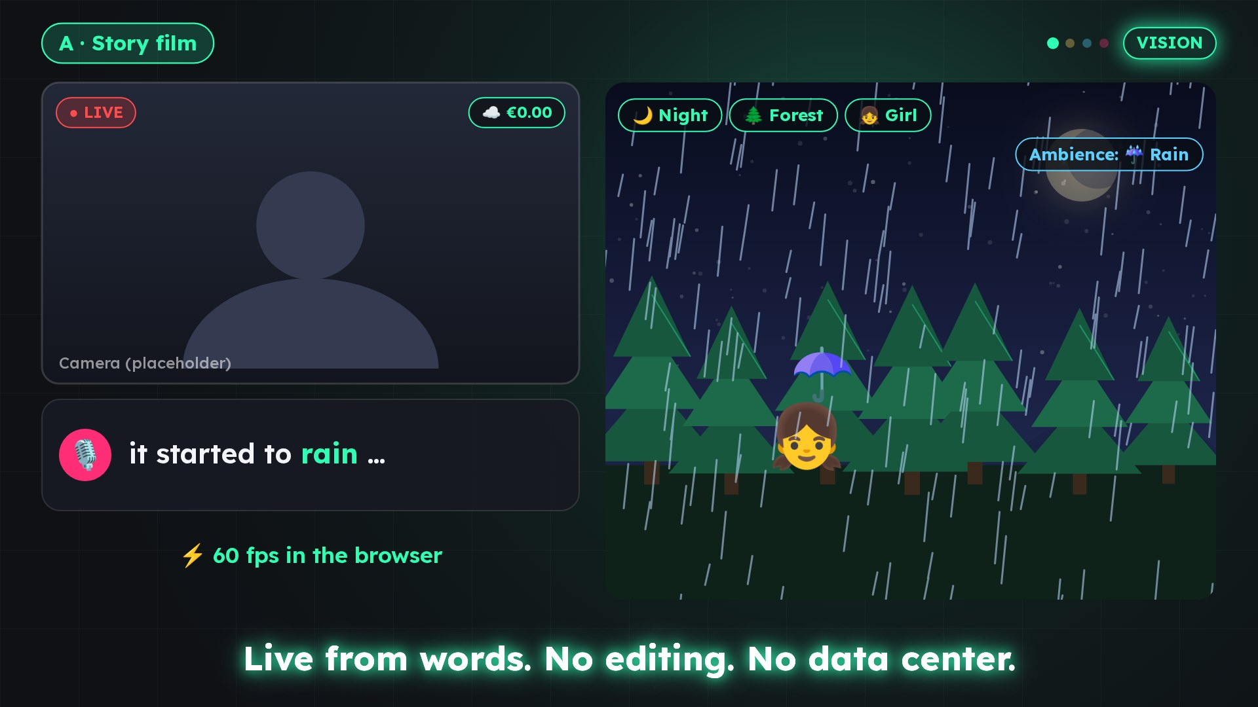
LiveFX:
Live streams
that listen
PRE-SEED INVESTMENT OPPORTUNITY
LIVEFX 2.1
The creator's voice becomes a meme, a sound and a scene in under a second – and tomorrow, a picture for everything spoken.
THE ROUND
FOUNDER & INVENTOR
€250,000
Tuncay Sancak
18 months · runway 18 months even without revenue
INVESTOR RELATIONS
Gönül Demet
Notes:
LiveFX: Live streams that listen – The creator's voice becomes a meme, a sound and a scene in under a second – and tomorrow, a picture for everything spoken.

Slide 2
A focused bet on voice as the live trigger
LIVEFX / INVESTMENT THESIS
01
02
03
04
05
Built & tested
An empty gap
Money in the stream
Draw, don't compute
One engine, four lines
Version 2.1 runs: 238 triggers, 143 free stickers, 575+ automated tests.
No widely used tool reacts to what the creator says.
Gifts ≈ 50% of streamer income [Source 5, 6].
Scenes in the browser: 240 to 10,000+ times cheaper than video AI.
WordPicture first; Story Film, Studio and Spaces in the follow-on round.
€250,000 takes LiveFX to market in 18 months and WordPicture from prototype to product.
Notes:
€250,000 takes LiveFX to market in 18 months and WordPicture from prototype to product.

Slide 3
Short videos get edited. Live stays raw
LIVEFX / THE MARKET GAP
MANUAL
AUTOMATIC
~50%
Viewer-
driven
Native effects, stickers
Alerts (Streamlabs, StreamElements)
share of gifts in live streamers' income [Source 5, 6]
picked by hand
react to follows, donations
USD 500–3,000
Voice-
driven
gifts per month at 20–100k followers [Source 5]
Voicemod, Stream Deck
LiveFX
> 100m
need hands
reacts to the voice – alone in the field
creators went live on TikTok in 2025 in SE Asia, the Caucasus and Central Asia alone, +77% [Source 2]
Sources: QUELLEN.en.md · 2×2 after PITCH-DECK.en.md, slide 10

Slide 4
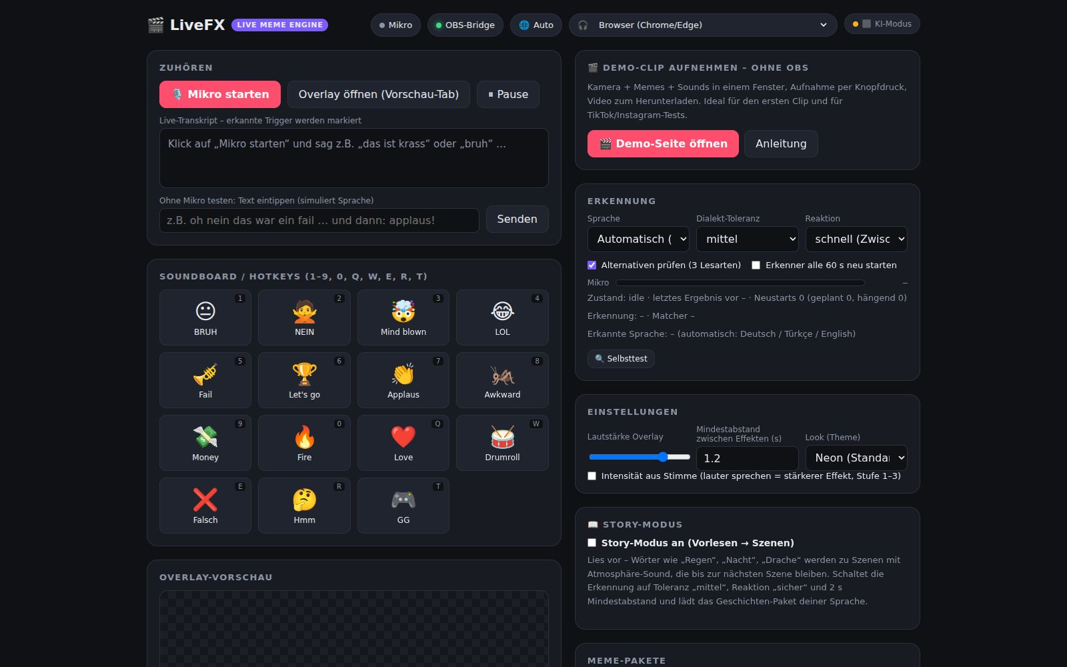
Version 2.1: from voice to effect in under a second
LIVEFX / VALIDATED BUILD
The creator says "no way", "yok artık" or "applause" – the meme appears, the sound plays. When he reads aloud, the overlay turns into an animated scene.
238
143
triggers in 5 packs
free stickers (MIT)
−63–69%
3
frame time (performance mode)
languages, auto-detected
< 1 s
575+
voice → effect
automated tests
v2.1 → TR launch Q4 2026 → Pro live month 3
New in 2.1: text-sticker packs TR/DE/EN · safe GIF search (KLIPY/GIPHY, rating g, child-safety filter) · story mode · viewer triggers · phone remote · offline · OBS/Streamlabs → TikTok LIVE, Instagram, YouTube, Twitch
Source: BUSINESSPLAN.en.md §3; live-fx/CHANGELOG.md 2.1.0 (measured with 31 effects, 1920×1080) · no revenue yet

Slide 5
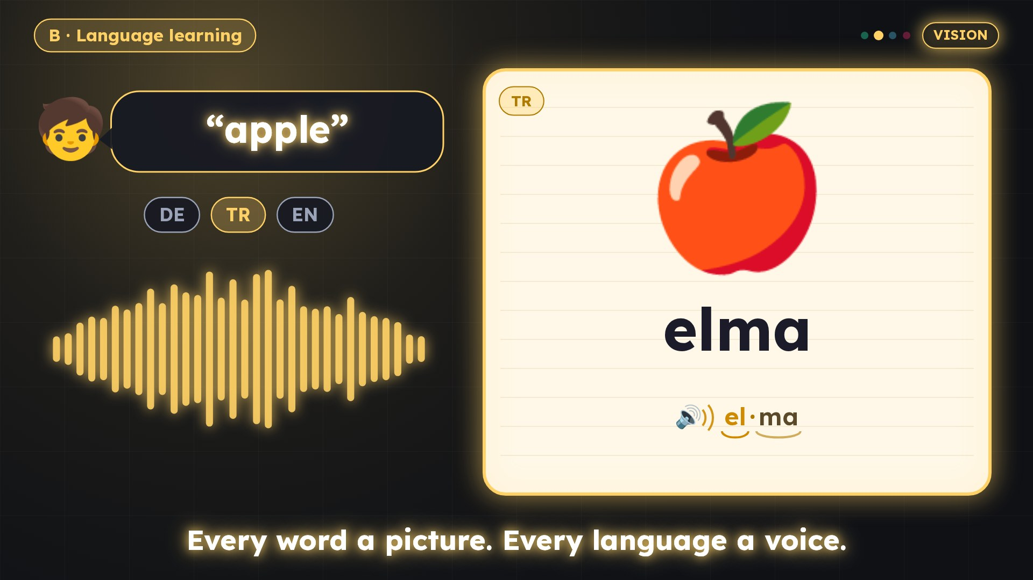
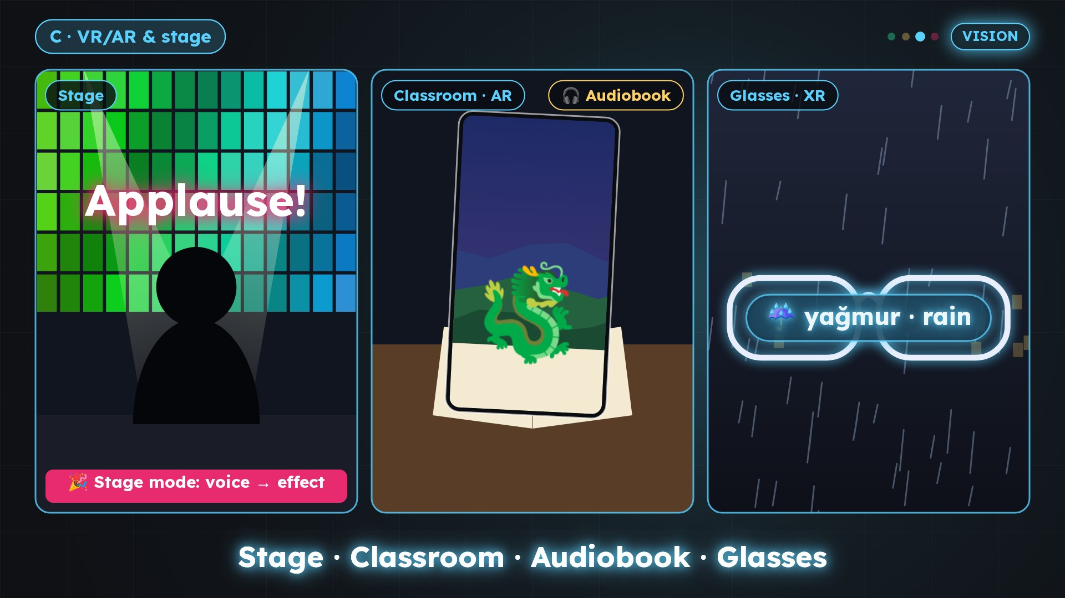
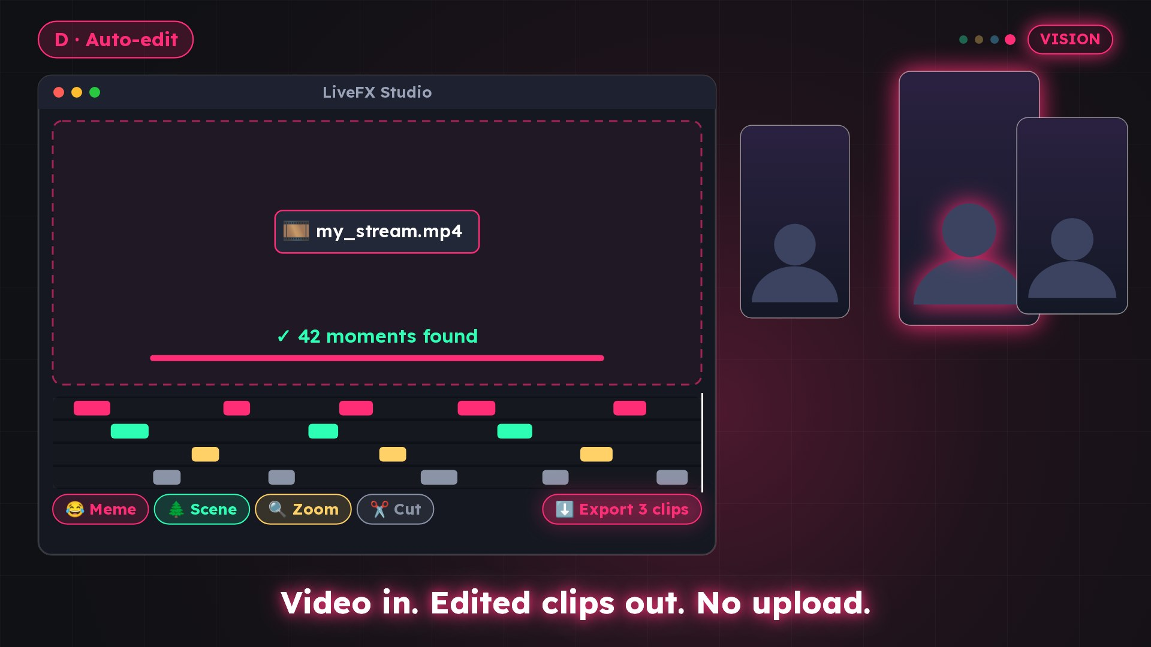
You talk. It becomes a scene
LIVEFX / VISION 2027–2029
A
Story Film
B
WordPicture
C
Spaces
D
Studio
Generative Scene Engine: narrated sentences become a continuous animated film, live.
Language learning: word → picture + target language + pronunciation; reading aid, repeat.
The same timeline on stage, projector, phone AR, VR and display glasses.
Highlights from the stream, auto-edit of finished videos, local export.
FOLLOW-ON ROUND
PRE-SEED → PRODUCT
FOLLOW-ON ROUND
FOLLOW-ON ROUND
The pre-seed funds WordPicture (€37,500); story engine, auto-edit and VR move to the follow-on round.
Source: VISION.en.md §1, BUSINESSPLAN.en.md §15 · images: vision trailer

Slide 6
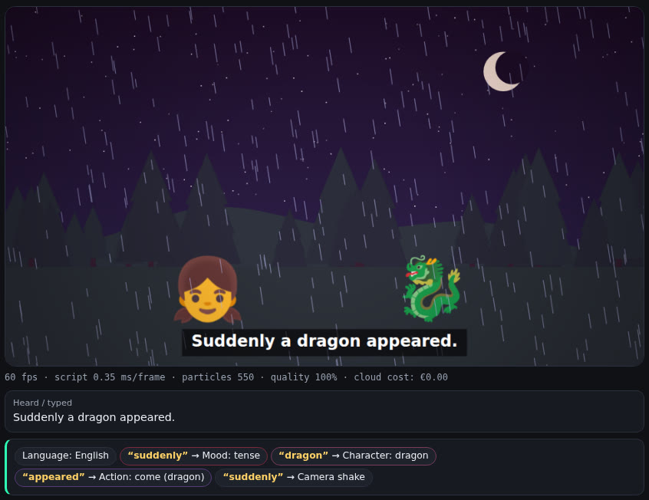
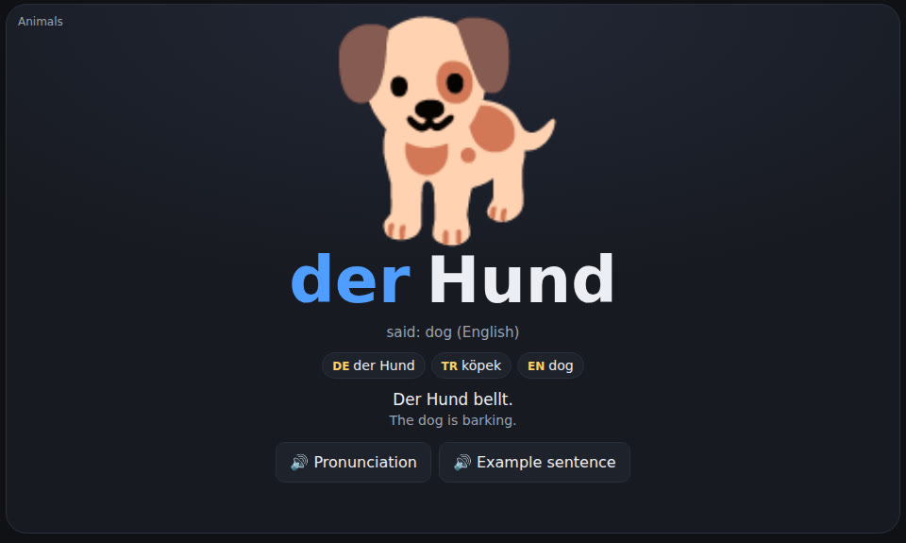
Two lines already run in the browser
LIVEFX / PROTOTYPES
Draw, don't generate
VIDEO AI
USD 180–2,700
per hour [Source 24, 25]
B · WordPicture
LIVEFX
sprachlernen.html: 85 words DE/TR/EN, syllables, pronunciation
€0 – USD 0.75
per hour (project measurement)
A · Story Film
live-story.html: 22 characters, 10 places, weather, mood · 60 fps
240 to more than 10,000 times cheaper – and the only one that runs live.
Source: prototypes/README.md, VISION.en.md §2 · screenshots of the prototypes

Slide 7
A growth market with a clear entry point
LIVEFX / MARKET
Core market: live
Adjacent (vision)
TAM · monetising live creators
USD 97–157bn
USD 3.67bn
10–20m
live streaming 2026 [S 1, 2]
AI video 2026 [S 23]
USD 2.68bn
SAM · TR/DE/EN
USD 216–260bn
video editing 2026 [S 51]
1–3m
USD 1.54bn
creator economy 2026 [S 3, 4]
language-learning apps 2025 [S 33]
~14%
€374m
SOM · paying, Y3
German audiobooks 2025 [S 19]
5–15k
live share ≈ USD 36bn [S 3]
USD 5.1bn
smart glasses 2026 [S 45]
Bottom-up, estimate (BUSINESSPLAN.en.md §6)
[S n] = [Source n] in QUELLEN.en.md · adjacent markets are not included in the SOM

Slide 8
Freemium for creators, licences for institutions
LIVEFX / BUSINESS MODEL
FREE
PRO
PRO+ (VISION)
Price anchors
€0
€9.99/month
€14.99/month
Streamlabs Ultra USD 27/month [S 11, 12]
StreamYard ~35 · Restream ~16 USD [S 12]
Voicemod ~USD 10/month [S 13]
ANTON school licence €250–700/year [S 41]
Core function, standard packs, phone remote
AI understanding, all scenes, viewer triggers; €79/year
AI scenes, auto-edit, MP4 export
WORDPICTURE FAMILY
PACKS
SCHOOL LICENCE
€4.99/month
€2.99–4.99
€300–800/year
Local software: marginal cost close to zero. AI only with Pro: USD 0.25–0.75 per stream hour.
Language learning and reading aid
Meme, story, world, vocabulary packs; marketplace 70/30
Course €49/teacher · events · publishers · agencies · B2B/SDK
Source: BUSINESSPLAN.en.md §9, §15.6 · vision and licence prices are estimates

Slide 9
The only trigger that is always there: the voice
LIVEFX / DIFFERENTIATION & RISKS
LiveFX
Alerts
Voicemod
Native
Editors
Risks – named up front
Voice-driven
!
Demand unproven
Cohort gates, budget only after release
Turkish / 3 languages
!
A platform copies it
Story/scene mode
Early pilot, language packs as a moat
Local / offline
!
Phone creators without OBS
Mobile developer first
Open API
!
Data protection school/family
Live (not after the fact)
Local, no accounts, on-device ASR
yes
partly
no
!
Vision spreads the team
Pre-seed funds WordPicture only; rest in the seed
Source: BUSINESSPLAN.en.md §7, §13

Slide 10
Launch. Monetise. Expand
LIVEFX / ROADMAP & GO-TO-MARKET
Q4 2026
M1 · Jan 2027
Month 3
Month 6
Month 7–9
Month 12
Month 18
v2.1 + TR launch
Closing €250k
Gate 0
Gate 1
DE/EN + pilot
Gate 2a
Gate 2 → seed
Performance mode, 143 stickers, safe GIFs
Marketing phase 1, trademark
Pro live, developer on board
Mobile app/PWA; WordPicture 300 words
Platform or education pilot
Traction; seed talks start
≈ €350k; story engine, Studio, VR
1 · TR community
2 · DE/EN
3 · Pilot
4 · Follow-on round
Months 1–6: own streams, pack and sticker drops
Months 7–18: read-aloud and education streams
From month 9: platform (8 weeks, 20 creators) or courses
From month 19: team, story engine, Studio, VR
Source: BUSINESSPLAN.en.md §10, §14.1 · LiveFX_Finanzmodell.xlsx (timeline: closing Jan 2027 = month 1)

Slide 11
€250,000 over 18 months: execution first
LIVEFX / USE OF FUNDS
PROPOSAL – REVIEW WITH TAX/LEGAL ADVISOR
50%
Team/product
€125,000
Developer from M3, founder in part, devices
20%
Go-to-market
€50,000
TR then DE/EN launch, ambassadors, 1 pilot
€250k
15%
WordPicture (vision B)
€37,500
18 MONTHS
300 words, voices DE/TR/EN, course pilot
10%
Legal, trademark, privacy
€25,000
Trademark DE/EU/TR, GDPR, agreements
5%
Reserve
€12,500
Not scheduled
Source: LiveFX_Finanzmodell.xlsx, sheet Use of funds. Story engine, auto-edit and VR move to the follow-on round.

Slide 12
Base case: EBITDA-positive in Y2, €3.2M revenue in Y5
LIVEFX / FINANCIALS
Cash by scenario (€k)
M6
M12
M18
M24
No revenue
179
88
8
−63
Conservative
183
102
49
−11
Base
191
134
146
175
Optimistic
208
202
369
698
Without the follow-on round. Break-even: base M22, optimistic M10.
18 months
runway even without any revenue (conservative: 22)
≈ €350k seed
Base EBITDA
−116 / +41 / +328 / +919 / +1,661 €k
Conservative
−148 / −114 / −59 / +36 / +147 €k
planning guide, closed by month 18 after gate 2
Optimistic
−48 / +496 / +1,499 / +3,178 / +5,134 €k
Source: LiveFX_Finanzmodell.xlsx (5-year P&L, monthly cash flow, follow-on) · Y1–Y3 revenue from BUSINESSPLAN.en.md §11.1 · scenarios, not forecasts

Slide 13
Founder offer: €2.25M pre-money, 10% for €250k
LIVEFX / VALUATION
NEGOTIATION RANGE – REVIEW WITH TAX/LEGAL ADVISOR
REFERENCE METHODS (INVESTOR VIEW) · PRE-MONEY
FOUNDER OFFER (PRICED ROUND)
Berkus (2× variant)
€2.35M
€2.25M
pre-money
5 factors up to €1M each: product 0.8, idea 0.7, team 0.5, relationships 0.25, revenue 0.1
Scorecard
€2.95M
€2.5M
post-money
€2.5M reference (lower part of DACH range €1.5–5M, below EU median ~€4.2M) × 1.18
VC method (upside)
€2.43M
10%
for investors · founder 90%
Y5 revenue €7.44M (optimistic) × 6 = €44.7M exit; 10× return, 40% dilution
Risk factor sum.
€3.0M
€2.5M base + 2 × €250k from twelve scored risks
Offer €2.25M – below every method
Alternative: SAFE / convertible
Why €2.25M
Valuation cap €2.25M (= offer)
Discount 20% (negotiable 15–20%)
No interest; converts at the seed round
Max. stake at the cap: 10%
Working product v2.1, 575+ automated tests
Own IP: 238 triggers, 143 stickers, matcher
DE/TR/EN incl. the Turkish niche
Vision options A–D on one engine
Market USD 97–157bn; SAM 1–3m creators
Built to v2.1 without external capital
Source: LiveFX_Finanzmodell.xlsx, sheet Valuation (founder view; valu.vc, upxcale, Capvisory, Equidam, SaaS Capital, Carta, Lexr, Vektora) · not investment advice

Slide 14
Scale only after evidence clears the gate
LIVEFX / MILESTONE GATES – 18 MONTHS
PROPOSAL – AGREE WITH INVESTORS
G2
G2a
MONTH 18
G1
Follow-on
MONTH 12
G0
Traction
MONTH 6
50,000 registered (19,000)
2,000 paying Pro (570)
MRR €22,586 (€6,495)
M3 retention ≥ 75%, ≥ 5 paying schools
→ seed round ≈ €350k
MONTH 3
Activation
Start
20,000 registered (8,000)
800 paying Pro (240)
MRR €8,073 (€2,500)
1 platform or education pilot
10,000 registered (threshold 4,000)
400 paying Pro (120)
20 beta creators, WordPicture 300 words
Week-4 retention ≥ 30%
Pro subscription live (payments)
Mobile/web developer on board
Unlocks GTM phase 2
Targets = base case, (threshold) = conservative case; status of every gate: target (not yet achieved). Source: LiveFX_Finanzmodell.xlsx, sheet Gates 18M.

Slide 15
The people behind LiveFX
LIVEFX / TEAM & ROUND
TS
Tuncay Sancak
GD
Gönül Demet
Team build after financing
FOUNDER & INVENTOR · MANAGING DIRECTOR
INVESTOR RELATIONS & FUNDRAISING
Mobile/web developer
Invented LiveFX and built it to 2.1 before any funding. Former project lead, AI expert and data scientist at Mercedes-Benz; native German and Turkish speaker. Author of children's books, including "Good That You Exist".
Leads investor outreach for the pre-seed round and prepared these materials.
from month 3
WordPicture: illustration, voices
months 4–15 (freelance)
Backend/ML, community
from month 19 (seed)
Second developer
from month 19 (seed)
€250,000 pre-seed · offer €2.25M pre-money, 10%
Investor contact: Gönül Demet · [email]
Confidential pre-seed materials. Forward-looking statements are subject to material risks and uncertainty; an investment may result in total loss.

