Slide 1





Watch And Read Buddy
An Artificial Intelligence Application
UPSchool Capstone Project Presentation
Presented by: Fatmanur VARLIK

Slide 2

Overview
About me
About Core Skills
About “Watch And Read Buddy”

Slide 3

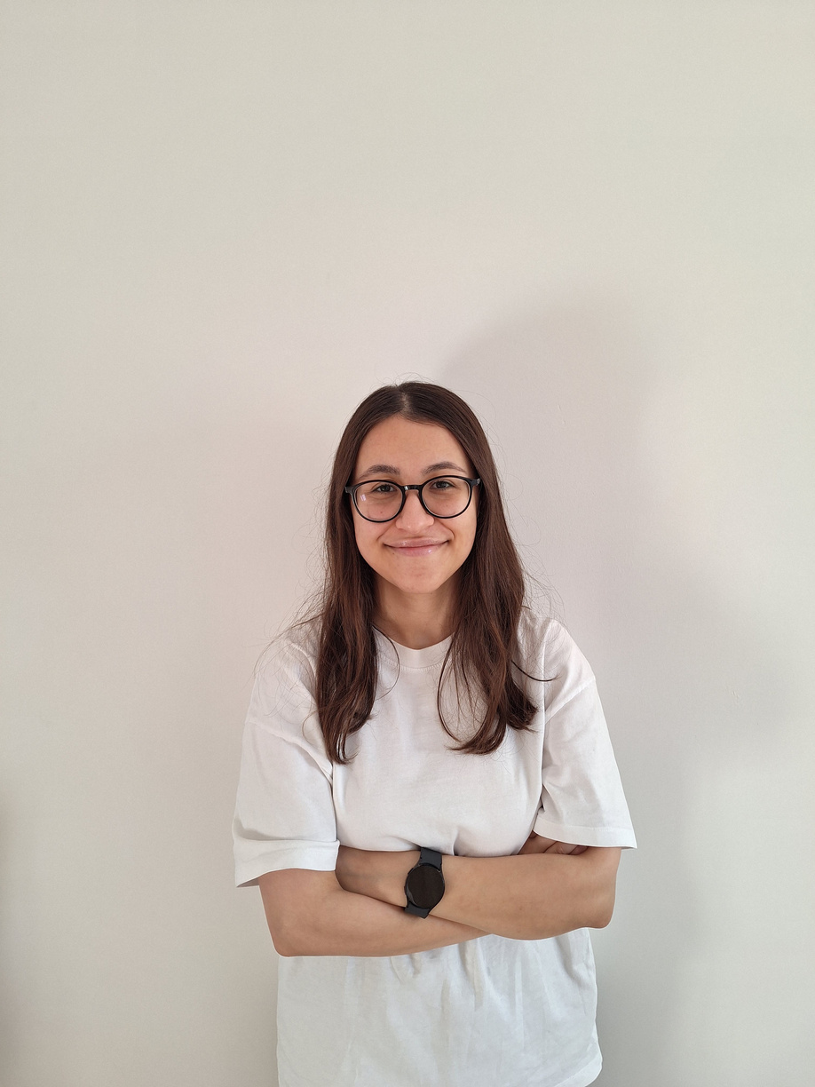




About me
Education
Eskişehir Technical University
Industrial Engineering
Business Analytics Minor Program
Experience
Business Intelligence Consultant

Slide 4





About core skills
Communication
Challenge myself
Appreciation
Motivation

Slide 5

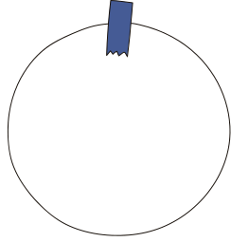

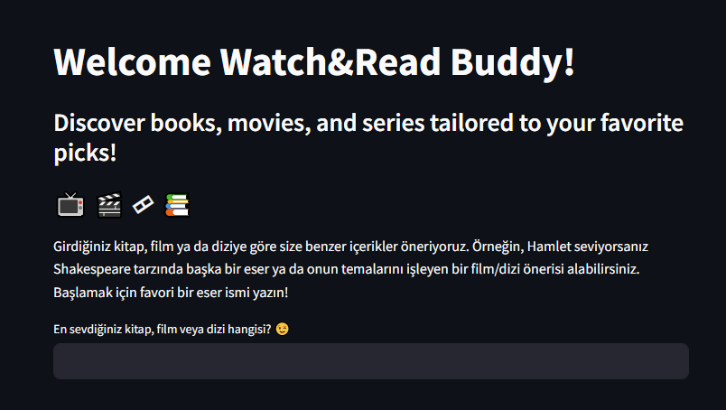

Watch And Read Buddy
a friendly chatbot for TV series, films and books
https://github.com/fatmanurvarlik/WatchandReadBuddy

Slide 6
Thank's For Watching
Fatmanur VARLIK
varlikfatmanur@gmail.com

