Slide 1
Accountability through Information Flow Experiments
Michael Carl Tschantz
UC Berkeley
Amit Datta, CMU
Anupam Datta, CMU
Jeannette M. Wing, MSR
www.cs.cmu.edu/~mtschant/ife

Slide 2
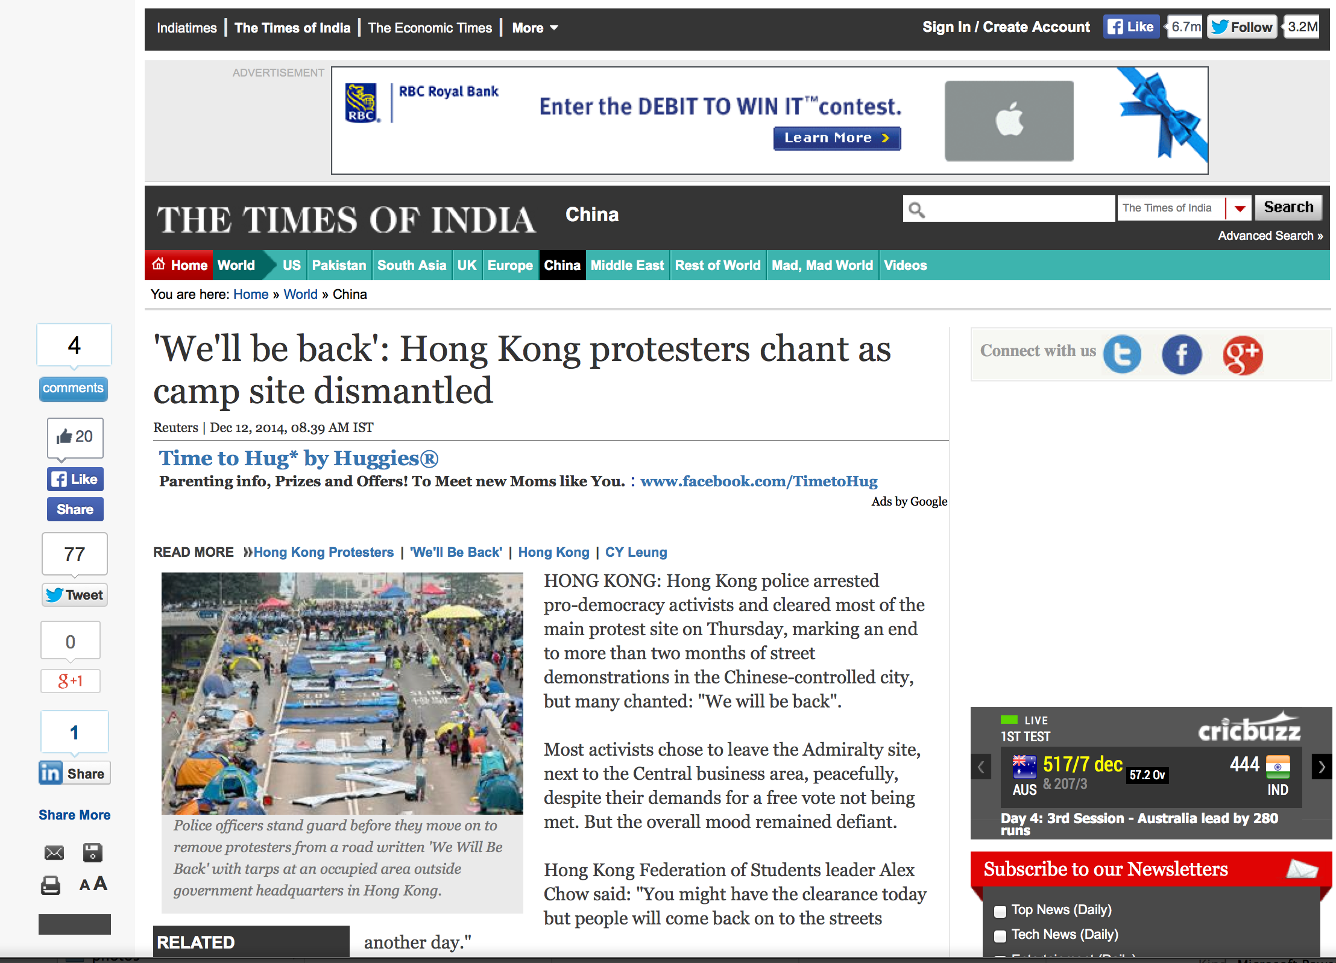
Notes:
Top one is a Double Click ad.

Slide 3
Google’s Privacy Policy
When showing you tailored ads, we will not associate a cookie or anonymous identifier with sensitive categories, such as those based on race, religion, sexual orientation or health.

Slide 4
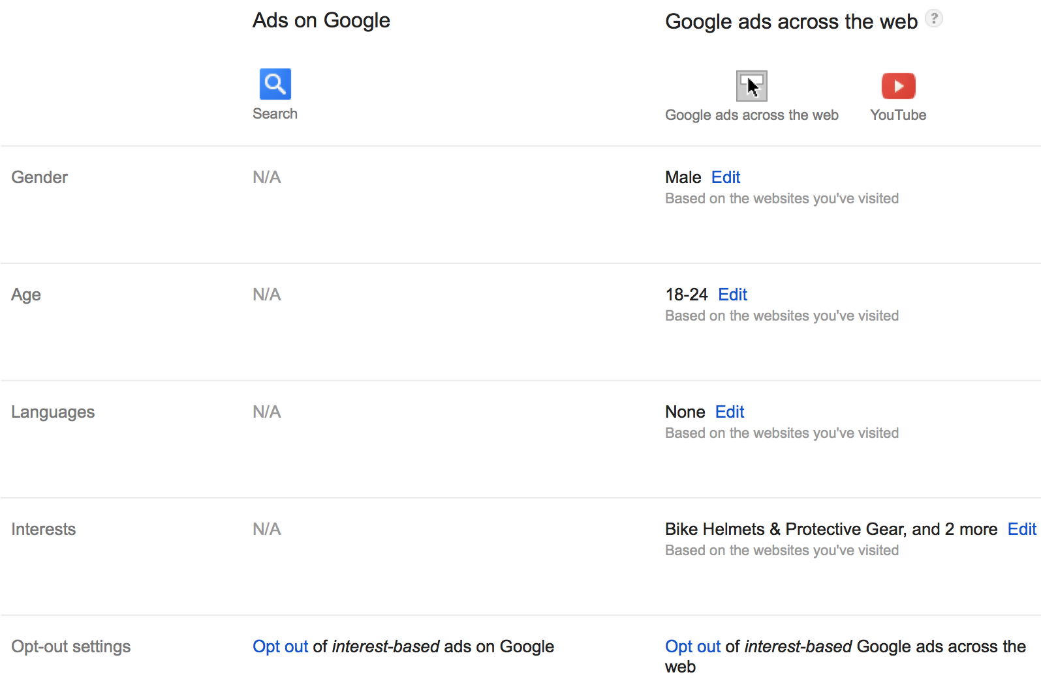
Google Ad Settings

Slide 5
Web browsing
Ad ecosystem
Advertisements
Inferences
Edits
Ad settings

Slide 6
AdFisher
Emulates users with fresh browser instances
Randomized assignment
Statistical analysis to find causal relations
Open source: github.com/tadatitam/info-flow-experiments

Slide 7
Transparency
Web browsing
Ad ecosystem
Advertisements
Significant causal effect on ads (p=0.000005)
Visit top 100 substance abuse sites
Ad settings
No effect on ad settings

Slide 8
Transparency Explanations
Substance Abuse Visitors | Control Group
The Watershed Rehab www.thewatershed.com/Help | Alluria Alert www.bestbeautybrand.com
Watershed Rehab www.thewatershed.com/Rehab | Best Dividend Stocks dividends.wyattresearch.com
The Watershed Rehab (none) | 10 Stocks to Hold Forever www.streetauthority.com

Slide 9
Choice
Web browsing
Ad ecosystem
Advertisements
Visits websites related to online dating
Causes significant reduction in dating ads
(p=0.008)
Ad settings
Removes interests related to online dating

Slide 10
Choice Explanation
Keeping Dating Interest | Removing Dating Interest
Are You Single? www.zoosk.com/Dating | Car Loans w/ Bad Credit www.car.com/Bad-Credit-Car-Loan
Top 5 Online Dating Sites www.consumer-rankings.com/Dating | Individual Health Plans www.individualhealthquotes.com
Why can't I find a date? www.gk2gk.com | Crazy New Obama Tax www.endofamerica.com

Slide 11
Discrimination
Web browsing
Ad ecosystem
Advertisements
Browse websites related finding a new job
Significant difference ads on news website
(p=0.000005)
Ad settings
Set the gender bit to female or male

Slide 12
Discrimination Explanation
Female Group | Male Group
Jobs (Hiring Now) www.jobsinyourarea.co | $200k+ Jobs - Execs Only careerchange.com
4Runner Parts Service www.westernpatoyotaservice.com | Find Next $200k+ Job careerchange.com
Criminal Justice Program www3.mc3.edu/Criminal+Justice | Become a Youth Counselor www.youthcounseling.degreeleap.com

Slide 13
Findings
Lack of transparency
Web browsing can affect ads without affecting Ad Settings
Users have some choice
Removing interests affects ads
Discrimination occurs
Gender affects job-related ads

Slide 14
Information Flow Experiments
Natural Sciences | Information Flow
Natural process | System in question
Population of units | Subset of interactions
… | …
Causation | Information flow
Theorem
Pearl’s Causation
=
Probabilistic Interference

Slide 15

Number of Unique Ads

Slide 16
Number of Unique Ads

Slide 17
Google’s Behavior is Complex
Notes:
To look into the possibility of creating such a model, we ran another experiment. This time, we only used one browser and collected ads by reloading the breaking news page of the Chicago Tribune ever minute for 200 minutes, with time on the x-axis. We assign each unique ad an id number in the order in which we see them, which we use for the y-axis. The results show that Google’s behavior changes over time. Thus, any probabilistic model would have to be more complex than those typically used statistics. With this in mind, we decided to use non-parametric statistics, which works without a model of Google even when there’s interactions between browser instances.

Slide 18
Prior Work on Behavioral Marketing
Authors | Test | Limitation
Guha et al. | Cosine similarity | No statistical significance
Balebako et al. | Cosine similarity | No statistical significance
Wills and Tatar | Ad hoc examination | No statistical significance
Liu et al. | Process of elimination | No statistical significance
Barford et al. | χ2 test | Assumes ads identically distributed
Lécuyer et al. | Parametric model | Correlation, not causation; assumes ads are independent
Englehardt et al. | Binomial test | Assumes ads identically distributed
18

Slide 19

Randomized Controlled Trials
Experimental Treatment
Control Treatment
Controlled Environment
Ad Ecosystem
Experimental Group
Control Group
Measurements
Ad Ecosystem
Test Statistic
Hypothetical Value
Observed Value

Slide 20

Our Methodology
Ad Ecosystem
Ad Ecosystem
Experimental Treatment
Ad Ecosystem
Control Treatment
Ad Ecosystem
block 1
Ad Ecosystem
Training Data
block n
Machine Learning
Ad Ecosystem
Measurements
Explanations
Classifier
Measurements
Significance Testing
p-value

Slide 21
Summary
Rigorous information flow experiments
Probabilistic interference = Pearl’s causation
Experimental design for causal determination
Significance testing with non-parametric statistics
Experimental study of Google Ads
AdFisher Tool
Findings of opacity, choice, and discrimination

Slide 22
Future Work
Extensions of AdFisher
Interpretable machine learning
Incorporating formal notions of discrimination
Discrimination vs. unfairness
How much transparency is right?
Internal auditing and preventing violations
Policing advertisers
Understanding models from machine learning

Slide 23
Accountability through Information Flow Experiments
Michael Carl Tschantz
UC Berkeley
Amit Datta, CMU
Anupam Datta, CMU
Jeannette M. Wing, MSR
www.cs.cmu.edu/~mtschant/ife

