Slide 1
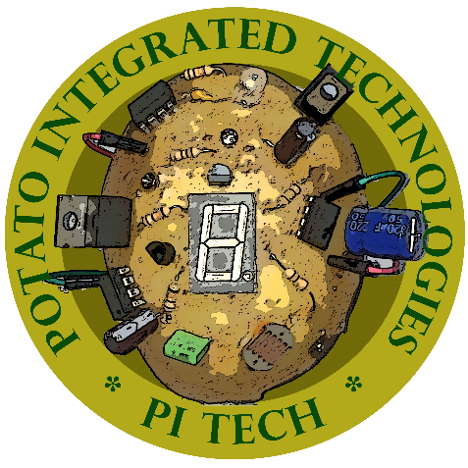
Potato Integrated Technologies
PITECH was founded in 2018 with five shareholders from different backgrounds. As PITECH engineers our aim is to build a robot that we can control from a specified distance with a remote controller. This robot tries to score within a playfield in its opponent’s goal and defend its own goal.
SHAREHOLDERS
BUDGET
Fatma Nur Arabacı - CEO
Furkan Bahadır ELİK - CTO
İrem COŞKUN - COO
Berkay GÖKSU - CMO
Aycan BEYENİR - CFO
Materials |  | Cost
DC Motor with Gearbox |  | 2 x $15
L298N Motor Driver |  | 2 x $1.5
Push-Pull Solenoid |  | 1 x $4
Clone Arduino Uno |  | 1 x $4
Clone Arduino Mega |  | 1 x $10
FPV Drone Kit |  | 1 x $35
NRF24L01+PA+LNA SMA |  | 2 x $4
Joystick |  | 1 x $0.50
LCD screen |  | 1 x $30
900 mAH Li-Po Battery |  | 1 x $14
1350 mAH Li-Po Battery |  | 1 x $18
Buck Converter |  | 3 x $1
Plexiglass Chassis |  | 1 x $6
Standard Wheels |  | 2 x $2
Ball Wheel |  | 3 x $1
Cables & Connectors |  | $6
Structural connections |  | $3
Dummy Robot |  | 1 x $2
Balls |  | 2 x $0.25
Play Field Walls |  | 3 x $1
Total: |  | $189
DELIVERABLES
Potato Robot Controller Unit 2 Li-Po Battery 6 Game Field Walls 2 Balls A Dummy Robot User Manual 2-year Warranty Software Pack
OUTSTANDING FEATURES
User friendly control module
Fast-learning curve for the user
Wide field of view
TECHNICAL SPECIFICATIONS
Telecontroller Side
Physical specifications
Size
Weight
Power Specifications
Idle Power
Max Power
Operation Time
Operational Specifications
Screen Resolution
Command Resolution | 8 bit
Robot Side
Physical specifications
Height
Diameter
Weight
Power Specifications
Idle Power
Max Power
Operation Time
Operational Specifications
Maximum Forward Speed | 0.45 m/sec
Maximum Rotational Speed | 2.3 rad/sec
Method of Solution
Command Interface : Joystick Command Transfer : 2.4 GHz NRF Communication Video Transfer : 5.8 GHz FPV Communication Shooting : Push - Pull Solenoid Motion : Brushed DC Motor with Gear Box
Customer & Engineering Requirements
$200 budget 30+ meters indoor range
Special Thanks To our Supervisor Arzu Tuncay KOÇ

