Slide 1
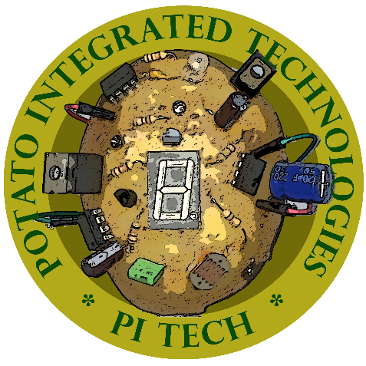
Potato Integrated Technologies
PITECH was founded in 2018 with five shareholders from different backgrounds.
Shareholders
Fatma Nur Arabacı - Chief Executer Officer
Furkan Bahadır ELİK - Chief Technology Officer
İrem COŞKUN - Chief Operating Officer
Berkay GÖKSU - Chief Marketing Officer
Aycan BEYENİR - Chief Financial Officer
Deliverables

